Slide 1
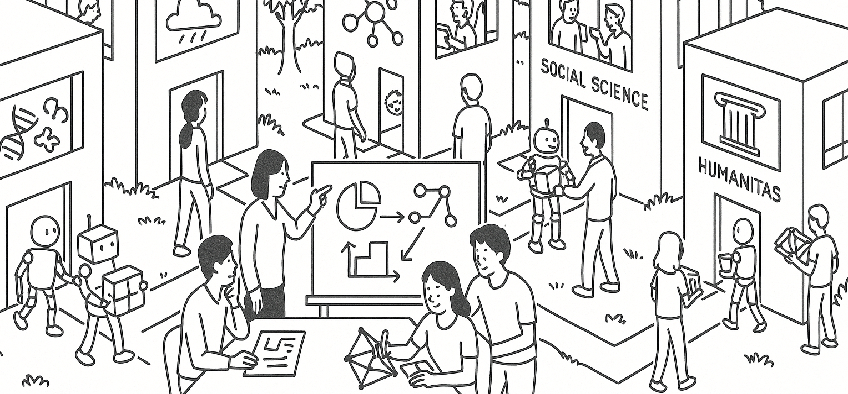

Probability practice
STAT UN 1001 · LECTURE 8
October 1st, 2026
Notes:
Lecture 7 revised as a probability-practice workshop. The opening Google Sheets demo is intentionally outside the slide deck.

Slide 2

Probability Thinking
Probability is about the chance of observing an event in a chance process.
Chance process generates one outcome at a time.
The outcome can be any of those in the sample space.
An event is defined a description of an outcome that belongs in the event.
According to this description, multiple outcomes (a subset) of the sample space correspond to an event.
COLUMBIA UNIVERSITY · DEPARTMENT OF STATISTICS
03
Notes:
This slide gives the repeated reasoning routine for every practice problem.

Slide 3
Probability problem checklist
1. Chance process
2. Sample space
3. Event of interest
We will write the sentence before computing the number.
4. Probability sentence
5. Rule or strategy
COLUMBIA UNIVERSITY · DEPARTMENT OF STATISTICS
03
Notes:
This slide gives the repeated reasoning routine for every practice problem.

Slide 4
Joint, marginal, conditional
Question type | Plain-language cue | Example probability
Joint | Both things happen | P(A and B)
Marginal | One thing happens, ignoring the other variable | P(A)
Conditional | One thing happens among a restricted group | P(A | B)
READING TIP
Circle words like “and,” “or,” “given,” “among,” and “at least.” They often tell you the probability structure.
The hardest part is often naming the denominator.
COLUMBIA UNIVERSITY · DEPARTMENT OF STATISTICS
04
Notes:
OpenIntro Section 3.2 concepts in one table.

Slide 5
Probability tree logic
BRANCH RULE
Start
A, P(A)
B, P(B | A)
C, P(C | A and B)
Path probability:
P(A and B and C)
= P(A) x P(B | A) x P(C | A and B)
Branches from the same split add to 1.
PATH RULE
Multiply along a path to get a joint probability.
EVENT RULE
Add the path probabilities that satisfy the event.
COLUMBIA UNIVERSITY · DEPARTMENT OF STATISTICS
05
Notes:
Connect Section 3.2 tree diagrams to multiplication and addition rules.

Slide 6
Practice 1: Pokemon pack
A promotion says that each pack independently has a 1 in 20 chance of containing a rare card. A student buys 3 packs.
What is the probability that at least one of the 3 packs contains a rare card?
First: describe the chance process in ordinary language.
COLUMBIA UNIVERSITY · DEPARTMENT OF STATISTICS
06
Notes:
Fictional teaching example inspired by collectible-card packs. Numbers are made up for class practice.

Slide 7
Pokemon pack setup
CHANCE PROCESS
Open 3 independent packs. Each pack can be Rare or Not rare.
SAMPLE SPACE
RRR, RRN, RNR, NRR, RNN, NRN, NNR, NNN
EVENT
At least one rare card: all outcomes except NNN.
PROBABILITY SENTENCE
P(at least one rare in 3 packs) = 1 - P(no rare in 3 packs)
Rule: complement. Answer: 1 - (19/20)^3 = 0.1426, about 14%.
COLUMBIA UNIVERSITY · DEPARTMENT OF STATISTICS
07
Notes:
Guide students from story to sample space and event.

Slide 8
Practice 2: Cognitive screening
In a campus pilot study, 120 volunteers take a short attention task and answer a sleep question.
 | Low sleep | Typical sleep | Total
Flagged by task | 18 | 12 | 30
Not flagged | 22 | 68 | 90
Total | 40 | 80 | 120
Find the marginal probability of low sleep, the joint probability of low sleep and flagged, and P(low sleep | flagged).
First: which probability uses all 120 volunteers as the denominator?
COLUMBIA UNIVERSITY · DEPARTMENT OF STATISTICS
08
Notes:
Fictional screening example. The goal is joint, marginal, and conditional probability.

Slide 9
Cognitive screening setup
CHANCE PROCESS
Randomly select one volunteer from this pilot study.
SAMPLE SPACE
The 120 volunteers, organized by task result and sleep report.
PROBABILITY SENTENCES
P(low sleep) = 40 / 120
P(low sleep and flagged) = 18 / 120
P(low sleep | flagged) = 18 / 30
Marginal: 0.333. Joint: 0.150. Conditional: 0.600.
COLUMBIA UNIVERSITY · DEPARTMENT OF STATISTICS
09
Notes:
Solve Practice 2 by naming conditional probability.

Slide 10
Cognitive screening tree
One useful tree starts with task result, then splits by sleep report.
Volunteer
Flagged, 30/120 = 0.25
Low sleep, 18/30 = 0.60
Typical sleep, 12/30 = 0.40
Not flagged, 90/120 = 0.75
Low sleep, 22/90 = 0.244
Typical sleep, 68/90 = 0.756
JOINT FROM ONE PATH
P(flagged and low sleep) = P(flagged) x
P(low sleep | flagged)
0.25 x 0.60 = 0.15
COLUMBIA UNIVERSITY · DEPARTMENT OF STATISTICS
10
Notes:
Represent the same screening table as a probability tree.

Slide 11
Practice 3: Quality check
A company tests 1,000 devices before shipping. About 3% have a hidden defect. The test flags 90% of defective devices and falsely flags 8% of non-defective devices.
If a device gets flagged, what is the probability that it truly has the defect?
HINT
Use a table with expected counts out of 1,000 devices.
COLUMBIA UNIVERSITY · DEPARTMENT OF STATISTICS
13
Notes:
Fictional diagnostic example for base rates and false positives.

Slide 12
Quality check setup
 | Test Outcome
True status | Flagged | Not flagged | Total
Defective | 27 | 3 | 30
Not defective | 78 | 892 | 970
Total | 105 | 895 | 1,000
PROBABILITY SENTENCE
P(defective | flagged) = count(defective and flagged) / count(flagged)
RULE
Conditional probability. Natural frequencies make the denominator visible.
Answer: 27 / 105 = 0.257, about 26%.
COLUMBIA UNIVERSITY · DEPARTMENT OF STATISTICS
14
Notes:
Solve Practice 4 through natural frequencies.

