Slide 1
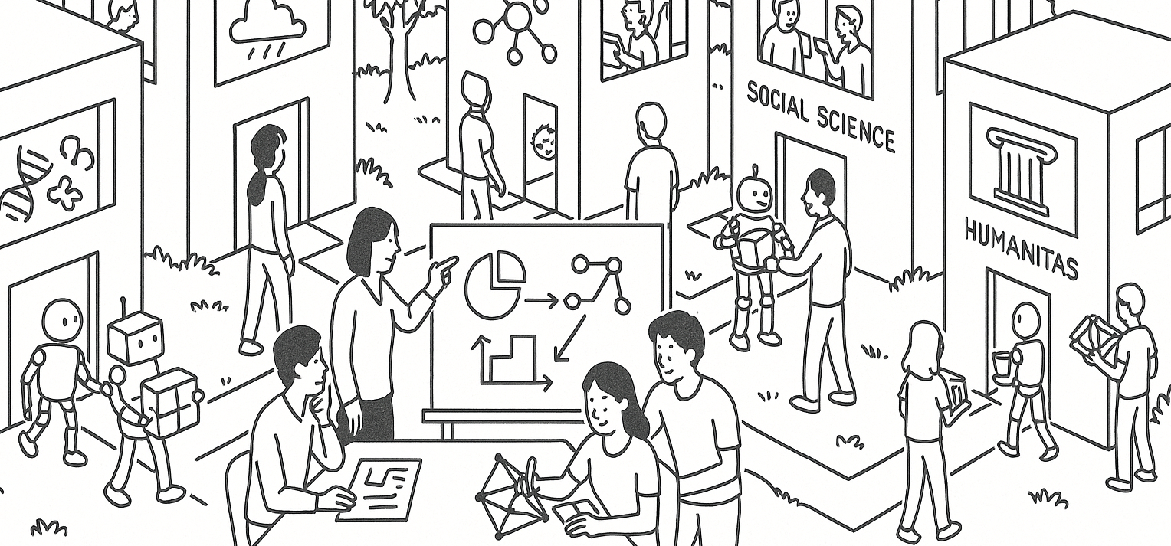

Sampling, replacement, and independence
STAT UN 1001 · LECTURE 9
October 6th, 2026
Notes:
Lecture 9 uses Week 05 flipped activity examples to focus on small-population sampling, replacement, and independence.

Slide 2
The five-part setup
1
Chance process
What random action repeats? Is it the same process?
2
Sample space
What outcomes could happen?
3
Event
Which outcomes count?
4
Probability sentence
What probability are we finding?
5
Rule
Complement, multiplication, table, or tree?
COLUMBIA UNIVERSITY · DEPARTMENT OF STATISTICS
03
Notes:
Repeated checklist for Week 05 practice problems.

Slide 3
Small population example
A study group has five practice cards. Two cards are probability, one is graphs, one is study design, and one is numerical summaries.
Card | A | B | C | D | E
Topic | Prob. | Prob. | Graphs | Study design | Summaries
QUESTION
If you draw two cards, what changes after the first draw?
The answer depends on replacement.
COLUMBIA UNIVERSITY · DEPARTMENT OF STATISTICS
04
Notes:
Introduce a concrete small-population example before comparing replacement rules.

Slide 4
With replacement
WHAT HAPPENS
Draw a card, record its topic, put it back, mix again, and draw the second card.
PROBABILITY CONSEQUENCE
The second draw still has five possible cards. The chance of the probability card stays 2/5.
INDEPENDENCE CONNECTION
The first draw does not change the probability for the second draw.
Everyday version: a playlist that allows repeats can play the same song again.
COLUMBIA UNIVERSITY · DEPARTMENT OF STATISTICS
05
Notes:
With replacement keeps the same population for each draw.

Slide 5
Without replacement
WHAT HAPPENS
Draw a card, keep it out, then draw the second card from the four cards that remain.
PROBABILITY CONSEQUENCE
The denominator changes from 5 to 4. The numerator may change too.
INDEPENDENCE CONNECTION
The first draw can change the probability for the second draw.
Everyday version: a no-repeat playlist changes what can come next.
COLUMBIA UNIVERSITY · DEPARTMENT OF STATISTICS
06
Notes:
Without replacement changes the population after each draw.

Slide 6
Two second-draw probabilities
Sampling method | First draw | Cards left | P(second card is probability)
Without replacement | Probability | 1 probability card among 4 cards | 1/4
 | Not probability | 2 probability cards among 4 cards | 2/4
With replacement | Any card | 2 probability cards among 5 cards | 2/5
Independence asks whether knowing the first outcome changes the probability of the next event.
MAIN INSIGHT
The same question can have different answers under different sampling rules.
COLUMBIA UNIVERSITY · DEPARTMENT OF STATISTICS
07
Notes:
Use the same small population to show how the first outcome changes the next probability.

Slide 7
Small versus large populations
Population | Remove one person | Effect on next draw
15 students | 1/15 of the population | Large enough to notice
1,500 students | 1/1,500 of the population | Usually tiny
PRACTICAL READING
Without replacement is not independent, but it can behave almost like independence when the population is huge compared with the sample.
This is why survey sampling often cares about sample size relative to population size.
COLUMBIA UNIVERSITY · DEPARTMENT OF STATISTICS
08
Notes:
Connect the Week 05 population-size practice question to everyday sampling.

Slide 8
Dinner-party seating
Eight people sit randomly around a round table. Your seat is fixed. You care whether Alex sits next to you.
CHANCE PROCESS
Randomly assign the seven other people to the seven remaining seats.
SAMPLE SPACE
There are 7 possible seats for Alex, not 8, because your seat is already occupied.
PROBABILITY
Two seats are next to you, so P(Alex sits next to you) = 2/7.
COLUMBIA UNIVERSITY · DEPARTMENT OF STATISTICS
09
Notes:
Use Week 05 practice question 5 and 6.

Slide 9
Raffle rules
A raffle has 30 tickets and 7 prizes. You bought one ticket.
Rule | What repeats? | Your chance of at least one prize
Without replacement | Seven different winning tickets | 7/30
With replacement | Your ticket could be drawn on any prize draw | 1 - (29/30)^7
A raffle question is incomplete until we know the replacement rule.
COLUMBIA UNIVERSITY · DEPARTMENT OF STATISTICS
10
Notes:
Compare Week 05 practice questions 7 and 8.

Slide 10
Socks and complements
Drawer: 4 blue socks, 5 gray socks, 3 black socks. You grab 2 socks without replacement.
MATCHING SOCKS
The event includes blue-blue, gray-gray, or black-black.
AT LEAST ONE BLACK SOCK
The complement is no black socks.
TWO BLUE SOCKS
The probability sentence is (4/12)(3/11). The second fraction changes because one blue sock has been removed.
COLUMBIA UNIVERSITY · DEPARTMENT OF STATISTICS
11
Notes:
Use Week 05 practice questions 11 through 13.

Slide 11
Independent is not the same as disjoint
Concept | Question it asks | Everyday wording
Disjoint | Can both happen at once? | One lunch order cannot be both only soup and only salad
Overlapping | Can both happen at once? | A student can have an iPhone and an Apple computer
Independent | Does knowing one change the probability of the other? | A replacement rule can make repeated draws independent
Disjoint is about possibility. Independent is about information.
COLUMBIA UNIVERSITY · DEPARTMENT OF STATISTICS
12
Notes:
Clarify a common confusion from Chapter 3.

Slide 12
In-class practice
For each situation, decide: with replacement, without replacement, or neither clear from the wording. Then say whether independence is reasonable.
1
A music app shuffles five songs and allows repeats.
2
A TA draws three student names from a hat and does not put names back.
3
A website shows survey respondents one of two versions, but the assignment algorithm is not described.
COLUMBIA UNIVERSITY · DEPARTMENT OF STATISTICS
14
Notes:
Three quick classify-and-explain prompts.

Slide 13
Good habits for working out problems
BEFORE CALCULATING
Name the chance process, sample space, event, and denominator.
BEFORE MULTIPLYING
Ask whether the next stage uses the same population or a changed population.
BEFORE ASSUMING INDEPENDENCE
Ask whether knowing one outcome changes the probability of another.
COLUMBIA UNIVERSITY · DEPARTMENT OF STATISTICS
15
Notes:
Connect today's lecture to the upcoming Chapter 3 quiz scope.

Slide 14
Takeaway
Probability is not just calculation. It is a way to describe how a random process unfolds and repeats.
WITH REPLACEMENT
The process resets.
WITHOUT REPLACEMENT
The process remembers what has already happened.
INDEPENDENCE
Knowing one event does not change the probability of the other.
COLUMBIA UNIVERSITY · DEPARTMENT OF STATISTICS
16
Notes:
End with a compact conceptual summary.

