Slide 1
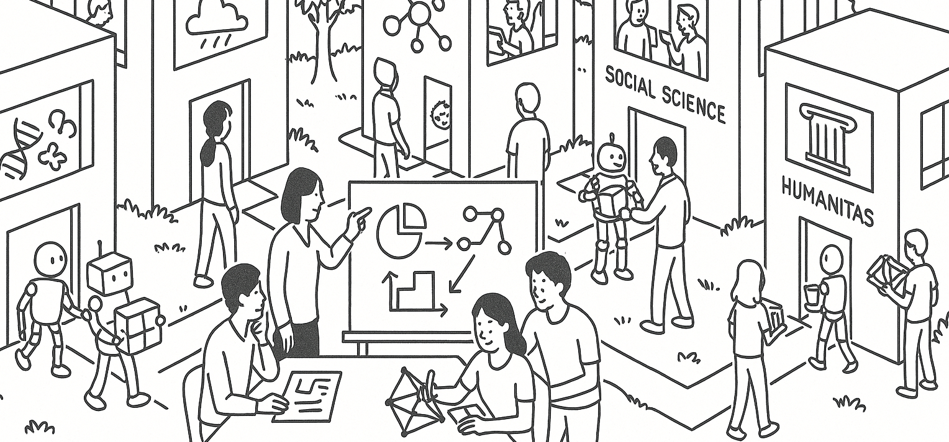
What does a statistician do?
Three research stories
Tian Zheng
Partition retention, AutoClimDS, Grade the Grader
STAT UN 1001, Fall 2026
Notes:
Introduce the research segment as three examples of statistical work: finding predictive structure, building trustworthy data workflows, and evaluating an evaluation system.

Slide 2
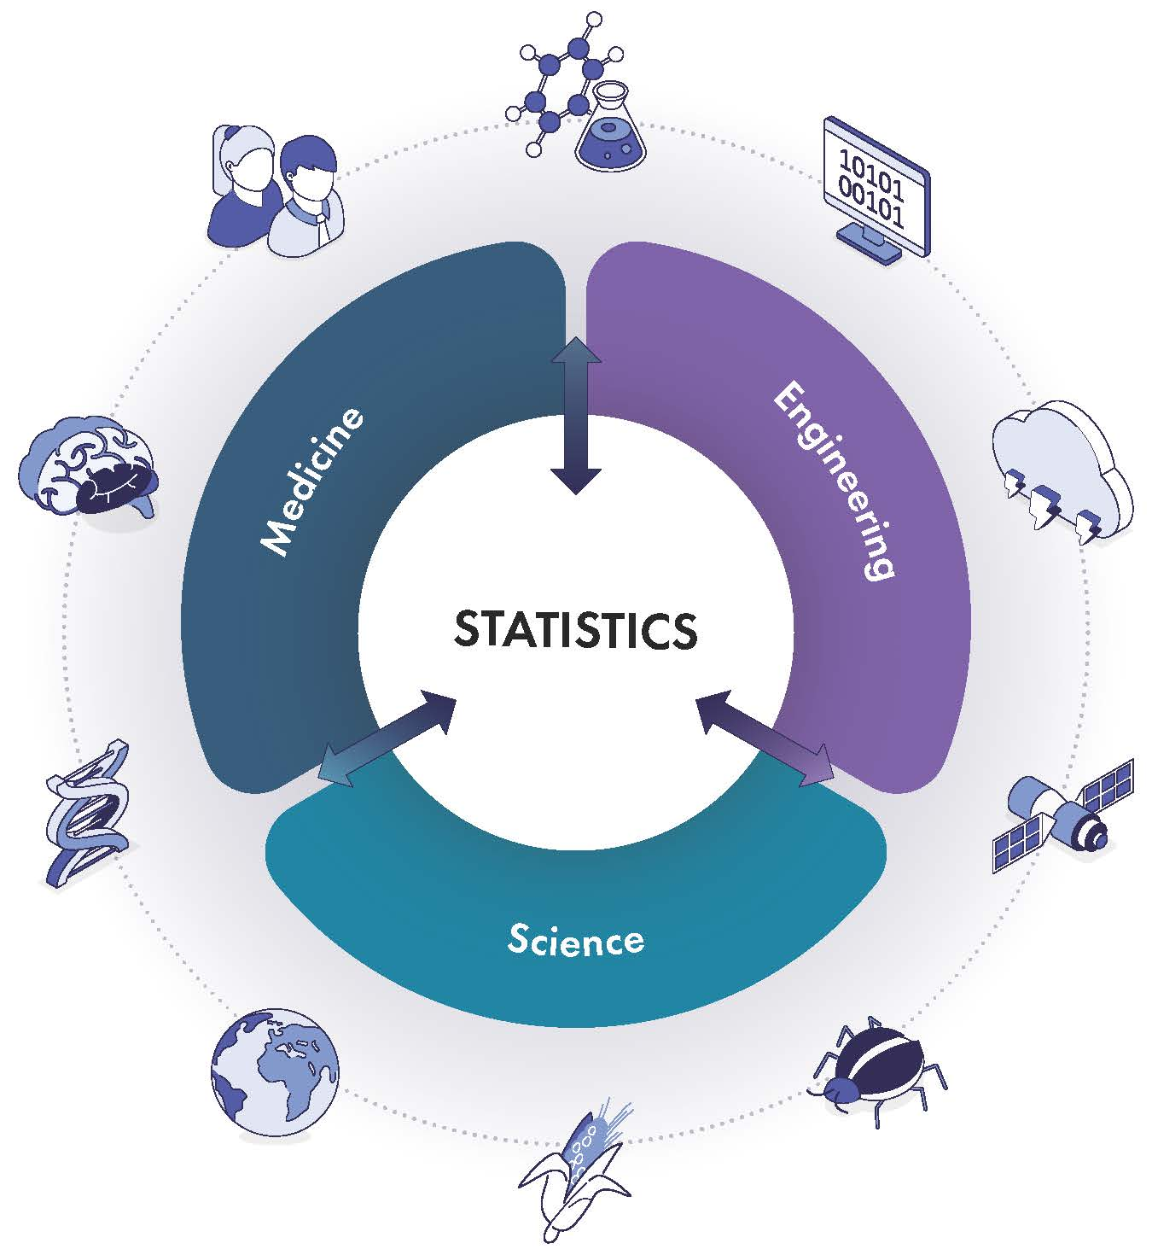
Notes:
NASEM framing: statistics sits at the core of science, engineering, and medicine because evidence in each domain depends on data collection, modeling, uncertainty, and evaluation. Source: National Academies, Frontiers of Statistics in Science and Engineering: 2035 and Beyond (2026).

Slide 3
What is statistics for?
“Statistics is a wonderful discipline.”
“How do we translate information into knowledge?”
“How to turn data into decisions”
Stephen Senn, Dicing with Death
COLUMBIA UNIVERSITY · DEPARTMENT OF STATISTICS
Notes:
Use these lines to frame statistics as a discipline that connects data, knowledge, and action. Source: Stephen Senn, Dicing with Death (Cambridge University Press, 2003), https://www.senns.uk/DICE.html (page updated February 15, 2025).

Slide 4
Three questions from my research
1
Why can a statistically significant variable predict poorly?
2
Can an AI agent assemble a trustworthy climate data workflow?
3
How do we know whether an AI grader judged an answer correctly?
Each problem asks how we generate evidence and whether our checks justify the conclusion.
COLUMBIA UNIVERSITY · DEPARTMENT OF STATISTICS
Notes:
Preview the three projects in language accessible to an introductory statistics class. Ask students what the word ‘significant’ means to them before using its statistical meaning.

Slide 5
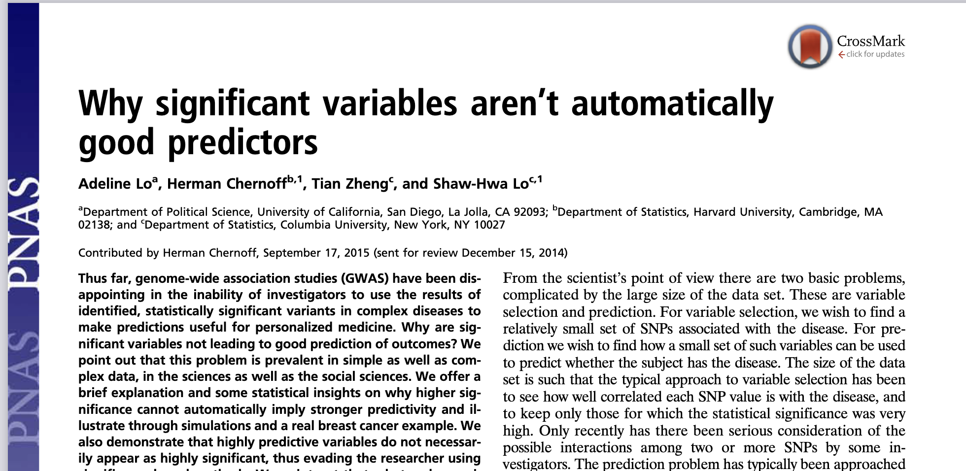
Notes:
Use the paper title to pose the central distinction. A statistically significant association may contribute little accuracy for new cases. Source: Lo, Chernoff, Zheng, and Lo, ‘Why significant variables aren’t automatically good predictors,’ PNAS (2015).

Slide 6
Significance and prediction answer different questions
STATISTICAL SIGNIFICANCE
PREDICTION
In the data at hand, how incompatible is the observed association with a specified chance model?
For a new case, how close is the forecast to the outcome that actually occurs?
A small p-value can accompany a weak forecast. Prediction often depends on combinations, interactions, and validation on new data.
COLUMBIA UNIVERSITY · DEPARTMENT OF STATISTICS
Notes:
Keep the distinction conceptual. Significance concerns evidence against a model-based null claim. Prediction concerns error on cases not used to build the model. Sample size can make a weak association statistically detectable without making it useful for prediction. Source: Lo, Chernoff, Zheng, and Lo, ‘Why significant variables aren’t automatically good predictors,’ PNAS (2015).

Slide 7
Partition retention searches for informative combinations
1
Start with a candidate set of variables and partition the cases by their joint values.
2
Score how much the outcome rates differ across the resulting groups.
3
Remove variables that do not improve the score. Repeat from many candidate sets.
Variables that repeatedly remain point to predictive combinations, including interactions that single-variable tests can miss.
COLUMBIA UNIVERSITY · DEPARTMENT OF STATISTICS
Notes:
Describe the method at a high level. The I-score measures how strongly outcome means differ across partitions of the cases. Partition retention repeatedly removes variables that do not help the score, which can reveal jointly informative variables. Source: Chernoff, Lo, and Zheng, ‘Discovering Influential Variables: A Method of Partitions,’ Annals of Applied Statistics (2009).

Slide 8
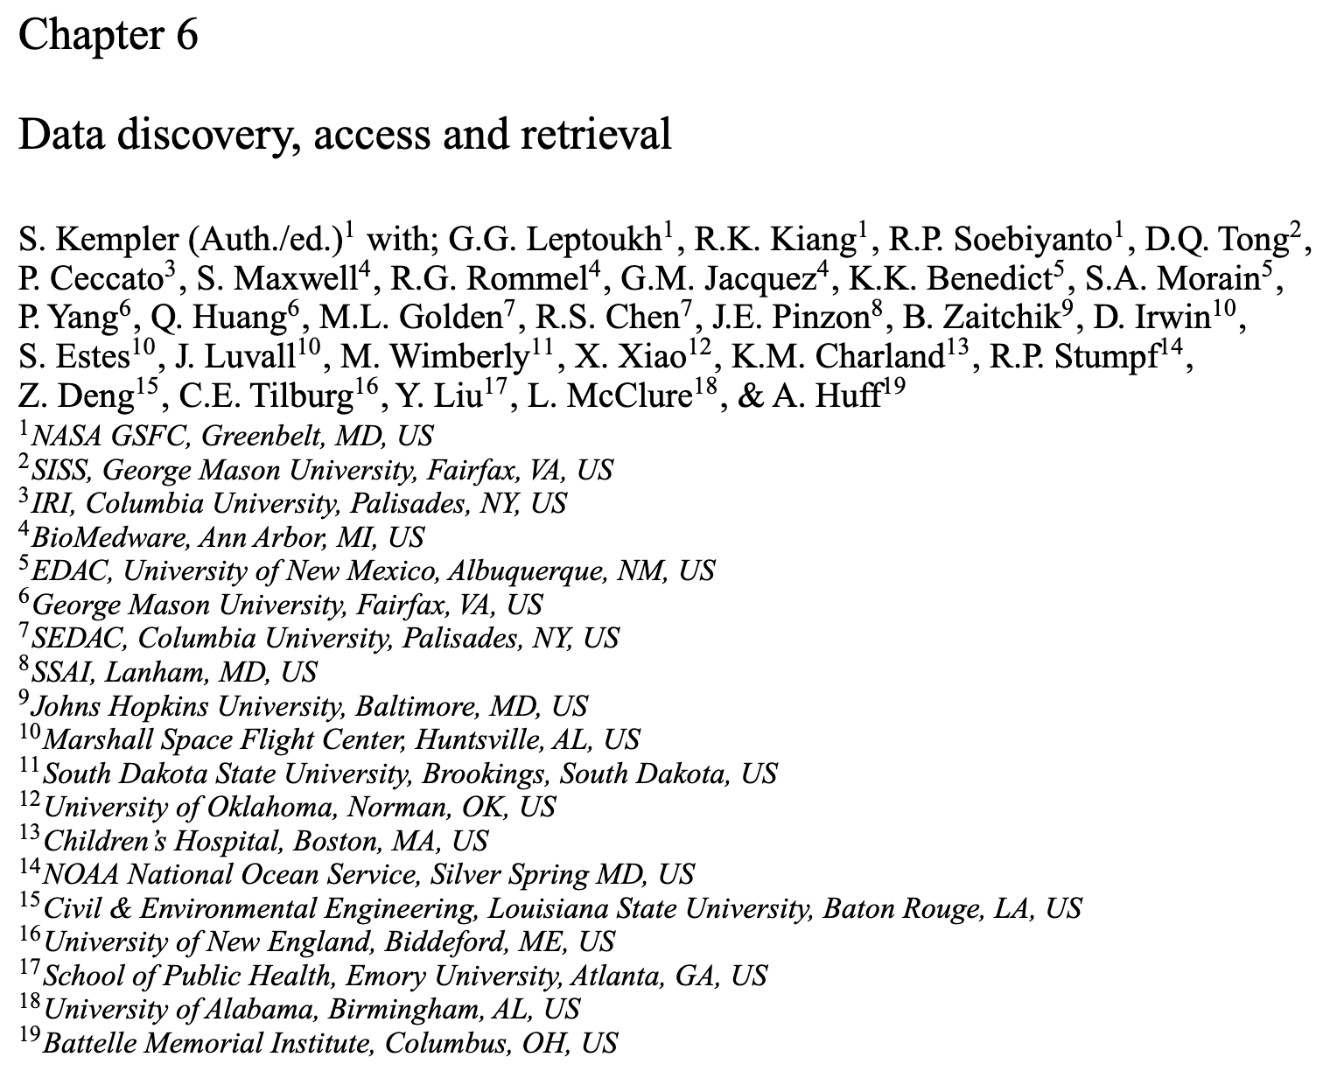
Bottlenecks in Climate Data Science
Fragmented ecosystem: multiple portals, formats, agencies
Retrieval-based workflows, not integration
“Complex and sometimes frustrating” (Kempler et al, 2012)
Kempler (Author/editor), S. (2012). Data discovery, access and retrieval. In Environmental Tracking for Public Health Surveillance. CRC Press.
Notes:
Climate data are distributed across many portals, formats, and agencies. The research problem includes finding and integrating data, not only fitting a model. Source cited on slide: Kempler et al. (2012).

Slide 9
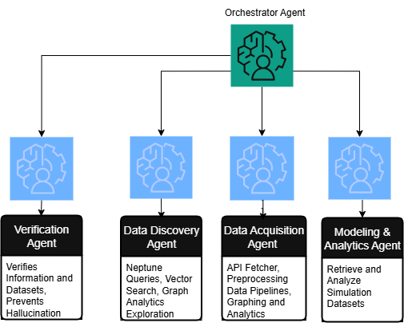
Notes:
Walk from the orchestrator to the four specialized agents: verification, data discovery, data acquisition, and modeling and analytics. Source: Jaber et al., AutoClimDS, IEEE CAI (2026), arXiv:2509.21553.

Slide 10
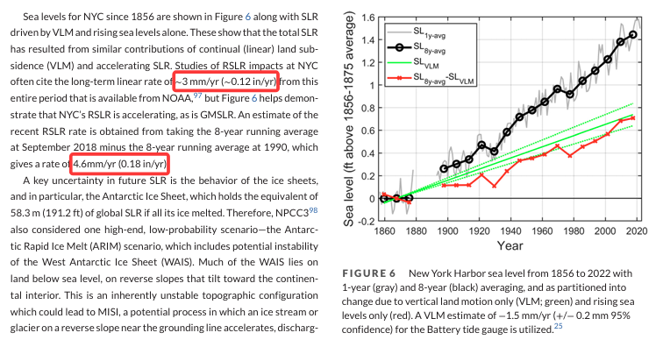
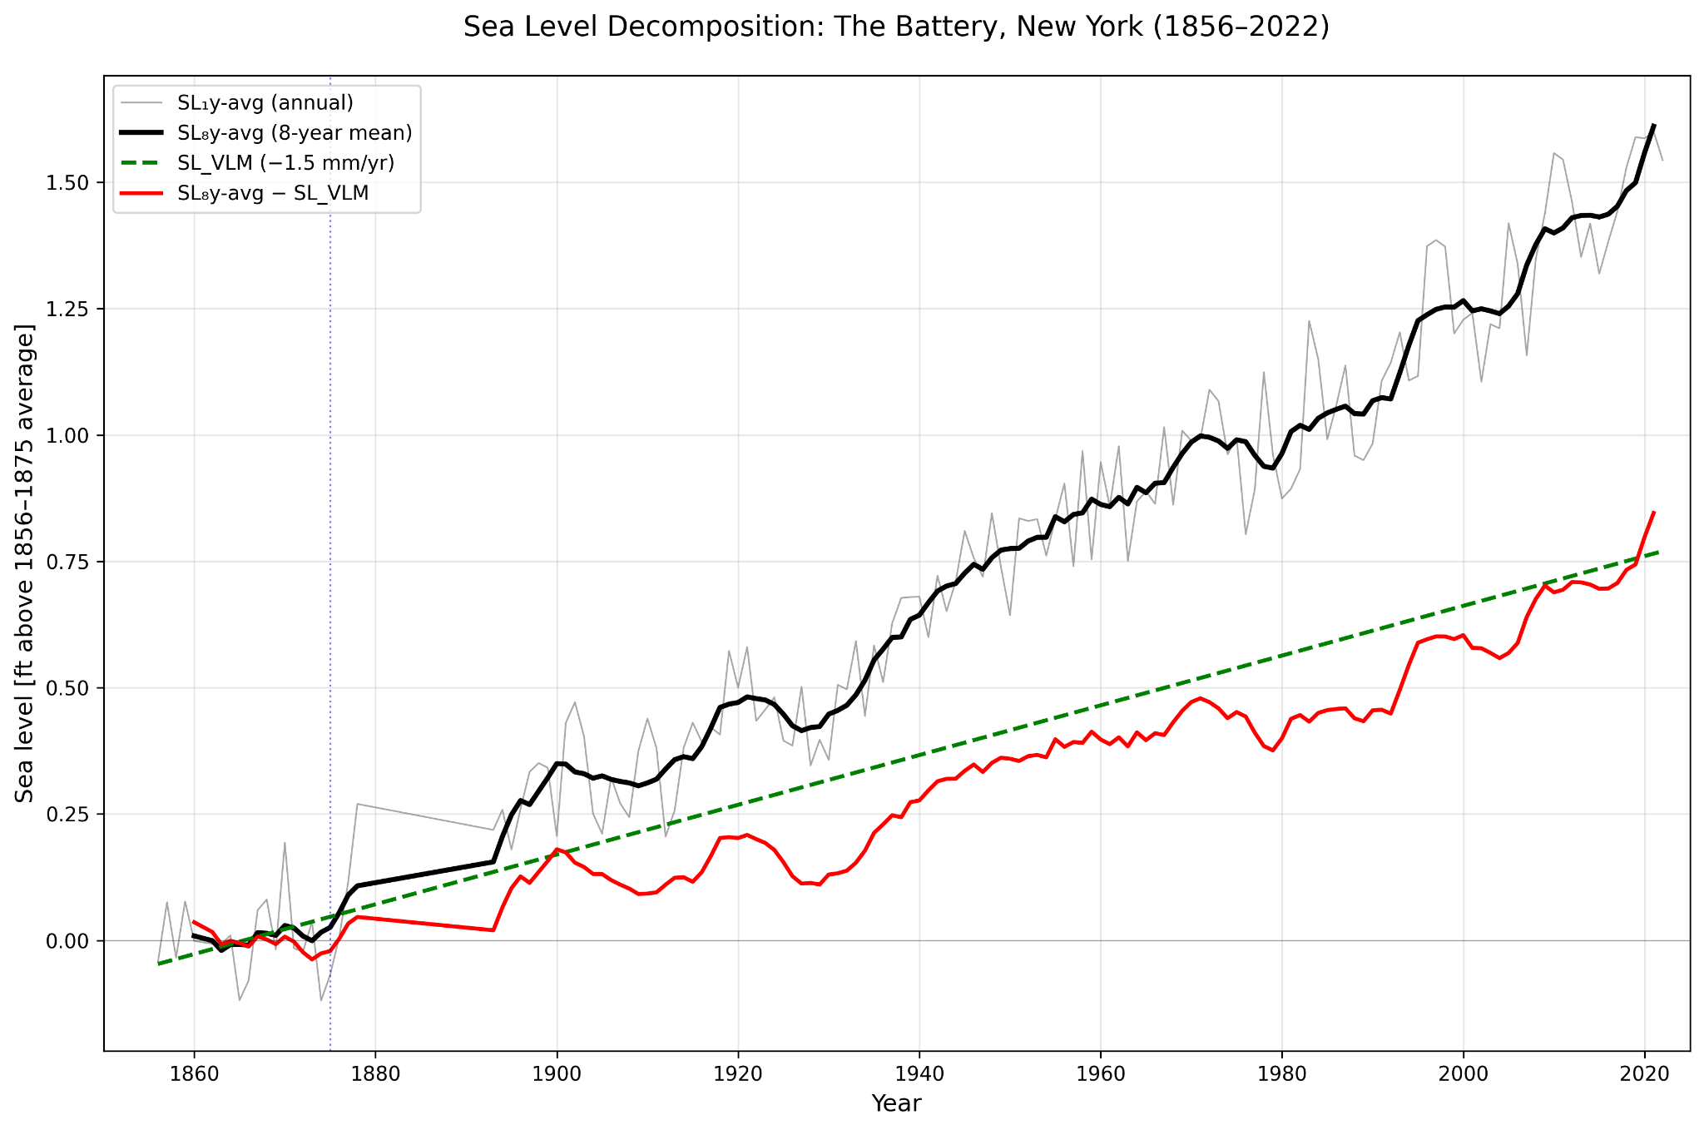
AutoClimDS Replicated using natural language queries only
Original Figure
Notes:
The proof of concept asks AutoClimDS to reproduce a published New York Harbor sea-level decomposition using natural-language requests. Compare the replicated figure with the original and discuss what must be checked beyond visual similarity. Sources: Jaber et al., AutoClimDS; NPCC4 technical report, DOI 10.1111/nyas.15116.

Slide 11
What AutoClimDS tests
Can a natural-language question become a traceable climate analysis?
The workflow must find appropriate data and metadata.
It must retrieve and preprocess the data before running the analysis.
A verification agent checks sources and results throughout the process.
Scientists still decide whether the variables, assumptions, and comparison support the conclusion.
COLUMBIA UNIVERSITY · DEPARTMENT OF STATISTICS
Notes:
Connect the architecture to the course language of data provenance, variables, measurement, and claims. Source: Jaber et al., ‘AutoClimDS: Climate Data Science Agentic AI — A Knowledge Graph Is All You Need,’ IEEE CAI (2026), arXiv:2509.21553.

Slide 12
The Problem: Grading Is Its Own Failure Mode
Case study: LAMBDA (multi-agent system) on 153 numerical QRData tasks from DSGym.
Agentic data-analysis systems
produce rich, multi-step outputs: code, execution logs, intermediate statistics, and verbal diagnostics, etc. extracting the intended scalar answer from this noise is non-trivial, so grading itself becomes error-prone.
The Grader: DSGym’s
default exact_match scorer treats “0.2” and “0.20” as distinct, producing false negatives. Core tension: the richer the output, the harder it is to grade genuine agent–ground-truth disagreement must be separated from grading artifacts.
Notes:
A rich agent output can contain the correct answer plus code, logs, and many other numbers. Exact string matching can create false negatives, such as treating 0.2 and 0.20 as different. Benchmark: 153 numerical QRData tasks from DSGym.

Slide 13
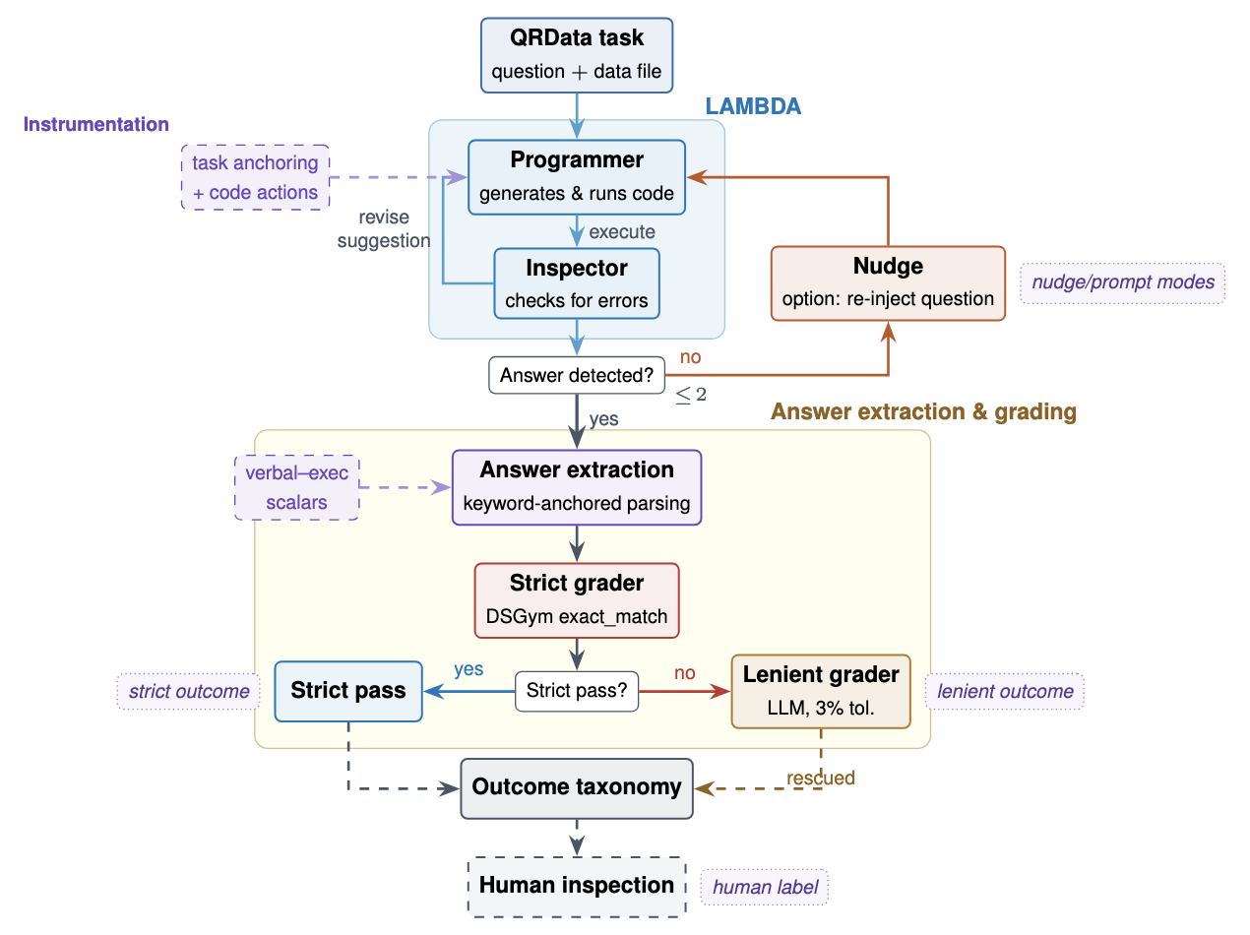
Notes:
The evaluation pipeline extracts an answer, applies a strict grader, uses a lenient grader when needed, and calibrates outcomes against human inspection. The nudge requests a single numerical answer when the system cannot confidently identify one.

Slide 14
A grader must also be evaluated
36% to 97%
26% to 86%
grading-run success after nudging
strict-grader recall with keyword-anchored parsing
35% to 97%
Human labels help separate agent errors from grader errors.
lenient-grader recall after nudging
Benchmark: 153 numerical QRData tasks from DSGym
COLUMBIA UNIVERSITY · DEPARTMENT OF STATISTICS
Notes:
Explain recall as the share of human-identified correct answers that the grader recognizes as correct. These results show that evaluation design can change the apparent performance of the same agent. Source: Grade the Grader project materials in the supplied deck and https://github.com/TZstats-Columbia/STAI-X-Grade-The-Grader.

Slide 15
The common statistical question
What system produced the evidence, and what can the evidence support?
Partition retention
case and variable combinations shape forecasts for future outcomes
AutoClimDS
data sources and workflow produce a climate result
Grade the Grader
agent output and evaluation pipeline determine the reported score
These are the same questions we will ask all semester about cases, variables, samples, uncertainty, and claims.
COLUMBIA UNIVERSITY · DEPARTMENT OF STATISTICS
Notes:
Close by connecting current research to introductory statistical reasoning. Each project requires defining the cases and variables, understanding the data-generating process, deciding what to summarize, and checking how far a conclusion can travel.

