Slide 1
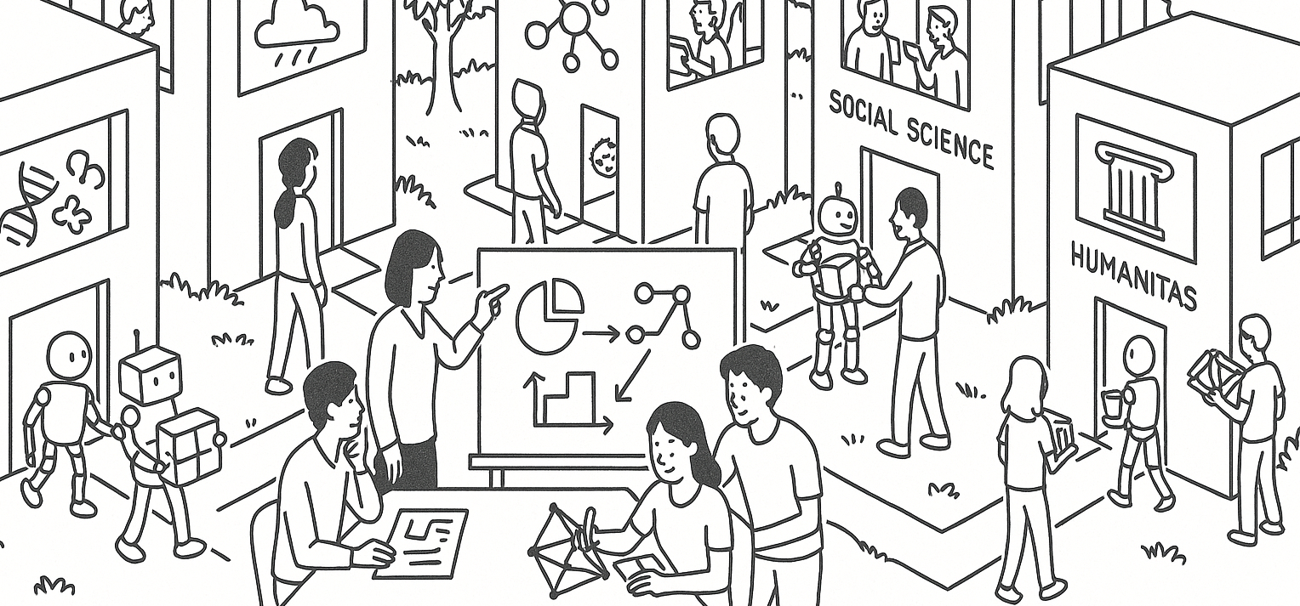
Can ChatGPT harm learning?
Reading a study statistically
STAT UN 1001 · LECTURE 2
TIAN ZHENG · FALL 2026
Notes:
Open with the public claim, then tell students that the class will reconstruct the evidence behind it. The live Ping Pong AI assistant demonstration follows the slide discussion.

Slide 2
The claim in the news
Using ChatGPT to write essays may be bad for your brain
A 2025 news report said ChatGPT users showed the lowest brain engagement and underperformed on neural, linguistic, and behavioral measures.
What would we need to know before believing that claim?
COLUMBIA UNIVERSITY · DEPARTMENT OF STATISTICS
Notes:
Source: TIME, ‘Is Using ChatGPT to Write Your Essay Bad for Your Brain?’ June 27, 2025. https://time.com/7298299/chatgpt-bad-for-brain-study/ . Read the large claim aloud before revealing any study details.

Slide 3
What does the claim mean?
PAIR DISCUSSION 3 MINUTES
Choose one phrase and make it measurable
“using ChatGPT”
“bad for your brain”
“underperformed”
Write one outcome that researchers could actually record.
Be ready to explain why your outcome represents the idea you chose.
COLUMBIA UNIVERSITY · DEPARTMENT OF STATISTICS
Notes:
Pairs work for three minutes. Ask for two proposed measures. Use their answers to distinguish a concept from its operational definition.

Slide 4
The study question
How does assistance during essay writing relate to neural activity and writing behavior?
The researchers compared ChatGPT, web search, and no external tools during repeated SAT-style essay tasks.
The paper remains a preprint. The authors posted version 1 in June 2025 and revised it in December 2025.
COLUMBIA UNIVERSITY · DEPARTMENT OF STATISTICS
Notes:
Source: Kosmyna et al., ‘Your Brain on ChatGPT,’ arXiv:2506.08872, version 2 posted December 31, 2025. https://arxiv.org/abs/2506.08872 . Explain that a preprint is public research that has not yet completed journal peer review.

Slide 5
The sample
54
18 to 39
5
participants in Sessions 1 to 3
years old
Greater Boston universities
The researchers randomly assigned 18 participants to each writing condition, balancing age and gender.
Eighteen participants completed the optional fourth session.
COLUMBIA UNIVERSITY · DEPARTMENT OF STATISTICS
Notes:
Source: Kosmyna et al., arXiv:2506.08872v2, Experimental Design, pp. 21–22. Participants came from MIT, Wellesley, Harvard, Tufts, and Northeastern. The age mean reported in the paper is 22.9 years.

Slide 6
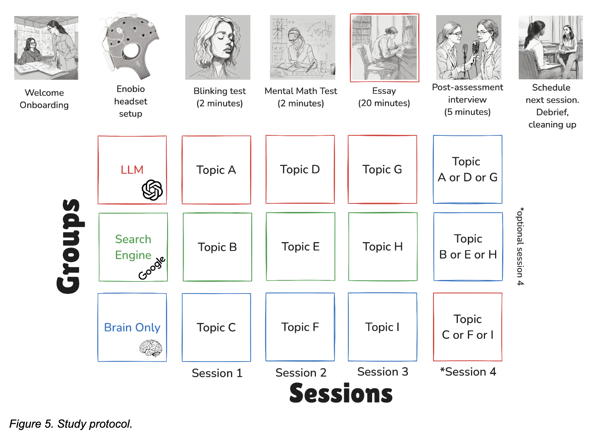
The study design
Sessions 1 to 3
The same assigned tool condition for each participant
Session 4
An optional crossover for the ChatGPT and brain-only groups
Each session included EEG recording, an essay, and a post-task interview.
COLUMBIA UNIVERSITY · DEPARTMENT OF STATISTICS
Notes:
Source figure: Kosmyna et al., arXiv:2506.08872v2, Figure 5, p. 29. The figure appears under the paper’s arXiv license. Explain the repeated sessions and the optional fourth-session crossover without yet evaluating the design.

Slide 7
Cases, variables, and values
PAIR DISCUSSION 4 MINUTES
Use the handout to complete the study map
Cases
Who or what has one row of data?
Variables
What characteristics did researchers record?
Values
Give one possible value for one variable.
Challenge: Does each participant contribute one observation or several?
COLUMBIA UNIVERSITY · DEPARTMENT OF STATISTICS
Notes:
Pairs complete Part A of the handout. The challenge introduces repeated measurements: a participant is a case, but participant-session records are repeated observations nested within that case.

Slide 8
The study map
Case
One participant
Repeated observation
One participant in one session
Explanatory variable
Assigned writing condition
Response variables
EEG connectivity, quotation recall, essay features, scores, and reported ownership
A variable names what can vary. A value records what occurred for one observation.
COLUMBIA UNIVERSITY · DEPARTMENT OF STATISTICS
Notes:
Connect to OpenIntro Statistics Chapter 1, Section 1.2. Distinguish a variable such as writing condition from values such as ChatGPT or brain-only.

Slide 9
Explanatory and response variables
Writing condition
Measured outcomes
The assigned condition may explain differences among outcomes.
Each outcome captures a different part of writing behavior or neural activity.
Which response variable best represents learning?
The answer depends on the domain question and the meaning of learning.
COLUMBIA UNIVERSITY · DEPARTMENT OF STATISTICS
Notes:
Connect to OpenIntro’s explanatory and response variable language. Ask students to nominate the most direct learning outcome and explain what it misses.

Slide 10
Random assignment and random sampling
Random assignment
Random sampling
Strengthens comparisons among the three conditions for the participants in this experiment
The study did not draw a random sample from all students or all ChatGPT users
The design helps with the comparison inside the experiment. The recruitment limits how far the result can travel.
COLUMBIA UNIVERSITY · DEPARTMENT OF STATISTICS
Notes:
Connect to OpenIntro Statistics Chapter 1, Sections 1.3 and 1.4. Random assignment addresses confounding across treatment groups. Random sampling addresses representativeness. Source for assignment and recruitment: Kosmyna et al., pp. 21–22.

Slide 11
One reported behavioral result
Participants unable to quote their essay accurately after Session 1
15 of 18 ChatGPT participants, compared with 2 of 18 in each other group
COLUMBIA UNIVERSITY · DEPARTMENT OF STATISTICS
Notes:
Source: Kosmyna et al., arXiv:2506.08872v2, p. 30. This chart shows Session 1 only. Later sessions had different counts, so do not describe this as a stable rate across the whole study.

Slide 12
What the authors reported
EEG
The authors described the brain-only group as having the strongest and most distributed connectivity.
Recall
ChatGPT users had more difficulty quoting their own essays in several sessions.
Ownership
Reported ownership tended to be lowest in the ChatGPT group.
These outcomes differ from long-term learning, intelligence, or brain damage.
COLUMBIA UNIVERSITY · DEPARTMENT OF STATISTICS
Notes:
Source: Kosmyna et al., arXiv:2506.08872v2, abstract and results. Keep the final distinction explicit. The study measured task-related EEG connectivity and behavioral outcomes, not IQ or brain damage.

Slide 13
How the claim grows
PAIR DISCUSSION 4 MINUTES
Observed data
Study interpretation
Public claim
Different measurements across assigned groups
ChatGPT assistance may reduce engagement during this task
ChatGPT is bad for your brain
Where does the evidence become too weak for the claim? Explain one gap.
COLUMBIA UNIVERSITY · DEPARTMENT OF STATISTICS
Notes:
Pairs complete Part C of the handout. Invite one pair to identify a gap between measurement and interpretation and another to identify a gap in generalization.

Slide 14
What does EEG connectivity represent?
Measured quantity
Target concept
Statistical coupling among signals recorded at scalp electrodes during the task
Learning, memory, critical thinking, or cognitive engagement
A later methodological comment warned that fewer statistically significant connections do not necessarily mean weaker overall neural activity.
COLUMBIA UNIVERSITY · DEPARTMENT OF STATISTICS
Notes:
Source: Stankovic et al., ‘Comment on: Your Brain on ChatGPT,’ arXiv:2601.00856, pp. 3–4. https://arxiv.org/abs/2601.00856 . Introduce measurement validity: a recorded variable may only approximate the concept named in a headline.

Slide 15
A later methodological critique
Sample size
Fifty-four participants, with only eighteen in the optional crossover session
Many comparisons
The EEG analysis considered many electrode pairs and repeated tests
Reproducibility
Some analytic choices and exclusions lacked enough detail for independent checking
Interpretation
Several broad cognitive claims went beyond the reported operational measures
COLUMBIA UNIVERSITY · DEPARTMENT OF STATISTICS
Notes:
Source: Stankovic et al., arXiv:2601.00856. Present the comment as scholarly critique, not a final verdict. The commenters also praised the valuable dataset and ambitious multimethod work.

Slide 16
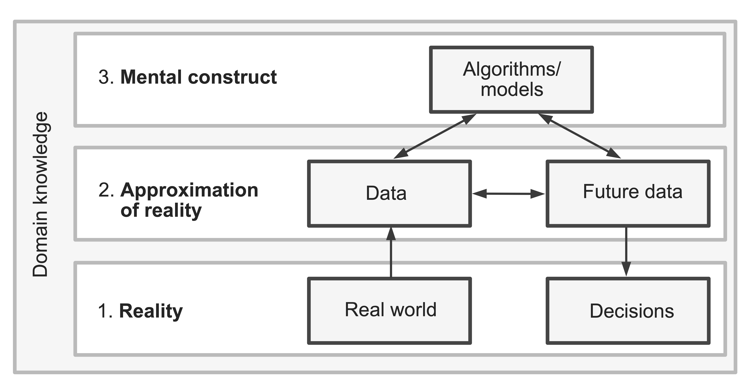
The VDS three-realms check
Reality
How people use AI while learning
Data
EEG signals, essays, and interviews from this experiment
Analysis
Models and judgment calls used to summarize the measurements
COLUMBIA UNIVERSITY · DEPARTMENT OF STATISTICS
Notes:
Source figure: Yu and Barter, Veridical Data Science, Chapter 1, Figure 1.1. https://vdsbook.com/01-veridical_ds . VDS describes data as an approximation of reality and analyses as human-designed mental constructs. Use the study to ask how strong each connection is.

Slide 17
Trustworthiness audit
PAIR DISCUSSION 6 MINUTES
Domain question
Does the study ask the question the headline answers?
Data
Do the sample and measurements reflect the relevant reality?
Analysis
Would reasonable analytic choices lead to similar conclusions?
Choose the weakest connection.
COLUMBIA UNIVERSITY · DEPARTMENT OF STATISTICS
Notes:
Pairs complete Part D. After four minutes, ask partners to choose their strongest point. Take two or three rapid share-outs. Source framework: VDS Chapter 1, Sections 1.1 and 1.2.

Slide 18
A claim the evidence can support
In this sample and constrained essay task, the assigned writing tool was associated with differences in EEG connectivity and several behavioral measures.
Broader conclusions about brain damage, intelligence, or learning across settings require larger and more varied studies with direct learning outcomes.
Good statistical reasoning makes the claim fit the evidence.
COLUMBIA UNIVERSITY · DEPARTMENT OF STATISTICS
Notes:
Compare this wording with the original news claim. Ask what precision was added: sample, task, assigned tool, measured outcomes, and limits on generalization.

Slide 19
Next: Ping Pong AI assistants
COLUMBIA UNIVERSITY · DEPARTMENT OF STATISTICS
Notes:
Transition to the live demonstration. Keep the same statistical questions active: What is the claim? What evidence appears? What remains uncertain? The user will introduce and operate the Ping Pong AI assistants from the laptop.

