Slide 1
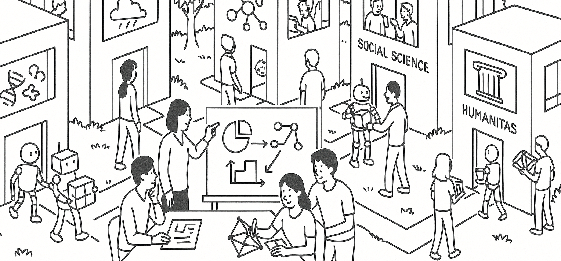
Study design, sampling, and bias
Two real studies
STAT UN 1001 · LECTURES 3–4
SEPTEMBER 15 AND 17, 2026
Notes:
This file covers both Week 2 meetings. Lecture 3 begins with slides 2–7, then uses the adoption case on slides 8–13. Lecture 4 begins at the divider on slide 14, then uses the homicide case and ends with the VDS and data-biography activities.

Slide 2
Last week Important concepts
A statistical question connects a population to a variable we want to understand.
Cases or individuals
The people, objects, places, or time periods represented by rows of data
Variables and values
A variable names what varies. A value records what we observed for one case.
Sample and population
The sample provides the data. The population defines the group we hope to describe.
A credible claim must match the evidence and how the data were produced.
COLUMBIA UNIVERSITY · DEPARTMENT OF STATISTICS
Notes:
Invite students to reconstruct each term before revealing or explaining it. Connect the final statement to the Week 1 discussion of claims, context, and the VDS idea that data approximate reality.

Slide 3
Sample vocabulary in one example
A random sample of 1,155 Americans reported their hours of relaxation after an average workday. The sample mean was 1.65 hours.
Observation
One sampled American
Variable
Hours available to relax
Statistic
The sample mean, 1.65 hours
Parameter
The unknown mean for all Americans in the target population
COLUMBIA UNIVERSITY · DEPARTMENT OF STATISTICS
Notes:
Adapted from OpenIntro Statistics, Chapter 1, Exercise 1.17, as used in the Week 2 practice quiz. Ask students to explain why 1.65 is not a parameter and why one American is an observation rather than a variable.

Slide 4
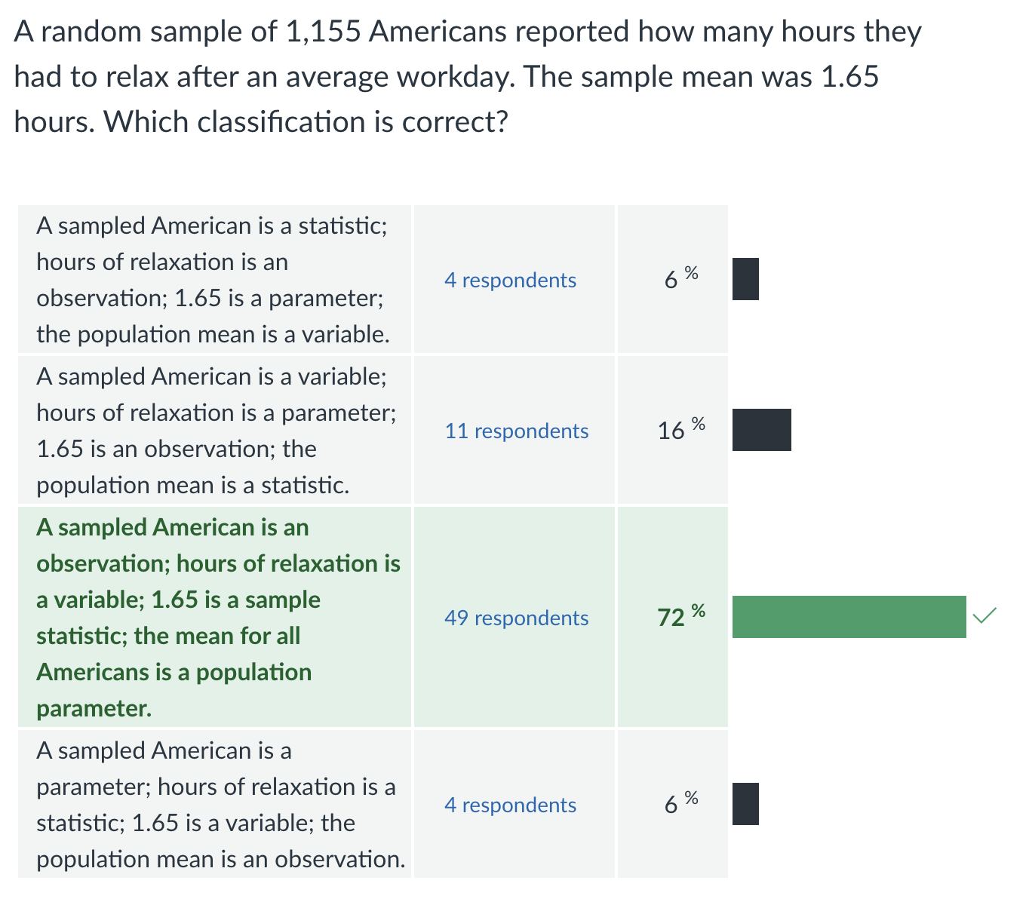

Slide 5
Topics from the flipped activity
Cases, variables, values, data matrices, and variable types
Observational studies versus experiments
Populations, samples, observations, statistics, and parameters
Association, causation, and confounding
Sampling methods and sources of sampling bias
Random assignment, controls, placebo, blinding, and blocking
Let’s take a quick look at the flipped quiz.
COLUMBIA UNIVERSITY · DEPARTMENT OF STATISTICS
Notes:
Before class, replace the verbal prompt with the top one or two difficulties from the anonymous preparation check-in and item-level quiz results. In class, ask for a quick show of hands, then use the next three slides selectively. Student questions may also determine which examples receive more time.

Slide 6
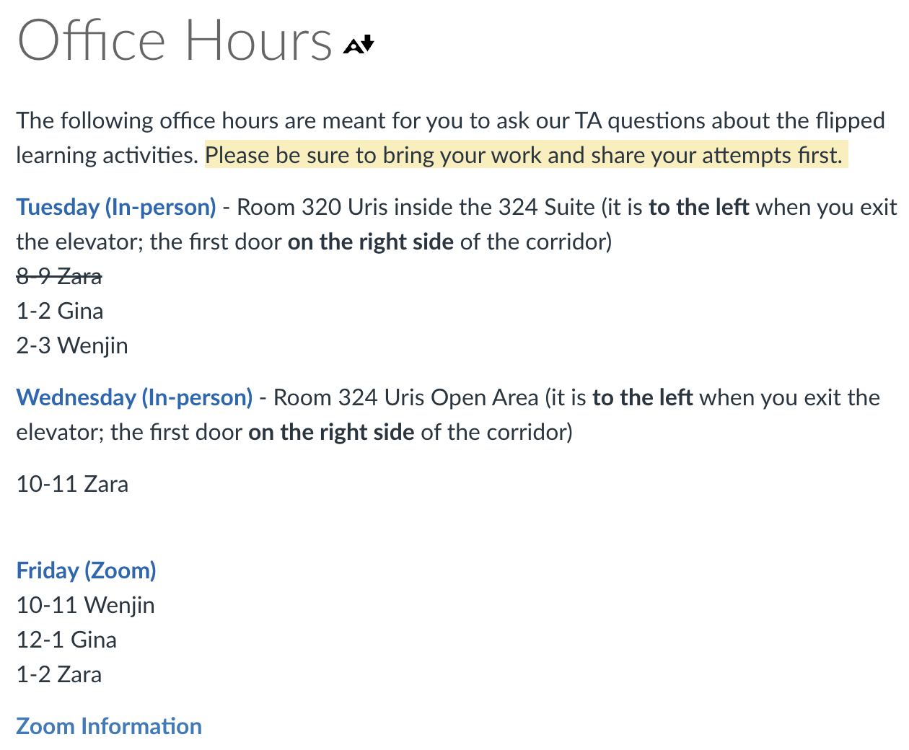
TA Office Hours
COLUMBIA UNIVERSITY · DEPARTMENT OF STATISTICS
Notes:
Before class, replace the verbal prompt with the top one or two difficulties from the anonymous preparation check-in and item-level quiz results. In class, ask for a quick show of hands, then use the next three slides selectively. Student questions may also determine which examples receive more time.

Slide 7


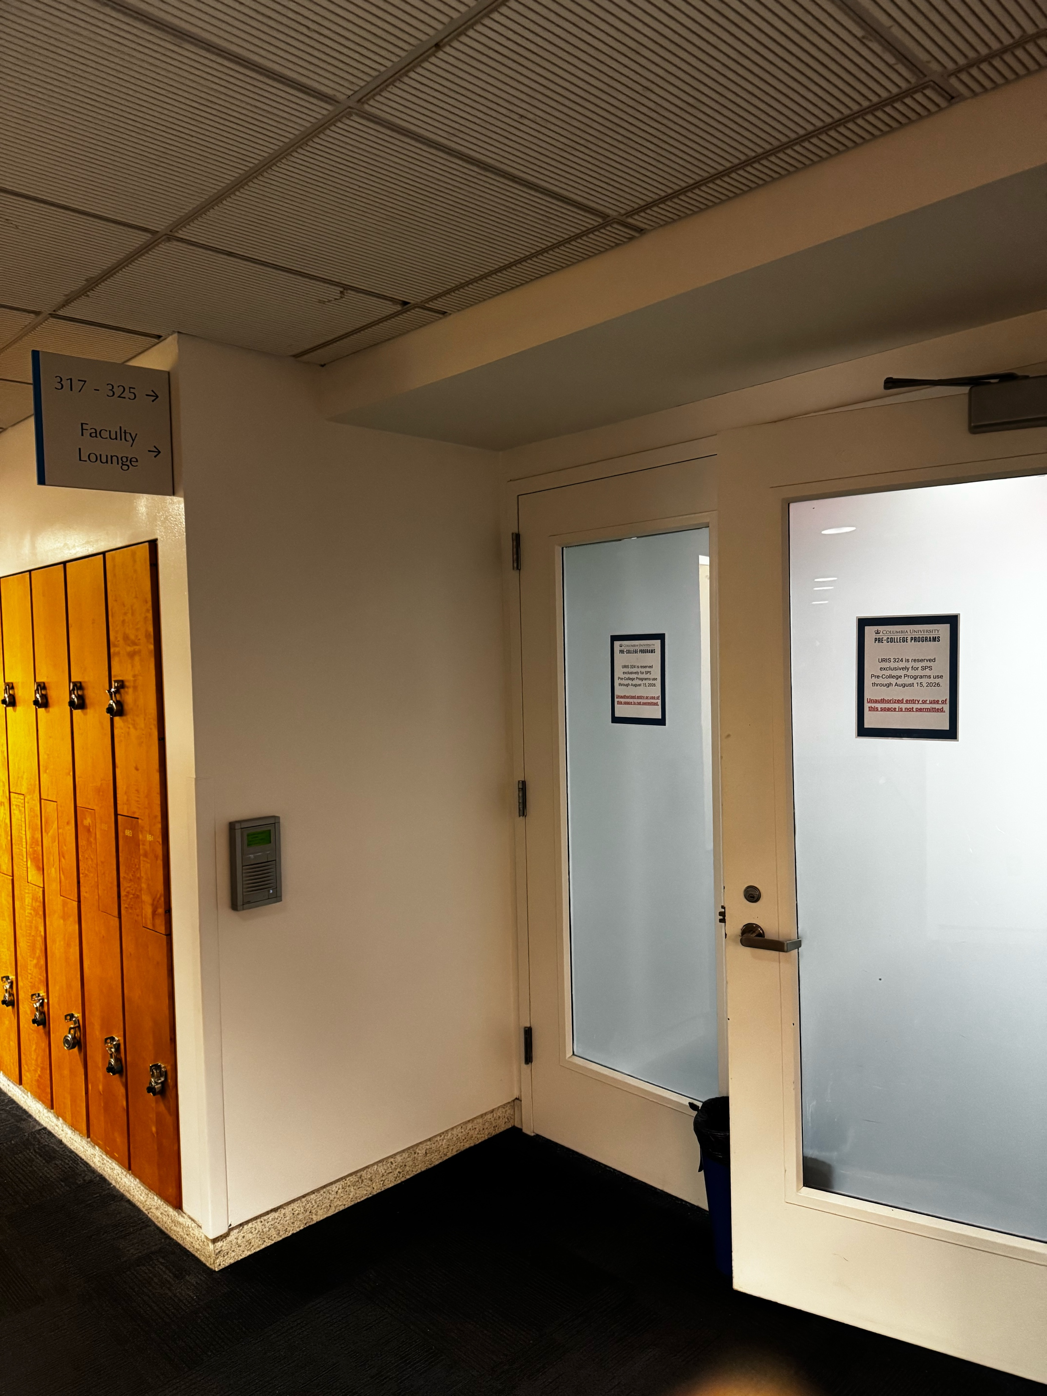
TA Office Hours
320 is behind this wall
COLUMBIA UNIVERSITY · DEPARTMENT OF STATISTICS
Notes:
Before class, replace the verbal prompt with the top one or two difficulties from the anonymous preparation check-in and item-level quiz results. In class, ask for a quick show of hands, then use the next three slides selectively. Student questions may also determine which examples receive more time.

Slide 8
Cases, variables, and values in a data matrix
Hypothetical data from a statistics practice-tool study
Student | Section | Prior quiz | Practice tool | Chapter 1 score
A | 001 | 14 | Yes | 18
B | 002 | 11 | No | 13
C | 001 | 16 | Yes | 19
D | 002 | 10 | No | 12
Values
Cases
Variables
One value
Students A–D
The column headings
Student B scored 13
COLUMBIA UNIVERSITY · DEPARTMENT OF STATISTICS
Notes:
All values are invented for instruction. Ask students why Student is an identifier rather than a measured variable of interest. Point out that a case can be a person here, but cases could also be cities, adoptions, or city-years in other datasets.

Slide 9
Concept map Cases to conclusions
recorded for
one value of
Cases
Values
Variables
Statistic
Parameter
sample values produce
population values define
A statistic summarizes observed sample values. A parameter describes the target population.
COLUMBIA UNIVERSITY · DEPARTMENT OF STATISTICS
Notes:
Read the map from the middle. Each case has a value for each variable. Statistics come from the observed sample. Parameters refer to the population and are usually unknown. Ask students where the word data belongs: the organized collection of observed values with their cases and variables.

Slide 10
Statistics and parameters
Research question
What is the average Chapter 1 score among all STAT UN 1001 students?
Statistic
Parameter
Mean score among the students in the sample
Mean score among every student in the target population
Computed from observed data
Usually unknown
COLUMBIA UNIVERSITY · DEPARTMENT OF STATISTICS
Notes:
A statistic estimates or describes a parameter. Ask students to change the target population to all Columbia undergraduates and explain how that changes the parameter without changing the observed sample statistic.

Slide 11
Variable types
Categorical
Numerical
Values place cases into groups or categories
Values record meaningful quantities
Nominal
Discrete
No natural order
Example: lecture section
Countable values
Example: problems completed
Ordinal
Continuous
Ordered categories
Example: confidence rating
Measured along a scale
Example: study time
COLUMBIA UNIVERSITY · DEPARTMENT OF STATISTICS
Notes:
Numbers can serve as category labels. The mathematical operations that make sense determine the type. Course section 001 and 002 are categorical labels even though they contain digits.

Slide 12
Variable classification Round 1
For each variable, choose categorical or numerical. Then give the subtype.
Lecture section
Confidence: low, medium, or high
Number of practice problems completed
Chapter 1 quiz score from 0 to 20
Minutes spent studying
Used the practice tool: yes or no
COLUMBIA UNIVERSITY · DEPARTMENT OF STATISTICS
Notes:
Answer key: lecture section is categorical nominal. Problems completed is numerical discrete. Minutes studying is numerical continuous. Confidence is categorical ordinal. Quiz score is numerical discrete when recorded as whole-number points. Practice-tool use is categorical nominal and binary.

Slide 13
Variable classification Tricky examples
Student ID: 384921
Completion rate: 80%
Categorical label. Averaging IDs has no meaning.
Numerical. Differences and ratios can carry meaning when the denominator is clear.
Satisfaction rating: 1 to 5
Class year: 1, 2, 3, 4
Usually categorical ordinal. The spacing between categories may not be equal.
Categorical ordinal when the numbers label first-year through fourth-year students.
The same symbols can represent different variable types. Context determines the meaning.
COLUMBIA UNIVERSITY · DEPARTMENT OF STATISTICS
Notes:
Ask which mathematical operation would be meaningful for each variable. Averages do not make sense for student ID or class-year codes. Averages of ordinal ratings are common in practice, but the interpretation assumes roughly equal spacing between levels.

Slide 14
Observational studies and experiments
Urban rat records
Vitamin C trial
Researchers analyzed complaints and official sightings. They did not assign cities to temperature conditions.
Researchers assigned volunteers to placebo or vitamin-C treatments and measured cold outcomes.
Observational study
Randomized experiment
The data can show association. Other explanations may remain.
Random assignment helps separate the treatment effect from confounding variables.
What are the variables and cases in these studies? How would you organize the data?
COLUMBIA UNIVERSITY · DEPARTMENT OF STATISTICS
Notes:
Both examples come from the Week 2 flipped work. For the rat study, reporting systems, public attention, and city differences can confound or distort the association. For the vitamin-C study, participants were blinded but nurses distributing pills knew assignments, so the design was not fully double-blind.

Slide 15
Cases | Average temp | Number of rat-related complaints
City 1
City 2
…
City 16

Slide 16
Cases | Treatment | Cold Outcome | Sick day out
Subject 1 | Placebo | 1
… | VC | 0
 | VC
Subject 20 | Placebo

Slide 17
Study design, sampling, and bias
Two real studies
STAT UN 1001 · LECTURES 3–4
SEPTEMBER 15 AND 17, 2026
Notes:
This file covers both Week 2 meetings. Lecture 3 begins with slides 2–7, then uses the adoption case on slides 8–13. Lecture 4 begins at the divider on slide 14, then uses the homicide case and ends with the VDS and data-biography activities.

Slide 18
Random sampling and random assignment
Applicability of Results
Experiments ONLY
RANDOM SAMPLING
RANDOM ASSIGNMENT
Who enters the study?
Who receives each treatment?
A probability sample can support generalization from the sample to the population.
Random assignment can support a causal comparison among the study participants.
Main threat: selection bias
Main threat: confounding
COLUMBIA UNIVERSITY · DEPARTMENT OF STATISTICS
Notes:
Use the chia-seed item from the Week 2 practice quiz. The experiment blocked by sex and randomly assigned treatment, so the treatment comparison can be causal for participants. Volunteer recruitment limits population generalization. Emphasize that sampling and assignment answer different questions.

Slide 19
Why Random Assignment?
Example Ice cream sales and drowning deaths
Months with higher ice cream sales also tend to have more drowning deaths.
Hot weather
Ice cream sales
Drowning deaths
Observed Association
More people buy ice cream
More people swim
COLUMBIA UNIVERSITY · DEPARTMENT OF STATISTICS
Notes:
This is a hypothetical teaching pattern rather than a dataset presented for estimation. Hot weather is associated with ice cream sales and changes swimming exposure, which affects drowning risk. The example demonstrates why temporal or seasonal variables can confound observational associations.

Slide 20
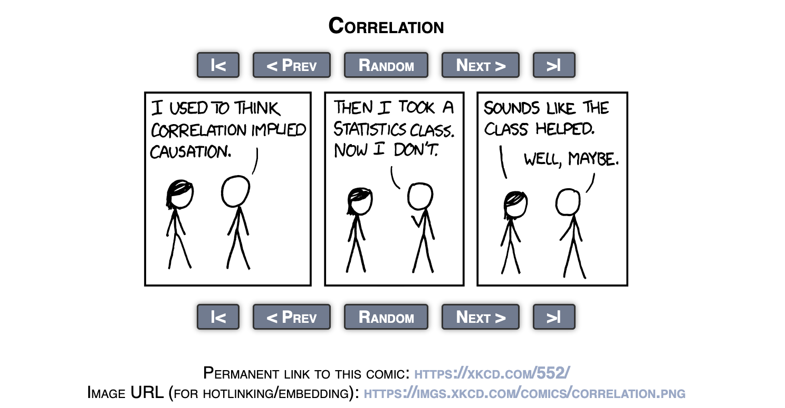

Slide 21
Why Random Assignment?
Example Practice-tool use and quiz scores
Self-selected comparison
Randomized comparison
Students choose whether to use the tool.
Researchers assign the tool at random.
Motivation can increase both tool use and quiz performance.
Random assignment balances motivation and other background variables on average.
A score difference may mix the tool effect with motivation.
A later score difference supports a causal comparison for the participants.
Blocking by prior quiz score can further reduce chance imbalance in an important known predictor.
COLUMBIA UNIVERSITY · DEPARTMENT OF STATISTICS
Notes:
Contrast sampling with assignment. Random assignment addresses confounding for the treatment comparison among participants. It does not make the participants representative of a broader population. Blocking by prior score happens before assignment, then researchers randomize within each block.

Slide 22
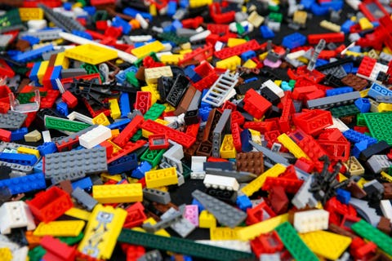
Why Random Sample?
How to randomly sample?
COLUMBIA UNIVERSITY · DEPARTMENT OF STATISTICS

Slide 23
Probability sampling designs Individual selection
Simple random sample
Systematic sample
Use the full course roster. Select 60 students so every set of 60 has the same chance of selection.
Choose a random starting point on the roster, then select every kth student.
Strength
Known and equal inclusion probabilities
Watch for
A roster pattern that matches the sampling interval
Both designs select individual students directly from a complete sampling frame.
COLUMBIA UNIVERSITY · DEPARTMENT OF STATISTICS
Notes:
For a roster of 300 students and a desired sample of 60, k would be 5. A systematic sample needs a random start among the first five entries. Ask what happens if the roster is sorted in a repeating pattern related to quiz performance.

Slide 24
Stratified, cluster, and multistage sampling
Stratified sample
Cluster sample
Multistage sample
Separate students by lecture section or prior performance, then randomly sample within every group.
Randomly select whole recitation sections, then invite every student in the selected sections.
Randomly select recitation sections, then randomly select students within those sections.
Purpose: representation and precision
Purpose: lower collection cost
Purpose: balance cost and coverage
Strata all contribute observations. – more balanced representation
Versus
A cluster sample observes only the selected clusters.
COLUMBIA UNIVERSITY · DEPARTMENT OF STATISTICS
Notes:
Students often confuse strata and clusters. In stratified sampling, sample from every stratum. In cluster sampling, randomly select some clusters and observe their members. Multistage sampling adds random selection within chosen clusters. These designs can use unequal probabilities if the probabilities are known and analysis uses appropriate weights.

Slide 25
The selection rule for today
Does every individual in the population have an equal chance of being selected?
If not, ask which individuals have larger, smaller, or zero chances of entering the data.
Unequal probabilities are most dangerous when they are unknown or related to the variable we want to measure.
COLUMBIA UNIVERSITY · DEPARTMENT OF STATISTICS
Notes:
Equal chance is a useful introductory diagnostic, not a requirement for every valid sampling design. Stratified designs may use known unequal probabilities and recover population estimates with design weights. The concern today is uncontrolled selection related to the outcome.

Slide 26
News brief Happy adopters still report challenges
SHELTER MEDICINE · FEBRUARY 20, 2026
More than 22,000 adopters from 112 shelters and rescues in 40 states answered surveys during the first month after adoption.
More than 94% rated the adoption positively at each survey time. Yet more than 78% of dog adopters and 50% of cat adopters reported at least one challenge.
Surveys were sent on Day 1, Week 1, and Month 1. A response counted only while the pet remained in the home.
Paraphrased from the University of Florida Shelter Medicine Program
COLUMBIA UNIVERSITY · DEPARTMENT OF STATISTICS
Notes:
Read this as a short news excerpt and ask students to mark the factual claims, the implied study, and one phrase that raises a selection question. Source: University of Florida Shelter Medicine Program, ‘Shelter to Home surveys of early post-adoption experiences with more than 22,000 dog and cat adopters,’ February 20, 2026. https://sheltermedicine.vetmed.ufl.edu/2026/02/20/shelter-to-home-surveys-of-early-post-adoption-experiences-with-more-than-22000-dog-and-cat-adopters/ . The slide is a paraphrase, not a quotation.

Slide 27
Case 1 Adoption satisfaction
More than
22,000
112
40
adopters surveyed
shelters and rescues
states represented
Over 94% rated the adoption positively at each survey time.
Responses counted only when the pet remained in the home.
COLUMBIA UNIVERSITY · DEPARTMENT OF STATISTICS
Notes:
Source: University of Florida Shelter Medicine Program, ‘Shelter to Home surveys of early post-adoption experiences with more than 22,000 dog and cat adopters,’ February 20, 2026. https://sheltermedicine.vetmed.ufl.edu/2026/02/20/shelter-to-home-surveys-of-early-post-adoption-experiences-with-more-than-22000-dog-and-cat-adopters/ . Ask students which number initially feels most convincing and why.

Slide 28
Adoption study Population and individuals
How would you organize the data?
PAIR DISCUSSION 4 MINUTES
Population
Which larger group do we want the 94% to describe?
Individual
Is one individual an adopter, an adoption, a pet, or a survey response?
Observation (cases)
The same adoption may produce a response on Day 1, Week 1, and Month 1.
COLUMBIA UNIVERSITY · DEPARTMENT OF STATISTICS
Notes:
Working answer: a defensible target population is all U.S. shelter and rescue adoptions during the study period. The primary individual for selection is one adoption or adopter-pet placement. A response at a particular survey time is an observation, and observations can repeat within an adoption.

Slide 29
Cases

Slide 30
Adoption study - Who entered the data?
PAIR DISCUSSION 5 MINUTES
1
2
3
4
All adoptions
Organizations
Respondents
Pet still home
Target population of shelter and rescue placements
Only participating shelters and rescues
Only adopters who answered a survey wave
Responses excluded after a return or other departure
At which step do some individuals receive a smaller or zero chance of appearing?
COLUMBIA UNIVERSITY · DEPARTMENT OF STATISTICS
Notes:
All three filters may create unequal inclusion. Organization participation affects coverage. Survey response creates nonresponse. The pet-still-in-home rule gives some unsuccessful placements zero chance of contributing an eligible satisfaction response. Source: University of Florida summary and Slater et al., Shelter to Home, https://jsmcah.org/index.php/jasv/article/view/158/447 .

Slide 31
Adoption satisfaction - measurement
Variable of interest
Measured value
Satisfaction with the adoption experience
Rating from 1 to 5
Ratings 4 or 5 were classified as positive
Challenges were measured separately, so an adopter could be satisfied and still report a problem.
Does this operational definition capture everything meant by a successful adoption?
COLUMBIA UNIVERSITY · DEPARTMENT OF STATISTICS
Notes:
Source: University of Florida summary. Positive ratings were defined as 4 or 5 out of 5. Distinguish the original ordinal rating from the derived binary variable. Ask whether satisfaction, challenges, and pet retention should remain separate outcomes.

Slide 32
Adoption selection bias and redesign
Why observed satisfaction may shift
A probability-based redesign
Adoptions ending in return or rehoming may have different satisfaction ratings.
Excluding them can make positive experiences more common in the observed data than in the target population.
1. Build a frame of all completed adoptions
2. Randomly sample placements
3. Follow every sampled placement, including returns
4. Record and adjust for nonresponse
Would the redesigned sample estimate a different satisfaction rate? Explain the direction you expect and the assumption behind it.
COLUMBIA UNIVERSITY · DEPARTMENT OF STATISTICS
Notes:
Do not tell students that the direction is mathematically guaranteed. The plausible concern is that placements ending early have lower satisfaction, which would make the eligible-response sample too positive. A national multistage sample could first sample organizations, then randomly sample adoptions within them, with known inclusion weights and follow-up regardless of placement status.

Slide 33
Redesigning a weak study
A stronger design changes at least one part of the study.
1
How individuals enter the data
2
How the variables are measured
3
How treatments are assigned when causality is the goal
COLUMBIA UNIVERSITY · DEPARTMENT OF STATISTICS
Notes:
Begin Thursday here. Ask students to recall the adoption redesign from Tuesday. The homicide case that follows focuses on population coverage, standardized measurement, and a claim that remains descriptive rather than causal. The Thursday goal is to identify a weakness, redesign the study, and revise the claim to match the improved evidence.

Slide 34
News brief - Homicide fell sharply in 35 cities
PUBLIC SAFETY · JANUARY 22, 2026
A year-end report found that homicide rates fell 21% from 2024 to 2025 across 35 U.S. cities, about 922 fewer homicides.
Thirty-one of the 35 cities recorded declines. The report used cities that consistently supplied monthly police or municipal data.
The authors warned that the cities do not form a nationally representative sample.
Paraphrased from AP News and the Council on Criminal Justice
COLUMBIA UNIVERSITY · DEPARTMENT OF STATISTICS
Notes:
Read this as a short news excerpt. Ask students to circle the numerical result, underline the study population, and box the caveat. Sources: Associated Press, ‘Homicide rate declines sharply in dozens of US cities,’ January 22, 2026, https://apnews.com/article/homicide-rate-decrease-cities-crime-b6fce2ee6c2169a6bb4aaf3e82bab032 ; Council on Criminal Justice, ‘Crime Trends in U.S. Cities: Year-End 2025 Update,’ https://counciloncj.org/crime-trends-in-u-s-cities-year-end-2025-update/ . The slide is a paraphrase, not a quotation.

Slide 35
Homicide study Population and individuals
Population
If the claim is national, which places belong in the target population?
Individual
For selection, is the individual a person, a homicide, or a city?
Observation
A city-year supplies a count and a rate. Two years allow a change to be calculated.
COLUMBIA UNIVERSITY · DEPARTMENT OF STATISTICS
Notes:
Working answer: for a national city-level claim, the target population could be all U.S. cities or reporting jurisdictions. The primary sampling unit is a city. A city-year is a repeated observation. Individual homicide incidents are cases in the administrative records, but the selection mechanism in this report operates mainly at the city level.

Slide 36
Homicide study Who entered the data?
1
2
3
All U.S. cities
Available systems
Timely reporters
Target population implied by a national headline
Police and municipal records with usable definitions
Cities reporting consistent monthly figures
Final study sample: 35 cities
Which cities had little or no chance of appearing, and how might they differ?
COLUMBIA UNIVERSITY · DEPARTMENT OF STATISTICS
Notes:
The report used cities with consistently available monthly data. Selection therefore depends on reporting infrastructure and participation rather than random selection. Smaller, rural, or less-resourced jurisdictions may have little or no chance of appearing. Source: Council on Criminal Justice methods and limitations.

Slide 37
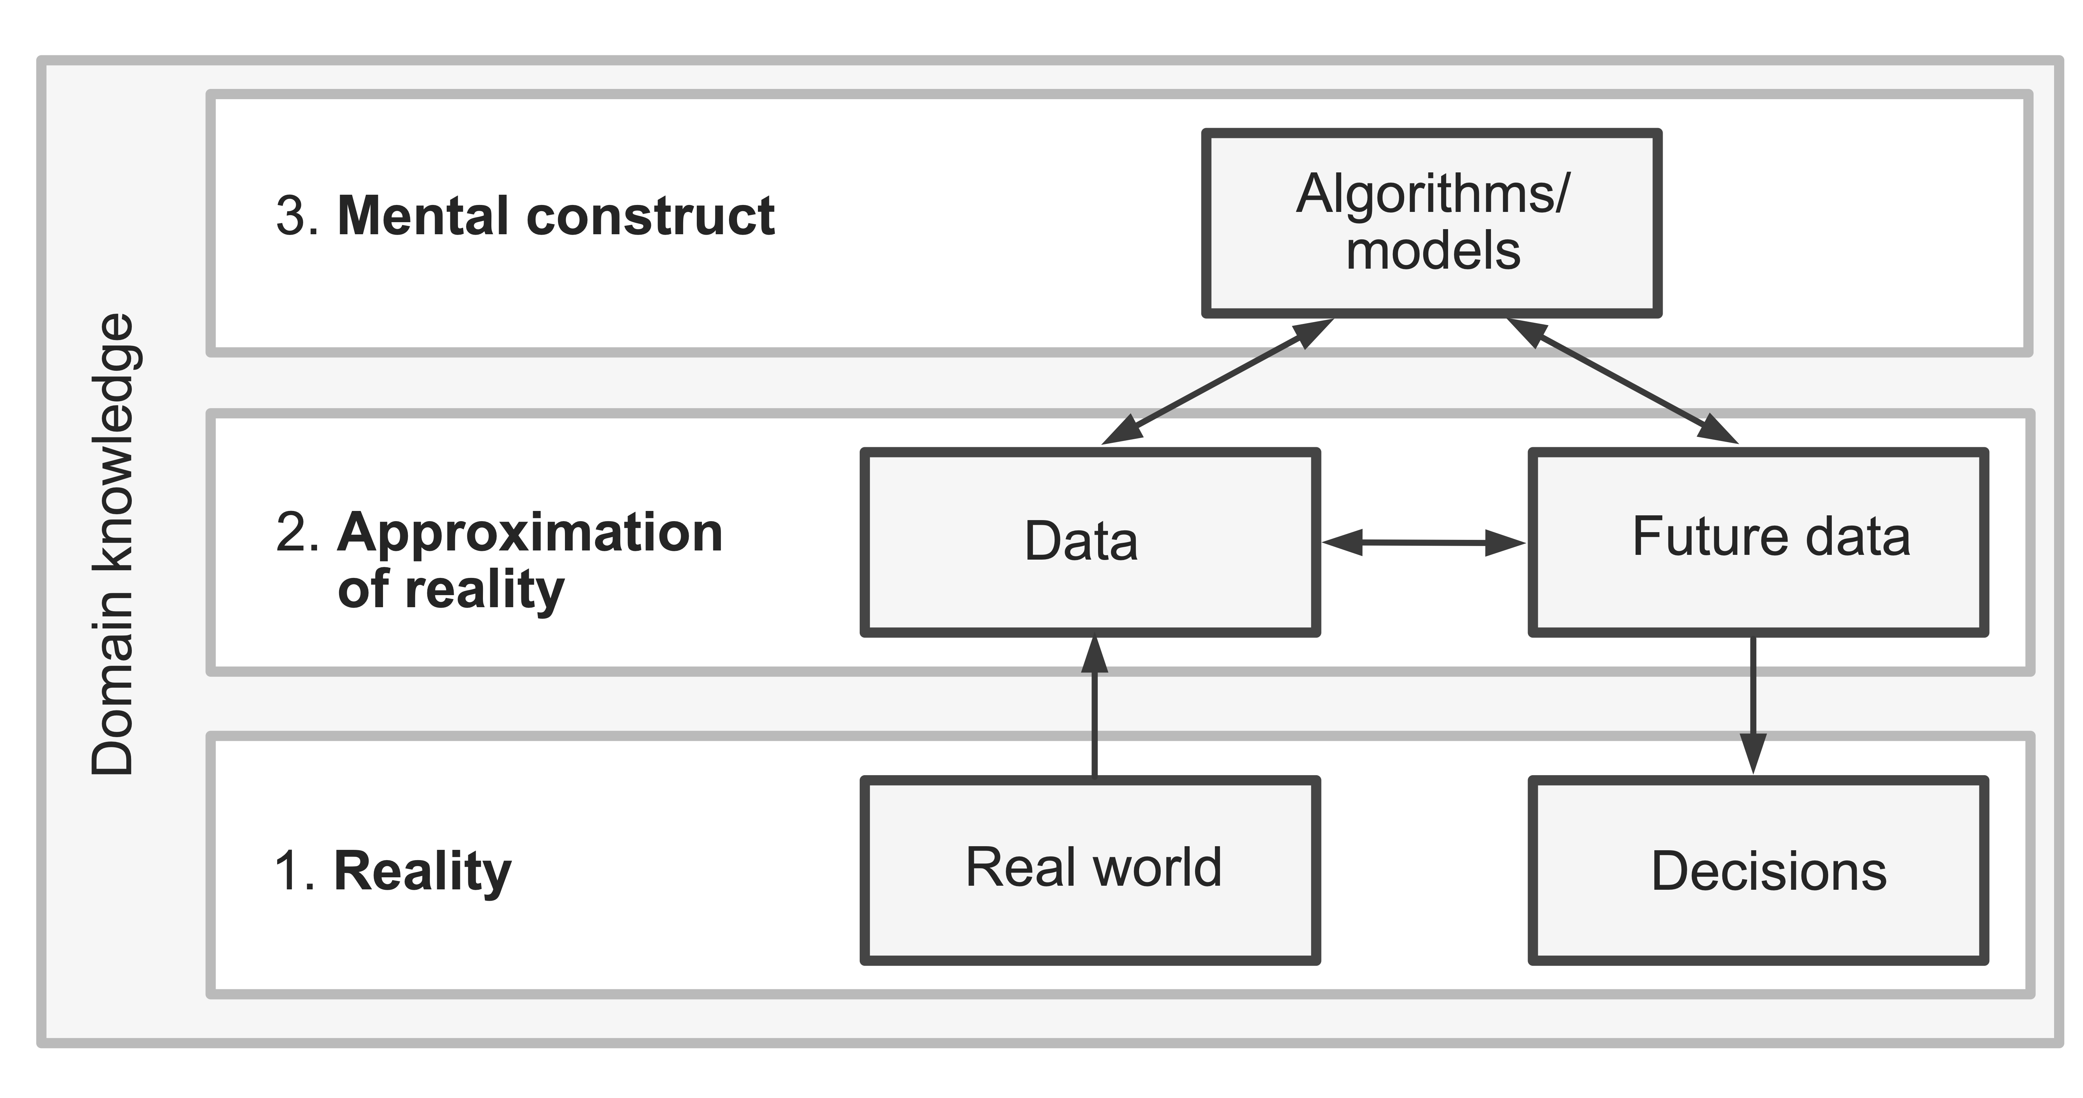
VDS three realms: data and future data
Reality
All individuals and their true values in the target population
Data
The individuals selected and the variables recorded now
Future data
What another sample or later measurement would record
COLUMBIA UNIVERSITY · DEPARTMENT OF STATISTICS
Notes:
Source figure: Bin Yu and Rebecca Barter, Veridical Data Science, Chapter 1, Figure 1.1, https://vdsbook.com/01-veridical_ds . Emphasize that data are an approximation of reality. Future data are not automatically a fresh unbiased view. They depend on the future measurement and selection process.

Slide 38
From a study description to a data biography
GENERAL DESCRIPTION
DATA BIOGRAPHY
“A survey of adopters found that more than 94% rated their adoption positively.”
Who produced the data, and why?
How were observations generated or selected?
What are the cases and variables? How were they measured?
A headline tells us the result.
A data biography tells us how the result became possible.
What is covered, missing, filtered, or excluded?
Which claims can these data support?
COLUMBIA UNIVERSITY · DEPARTMENT OF STATISTICS
Notes:
Transition from critique to documentation. The short description reports a result but hides provenance, selection, measurement, coverage, missingness, and limits. Tell students that a data biography makes those hidden decisions visible. This mirrors Mini-project 1: Data Biography and Retrieval Audit.

Slide 39
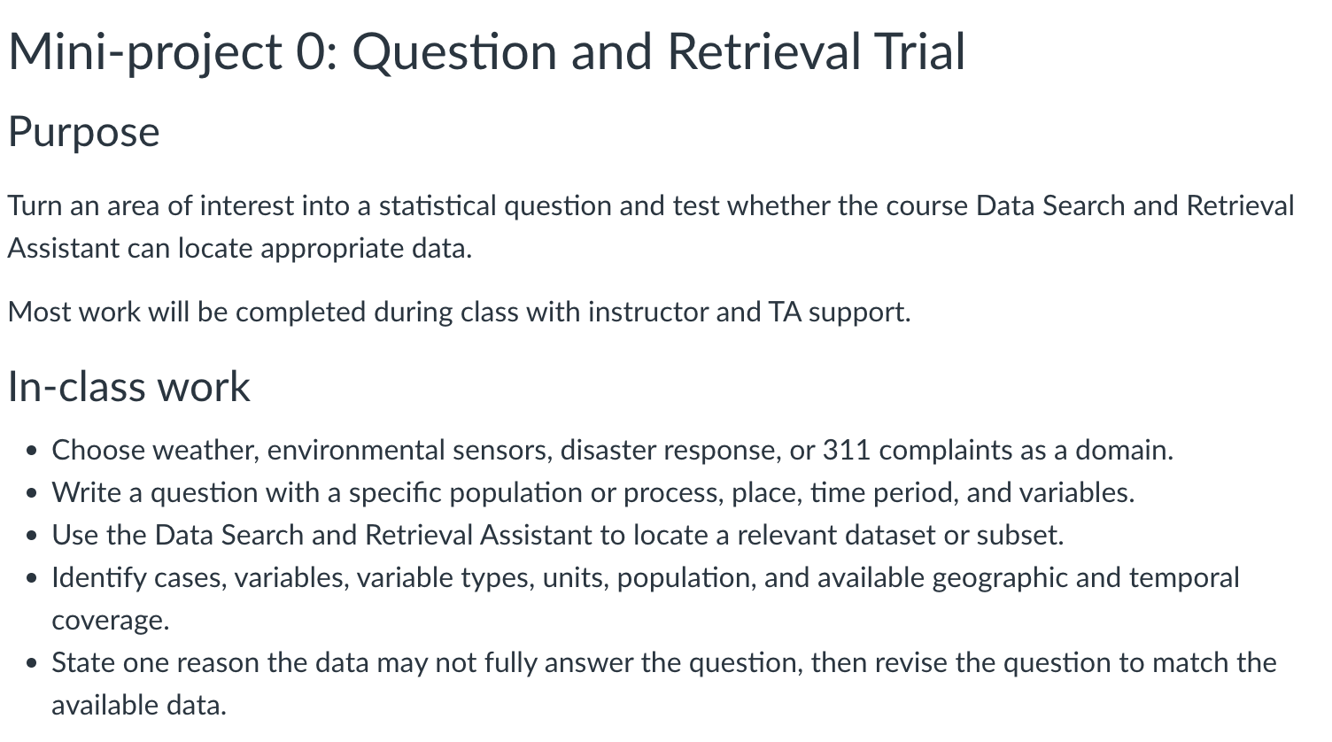
Let’s find some data with Taffy
and Build a first data biography
COLUMBIA UNIVERSITY · DEPARTMENT OF STATISTICS
Notes:
Have pairs choose either the adoption study or the homicide study. Ask for six concise sentences, then invite one pair to read theirs aloud while classmates identify what is still unknown. This is a low-stakes rehearsal for Mini-project 1. The submitted project biography later also documents geographic and temporal coverage, aggregation, missing values, filters, and claims the data cannot support.

Slide 40
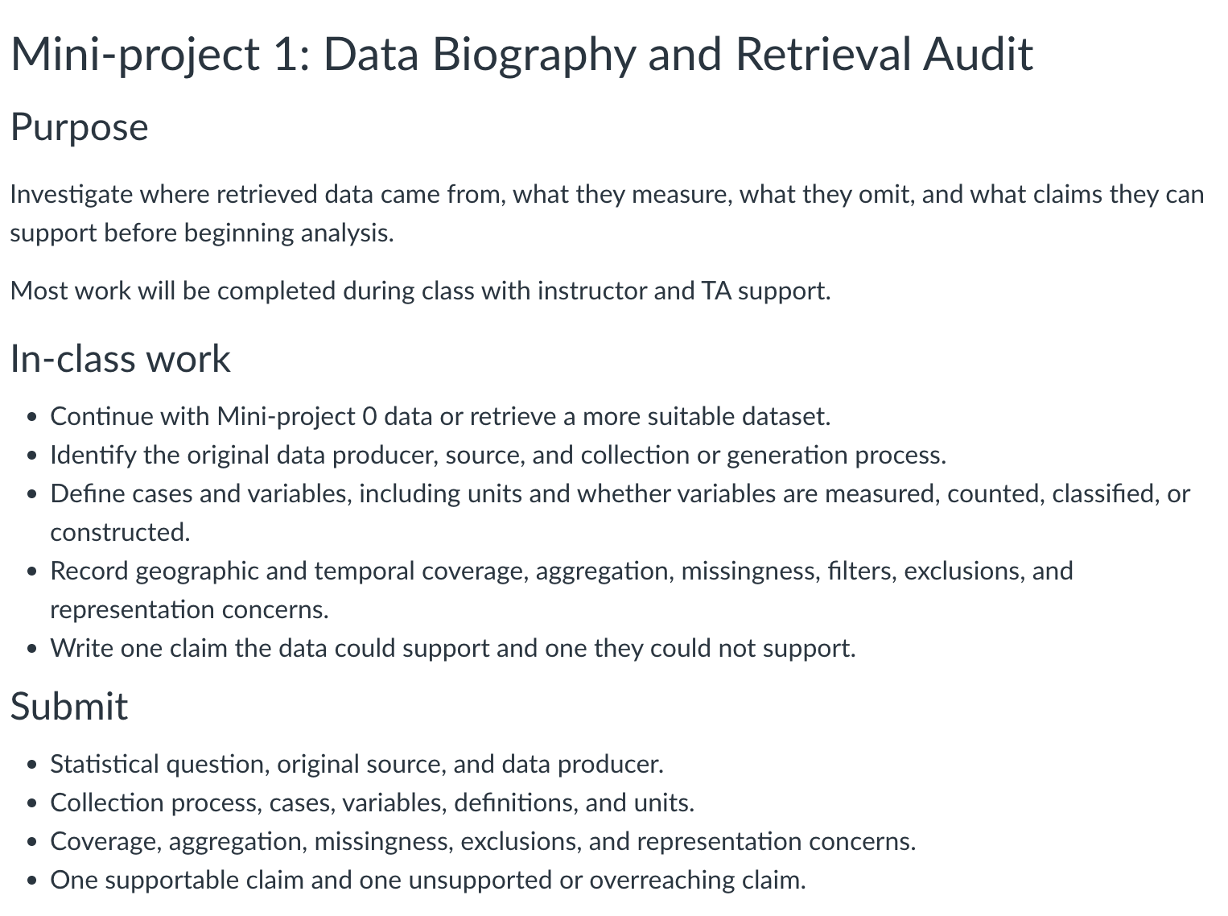
Let’s find some data with Taffy
and Build a first data biography
COLUMBIA UNIVERSITY · DEPARTMENT OF STATISTICS
Notes:
Have pairs choose either the adoption study or the homicide study. Ask for six concise sentences, then invite one pair to read theirs aloud while classmates identify what is still unknown. This is a low-stakes rehearsal for Mini-project 1. The submitted project biography later also documents geographic and temporal coverage, aggregation, missing values, filters, and claims the data cannot support.

