Slide 1
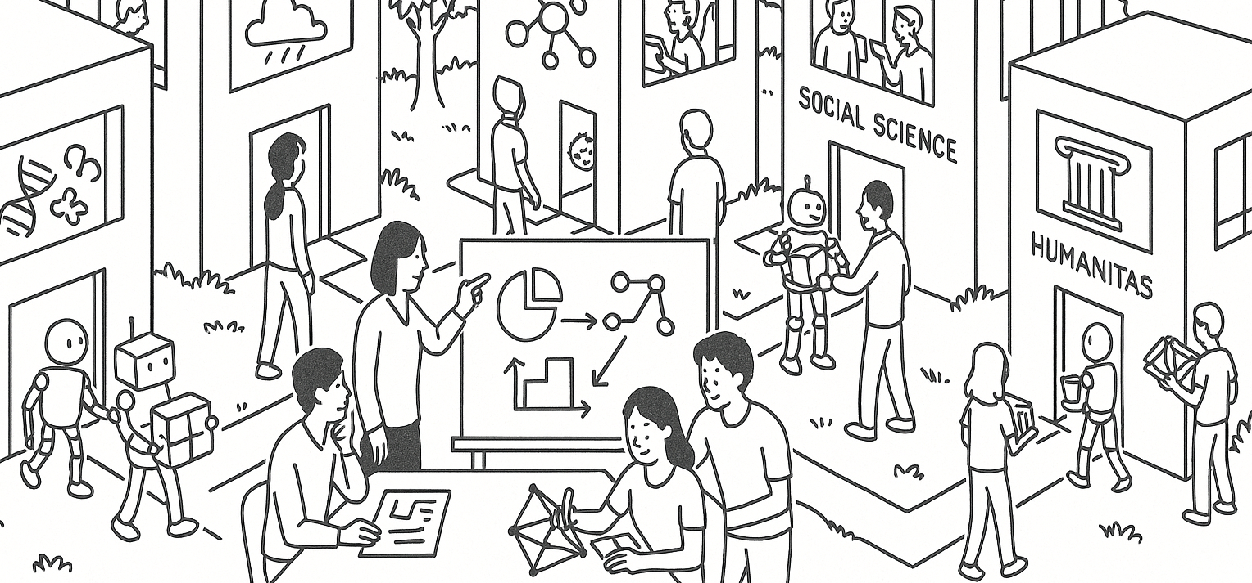

Bayes, random variables,
and linear combinations
STAT UN 1001 · LECTURE 11
October 13th, 2026
Notes:
Lecture 9 uses Week 05 flipped activity examples to focus on small-population sampling, replacement, and independence.

Slide 2
From flipped activities check-in
REQUESTS FOR REVIEW
Topic | Student signal
Bayes’ rule | 33 check-in requests
P(A | B) from the tree | 55% correct
Linear combinations | shift plus scale needs another pass
TODAY'S AIM
Use the story and the denominator before using formulas.
COLUMBIA UNIVERSITY · DEPARTMENT OF STATISTICS
02

Slide 3
The five-part setup
1
Chance process
What random action repeats?
2
Sample space
What outcomes could happen?
3
Event
Which outcomes count?
4
Probability sentence
What probability are we finding?
5
Rule
Tree, table, complement, or multiplication?
COLUMBIA UNIVERSITY · DEPARTMENT OF STATISTICS
03

Slide 4
Exactly two successes in three tries
Chance of success each time is 0.5. We want exactly two successes in three tries.
Path | Probability
SSW | 0.5 × 0.5 × 0.5 = 0.125
SWS | 0.5 × 0.5 × 0.5 = 0.125
WSS | 0.5 × 0.5 × 0.5 = 0.125
3 paths × 0.125 = 0.375
COLUMBIA UNIVERSITY · DEPARTMENT OF STATISTICS
15

Slide 5
Practice quiz tree
A = household has a cat B = household bought pet food
First branch | Probability | Second branch | Probability
A | P(A) = 0.30 | B given A | P(B | A) = 0.80
not A | P(not A) = 0.70 | B given not A | P(B | not A) = 0.20
Question: among households that bought pet food, what fraction have a cat?
COLUMBIA UNIVERSITY · DEPARTMENT OF STATISTICS
04

Slide 6
Rebuilding the denominator
We restrict attention to households that bought pet food.
Path | Probability
cat and bought food | 0.30 × 0.80 = 0.24
no cat and bought food | 0.70 × 0.20 = 0.14
all bought food | 0.24 + 0.14 = 0.38
P(A | B) = 0.24 / 0.38 = 0.63
COLUMBIA UNIVERSITY · DEPARTMENT OF STATISTICS
05

Slide 7
P(B | A) and P(A | B)
Expression | Words | Denominator
P(B | A) | Among households with cats, how many bought pet food? | households with cats
P(A | B) | Among households that bought pet food, how many have cats? | households that bought pet food
Same events, different denominator, different question.
COLUMBIA UNIVERSITY · DEPARTMENT OF STATISTICS
06

Slide 8
Guided Practice: Phone update and typos
SETUP
New software: P(typo)=30%.
Old software: P(typo)=10%.
Your friend has typos in two recent texts.
WHAT WE NEED BEFORE COMPUTING
Prior chance that she updated her phone.
ASSUMPTIONS TO DISCUSS
Do the reported typo rates apply to this friend?
The two texts behave independently given the phone system.
The definition of typo stays consistent.
COLUMBIA UNIVERSITY · DEPARTMENT OF STATISTICS
07

Slide 9
Phone update tree
U = updated phone T = two recent texts have typos
Branch | Probability
U | P(U) = p
not U | P(not U) = 1 − p
Typo evidence | Probability
T given U | 0.30 × 0.30 = 0.09
T given not U | 0.10 × 0.10 = 0.01
P(U | T) depends on both the evidence and the prior p.
COLUMBIA UNIVERSITY · DEPARTMENT OF STATISTICS
08

Slide 10
The prior changes the answer
Prior P(U) | P(U and T) | P(T) | P(U | T)
0.10 | 0.10×0.09 = 0.009 | 0.009 + 0.90×0.01 = 0.018 | 0.50
0.20 | 0.20×0.09 = 0.018 | 0.018 + 0.80×0.01 = 0.026 | 0.69
0.50 | 0.50×0.09 = 0.045 | 0.045 + 0.50×0.01 = 0.050 | 0.90
The same two typo texts lead to different posteriors when the prior changes.
COLUMBIA UNIVERSITY · DEPARTMENT OF STATISTICS
09

Slide 11
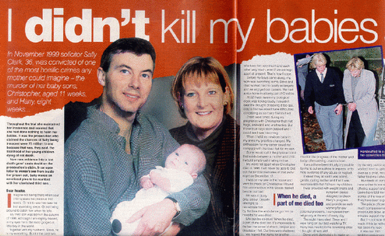
Bayes’ Rule Saves Lives – Sally Clark SIDS Case
In November 1999, Sally Clark, an English solicitor, was convicted of murdering her infant sons. The first, Christopher, had been 11 weeks old when he died, in 1996, and the second, Harry, 8 weeks old, in January 1998, when he was found dead. Christopher was believed to have been a victim of “cot death”, called SIDS (Sudden Infant Death Syndrome) in the US. After her second baby, Harry, also died in his crib, Sally Clark was arrested for murder.
The star witness for the prosecution was a well known pediatrician and professor, Sir Roy Meadow, who authored the infamous Meadow’s Law :“One sudden infant death is a tragedy, two is suspicious and three is murder until proved otherwise”².
The Royal Statistical Society protested the misuse of statistics in courts, but not early enough to prevent Sally Clark’s conviction. She was eventually acquitted and released, only to die at the age of 42 through alcohol poisoning.
https://stat20.berkeley.edu/spring-2024/3-probability/02-cond-prob-indep/notes.html
COLUMBIA UNIVERSITY · DEPARTMENT OF STATISTICS
08

Slide 12
Bayes’ Rule Saves Lives – Sally Clark SIDS Case
The math presented by Meadow, in brief: Based on various studies, there is a probability of 1 in 8,543 of a baby dying of SIDS in a family such as the Clarks. As the Clarks suffered two deaths, Meadow multiplied 8,543 by 8,543 to arrive at 73 million. He told the jury that the chance or probability that the event of two “cot deaths” was 1 in 73 million.
The first error was in treating the deaths as independent. It turns out that the probability of a second child dying of “cot death” or SIDS is 1/60 given that the first child died of SIDS.
The second error is an example of what is called the Prosecutor’s Fallacy. What is needed is P(innocence | evidence), but it is often confused with P(evidence | innocence).
The prosecutor failed to recognize the low chance of murders.
https://stat20.berkeley.edu/spring-2024/3-probability/02-cond-prob-indep/notes.html
COLUMBIA UNIVERSITY · DEPARTMENT OF STATISTICS
08

Slide 13
Random variables
A random variable assigns a number to each outcome of a chance process.
Example: X = number of typo-containing messages among two texts.
Outcome | X
no typo, no typo | 0
typo, no typo | 1
no typo, typo | 1
typo, typo | 2
COLUMBIA UNIVERSITY · DEPARTMENT OF STATISTICS
10

Slide 14
Expected typo-containing texts
System | P(X=0) | P(X=1) | P(X=2) | E(X)
Old | 0.81 | 0.18 | 0.01 | 0.20
New | 0.49 | 0.42 | 0.09 | 0.60
E(X) = sum of value × probability
Interpretation: over many pairs of texts, the new system averages 0.60 typo-containing texts per pair.
COLUMBIA UNIVERSITY · DEPARTMENT OF STATISTICS
11

Slide 15
Expected value interpretation
ONE RUN
One pair of texts may have 0, 1, or 2 typo-containing messages.
MANY RUNS
The expected value describes the long-run average under the same chance process.
Practice: if X has values 0, 1, 2 with probabilities .25, .50, .25, what is E(X)?
COLUMBIA UNIVERSITY · DEPARTMENT OF STATISTICS
12

Slide 16
Linear combinations
If Y = aX + b, then
Quantity | Rule | Meaning
Mean | E(Y) = aE(X) + b | shift and scale affect center
Standard deviation | SD(Y) = |a|SD(X) | scale affects spread
Adding b | no change to SD | a shift moves values together
This is OpenIntro Section 3.4: linear combinations of random variables.
COLUMBIA UNIVERSITY · DEPARTMENT OF STATISTICS
13

Slide 17
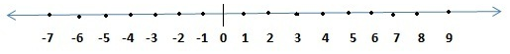
Linear combinations
Random Variable X
Random Variable Y = 2X
Mean of Y = 2 (mean of X)
std. dev of Y = 2 (std. dev of X)
COLUMBIA UNIVERSITY · DEPARTMENT OF STATISTICS
13

Slide 18
Linear combinations
Random Variable X
Random Variable Y = X+1
Mean of Y = (mean of X) + 1
std. dev of Y = (std. dev of X)
COLUMBIA UNIVERSITY · DEPARTMENT OF STATISTICS
13

Slide 19
Linear combinations
Random Variable X
Random Variable Y = 2X+1
Mean of Y = 2 (mean of X) + 1
std. dev of Y = 2 (std. dev of X)
COLUMBIA UNIVERSITY · DEPARTMENT OF STATISTICS
13

Slide 20
Celsius to Fahrenheit
Daily temperature C has mean 20 and SD 3. F = 1.8C + 32.
Quantity | Computation | Answer
Mean of F | 1.8×20 + 32 | 68
SD of F | 1.8×3 | 5.4
Common mistake
Adding 32 changes every value by the same amount, so it does not change spread.
COLUMBIA UNIVERSITY · DEPARTMENT OF STATISTICS
14

