Slide 1
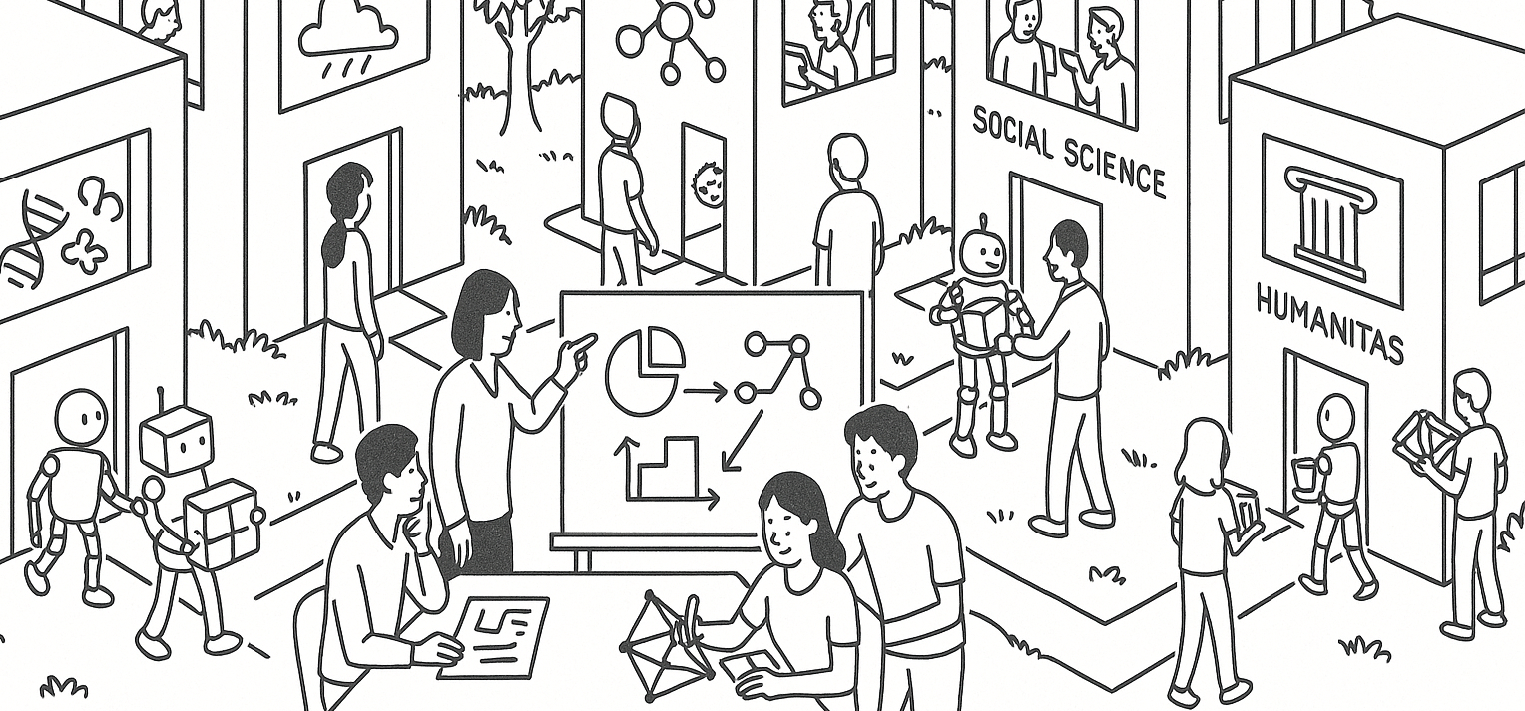

Reasoning with distribution models
STAT UN 1001 · LECTURE 12
October 15th, 2026
Notes:
Lecture 9 uses Week 05 flipped activity examples to focus on small-population sampling, replacement, and independence.

Slide 2
Distribution model thinking
1
Observed data
a histogram, a table, a sample proportion
2
Model
an idealized chance process with probabilities
3
Event
a set of values we care about
4
Probability
area under a curve, or a formula
5
Check
does the model fit the context well enough?
COLUMBIA UNIVERSITY · DEPARTMENT OF STATISTICS
03

Slide 3
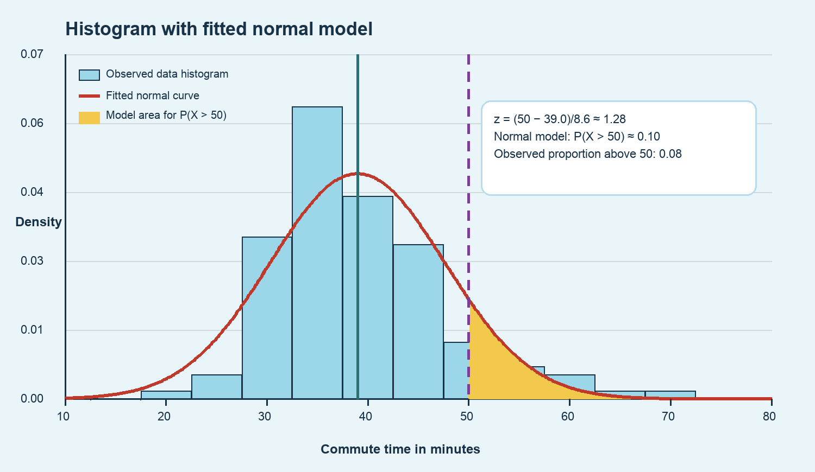
A histogram with a fitted normal curve
What does the histogram show?
Curve: a distribution model
COLUMBIA UNIVERSITY · DEPARTMENT OF STATISTICS
04

Slide 4
Guided example 1: commute above 50
Part | Fill in together
Chance process | randomly sample one commute from this setting
Random variable | X = commute time in minutes
Event | X > 50
Model | Normal with mean about 39.0 and SD about 8.6
Interpret first: “We want the chance a randomly sampled commute is longer than 50 minutes.”
COLUMBIA UNIVERSITY · DEPARTMENT OF STATISTICS
05

Slide 5
Standardizing the cutoff
Why standardize? It turns the original scale into standard-deviation units.
Step | Computation | Meaning
subtract mean | 50 − 39.0 = 11.0 | 11 minutes above average
divide by SD | 11.0 / 8.6 ≈ 1.28 | 1.28 SDs above average
probability sentence | P(X > 50) = P(Z > 1.28) | right-tail area
Ask students before showing the table: should this be a small, medium, or large right-tail probability?
COLUMBIA UNIVERSITY · DEPARTMENT OF STATISTICS
06

Slide 6
From z-score to probability
P(X > 50) = P(Z > 1.28) ≈ 0.10
Quantity | Value | How to read it
Observed sample proportion above 50 | about 0.08 | what happened in this sample
Normal-model probability above 50 | about 0.10 | what the fitted model predicts
COLUMBIA UNIVERSITY · DEPARTMENT OF STATISTICS
07

Slide 7
Guided example 2: compare two commutes
Student | Commute | Context mean | Context SD | Question
A | 50 min | 39 min | 8.6 min | How unusual?
B | 35 min | 25 min | 5 min | How unusual?
PAIR DISCUSSION
Which commute is longer in minutes? Which commute is more unusual relative to its context?
Key distinction: raw value and standardized value answer different questions.
COLUMBIA UNIVERSITY · DEPARTMENT OF STATISTICS
08

Slide 8
Standardized comparison
Student | z-score | Interpretation
A | (50 − 39) / 8.6 ≈ 1.28 | 1.28 SDs above the city mean
B | (35 − 25) / 5 = 2.00 | 2.00 SDs above the city mean
Student B is more unusual relative to context, even though Student A has the longer commute.
COLUMBIA UNIVERSITY · DEPARTMENT OF STATISTICS
09

Slide 9
Binomial model: what it is for
A binomial model counts the number of successes in a fixed number of yes/no trials.
Condition | Meaning | Phone-message example
Fixed n | same number of trials | 5 messages
Two outcomes | success or failure | typo or no typo
Same p | same success probability | p = 0.30 each message
Independent | one trial does not change another | assume messages are independent
COLUMBIA UNIVERSITY · DEPARTMENT OF STATISTICS
11

Slide 10
Guided example 3: exactly two typos
SETUP
Suppose 5 independent messages each have probability 0.30 of containing a typo.
Symbol | Meaning
X | number of messages with typos
n | 5 messages
p | 0.30 per message
Event | X = 2
Ask first: what would one specific order look like? Example: typo, typo, no, no, no.
COLUMBIA UNIVERSITY · DEPARTMENT OF STATISTICS
12

Slide 11
Exact binomial probability
Piece | Value | Why
choose the two typo slots | C(5, 2) = 10 | 10 possible positions
two typo messages | (0.30)^2 | two successes
three no-typo messages | (0.70)^3 | three failures
P(X = 2) = C(5, 2)(0.30)^2(0.70)^3 ≈ 0.309
Interpretation: across many groups of five messages, about 31% of groups would have exactly two typo messages.
COLUMBIA UNIVERSITY · DEPARTMENT OF STATISTICS
13

Slide 12
Binomial mean and standard deviation
Quantity | Formula | For n = 5, p = 0.30 | Meaning
Mean | np | 5(0.30) = 1.5 | long-run average count
SD | sqrt(np(1−p)) | sqrt(5×0.30×0.70) ≈ 1.02 | typical variation around mean
The mean is not a promised count for one set of five. It is the average count over repeated sets of five.
COLUMBIA UNIVERSITY · DEPARTMENT OF STATISTICS
14

Slide 13
Distribution model reasoning
1
Chance process
what random process are we modeling?
2
Random variable
what number are we tracking?
3
Event
what set of values matters?
4
Model
normal curve or binomial count?
5
Computation
area, z-score, or binomial formula?
6
Interpretation
what does the probability mean in context?
COLUMBIA UNIVERSITY · DEPARTMENT OF STATISTICS
17

Slide 14
Gemini Notebook for data analysis demo
COLUMBIA UNIVERSITY · DEPARTMENT OF STATISTICS
15

