Slide 1
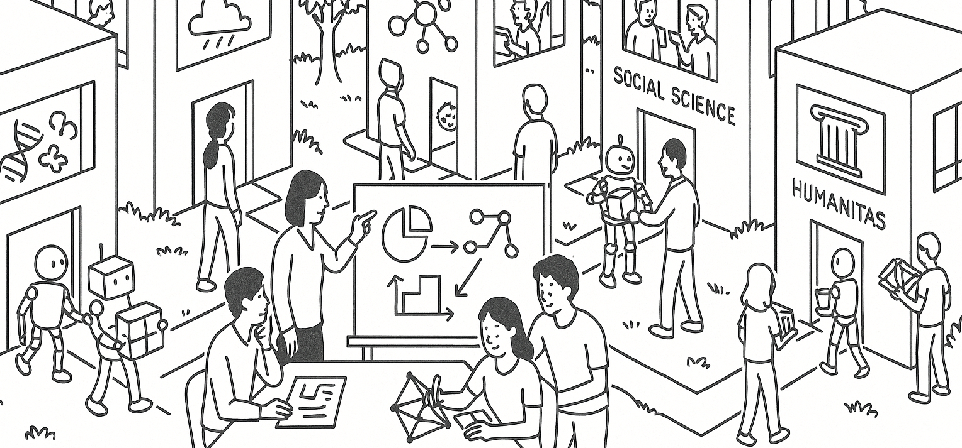

Sampling variability and inference
STAT UN 1001 · LECTURE 13
October 20th, 2026
Notes:
Lecture 9 uses Week 05 flipped activity examples to focus on small-population sampling, replacement, and independence.

Slide 2
Week 7 response map
55 check-ins
25 practice-quiz submissions
First review priority | Responses | Share
Sampling distributions of means | 19 / 55 | 35%
Binomial counts | 16 / 55 | 29%
Normal tails / intervals | 11 / 55 | 20%
Model assumptions | 9 / 55 | 16%
The hardest practice items were normal intervals (60%) and estimated standard error (56%). We will work those slowly, then connect them to the larger inference story.
COLUMBIA UNIVERSITY · DEPARTMENT OF STATISTICS
03
Notes:
Use the aggregate response counts as an invitation, not as a judgment. Ask students whether the pattern matches their own experience. Canvas's anonymous survey API exposed the two multiple-choice distributions but not written-response text.

Slide 3
Reasoning moves from models to inference
Question | Model language | Inference language
What can happen? | Outcomes and events | Information in a Sample about the Population
How often? | Probability | Sampling variability
What number do we report? | Area or formula | Statistic and point estimate
How much trust? | Check model fit | Check bias and standard error
Workflow: choose the model, name the event or parameter, calculate only after the setup is clear, and finish with a sentence in context.
COLUMBIA UNIVERSITY · DEPARTMENT OF STATISTICS
04
Notes:
This is the central arc. Students already know chance-process vocabulary from Chapters 3 and 4. Section 5.1 applies the same discipline to repeated samples from a population.

Slide 4
Normal-model intervals
A probability sentence comes before the calculator
Step | What we write | Why
1 | State the event: 60 < X < 65 | Name the values we care about
2 | Convert both endpoints to z | Put the problem on the standard scale
3 | Subtract P(Z < z_low) from P(Z < z_high) | Keep only the area between the cutoffs
4 | Write the result in context | A decimal needs a meaning
COLUMBIA UNIVERSITY · DEPARTMENT OF STATISTICS
05
Notes:
Connect to the practice result: only 15 of 25 selected the correct interval setup. Ask students to say the event in words before writing z-scores.

Slide 5
Exercise 4.44: heights of 10-year-olds
Use X ~ normal with mean 55 inches and standard deviation 6 inches.
Let’s set up each question before calculating.
Part | Question | Setup to show
a | What proportion is shorter than 48 inches? | One left-tail z-score
b | What proportion is between 60 and 65 inches? | Two z-scores and an area difference
c | What height marks the tallest 10%? | The 90th percentile, transformed back to inches
COLUMBIA UNIVERSITY · DEPARTMENT OF STATISTICS
06

Slide 6
Appendix C.1: read the normal table
The table reports the area to the left of a Z-score
 | Second Decimal Place
Z row | 0.00 | 0.01 | 0.04 | 0.05 | 0.09
0.4 | 0.6554 | 0.6591 | 0.6700 | 0.6736 | 0.6879
1.0 | 0.8413 | 0.8438 | 0.8508 | 0.8531 | 0.8621
Read the row through the first decimal place, then use the column for the second decimal place. Example: z = 0.45 uses row 0.4 and column 0.05, giving 0.6736.
Appendix C.1 gives an abbreviated table on p. 408 and the full table on p. 410.
COLUMBIA UNIVERSITY · DEPARTMENT OF STATISTICS
07
Notes:
Emphasize the meaning of the table: every entry is a lower-tail probability P(Z < z), not the height of the curve and not automatically a right-tail probability. Point to the row and column headers as students read 0.45.

Slide 7
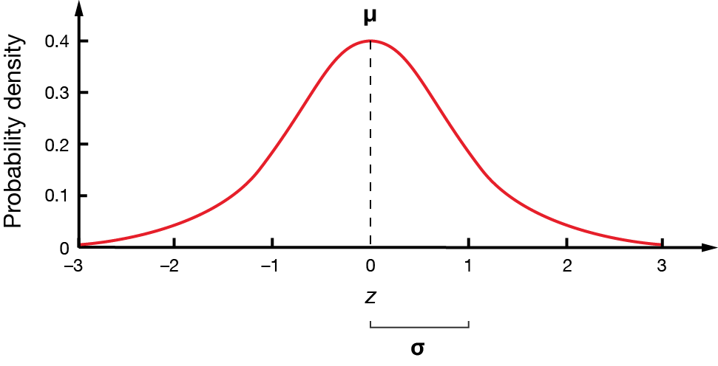
Appendix C.1: read the normal table
COLUMBIA UNIVERSITY · DEPARTMENT OF STATISTICS
07
Notes:
Emphasize the meaning of the table: every entry is a lower-tail probability P(Z < z), not the height of the curve and not automatically a right-tail probability. Point to the row and column headers as students read 0.45.

Slide 8
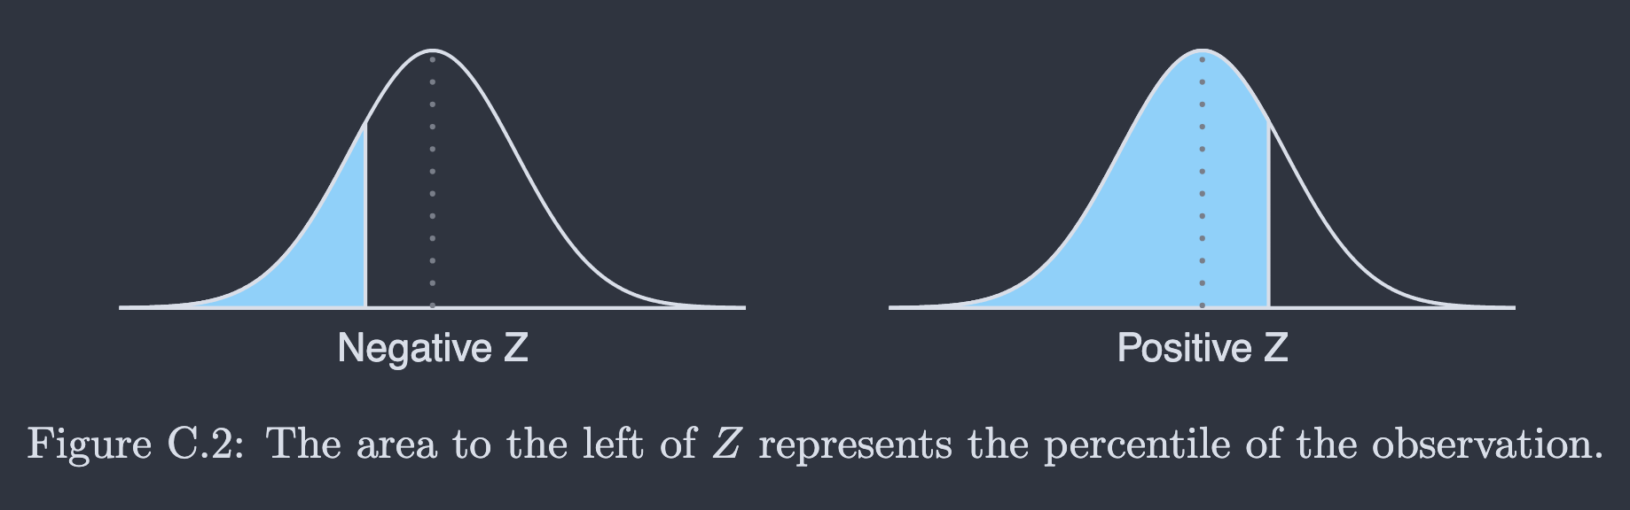
Appendix C.1: read the normal table
COLUMBIA UNIVERSITY · DEPARTMENT OF STATISTICS
07
Notes:
Emphasize the meaning of the table: every entry is a lower-tail probability P(Z < z), not the height of the curve and not automatically a right-tail probability. Point to the row and column headers as students read 0.45.

Slide 9
Example C.1: Ann's SAT percentile
SAT scores: X ~ normal with mean 1100 and SD 200
Ann's score: x = 1300
Step | Work | Meaning
1 | z = (1300 - 1100) / 200 = 1.00 | Ann is 1 SD above the mean
2 | Row 1.0, column 0.00 -> 0.8413 | Area to the left of z = 1.00
3 | 0.8413 = 84.13% | Ann is about the 84th percentile
Percentile means the percentage of observations below the score.
COLUMBIA UNIVERSITY · DEPARTMENT OF STATISTICS
08
Notes:
Ask students to predict whether the percentile should be above or below 50% before opening the table. The table entry 0.8413 is a proportion below Ann's score, so it becomes 84.13th percentile.

Slide 10
Example C.2: upper tails and reverse lookup
Question | Table move | Answer
P(Z > 1.00) | 1 - P(Z < 1.00) = 1 - 0.8413 | 0.1587, or 15.87%
Z for the 80th percentile | Find the table entry closest to 0.8000 | 0.7995 ➡️ z = 0.84
The normal table gives left-tail area.
For a right tail, subtract from 1.
For a percentile-to-Z question, search the table body first.
Notice the direction: a high score has a large left-tail percentile but a small right-tail area.
COLUMBIA UNIVERSITY · DEPARTMENT OF STATISTICS
09
Notes:
Have students say the complement sentence aloud: P(Z > 1.00) = 1 - P(Z < 1.00). Then reverse the process: a percentile is an area, so search for the closest area and read off the row and column to recover z = 0.84.

Slide 11
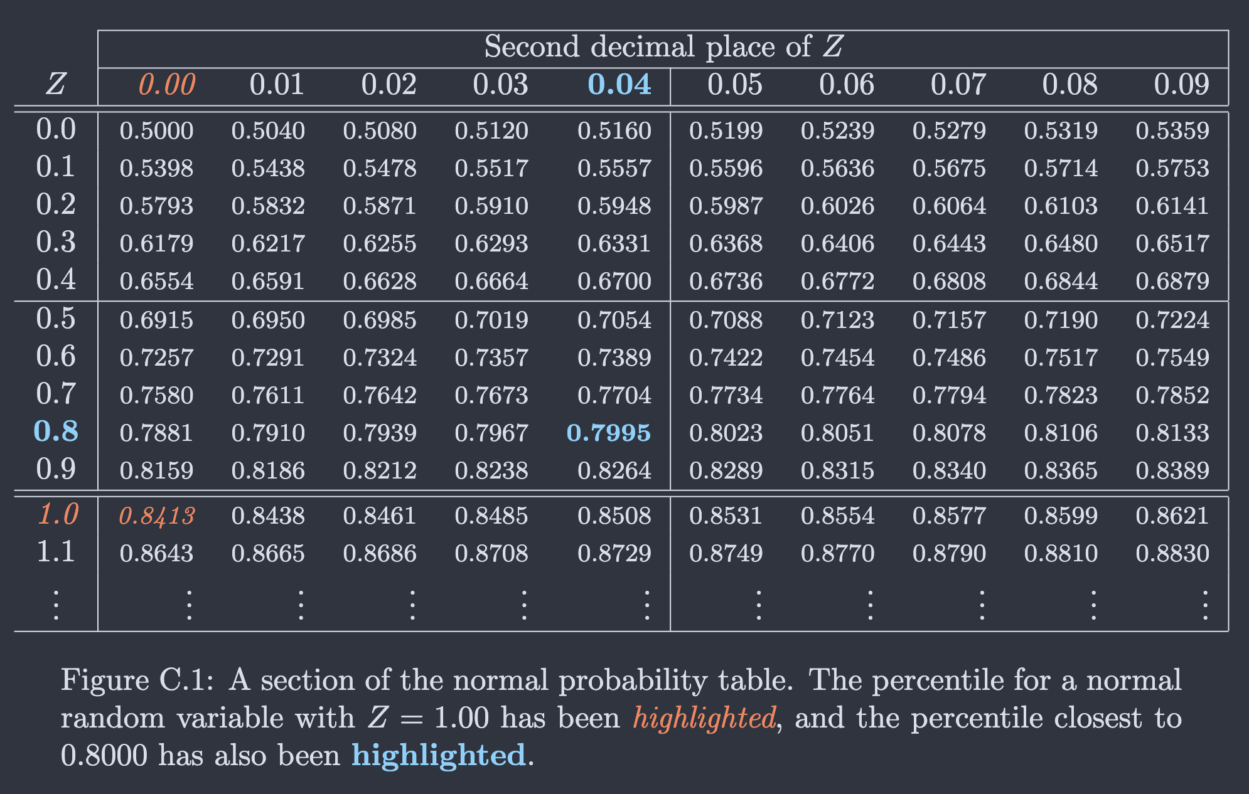
Example C.2: upper tails and reverse lookup
Notice the direction: a high score has a large left-tail percentile but a small right-tail area.
COLUMBIA UNIVERSITY · DEPARTMENT OF STATISTICS
09
Notes:
Have students say the complement sentence aloud: P(Z > 1.00) = 1 - P(Z < 1.00). Then reverse the process: a percentile is an area, so search for the closest area and read off the row and column to recover z = 0.84.

Slide 12
Try it: use the table
Name the row, column, and tail before finding the area.
Prompt | Answer based on Table entry
1. Find P(Z < 0.33) | Row 0.3, column 0.03
2. Find P(Z > 1.15) | 1 - P(Z < 1.15)
3. Find z at the 70th percentile | Search for 0.7000; use the closest entry
COLUMBIA UNIVERSITY · DEPARTMENT OF STATISTICS
10
Notes:
Give students 4 minutes. Ask one pair to explain why Question 2 needs a complement and another to explain why Question 3 searches the table body rather than the row labels. Keep the emphasis on direction and lookup mechanics.

Slide 13
Exercise 4.44: between 60 and 65
Set up the calculation together
z_low = (60 - 55) / 6 = 0.83
z_high = (65 - 55) / 6 = 1.67
P(60 < X < 65)
= P(0.83 < Z < 1.67)
= P(Z < 1.67) - P(Z < 0.83)
Now calculate the area. Then write: “About ___% of 10-year-olds are between 60 and 65 inches, under this model.”
Check: can you draw a standard normal curve and mark the areas corresponding to the table entries and explain the calculation?
COLUMBIA UNIVERSITY · DEPARTMENT OF STATISTICS
11
Notes:
The approximate area is 0.151 using standard normal tables or a calculator. Do not make the exact decimal the learning target. The important move is two endpoints, standardized, then subtracted.

Slide 14
Binomial event language
Exercise 4.24 uses the same chance-process discipline
Wording | What it asks | Typical setup
Exactly two | A count | P(X = 2) with choose(3,2)
At least one | A count plus its complement | 1 - P(X = 0)
The third child is the first diseased child | One ordered path | not diseased, not diseased, diseased
Before any arithmetic: identify one trial, the success, n, p, and whether order matters.
COLUMBIA UNIVERSITY · DEPARTMENT OF STATISTICS
12
Notes:
Use this slide to separate binomial counts from ordered sequences. Ask students to point to the word in the prompt that determines the setup.

Slide 15
Exercise 4.24: choose the setup
Three children. Each has probability p = 0.25 of having the disease. Treat the trials as independent.
Question | Choose one setup
Exactly two children have the disease | P(X = 2) = choose(3,2)(0.25)^2(0.75)^1
None have the disease | P(X = 0) = (0.75)^3
At least one is neither disease nor carrier | Use a complement
The first diseased child is the third child | (0.75)(0.75)(0.25)
Why the first and fourth rows are not the same kind of question?
COLUMBIA UNIVERSITY · DEPARTMENT OF STATISTICS
13
Notes:
Have students answer verbally before revealing the formulas. The fourth row is a particular order; the first row counts outcomes without caring about order.

Slide 16
Exercise 4.40: one bulb versus a sample mean
 | One bulb | Mean of 15 bulbs
Center | mu = 9,000 | mu_xbar = 9,000
Spread | sigma = 1,000 | sigma_xbar = 1,000 / sqrt(15)
Cutoff | x = 10,500 | xbar = 10,500
Standardize | (10,500 - 9,000) / 1,000 | (10,500 - 9,000) / (1,000/sqrt(15))
Averages are less variable than individual observations. The center stays the same.
COLUMBIA UNIVERSITY · DEPARTMENT OF STATISTICS
14
Notes:
Ask students to explain why xbar is not centered at 15. Use the 72% practice result to motivate a careful two-column comparison.

Slide 17
A sampling distribution describes repeated samples
Imagine repeating the same random sampling process many times.
One sample | Many repeated samples
One statistic, such as p-hat = 0.127 | A distribution of possible p-hat values
One estimate of the parameter | A way to describe typical sampling variation
May be above or below the parameter | Centered near the parameter for a sound design
Sampling variability is not a mistake. It is the variation we expect when a chance process selects a different sample.
COLUMBIA UNIVERSITY · DEPARTMENT OF STATISTICS
15
Notes:
This slide is the conceptual bridge into inference. Ask students why two random samples can differ even when neither researcher did anything wrong.

Slide 18
Inference vocabulary
Object | Meaning in the chip story | Symbol
Population | The larger production process of interest | all chips
Parameter | The unknown long-run severe-defect proportion | p
Sample | The 212 inspected chips | n = 212
Statistic | The defect proportion computed from the sample | p-hat
Point estimate | The statistic used as one estimate of p | 27/212 = 0.127
A parameter belongs to the population. A statistic belongs to the sample.
COLUMBIA UNIVERSITY · DEPARTMENT OF STATISTICS
16
Notes:
Use Exercise 5.1 as a quick verbal check. The word 'percentage' does not by itself determine whether the parameter is a mean or a proportion. Identify the type of response first.

Slide 19
Exercise 5.1: identify the parameter
For each situation, decide whether the population parameter is a mean or a proportion.
Ask first | Mean | Proportion
What kind of response does each person or case have? | A numerical measurement, such as hours or a score | A yes/no or category event, such as defective/not defective
What does the parameter summarize? | The population average | The population fraction in the event
A reported percentage can still be a mean if each person's response is numerical. Look at the response, not the formatting.
COLUMBIA UNIVERSITY · DEPARTMENT OF STATISTICS
17
Notes:
Use one or two of the five textbook situations, then let students explain the classification. Keep the distinction conceptual rather than turning this into a notation exercise.

Slide 20

Exercise 5.3: estimate and uncertainty
212 chips inspected
27 severe defects
Historical rate: 10%
Point estimate
p-hat = 27 / 212 = 0.127
Estimated standard error
SE(p-hat) = sqrt[p-hat(1-p-hat)/n]
What does 0.127 estimate?
What does it not prove?
Why do we report an uncertainty measure too?
COLUMBIA UNIVERSITY · DEPARTMENT OF STATISTICS
18
Notes:
The estimated SE is about 0.023. Students do not need to memorize a procedure without context. Walk through p-hat, 1-p-hat, and n. Ask what would change if n were 848.

Slide 21
Precision and bias are different
 | Small sample | Large sample
Sound sampling process | More variable estimates | More stable estimates
Biased sampling process | Variable and systematically shifted | More stable, still systematically shifted
A larger sample can improve precision. It cannot repair undercoverage, self-selection, or a flawed measurement process.
COLUMBIA UNIVERSITY · DEPARTMENT OF STATISTICS
19
Notes:
Collect the three-sentence exit ticket: (1) parameter versus statistic, (2) what standard error tells us, and (3) what larger n improves and what it cannot fix. Use the responses before Thursday's workshop.

