Slide 1
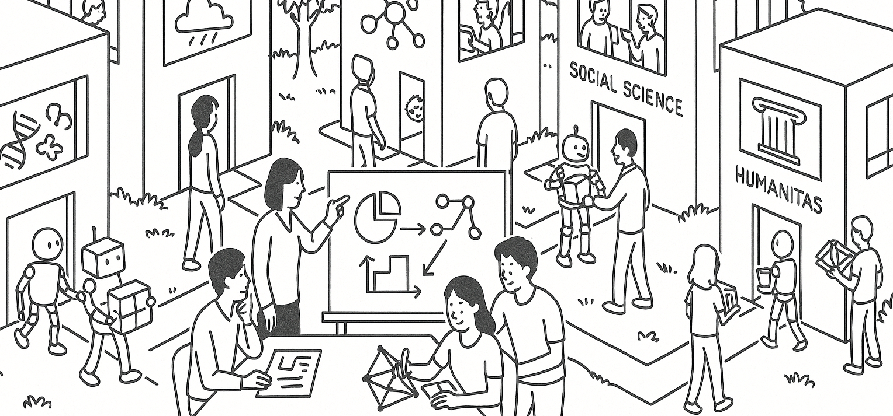

The sample mean as a random variable
STAT UN 1001 · LECTURE 14
October 22nd, 2026
Notes:
Lecture 9 uses Week 05 flipped activity examples to focus on small-population sampling, replacement, and independence.

Slide 2
A sample mean is a random variable
The number changes because the sample is selected by chance.
Object | What it means
Population parameter μ | A fixed (usually unknown) feature of the population
Chance process | Select a random sample of n units
Outcome: Statistic x̄ | Compute the average of the selected values
Random variable | x̄ can take different values in different samples
Before the sample is selected, x̄ is a possible numerical outcome. After the sample is selected, it is one observed statistic.
COLUMBIA UNIVERSITY · DEPARTMENT OF STATISTICS
03
Notes:
Connect to prior lessons: a statistic is computed from a sample, but when the sample is random, the statistic has a distribution of possible values. Ask students whether the population mean is random in this setup (no: it is fixed, even if unknown).

Slide 3
Name the chance process before calculating
Example: measure a numerical value for a random sample of 20 households.
Part of the setup | Answer
Chance process | Select a simple random sample of 20 households
One outcome | The particular 20 households selected
Sample space | All possible samples of 20 households
Random variable | X̄ = the average number of household members in the selected sample
Event | For example, X̄ ≥ 2
The event is a set of possible sample outcomes—not just one sample's value.
COLUMBIA UNIVERSITY · DEPARTMENT OF STATISTICS
04
Notes:
Have students supply the event in words: ‘the selected pair has an average of at least 4.’ Stress that the sample space is made of complete samples, because the statistic is computed from the whole sample.

Slide 4
Build a SIMPLE sampling distribution
Population values: 2, 4, 6. Select 2 without replacement.
Each unordered sample is equally likely.
Possible sample | Sample mean X̄ | Probability
{2, 4} | 3 | 1/3
{2, 6} | 4 | 1/3
{4, 6} | 5 | 1/3
The sampling distribution of X̄ is the list of possible sample means and their probabilities.
COLUMBIA UNIVERSITY · DEPARTMENT OF STATISTICS
05
Notes:
Work the three combinations with the class. The population mean is 4, and the sampling distribution of X̄ is centered at 4. Point out that X̄ itself can be 3, 4, or 5 in this small example.

Slide 5
Study an event for the sample mean
Event: the selected pair has an average of at least 4
Possible X̄ | Probability | Counts for X̄ ≥ 4?
3 | 1/3 | No
4 | 1/3 | Yes
5 | 1/3 | Yes
P(X̄ ≥ 4)
= P(X̄ = 4) + P(X̄ = 5)
= 1/3 + 1/3 = 2/3
In words: over repeated random samples of two, about two-thirds would have a mean of at least 4 in this population.
COLUMBIA UNIVERSITY · DEPARTMENT OF STATISTICS
06
Notes:
Ask students to write the probability sentence before the arithmetic. The event is about the statistic X̄, not about one randomly selected population value.

Slide 6
Standard error = the spread of a statistic
Quantity | What its spread describes
SD of individual values | How much units differ within one population or sample
SE(X̄) | How much sample means differ across repeated random samples
SE(X̄) is the standard deviation of the sampling distribution of X̄.
Under the usual model:
SE(X̄) = σ / √n
Interpretation: a typical sample mean is about one standard error from the center of its sampling distribution.
COLUMBIA UNIVERSITY · DEPARTMENT OF STATISTICS
07
Notes:
Make the distinction explicit: the SD of the raw data is not automatically the SE of the mean. Standard error belongs to a statistic and asks how that statistic would move across repeated samples.

Slide 7
Why larger samples usually improve precision
Suppose the population SD is σ = 8.
Sample size n | SE(X̄) = 8 / √n | What changes?
1 | 8 | One observation: most variable
4 | 4 | Four observations: half the SE
16 | 2 | Sixteen observations: one-quarter the SE
A larger n narrows the sampling distribution around the same center. It improves precision, but it does not automatically remove bias.
COLUMBIA UNIVERSITY · DEPARTMENT OF STATISTICS
08
Notes:
Ask: if n is multiplied by 4, what happens to the SE? It is divided by 2. Connect to the Week 7 practice quiz, where this was a central idea.

