Slide 1


Inference and confidence intervals
STAT UN 1001 · LECTURE 15
OCTOBER 27, 2026
Notes:
Lecture 15 uses the Week 08 practice quiz and anonymous check-in to introduce confidence-interval and hypothesis-testing logic.

Slide 2
Today's plan
1
Mini-project 2 checkpoint
2
Quiz 3 questions
Why p̂ changes from one random sample to another.
3
Sampling distributions
Inference and confidence intervals
How a sample gives evidence about an unknown population parameter.
4
A first look at claims, evidence, and decision errors.
5
Hypothesis-testing logic
COLUMBIA UNIVERSITY · DEPARTMENT OF STATISTICS
02
Notes:
State the class agenda. The first two items address immediate course needs; the remaining items introduce the logic of inference.

Slide 3
A sample proportion is a random variable
Population parameter p
A fixed, usually unknown proportion in the population.
Chance process
Randomly select a sample of n people from that population.
Outcome: p̂
Compute the proportion in the selected sample with the trait.
Random variable: p̂
A different random sample can produce a different p̂.
Before the sample, p̂ can vary.
After the sample, p̂ is one observed statistic.
COLUMBIA UNIVERSITY · DEPARTMENT OF STATISTICS
06
Notes:
Revisit the Week 7 foundation, now with a sample proportion. Emphasize that the chance process occurs before the sample is selected.

Slide 4
One population, many possible samples
Population
Suppose the true proportion of adults who support a policy is p = 0.88. That value does not change when we take another sample.
Repeated chance process
Randomly sample 1,000 adults, calculate p̂, put the sample back conceptually, and repeat.
Possible outcomes
The first sample might give p̂ = 0.873; another might give 0.887; a third might give 0.901. The values change because the samples differ.
Which quantity stays fixed across the repetitions: p or p̂? Why?
COLUMBIA UNIVERSITY · DEPARTMENT OF STATISTICS
07
Notes:
Use the simplest possible contrast between the fixed parameter and the varying statistic. Invite students to say which part is random.

Slide 5
The sampling distribution
For repeated random samples of the same size, the sampling distribution describes the possible values of p̂ and how likely they are.
Where do p̂ values center?
Near the true population proportion p.
The standard error describes a typical sample-to-sample distance.
How much do p̂ values vary?
When can we use a normal model?
When the sampling assumptions and success/failure conditions are reasonable.
Inference uses one observed p̂ to reason about the unknown p.
COLUMBIA UNIVERSITY · DEPARTMENT OF STATISTICS
08
Notes:
Explain that the sampling distribution is a model for all possible p-hat outcomes before the sample is observed. Do not ask students to calculate here.

Slide 6



The sampling distribution
Sampling Distribution of p̂
Parameter P
COLUMBIA UNIVERSITY · DEPARTMENT OF STATISTICS
08
Notes:
Explain that the sampling distribution is a model for all possible p-hat outcomes before the sample is observed. Do not ask students to calculate here.

Slide 7
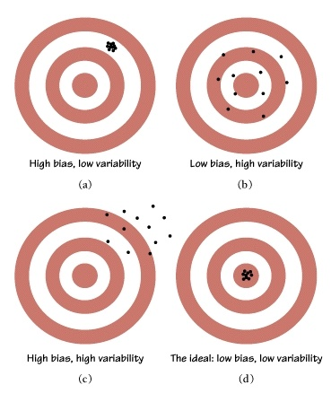
The sampling distribution
COLUMBIA UNIVERSITY · DEPARTMENT OF STATISTICS
08
Notes:
Explain that the sampling distribution is a model for all possible p-hat outcomes before the sample is observed. Do not ask students to calculate here.

Slide 8
From sample to population
Population question
What proportion p of all adults supports the policy?
Observed data
In one random sample of 1,000 adults, 887 support it. Thus p̂ = 0.887.
Modeling idea
A random sample gives a p̂ near p, with ordinary sample-to-sample variation.
Inference question
Which population values of p are plausible
given p̂ = 0.887 and the model?
A confidence interval gives a plausible range for the population parameter.
COLUMBIA UNIVERSITY · DEPARTMENT OF STATISTICS
09
Notes:
Make the sample-to-population logic explicit before introducing formula mechanics.

Slide 9
Confidence interval ingredients
confidence interval = point estimate ± margin of error
The margin of error combines a critical value and the standard error of the point estimate.
Point estimate
p̂ = 0.887
what the sample says
Standard error
SE = 0.010
typical variation
95% critical value
z* = 1.96
confidence level
COLUMBIA UNIVERSITY · DEPARTMENT OF STATISTICS
10
Notes:
Introduce the mechanics using the exact Week 08 Example 5.8 values. Identify each term before calculating.

Slide 10
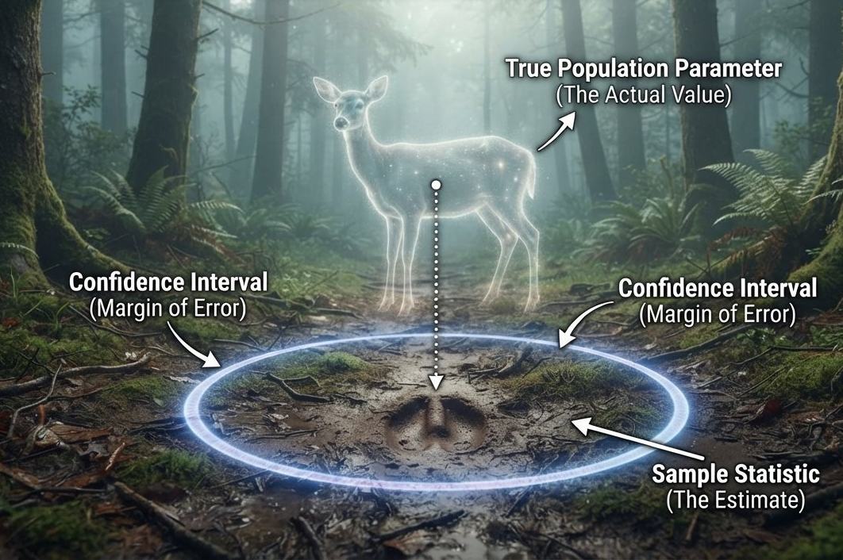
Confidence Interval – Inferential THINKING
What decide the range of inference?
Center/Starting point -> Estimate
Confidence
-> Critical Values
Model and Assumptions
-> Standard Error
COLUMBIA UNIVERSITY · DEPARTMENT OF STATISTICS
10
Notes:
Introduce the mechanics using the exact Week 08 Example 5.8 values. Identify each term before calculating.

Slide 11
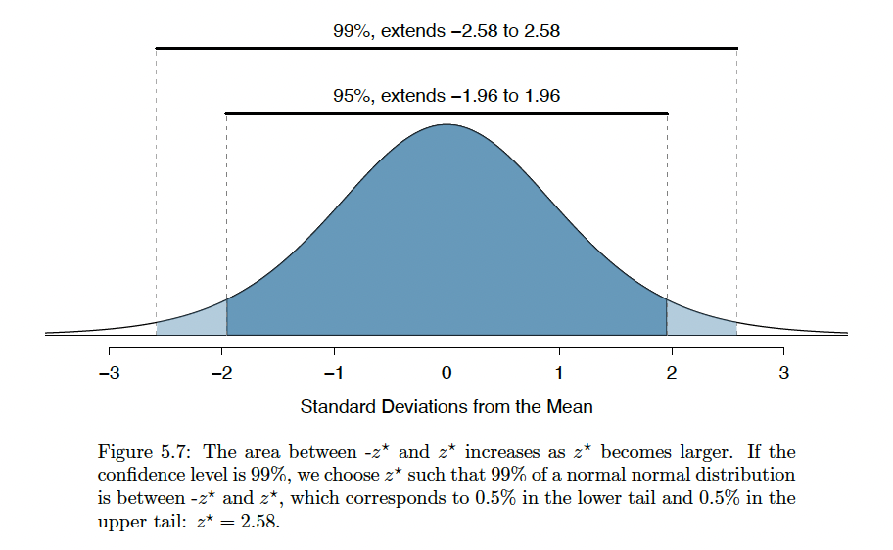
Critical Values
COLUMBIA UNIVERSITY · DEPARTMENT OF STATISTICS
10
Notes:
Introduce the mechanics using the exact Week 08 Example 5.8 values. Identify each term before calculating.

Slide 12
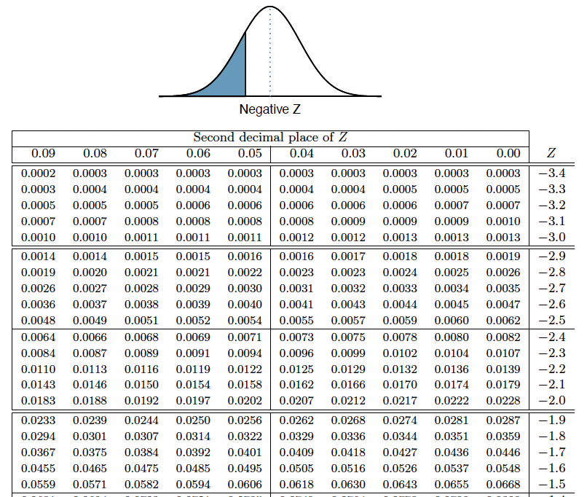
Critical Values
Find the critical value corresponding to 90% confidence.
COLUMBIA UNIVERSITY · DEPARTMENT OF STATISTICS
10
Notes:
Introduce the mechanics using the exact Week 08 Example 5.8 values. Identify each term before calculating.

Slide 13
Figure 5.6: what repeats and what stays fixed
The population parameter p
Stays fixed. The population has not changed.
The sample proportion p̂
Changes because each random sample differs.
The 95% confidence interval
Changes because it is built from that sample's p̂ and standard error.
Of 25 intervals in the book, 24 captured p and 1 missed. That long-run performance defines the 95% method.
Quick check: What does the number “95%” describe?
COLUMBIA UNIVERSITY · DEPARTMENT OF STATISTICS
11
Notes:
This directly addresses the lowest-scoring Week 08 practice question. Keep the model statement precise.

Slide 14
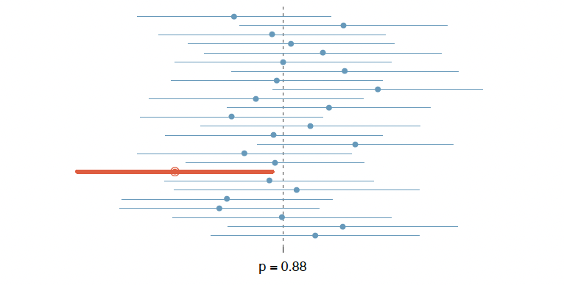
Figure 5.6: what repeats and what stays fixed
COLUMBIA UNIVERSITY · DEPARTMENT OF STATISTICS
11
Notes:
This directly addresses the lowest-scoring Week 08 practice question. Keep the model statement precise.

Slide 15
What “95% confident” means
Careful wording
If we repeat the sampling process many times and build intervals the same way, about 95% of those intervals contain the true population parameter.
Avoid
“95% of the data lie in the interval.” The interval concerns a population parameter, not individual data.
Avoid
“There is a 95% probability p is in this finished interval.” In this setup p is fixed.
Use
“This method captures p about 95% of the time.”
COLUMBIA UNIVERSITY · DEPARTMENT OF STATISTICS
12
Notes:
Use the correct statement and contrast it with common imprecise wordings from the check-in. Avoid shaming students; make the distinction about the method.

Slide 16
Hypothesis testing asks a different question
Confidence interval question
Which population values are plausible, given our sample and a model for sampling variability?
Hypothesis-testing question
If a stated population claim were true, would a sample result like ours count as unusually strong evidence against that claim?
Core pieces
The null hypothesis states the chance-model claim. The alternative states the competing claim. Data supply evidence, not certainty.
COLUMBIA UNIVERSITY · DEPARTMENT OF STATISTICS
13
Notes:
Preview testing as an evidence question, not a second formula on the same day.

Slide 17
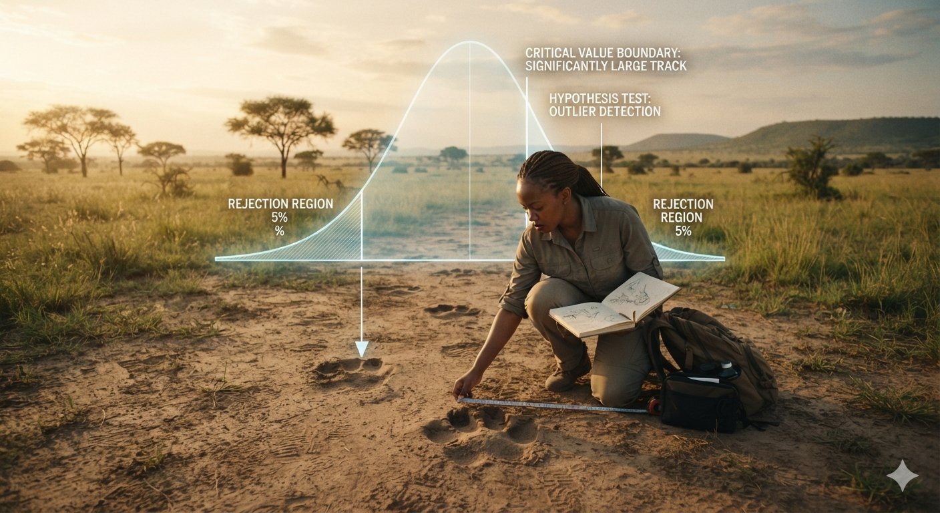
Hypothesis testing - Inferential THINKING
COLUMBIA UNIVERSITY · DEPARTMENT OF STATISTICS
13
Notes:
Preview testing as an evidence question, not a second formula on the same day.

Slide 18
Hypothesis-testing definitions
Term | Definition | Example: a report claims p = 0.90
Null hypothesis (H₀) | The claim we test, usually “no effect” or a stated value | H₀: p = 0.90
Alternative (Hₐ) | The competing claim the data might support | Hₐ: p ≠ 0.90
Test statistic | How far the sample result sits from H₀, in standard errors | z = (0.887 − 0.90) / 0.0095 ≈ −1.37
p-value | Chance of a result at least this extreme if H₀ were true | 2 × P(Z ≤ −1.37) ≈ 0.17
Significance level (α) | Evidence cutoff, chosen before seeing the data | α = 0.05
Conclusion | Reject H₀ if p-value ≤ α; otherwise fail to reject | 0.17 > 0.05: fail to reject; 90% stays plausible
COLUMBIA UNIVERSITY · DEPARTMENT OF STATISTICS
13
Notes:
Preview testing as an evidence question, not a second formula on the same day.

Slide 19
Decision errors: one useful analogy
Decision | Reality | Name
Reject H₀ | H₀ was true | Type I error
Fail to reject H₀ | H₀ was false | Type II error
Either decision | The corresponding statement was true | Correct decision
Courtroom: H₀ means innocent.
Type I: convict an innocent person. Type II: fail to convict a guilty person.
COLUMBIA UNIVERSITY · DEPARTMENT OF STATISTICS
14
Notes:
Use the courtroom analogy as a bridge, while noting it is an analogy rather than the full legal system.

