Slide 1


Confidence Intervals and Hypothesis Testing: Guided Practice
STAT UN 1001 · LECTURE 16
OCTOBER 29, 2026
Notes:
Lecture 16 revisits Week 08 practice items through guided computation and interpretation before Quiz 3.

Slide 2
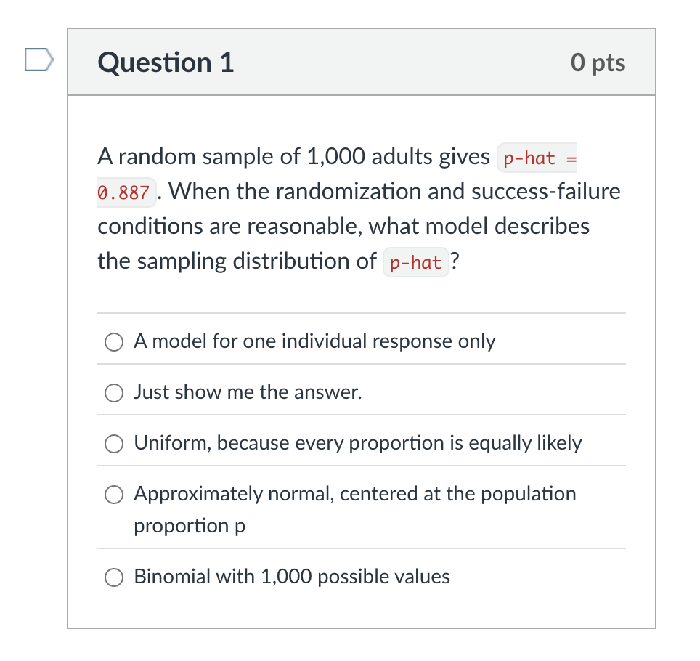
Practice 1: check the model for p̂
COLUMBIA UNIVERSITY · DEPARTMENT OF STATISTICS
04
Notes:
Use Week 08's Example 5.8 setup. Let students compute the two success/failure counts before showing the conclusion.

Slide 3
Practice 1: check the model for p̂
A random sample of n = 1,000 adults includes 887 who support a policy. Thus p̂ = 887 / 1,000 = 0.887.
Randomness / independence
How was the sample selected? Is it small relative to the population?
Expected successes
n p̂ = 1,000(0.887) = 887, which is at least 10.
Expected failures
n(1 − p̂) = 1,000(0.113) = 113, which is at least 10.
When the conditions fit, we can use an approximate normal model for p̂.
COLUMBIA UNIVERSITY · DEPARTMENT OF STATISTICS
04
Notes:
Use Week 08's Example 5.8 setup. Let students compute the two success/failure counts before showing the conclusion.

Slide 4
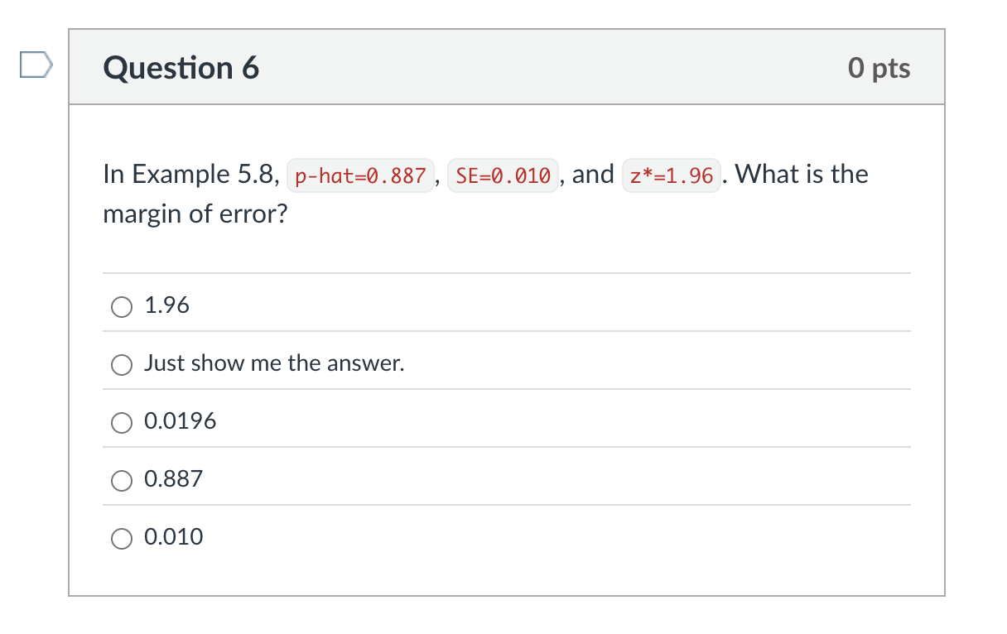
Practice 2: Margin of error
COLUMBIA UNIVERSITY · DEPARTMENT OF STATISTICS
05
Notes:
This is the calculation students selected most often in the Week 08 check-in. Pause after each line and have students compute before revealing the next line.

Slide 5
Margin of error
Example 5.8 provides SE = 0.010 and uses z* = 1.96 for a 95% confidence level.
margin of error = z* × SE = 1.96 × 0.010 = 0.0196
The margin of error measures the distance from p̂ to each endpoint.
If this number changes... | Then the interval width...
Standard error gets larger | Gets larger.
Confidence level rises from 95% to 99% | Gets larger because z* rises.
COLUMBIA UNIVERSITY · DEPARTMENT OF STATISTICS
05
Notes:
This is the calculation students selected most often in the Week 08 check-in. Pause after each line and have students compute before revealing the next line.

Slide 6
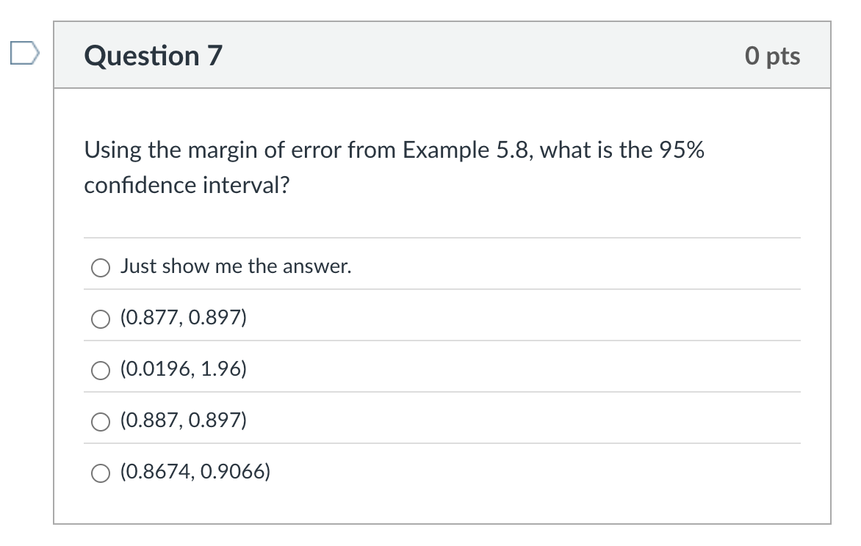
Practice 3: calculate the endpoints
COLUMBIA UNIVERSITY · DEPARTMENT OF STATISTICS
06
Notes:
Work the endpoints separately to address a common error of reporting the margin-of-error ingredients as the interval.

Slide 7
Practice 3: calculate the endpoints
We have p̂ = 0.887 and margin of error = 0.0196.
Step | Calculation | Result
Lower endpoint | 0.887 − 0.0196 | 0.8674
Upper endpoint | 0.887 + 0.0196 | 0.9066
95% confidence interval | (lower endpoint, upper endpoint) | (0.8674, 0.9066)
COLUMBIA UNIVERSITY · DEPARTMENT OF STATISTICS
06
Notes:
Work the endpoints separately to address a common error of reporting the margin-of-error ingredients as the interval.

Slide 8
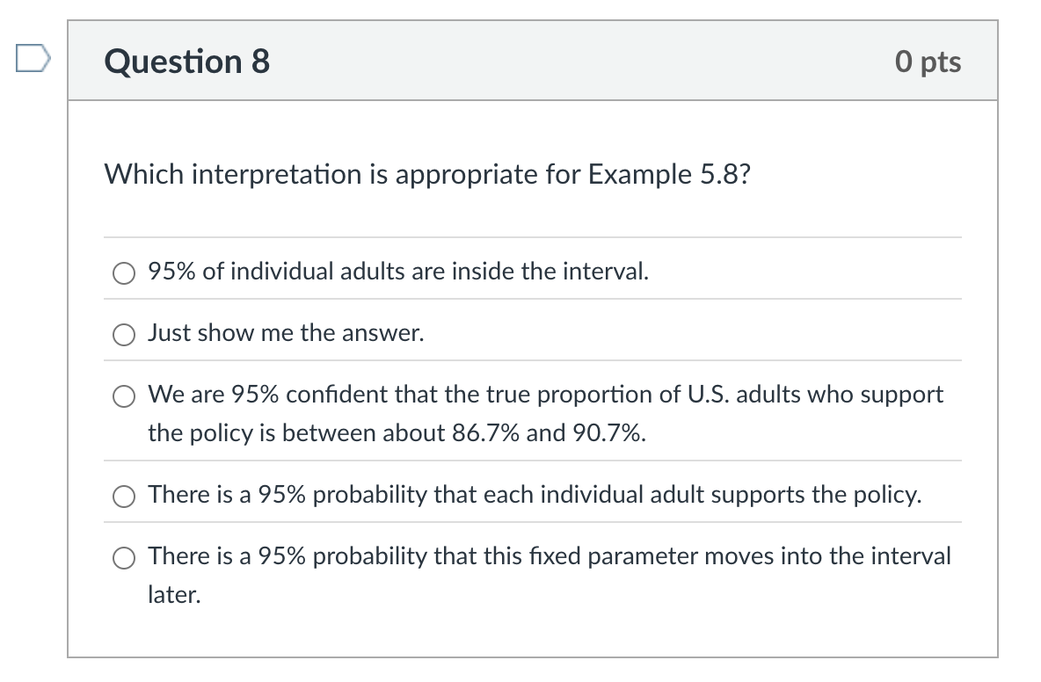
Practice 3: calculate the endpoints
COLUMBIA UNIVERSITY · DEPARTMENT OF STATISTICS
06
Notes:
Work the endpoints separately to address a common error of reporting the margin-of-error ingredients as the interval.

Slide 9
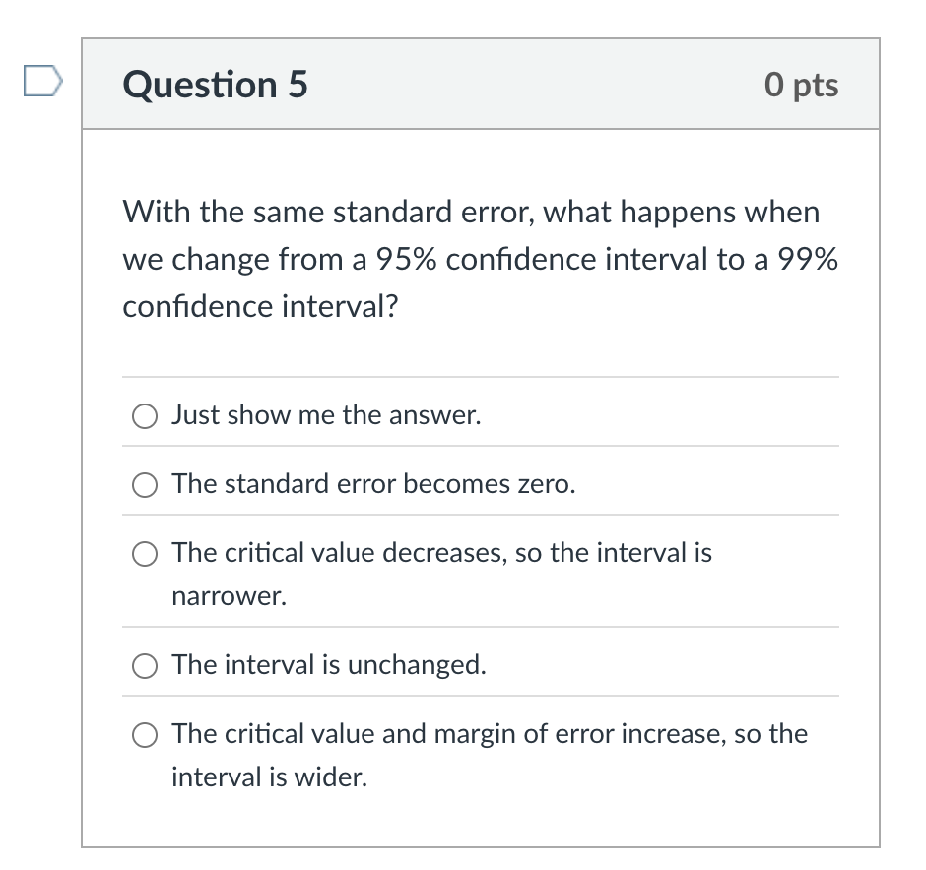
Practice 4: 95% versus 99%
COLUMBIA UNIVERSITY · DEPARTMENT OF STATISTICS
08
Notes:
Use Guided Practice 5.9. Ask for the direction before revealing the critical values and the reason.

Slide 10
95% versus 99%
95% confidence
z* = 1.96
Baseline interval width
99% confidence
z* = 2.58
Wider interval
Reason
Higher confidence needs a wider interval
Lower precision
COLUMBIA UNIVERSITY · DEPARTMENT OF STATISTICS
08
Notes:
Use Guided Practice 5.9. Ask for the direction before revealing the critical values and the reason.

Slide 11
Practice 6: precision and validity
A survey reports that 49% of U.S. adults find healthcare affordability difficult, with a published overall sampling margin of error of ±2.1 percentage points.
Published margin
49% ± 2.1% gives 46.9% to 51.1%. This describes precision.
Smaller samples usually have larger standard errors, so their estimates are less precise.
Subgroups
Validity
Margin of error does not solve biased wording, coverage, or an unrepresentative sample.
A narrow interval can still mislead when the measurement or sample does not represent the intended population.
COLUMBIA UNIVERSITY · DEPARTMENT OF STATISTICS
09
Notes:
Use the local Week 08 healthcare-affordability story. Emphasize that a narrow interval cannot cure biased measurement or an unrepresentative sampling frame.

Slide 12
Hypotheses first
A college considers a new tutoring program. The current pass rate is 70%. Under the new program, 75 out of 100 students passed the exam.
The question: does the program change the pass rate?
Null hypothesis H₀
The program does not change the pass rate: p = 0.70.
Alternative hypothesis Hₐ
The program changes the pass rate:
p ≠ 0.70.
Evidence question
If H₀ were true, would our sample result be unusually far from 0.70?
The null gives us a chance model.
We ask whether the data look surprising under that model.
COLUMBIA UNIVERSITY · DEPARTMENT OF STATISTICS
10
Notes:
Give an applied example that is distinct from the courtroom analogy. Pause for students to formulate H0 and HA in words before symbolic notation.

Slide 13
Decision errors
Type I error
Reject H₀ when the program truly has no effect. We claim a change when there is none.
Type II error
Fail to reject H₀ when the program truly changes pass rates. We miss a real change.
Correct decision
The decision matches reality. Which error would cause more harm depends on the setting.
COLUMBIA UNIVERSITY · DEPARTMENT OF STATISTICS
11
Notes:
Directly address the student request for examples beyond the courtroom. Use the tutoring program scenario from the prior slide.

