Slide 1
Project3-Group4
Dog VS Chicken
Applied Data Science FALL 2016
Wu, Weichuan
Zhang, Yunyi
Sheng, Tian
Raikes, William Robert
Lim, Kyongmook

Slide 2
Summary of the project
1. Methodology
1.1 Methodology graph
1.2 New Features
1.3 New Classifiers
1.4 Choosing the model based on results
2. Interpretation
2.1 Preprocessing Images
2.2 Feature Engineering
2.3 Dimension Reduction and Overfitting
3. Improvement

Slide 3
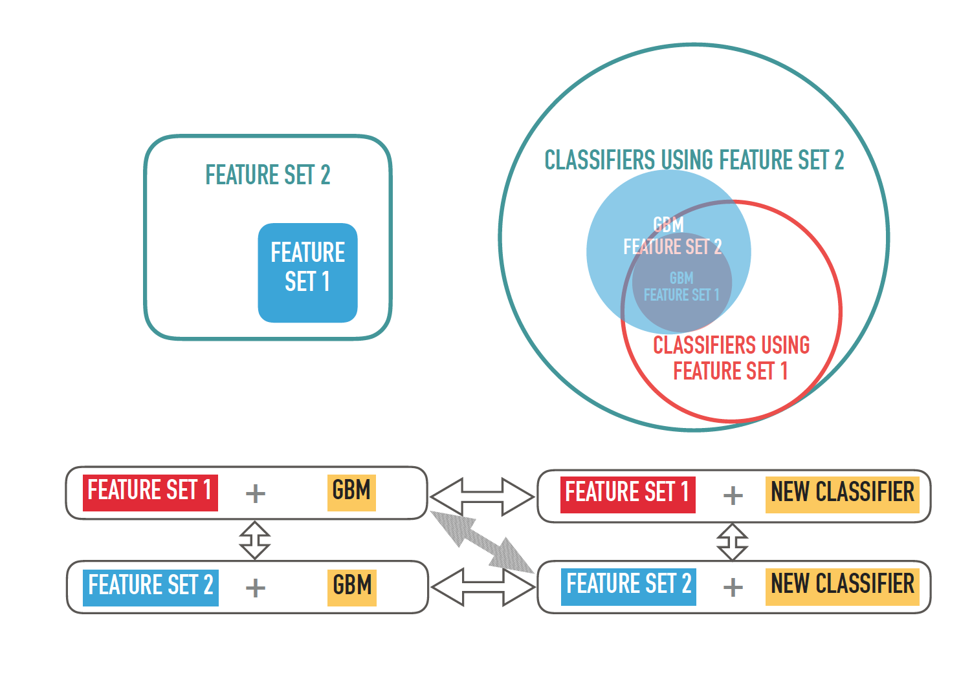
1.1 Methodology

Slide 4
1.2 & 1.3 New Features & Classifier
Features
SIFT
RGB
Classifier
GBM
SVM(radial)
PIXEL
SVM(linear)
Random Forest
LDA

Slide 5
1.4.1 Prediction result using SIFT features
Feature | Method | Average Accuracy Under 10-fold CV | Accuracy Volatility Under 10-fold CV | Process Time
SIFT | GBM | 65.2% | 4.1% | 3min
 | SVM (Linear Kernel) | 66.9% | 3.1% | 5min
 | SVM (Radial Kernel) | 69.5% | 3.1% | 5min
 | Random Forest | 69.8% | 3.4% | 5min
 | LDA | 66.9% | 1.7% | 3min
Notes:
Support vector machines (SVMs) are a set of supervised learning methods used for classification, regression and outliers detection.

Slide 6
1.4.2 Prediction result using Pixel features
Feature | Method | Average Accuracy Under 10-fold CV | Accuracy Volatility Under 10-fold CV | Process Time
PIXEL | GBM | 77.7% | 4.3% | 5min
 | SVM (Linear Kernel) | 80.5% | 5.7% | 6min
 | SVM (Radial Kernel) | 83.6% | 4.4% | 7min
 | Random Forest | 82.1% | 4.2% | 13min
 | LDA | 79.7% | 4.4% | 2min
Notes:
Support vector machines (SVMs) are a set of supervised learning methods used for classification, regression and outliers detection.

Slide 7
1.4.3 Prediction result using RGB features
Feature | Method | Average Accuracy Under 10-fold CV | Accuracy Volatility Under 10-fold CV | Process Time
RGB | GBM | 83.2% | 1.5% | 4min
 | SVM (Linear Kernel) | 85.6% | 1.3% | 4min
 | SVM (Radial Kernel) | 87.8% | 3.0% | 5min
 | Random Forest | 86.8% | 1.9% | 10min
 | LDA | 84.9% | 2.7% | 1min
Notes:
Support vector machines (SVMs) are a set of supervised learning methods used for classification, regression and outliers detection.

Slide 8
1.4.4 Prediction result using SIFT+RGB features
Feature | Method | Average Accuracy Under 10-fold CV | Accuracy Volatility Under 10-fold CV | Process Time
SIFT+RGB | GBM | 83.8% | 1.7% | 8min
 | SVM (Linear Kernel) | 86.7% | 2.7% | 10min
 | SVM (Radial Kernel) | 88.6% | 2.7% | 13min
 | Random Forest | 87.5% | 2.6% | 15min
 | LDA | 85.8% | 2.6% | 4min
Notes:
Support vector machines (SVMs) are a set of supervised learning methods used for classification, regression and outliers detection.

Slide 9
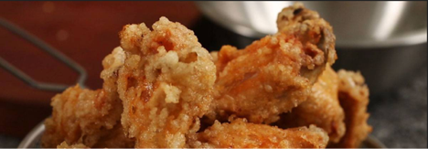

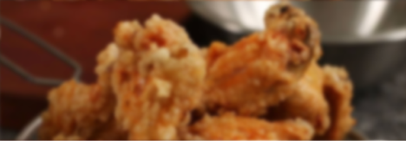
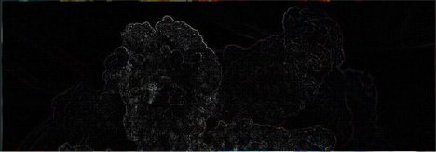
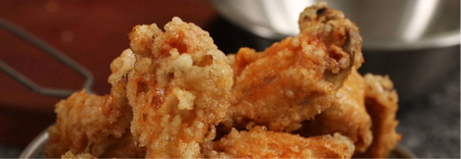
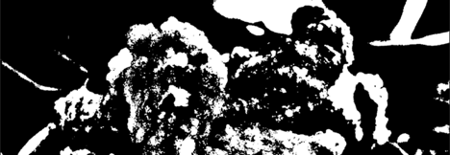
2. Interpretation
2.1 Preprocessing Images：use different filters to reduce noise
a. original c. Low-Pass
b. linear filtering d.High-Pass
e. Median Filter f. Adaptive thresholding
Notes:
Linear discriminant analysis (LDA) is a generalization of Fisher's linear discriminant, a method used in statistics, pattern recognition and machine learning to find a linear combination of features that characterizes or separates two or more classes of objects or events. The resulting combination may be used as a linear classifier, or, more commonly, for dimensionality reduction before later classification.

Slide 10

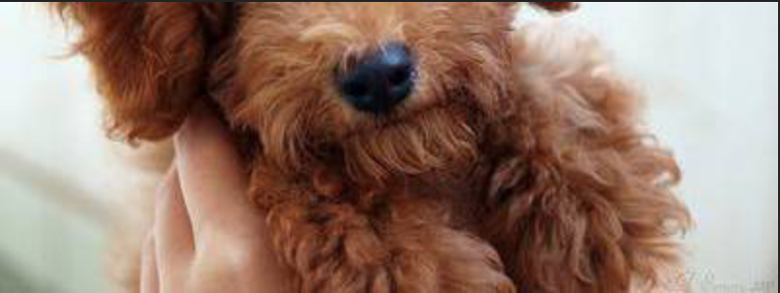
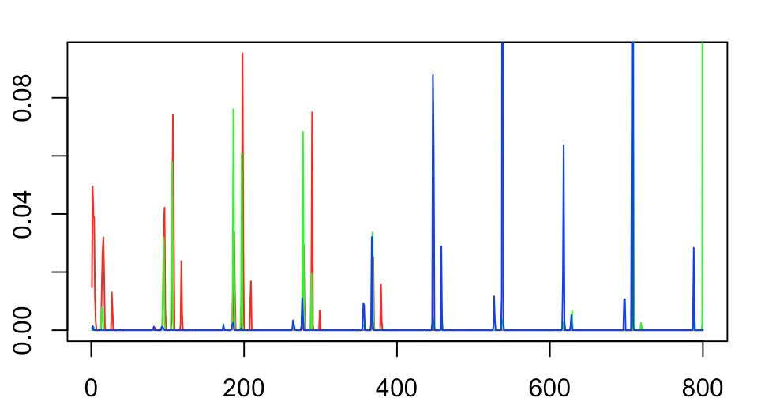
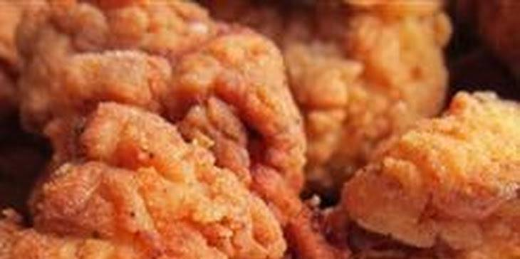

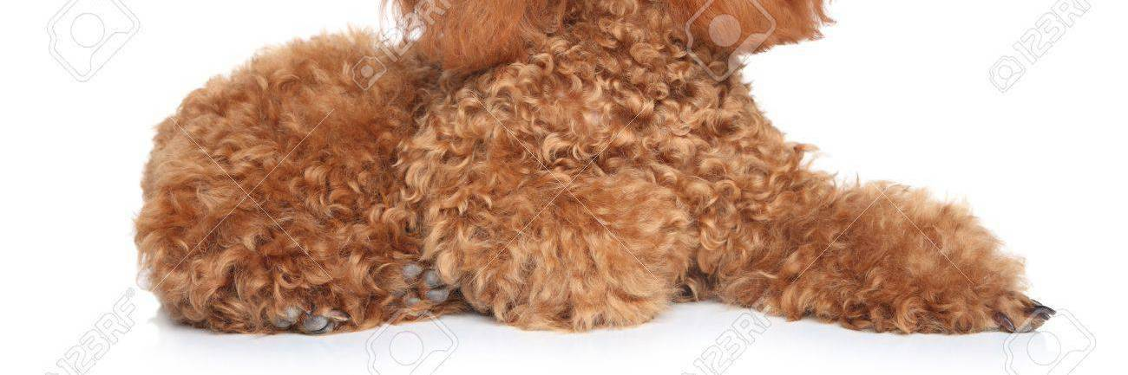
2.2 Feature Engineering
(1) Pixel Feature
a. Original
(2) RGB Feature
b. Resized28*28
Red line:
frequency
Blue line:
Green line
Color

Slide 11
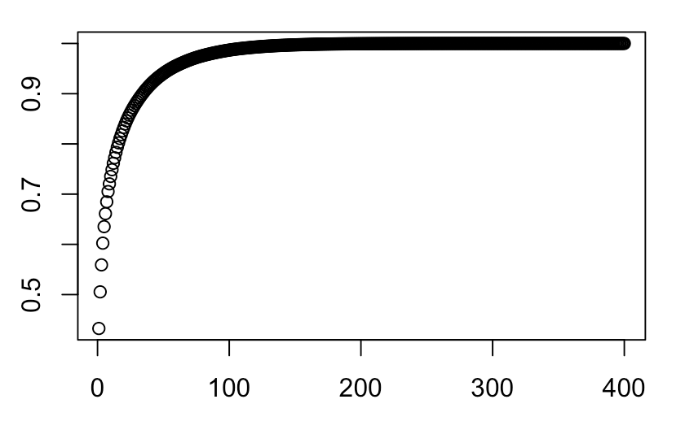
2.3 Dimension Reduction and Overfitting
(1) Dimension Reduction (PCA)
(2) Overfitting
Cross Validation & PCA: at the same time
Never use the test data when doing PCA
Explained Variance
Number of Components

Slide 12
3. Improvement
1. Try more complicated color system to distinguish the pictures
2. Combine color features and other new features such as contours
3. Try better classifiers : deep learning methods like Caffe
4. Tune more parameters

