Slide 1
Association mining of music and text
Kezhi Cai

Slide 2
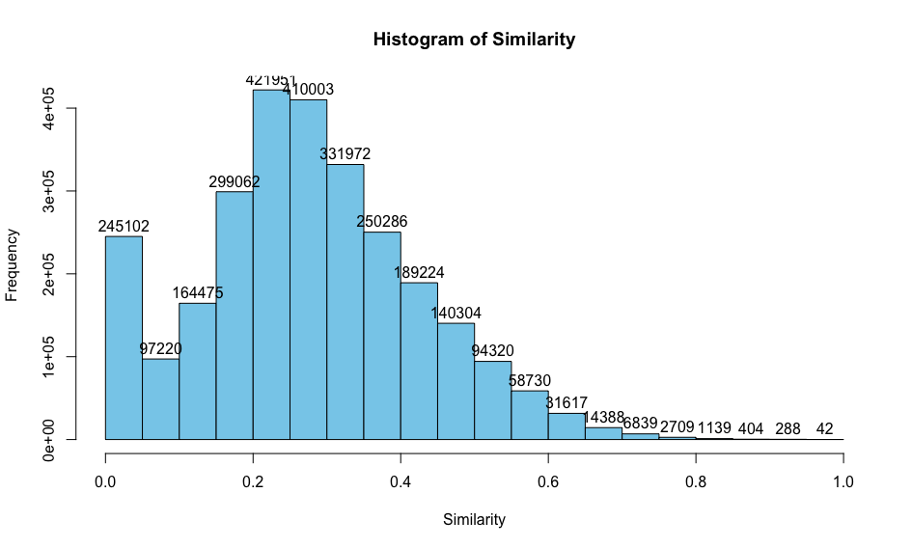
Histogram of Similarity
Similarity | Percentage (%)
>80 | 0.68
>60 | 2
>40 | 20
>30 | 40
>20 | 71

Slide 3
Collaborative Filtering

Slide 4
Feature Selection
The Top 8 Features
1 Variance of the difference in loudness( from start to max)
2 Variance of beats confidence
3 Length of the song
4 Other five from timbre

Slide 5
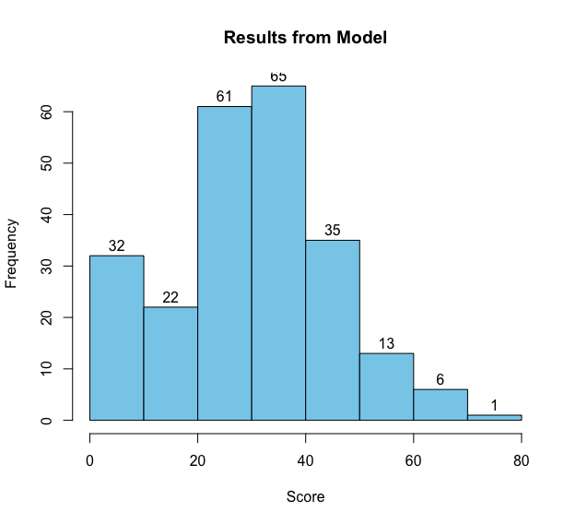
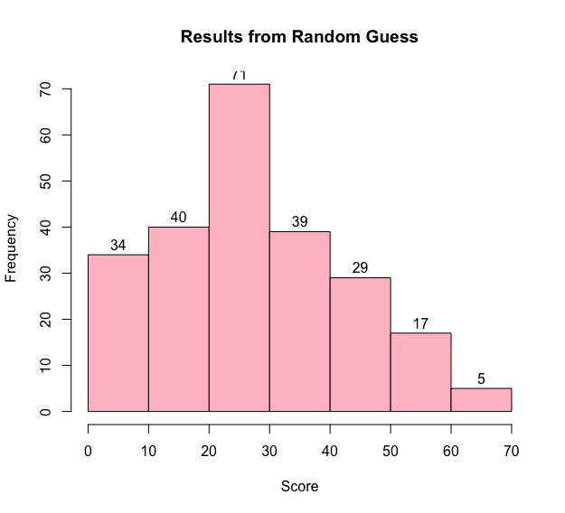
Results
Average score ≈ 31
Average score ≈ 28

Slide 6
Improvements
1. Find stronger features
2. Consider lyric word
3. Cross- Validation to find model parameter

