Slide 1
ADS Project 4: Words for Music
Presenter: Xuechun Sun
Notes:
Hi, my name is Xuechun Sun and I am gonna present some of my ideas and thoughts about this Words for Music project.

Slide 2
Headlines:
● Clustering lyrics words using Topic Modeling
● Extract Features through “/analysis” files
● Make prediction using Multinomial regression
Notes:
Here, I split the project into three part.

Slide 3
Step 1 Topic Modeling
What we can get through Topic Modeling?
1. Generating words distribution for each topic.
2. Generate the topic of each word, given that word in a song
Notes:
Since last time, TAs have already told us about the algorithm and background of Topic Modeling,so I will skip it and simply explain why I choose this methods.
Using Topic modeling, I can get two things here, first … . Thus, if we can predict topic for each new song, we would have a word rank or distribution for each new song.
The second is that …, that will be intermediate part used in the next few steps.

Slide 4
Step 1 Topic Modeling
Function used: lda.collapsed.gibbs.sampler()
Parameter:
1. K <- number of Topic
2. G <- number of iterations (slightly conservative to ensure convergence)
3. Alpha <- Dirichlet hyperparameter for topic proportions (document-topic distributions)
4. eta <- Dirichlet hyperparamater for topic multinomials (topic-term distributions )
Choose K <- 18; G <- 1000; Alpha <- 0.1, eta <- 0.1
(generated from experiments)

Slide 5
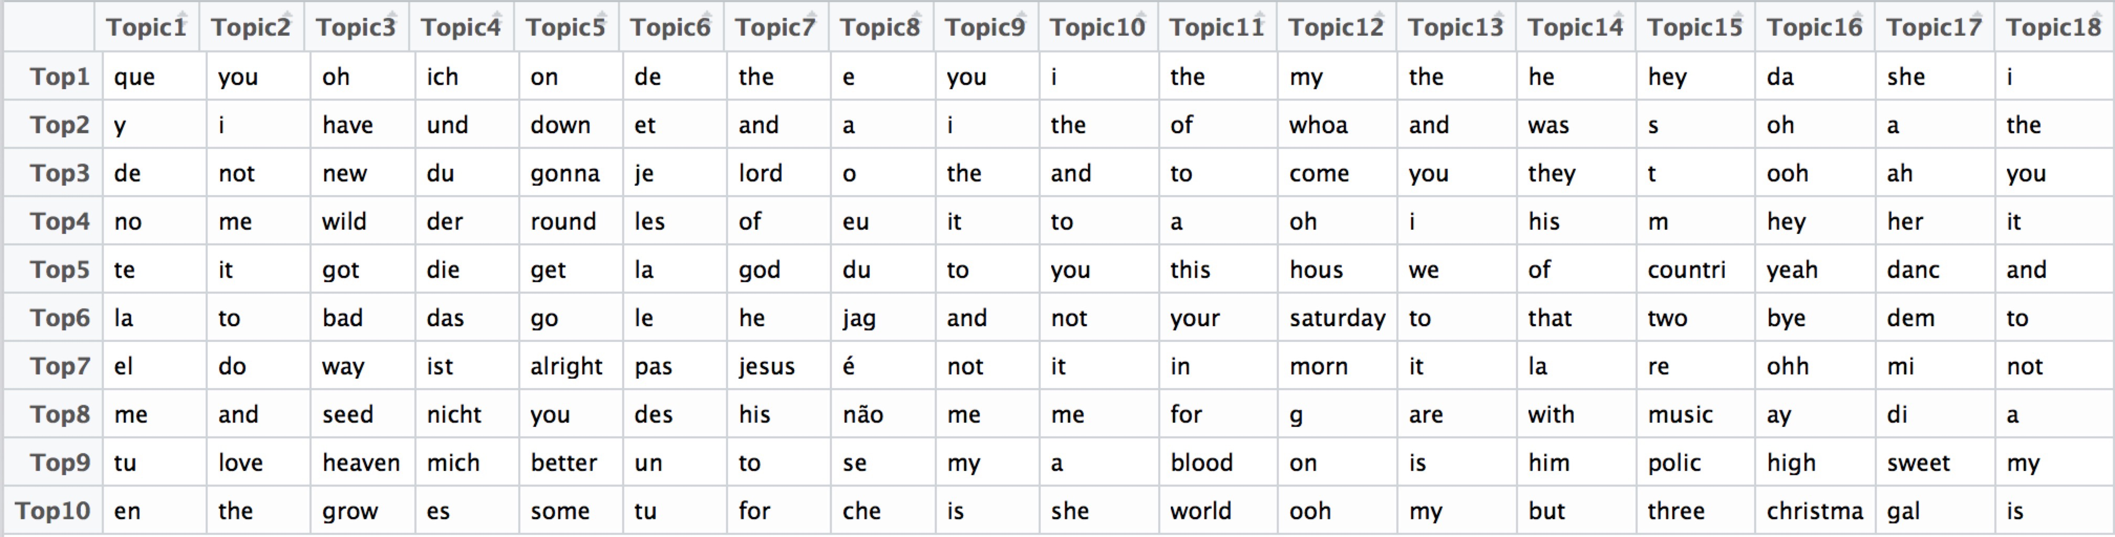
Step 1 Topic Modeling
Results:
1. Top 10 Words for each topic
Notes:
First result of this picture shows top 10 words for each topic. Just in a glance, we can find the most common words for each topics are “she”, “you”, “the”,”I”… This make sense, because almost every type of topics will use this common words to express main ideas. So what we need to focus are the top words after these common words. For example, for topic 2, “love” is high probability words, for topic 7, “lord”, “god”, “jesus” are the high probability words.
Second pictures show the frequency for each topic

Slide 6
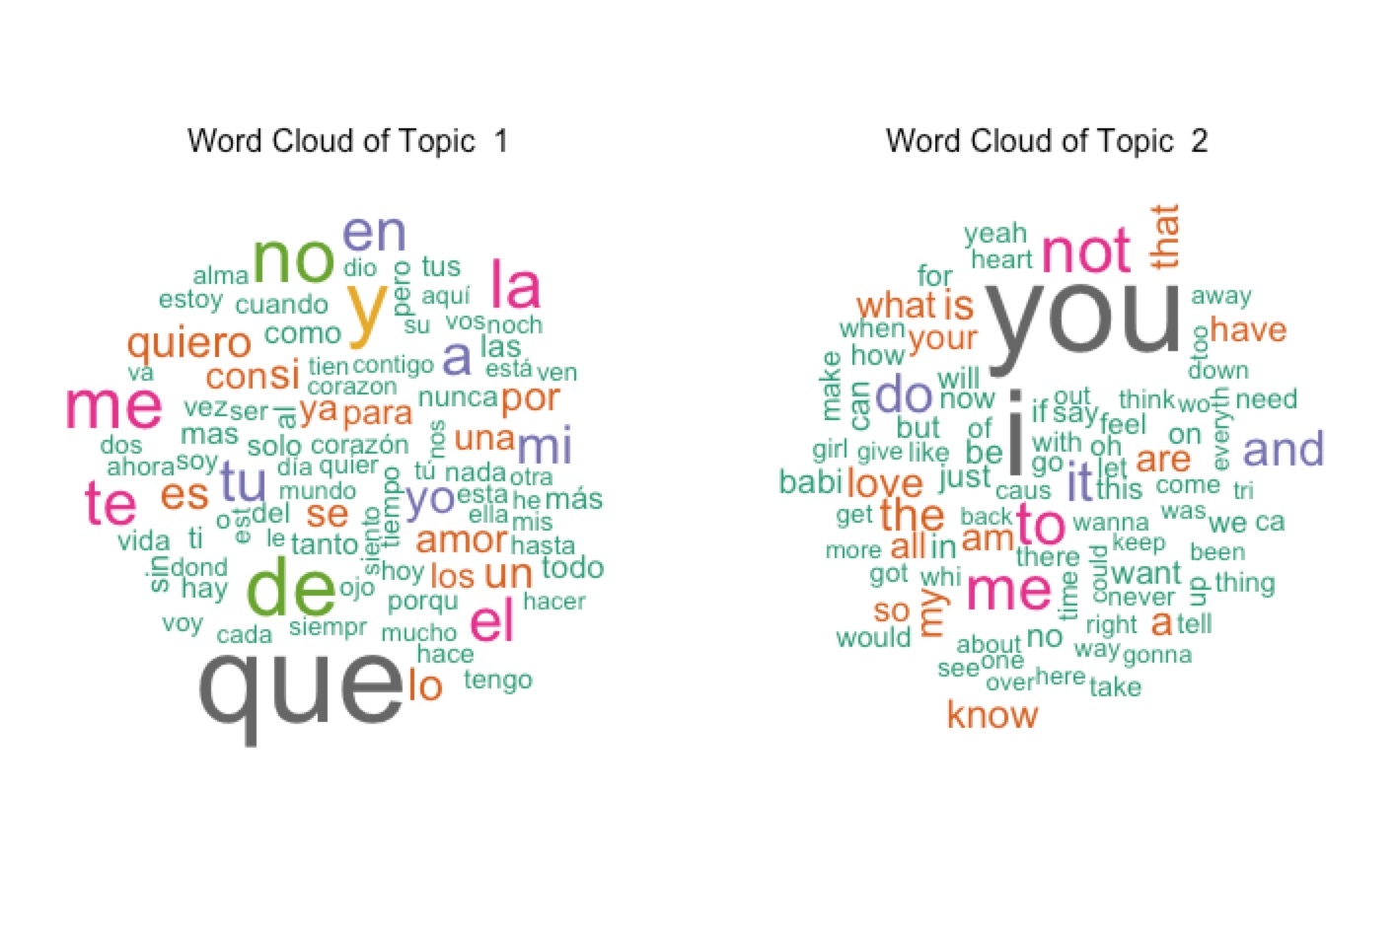
Step 1 Topic Modeling
Word Cloud for each topic
Notes:
These are word cloud visualization for each topic, here, we can have more clear view for high probability words for each topic.

Slide 7
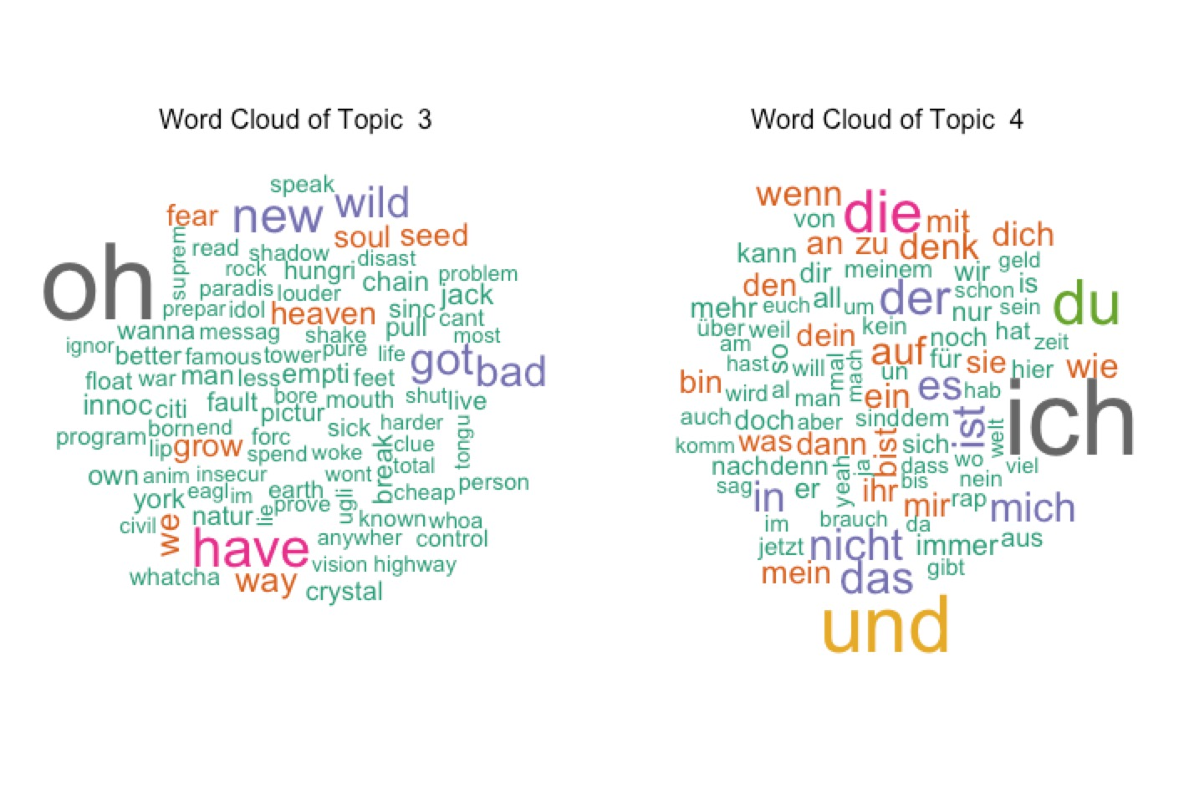
Step 1 Topic Modeling
Word Cloud for each topic
Notes:
Topic 2,”new”,”wild”,”heaven”. Kind of like words in rock music I guess.

Slide 8
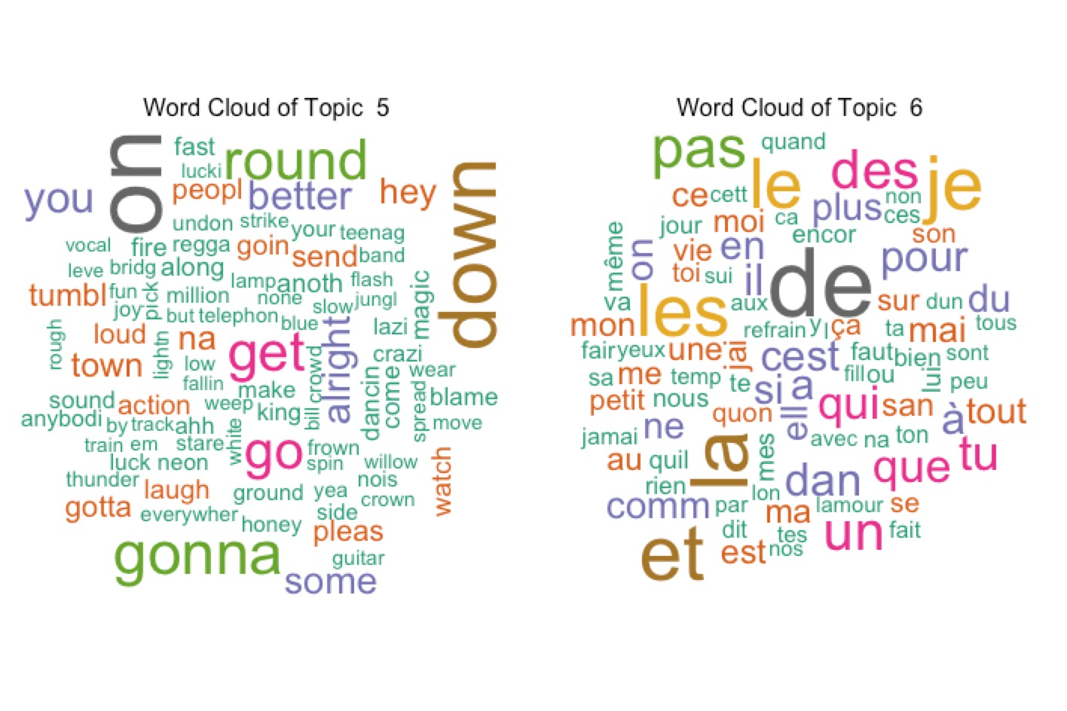
Step 1 Topic Modeling
Word Cloud for each topic
Notes:
Topic 5,”better”, “people”, “loud”,”laugh” here.

Slide 9
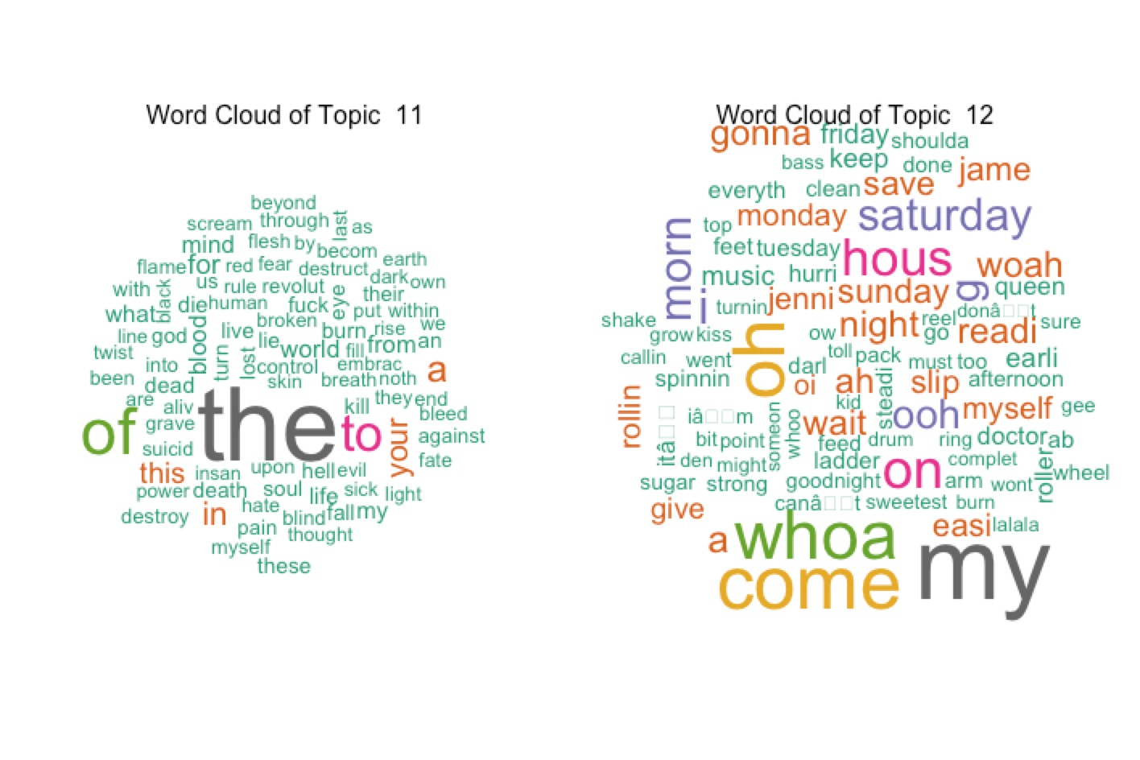
Step 1 Topic Modeling
Word Cloud for each topic
Notes:
Topic 12 “saturday”, “monday”,“hours”.

Slide 10
Step 2 Feature Extraction
Variables Process through “/analysis” files
(don’t consider “confidence” variables)
1. bars_start (n1 dim vector): start time of each bar according to The Echo Nest
2. beats_start (n1 dim vector): start time of each beat according to The Echo Nest
3. sections_start (n2 dim vector): start time of each section according to The Echo Nest
4. segments_loudness_max (n3 dim vector): max loudness during each segment
5. segments_loudness_start (n3 dim vector): loudness at the beginning of each segment
6. segments_pitches (12 * n3 dim vector): chroma features for each segment
7. segments_timbre (12 * n3 dim vector): MFCC-like features for each segment
8. tatums_start(n4 dim vector): start time of each tatum according to The Echo Nest

Slide 11
Step 2 Feature Extraction
Assumptions: values of variables should have some dependency with time
For values in variables 1,2,3,8 in the previous slides, the number is actually increasing time points.
Cumulative time point (already have time description)
Methods: Choose Summary statistics (quantiles), mean and SD for these variables for each song
7 dim vector for each variable
For values in variables 4,5,6,7 in the previous slides, the number is time points in each small time segment
Not cumulative time point(make sequence points for each variable)
Methods: Get sample points equidistant from raw dataset, in other words, choosing sample data successively from the original data, where the interval of each two sampling data are the same.
get 20 intervals and 21 sample points for each variable

Slide 12
Step 2 Feature Extraction
Now, for each song, I concatenate all the feature vectors that we collected in the previous slide of each song into each row.
Then, I have Number_of_song * 573 dim matrix(Original Feature Matrix)

Slide 13
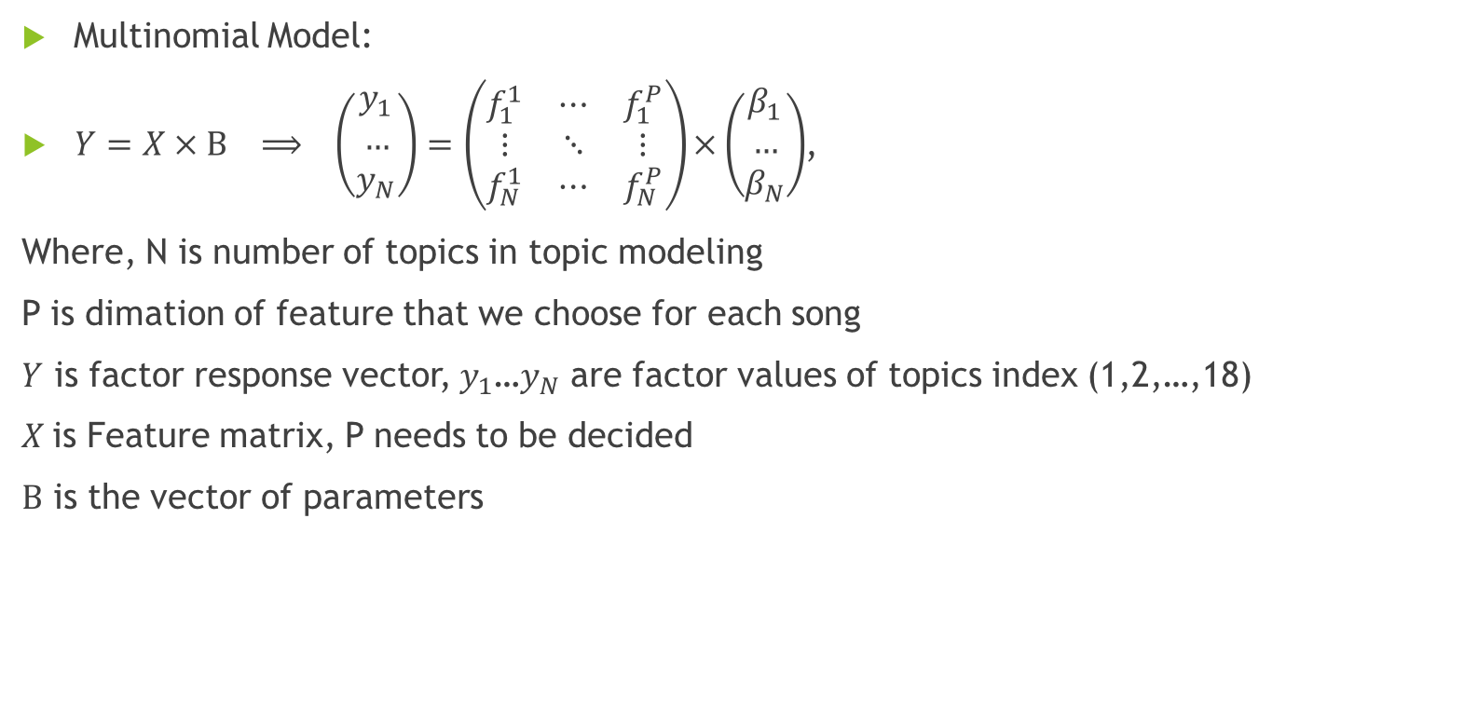
Step 3 Make prediction using Multinomial regression
Multinomial Model:
$Y=X × Β ⟹ \left(\begin{matrix}y_{1} \\ … \\ y_{N}\end{matrix}\right)=\left(\begin{matrix}f_{1}^{1} & ⋯ & f_{1}^{P} \\ ⋮ & ⋱ & ⋮ \\ f_{N}^{1} & ⋯ & f_{N}^{P}\end{matrix}\right)×\left(\begin{matrix}β_{1} \\ … \\ β_{N}\end{matrix}\right)$,
Where, N is number of topics in topic modeling
P is dimation of feature that we choose for each song
$Y$ is factor response vector, $y_{1}$…$y_{N}$ are factor values of topics index (1,2,…,18)
$X$is Feature matrix, P needs to be decided
$Β$ is the vector of parameters

Slide 14
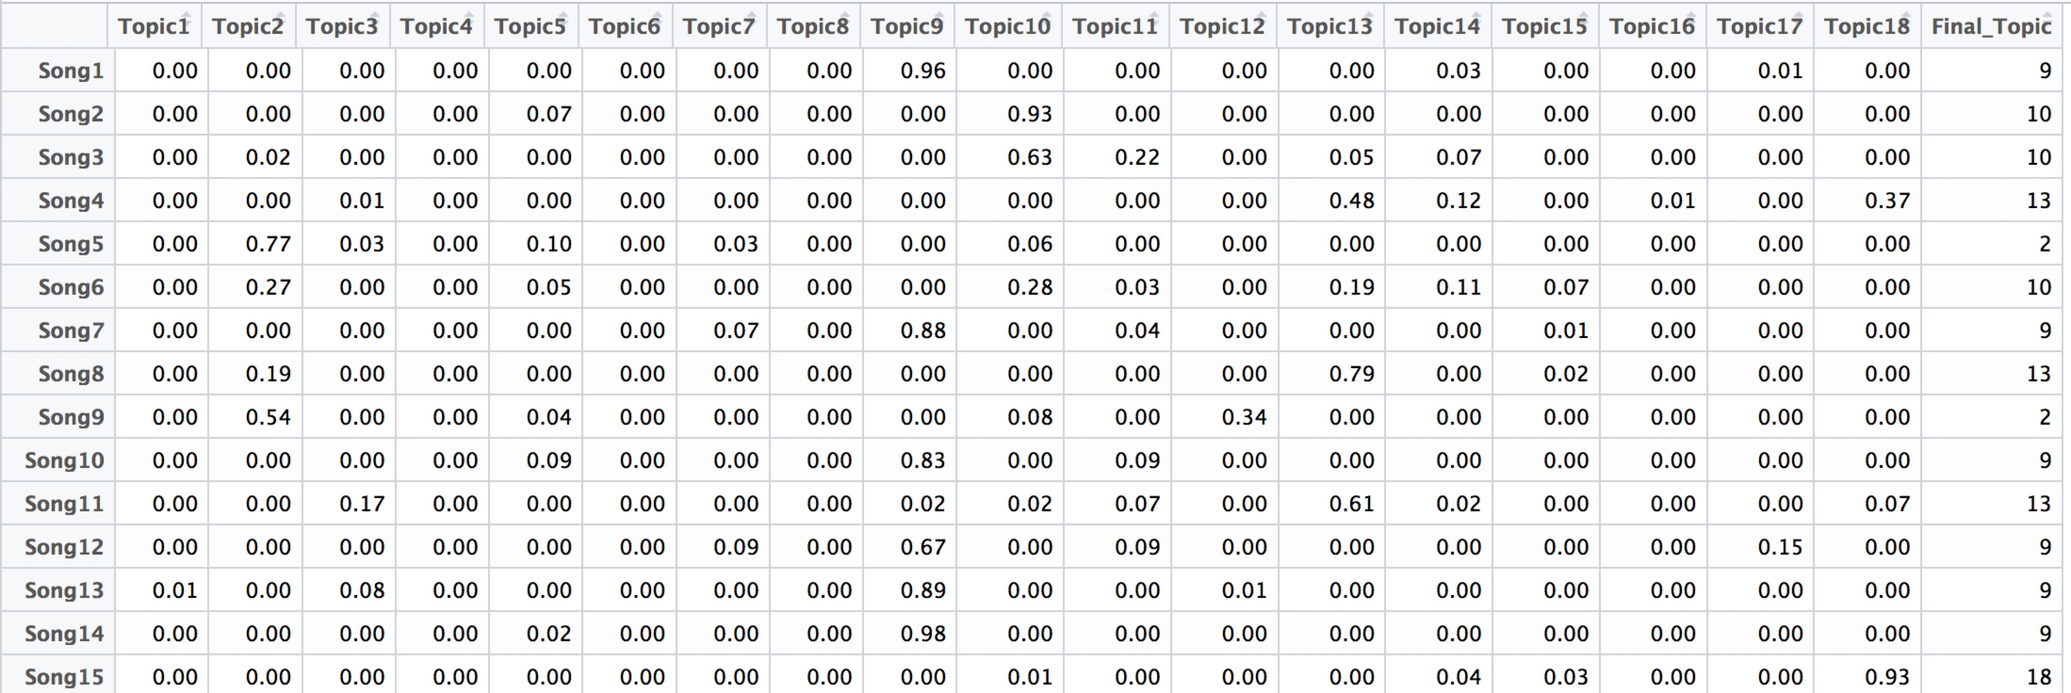

Step 3 Make prediction using Multinomial regression
To get $Y$, calculate the majority topic for each song
Summary, Frequency for each topic

Slide 15
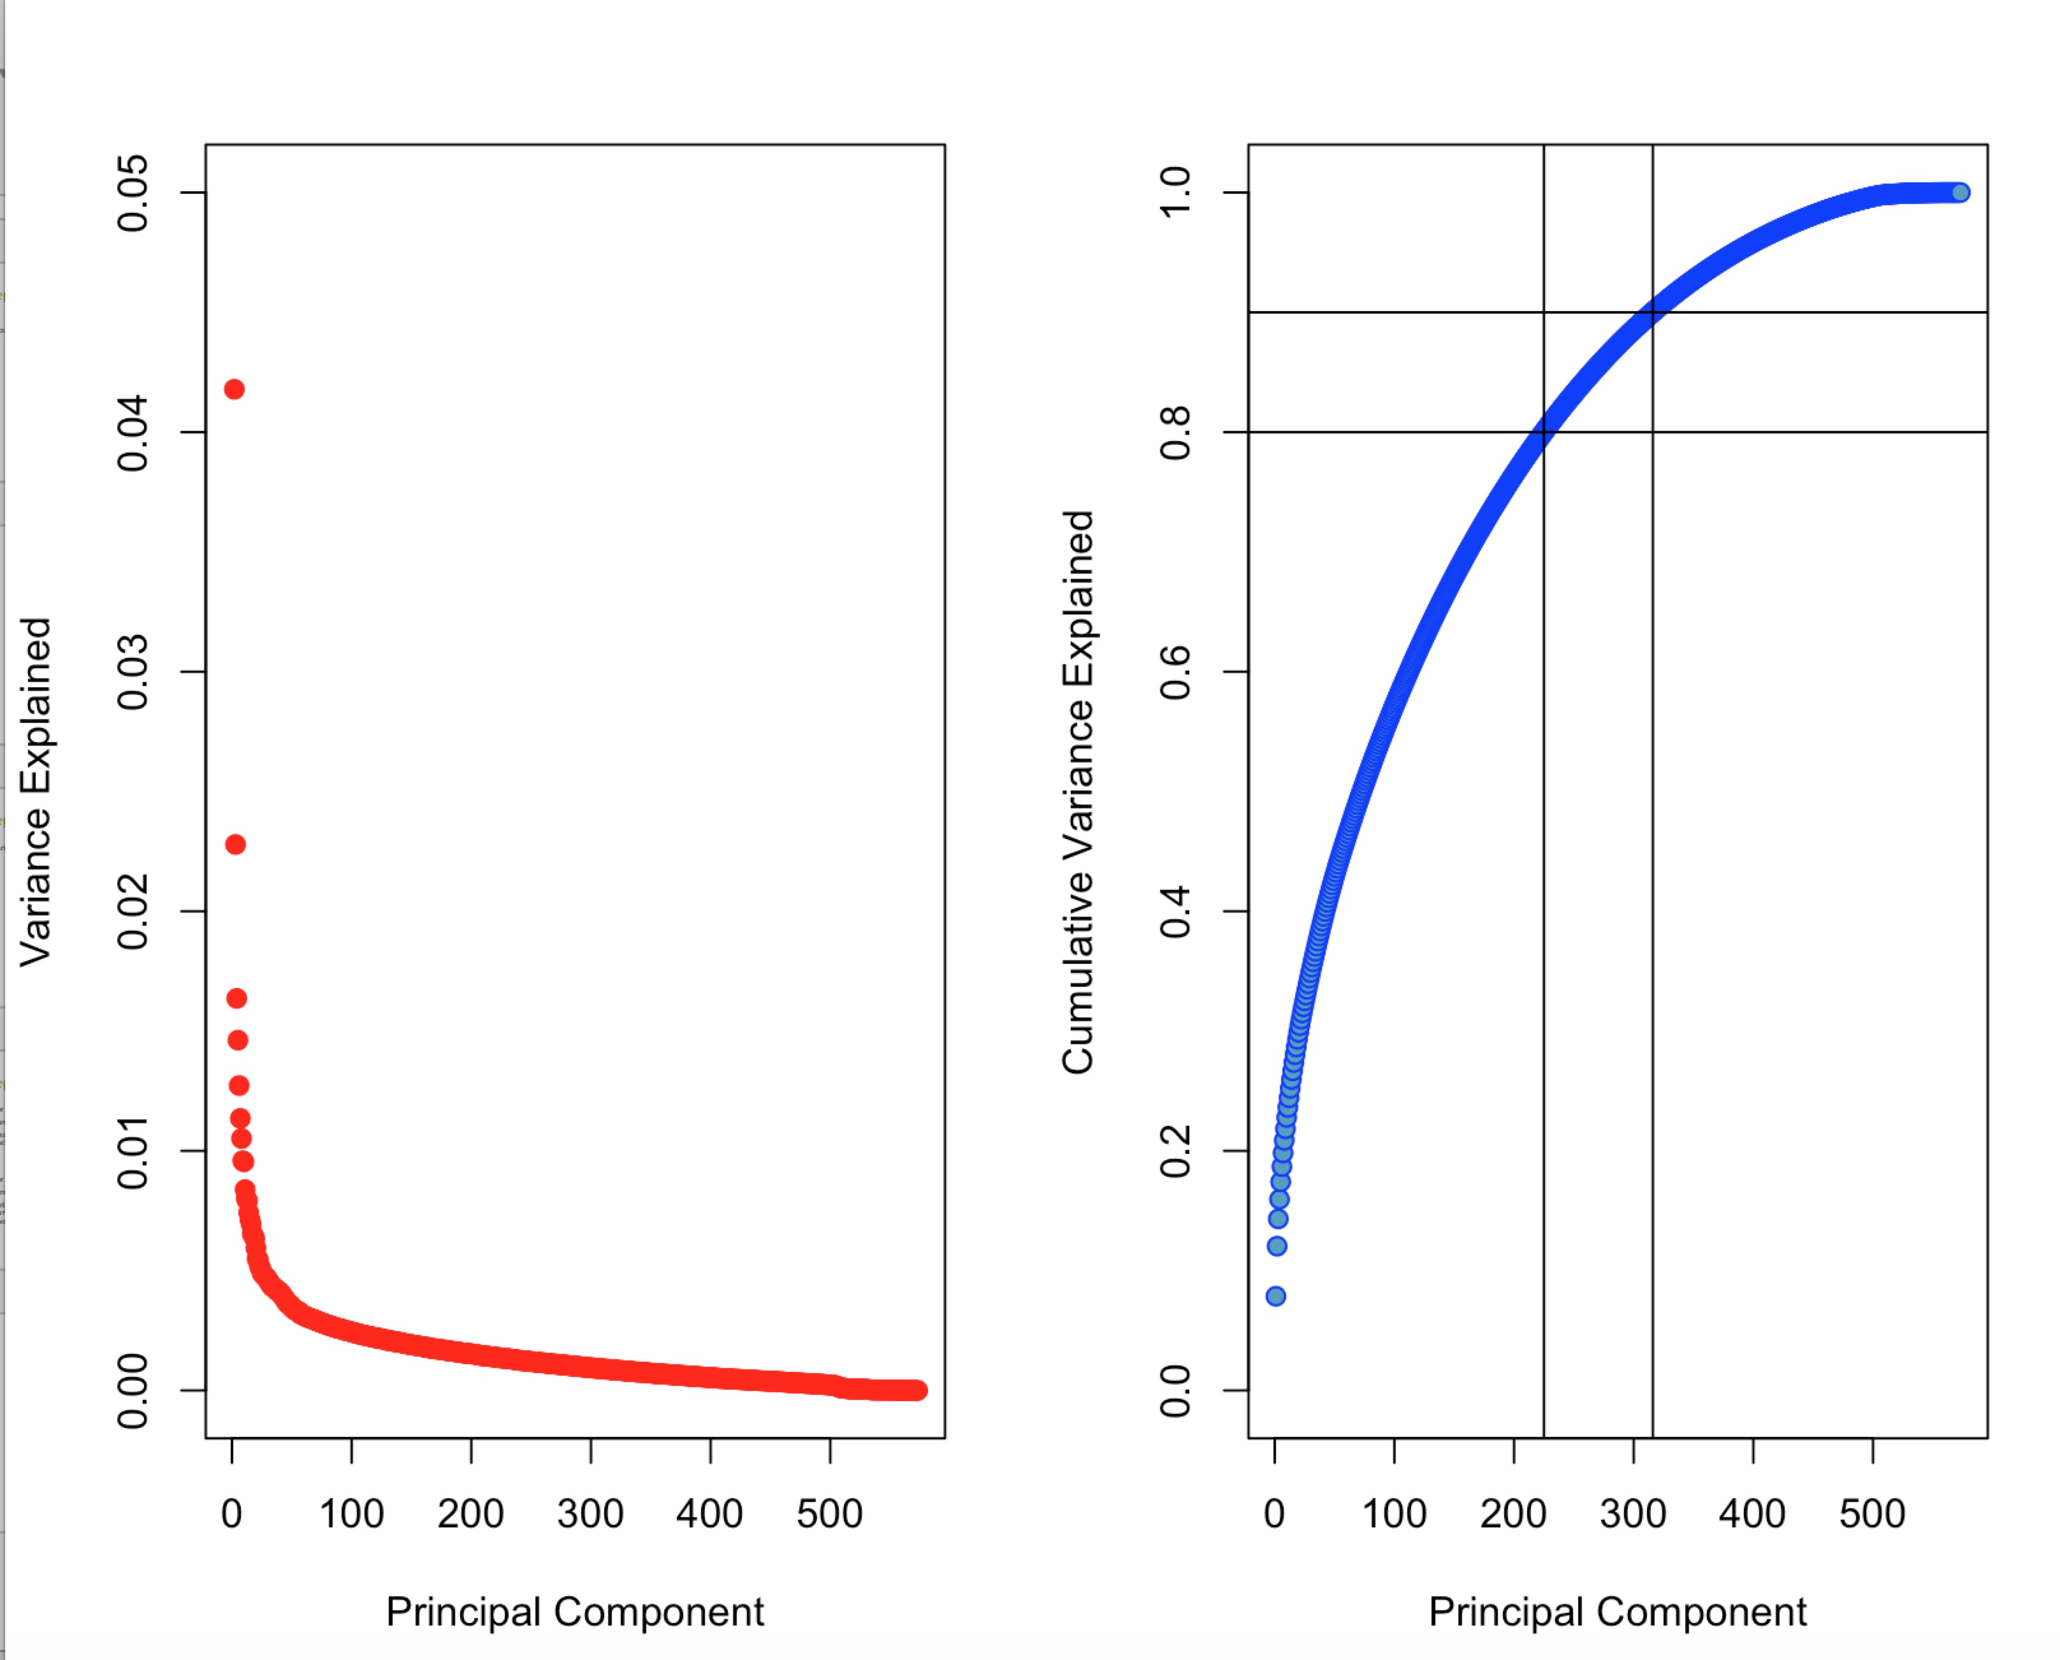

Step 3 Make prediction using Multinomial regression
To get $P$, using PCA
feature_matrix_pca <- prcomp(feature_matrix, center = TRUE, scale = TRUE )

Slide 16
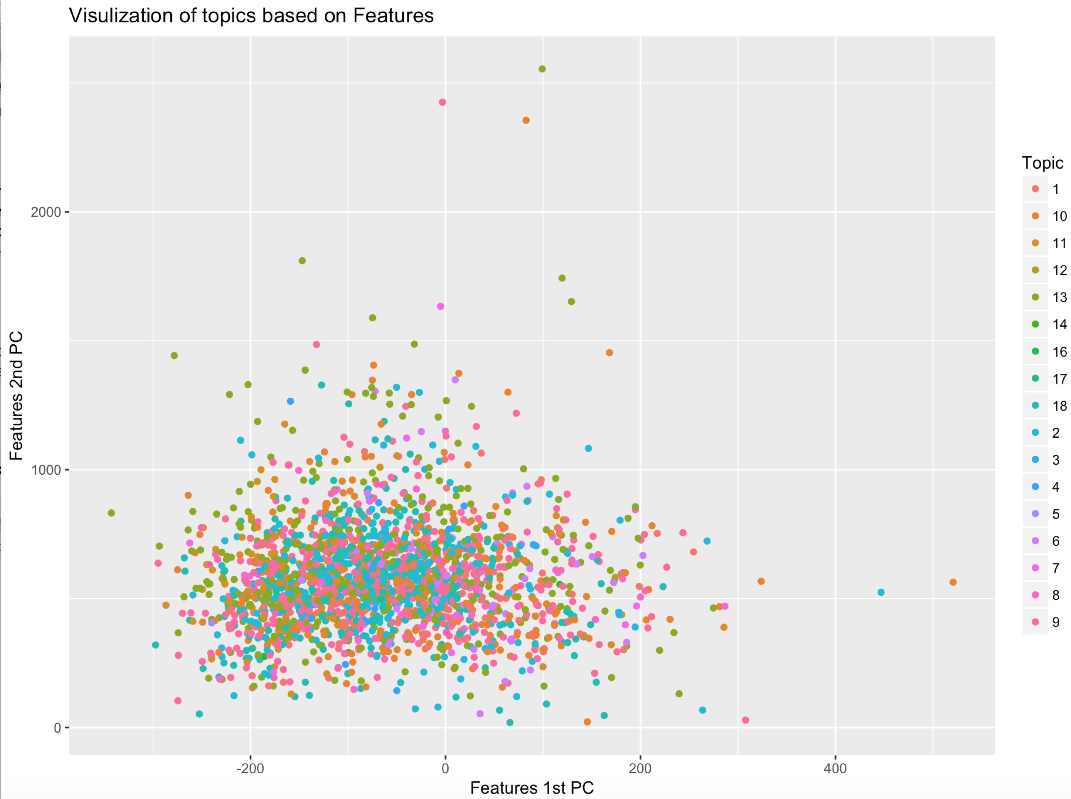
Step 3 Make prediction using Multinomial regression
Visualization of Topics in First two PCs of Feature Matrix

Slide 17
Step 3 Make prediction using Multinomial regression
Choose first 30 to 50 PCs, Construct new feature matrix
feature_30dim <- feature_matrix %*% feature_matrix_pca$rotation[,1:30]

Slide 18
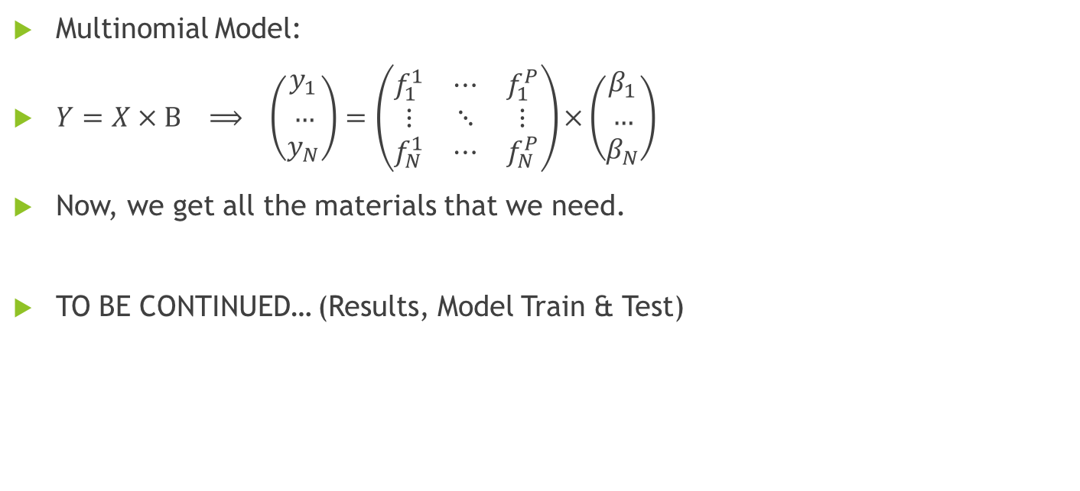
Step 3 Make prediction using Multinomial regression
Multinomial Model:
$Y=X × Β ⟹ \left(\begin{matrix}y_{1} \\ … \\ y_{N}\end{matrix}\right)=\left(\begin{matrix}f_{1}^{1} & ⋯ & f_{1}^{P} \\ ⋮ & ⋱ & ⋮ \\ f_{N}^{1} & ⋯ & f_{N}^{P}\end{matrix}\right)×\left(\begin{matrix}β_{1} \\ … \\ β_{N}\end{matrix}\right)$
Now, we get all the materials that we need.
TO BE CONTINUED… (Results, Model Train & Test)

Slide 19
THANK YOU FOR LISTENING! Any Question?

