Slide 1


DJI Trading Strategies Based on Daily News
Presented by Group 13

Slide 2
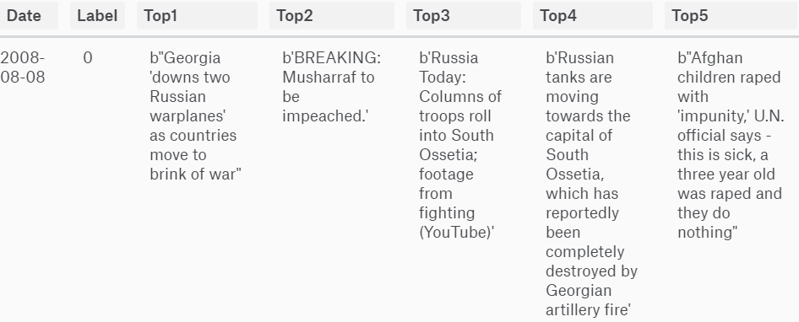
Data Set – News(X)
Top 25 news headlines from Reddit WorldNews Channel
Range: 2008-08-08 to 2016-07-01(i.e. 1988 observations)
Notes:
Social news and -media aggregation. Users can vote to decide the positions on the site’s page, so it reflects the taste of general public, thus a good source for the sentiment of stock market

Slide 3
Data Set – Stock Price(Y)
Dow Jones Industrial Average (DJIA)
Range: 2008-08-08 to 2016-07-01
Simplification: only concerned about whether DJIA is up (1) or down(0) on the next day

Slide 4
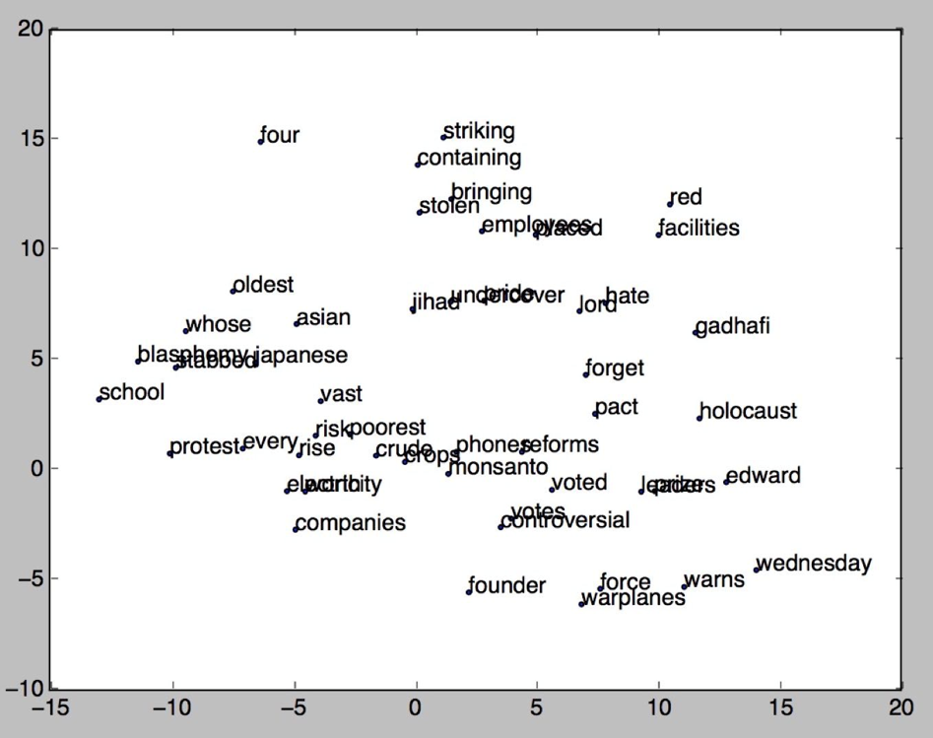
Feature Extraction - WordtoVec
Word to Vector (in R³⁰⁰ )
50 Most frequent words are shown
For each day, calculate the center
of all the points
Feature of 300 dimensions

Slide 5
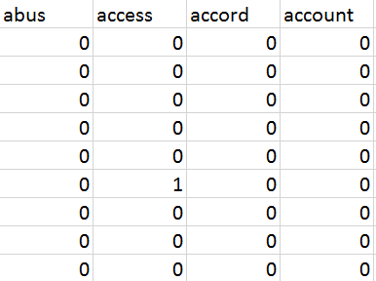
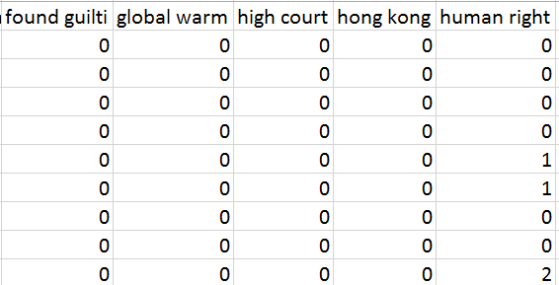
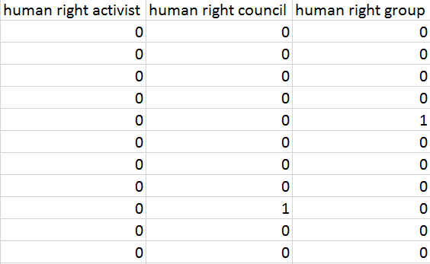
Feature Extraction - DTM
document term matrix
1-gram, 2-gram, 3-gram
Feature of 730 dimensions
In total, 1030 features = 300 (W2V) + 730 (DTM)

Slide 6
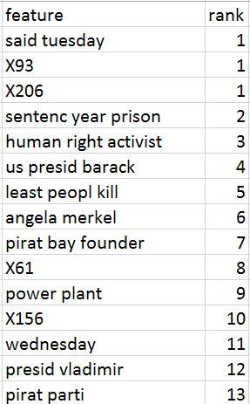
Feature/Model Selection
Feature Selection:
Recursive Elimination Algorithm
Cross Validation
Model Selection:
Random Forest
KNN
Naïve Bayes
Result:
KNN with 9 neighbors with 45 top features

Slide 7
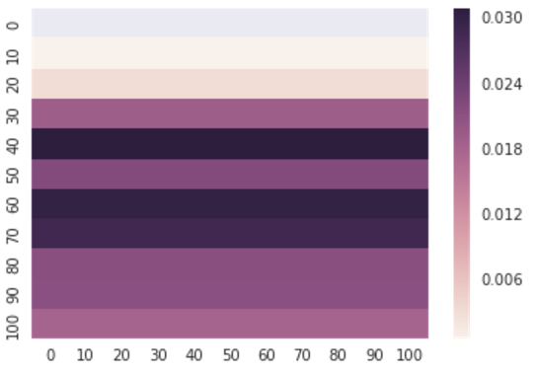
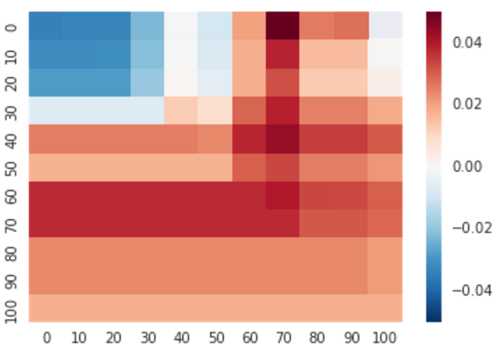
Prediction
Label Accuracy Rate: 56.94%
Threshold Optimization:
Algorithm: gird search optimization (maximize Sharpe Ratio)
Long-only strategy: < 0.4, labelled 1; >0.4 labelled 0
Long-short strategy: <0.4, labelled 1; >0.7, labelled 0
Optimization Result:
Benchmark (DJIA): Sharpe Ratio 0.011
Long-only strategy: Sharpe Ratio 0.044
Long-short strategy: Sharpe Ratio 0.040

Slide 8
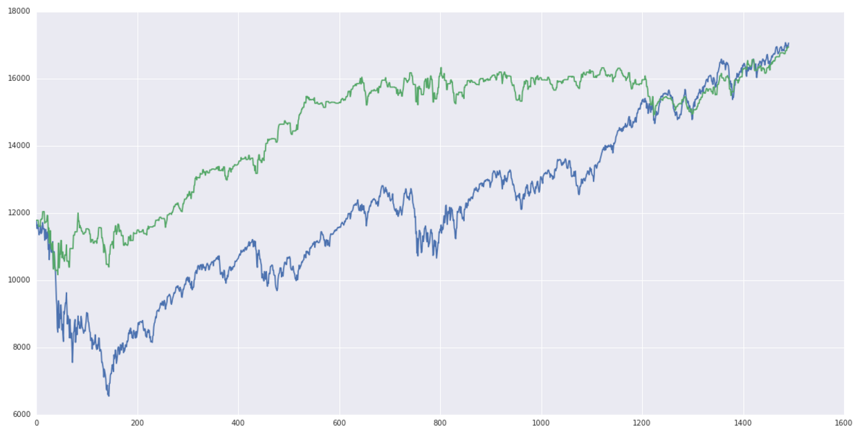
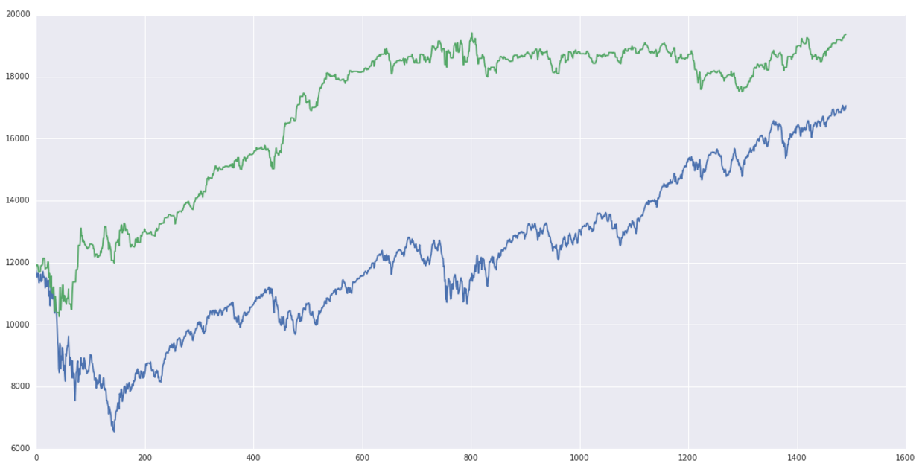
Trading Strategy on Training Set
Long-only (0.4 thresholds)
Long-short (0.4, 0.7 thresholds)

Slide 9
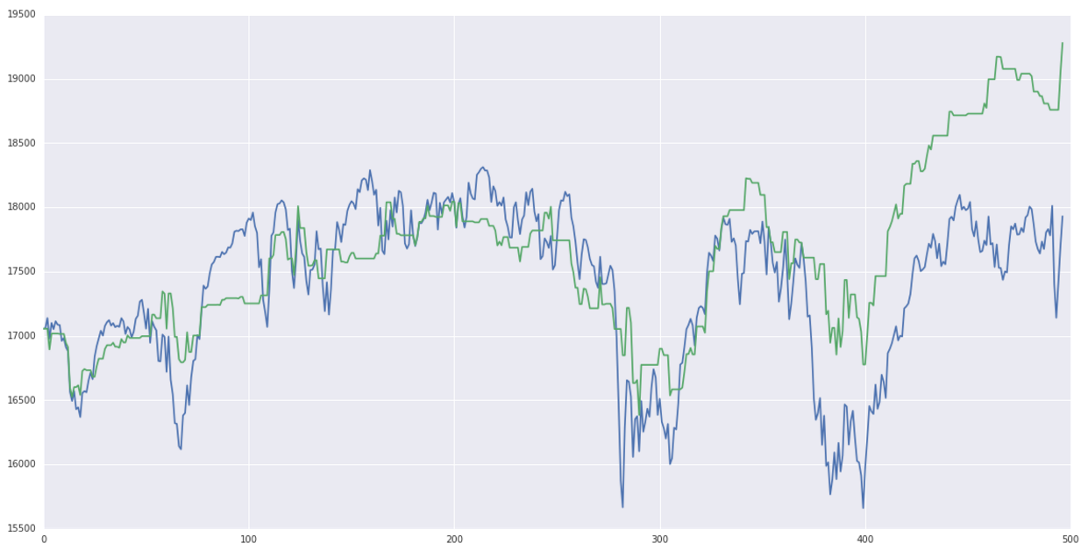
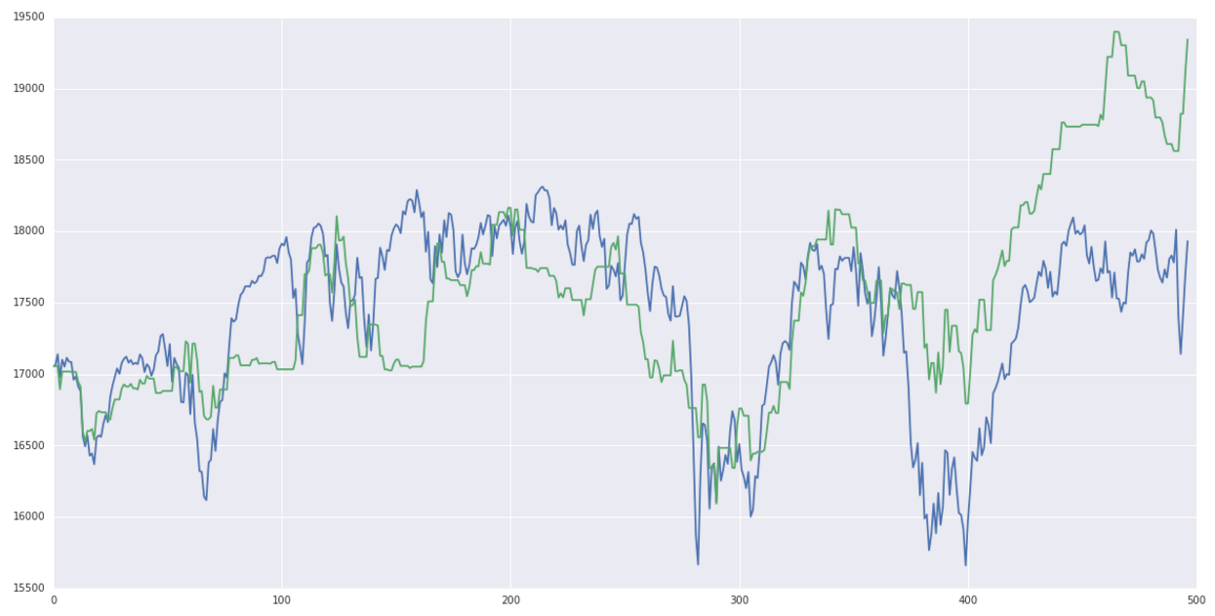
Trading Strategy on Testing Set
Long-only (0.4 thresholds)
Long-short (0.4, 0.7 thresholds)

Slide 10
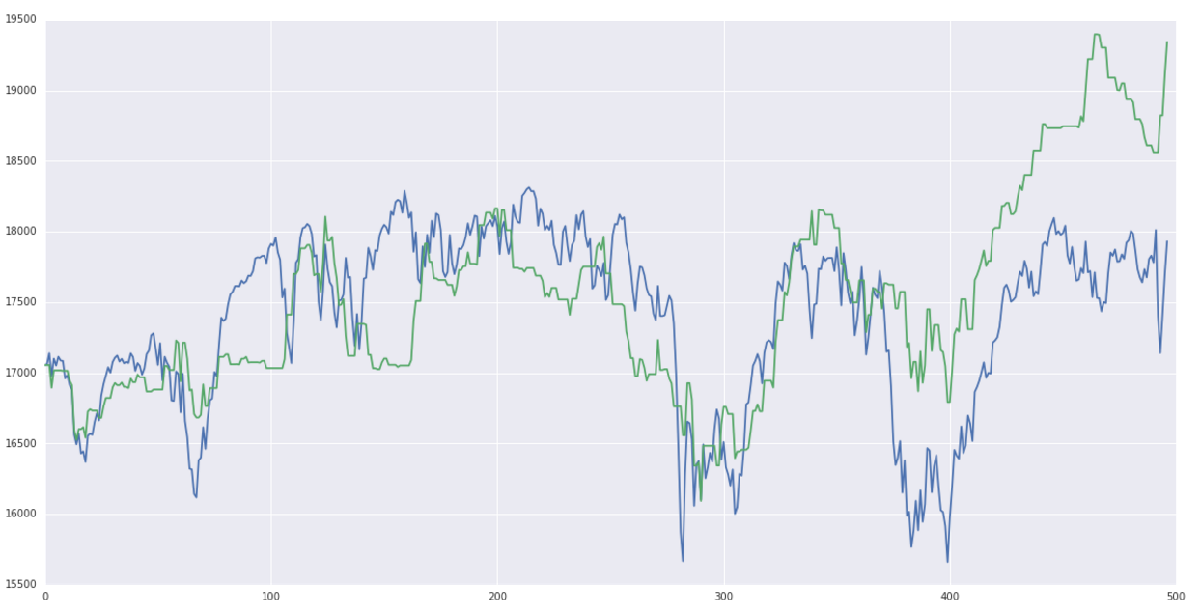
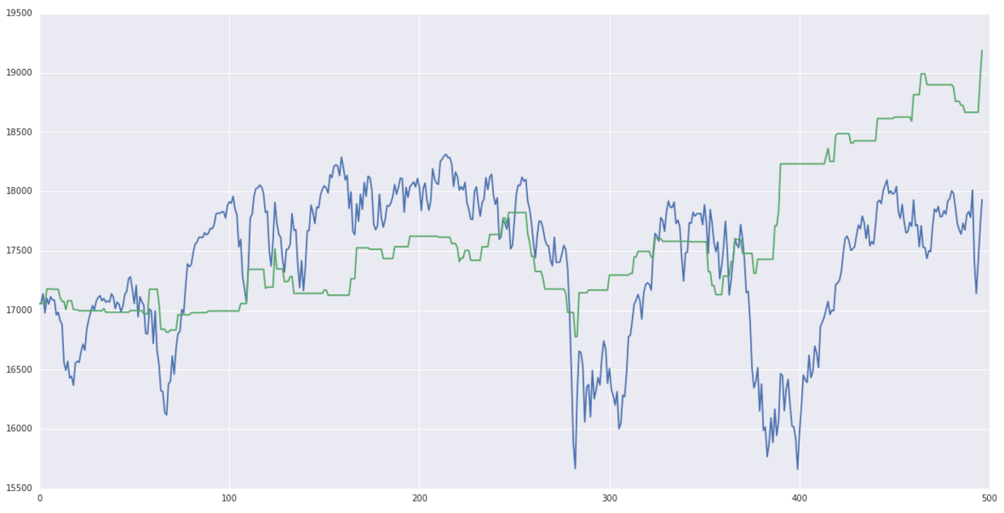
Problem
Long-short (0.4, 0.7 thresholds)
Long-short (0.2, 0.9 threshold)

