Slide 1
Santander Product Recommendation
Chenxi (Celia) Huang
The Santander Data Group

Slide 2
Today’s Agenda
Project Description
Data Processing
Feature Engineering
Model Selection
Future Considerations

Slide 3
Project Description
Project Nature:
Product Recommendation
Our Goal:
Based on customers’ past behaviors and those of similar customers,
to predict which products their existing customers will use in the next month.
The Data
13 million x (24 features + 24 labels)

Slide 4
Data processing & cleaning
Super Large Data Set
Sampling
13 million to 1 million
Empty Strings: “”
Treating as one factor level
Assign “unknown”
Missing Values: NA
Filling case by case
11 Columns,
by observations

Slide 5
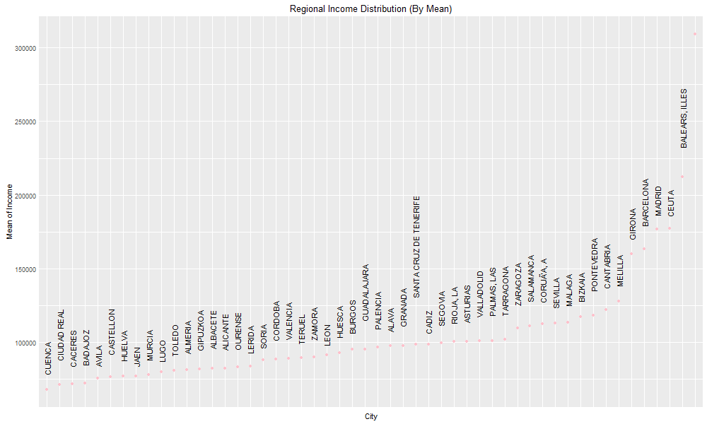
How to 1. By total Average? 2. By cities!
Filling in missing values for example: income

Slide 6
Feature Engineering
Does time matter?
e.g. created “month’ feature (Christmas would buy more?).
Cross-validation error rate from 9% to 10% in the same model → abandoned
How to create features to reflect past behaviors?
Thoughts: can current situations be used to predict future (martingale)?
Solutions: Appending current month’s labels to original features
24 more features for each data
New Features |  | New Labels
April’s Features | April’s Labels | May’s Labels

Slide 7
Model Selection
What is the problem?
Multi-label Classification
Our Models (what we can do in R)
Baseline ( = clustering?)
rFerns in mlR
XGBoosting
Random Forrest
SVM
Not in R: ML-KNN, Neural Networks.

Slide 8
Baseline Model
1. Method
(1) Only Feature: customer ID (ignore all other features, e.g. cities, age, income.)
Just consider the past purchasing behaviors of a certain customer A
(2) Assign Predicated Value = Majority Label
Calculated means of each label column for customer A
If P(A purchases product 1) > 0.5, then predict yes (assign label value = 1)
If P(A purchases product 1) <= 0.5, then predict yes (assign label value = 0)
2. Cross Validation Error Rate = 0.87% (K=5)
3. Pros & Cons
Advantages | Disadvantages
no brainer. easy to understand and compute. Great performance | not using most features, in a sense similar to guessing

Slide 9
Multi-label Classification in R {mlR} rFerns
1. Method
{mlR} Machine Learning in R, came out in Oct 2016
Problem transformation methods (transform into binary/multiclass classification)
Algorithm adaptation method (adapt multiclass algorithms so they can be applied directly)
2. Cross Validation Error Rate = 24%
3. Pros & Cons
K=5 | Regular Method | Regular Method + Added Features
Error Rate | 24.00% | 30.18%
Advantages | Disadvantages
predicting all labels at the same time. | demanding requirements on the format of the data, e.g. Labels = logicals
convenient & neat technique. | not very good results

Slide 10
XG Boosting
1. Method
predicting labels column by column
2. Error Rate = 0.3%
3. Pros & Cons
K=5 | Regular Method | Regular Method + Added Features
Error Rate | 4.12% | 0.29%
Advantages | Disadvantages
Great Performance | doesn't not take into account any of the prior months – strong assumption on the data!
Simply Implementation

Slide 11
Random forest
1. Method
Predicting labels column by column
2. Error Rate =
3. Pros & Cons
K=5 | Regular Method | Regular Method + Added Features
Error Rate | 4.09% | 3.81%
Advantages | Disadvantages
enhance the strength of the model through averaging the results | Not very consistent outcomes among labels. 99.99% Vs 74.56%
Good results | Improvement not enhanced by a lot

Slide 12
SVM
1. Method
Predicting labels column by column
2. Error Rate = 4.66%
Tuning parameter (radial kernel, default gamma, cost = 0.001)
3. Pros & Cons
Advantages | Disadvantages
Widely used model, stable | Hard to tune Takes way too long time
easy to interpret | Once can fit only one Column of labels
Good results

Slide 13
conclusions
1. Feature Selection
Appending labels as new features is working!
Sometimes less is more (baseline)!
2. Model Selection
Direct Multi-label Classification in {mlR} doesn’t work too well here.
XG boosting is the best
2. How to choose in the end?
Baseline: stable
New Features: strong assumptions. Works in the short-run.
XG Boosting + New Features is our selected model

Slide 14
Future considerations
The main objective of the project: predict additional products next month
The error rate reflects which products will be owned,
not which products were recently acquired
Feature Engineering
hard to incorporate past behaviors into account
append baseline labels as features?
Combined Model
by model votes and majority labels?
R Shiny?

Slide 15
references
https://mlr-org.github.io/mlr-tutorial/release/html/multilabel/index.html#predict
https://en.wikipedia.org/wiki/Multi-label_classification
https://www.kaggle.com/c/santander-product-recommendation
https://cran.r-project.org/web/packages/MLPUGS/vignettes/tutorial.html
And many more!

Slide 16
The end Thank you!

