Slide 1
Dogs or Fried Chicken or Blueberry Muffins?
GROUP 5

Slide 2
introduction
In this project, we applied different machine learning algorithms to train a method to recognize dogs, fried chicken and blueberry muffins. Following are our steps:
Feature Extraction (SIFT + GIST)
SVM (linear and non-linear)
Random Forest
XGBoost
GBM (Baseline)

Slide 3
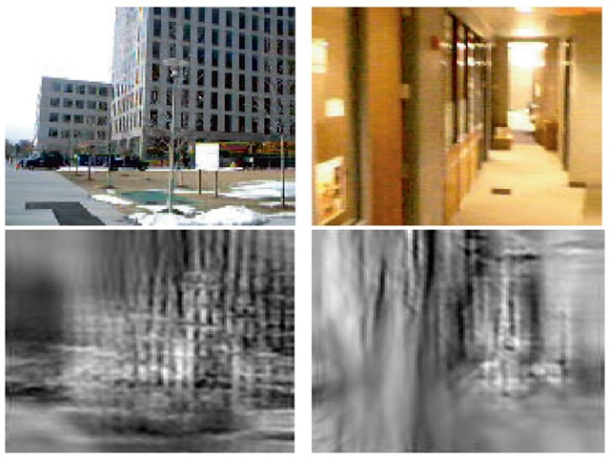
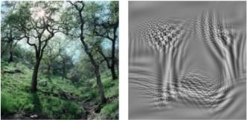
FEATURE EXTRACTION
GIST includes all levels of visual information—ranging from low-level features (e.g., color, contours) to intermediate (e.g., shapes, texture regions) and high-level information (e.g., activation of semantic knowledge)

Slide 4
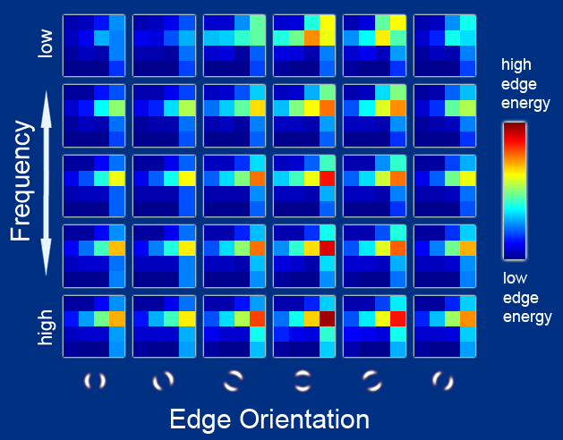
FEATURE EXTRACTION
GIST summarizes the gradient information (scales and orientations) for different parts of an image, which provides a rough description (the gist) of the scene.
Step 1: Consider 3 color channels (Red, Green, Blue)
Step 2: Divide each feature map into 16 regions (by a 4x4 grid), and then average the feature values within each region
Step 3: Convolve the image with 8 orientations for the two finer scales and 4 orientations for the coarser scale, producing 20 feature maps of the same size of the input image.
Thus, in total, we can get 3 x 16 x (8 + 8 + 4) = 3 x 320 = 960 GIST descriptors for each image.

Slide 5
SIFT VS GIST
Dimension
Field
Speed

Slide 6
CoMPARISON of accuracy
SVM (linear): 71.7%
Random Forest: 71.3%
GBM: 75.5%
XGBoost: 89.6%

Slide 7
XGBoost
XGBoost is an optimized distributed gradient boosting library designed to be highly efficient, flexible and portable. It implements machine learning algorithms under the Gradient Boosting framework.

Slide 8
Training process (XGBOOST)
Split the data (33% test data, 67% train data)
Run the CV on the training set
Select the parameters with lowest CV error rate
Use the selected parameters to train the entire training set

Slide 9
XGBOOST VS GBM
1. Regularization:
Compared to standard GBM implementation, XGBoost has regularization, which helps to reduce overfitting.
2. Parallel Processing:
XGBoost implements parallel processing and is blazingly faster as compared to GBM.
3. Tree Pruning:
A GBM would stop splitting a node when it encounters a negative loss in the split. Thus it is more of a greedy algorithm. On the other hand, XGBoost make splits up to the max depth specified and then start pruning the tree backwards and remove splits beyond which there is no positive gain.

Slide 10
Thank you!

