Slide 1
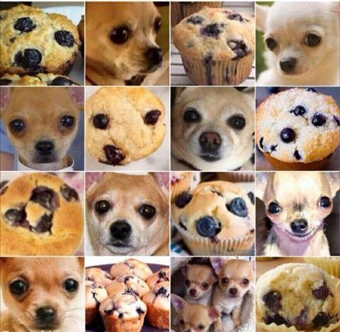
Selection of the best predictive model to classify dogs, fried chicken and blueberry muffins
Team 7: Carantino, Vassily / Gao, Xin / Han, Lin / Li, Yijia / Shi, Qian
Presentation Layout:
Specifying the objective of the study: finding the best predictive model to classify dogs, fried chicken and blueberry muffins
Improvement strategies for classification using SIFT features
Exploring other options for feature extraction
Comparison of different strategies combination
Recommendation

Slide 2
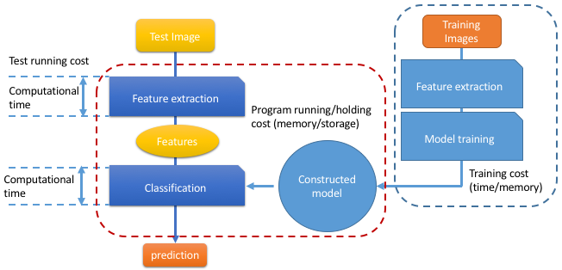
1) Objective of the study: finding the best predictive model to classify dogs, fried chicken and blueberry muffins
What is the “best” predictive model ?
Our interest is not only the predictive power of the model but also:
the ease of reproducibility
the portability of the strategy:
Computational speed
Memory use
For this, we can play on two levers:
the feature extraction model
the classification model
We are going to find strategies to improve the current model –using boosted decision stumps on SIFT features – with a reasonable reproducibility and portability.

Slide 3
2) Other classification strategies outperform GBM using SIFT features
For each algoritghm, explain the parameters found using CV, and advantage / drawback as compared to GBM

Slide 4
3) Different strategies are possible for feature extraction
Explain the different algorithm used for feature extraction here, how do they work, differences, advantage

Slide 5
4) What combination of features extraction and classification strategies work the best ?
Insert comparative table !

Slide 6
5) Recommendation for a reproducible and portable classification engine:
Final recommendation, comparison with initial situation, improvement made

Slide 7
In this project, we created a classification engine for images of Dogs, images of Fried Chicken and images of Blueberry Muffins. We set our baseline model using SIFT features and gradient boosting machine(GBM) classifier. Besides the SIFT features, we also used HOG, RGB and HSV to do feature selection. In terms of classifiers, we considered SVM(linear and non-linear), Random Forest, XGBoost and Neural Network. After model evaluation and comparison, the final advanced model we selected is using RGB feature and XGBoost classifier. We increased the accuracy by 12.25% and only took 13.94% of running time as in baseline model.

