Slide 1
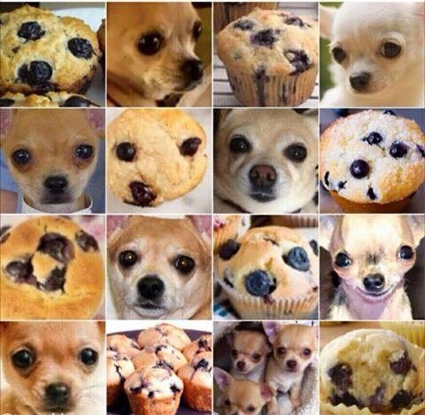
Selection of the best predictive model to classify dogs, fried chicken and blueberry muffins
Team 7: Carantino, Vassily / Gao, Xin / Han, Lin / Li, Yijia / Shi, Qian
Presentation Layout:
Specifying the objective of the study: finding the best predictive model to classify dogs, fried chicken and blueberry muffins
Analysis of the current model’s performance
Improvement strategies for classification using SIFT features
Exploring other options for feature extraction
Comparison of different strategies combination
Recommendation

Slide 2
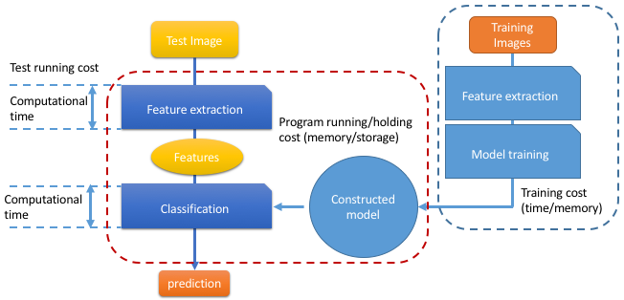
1) Objective of the study: finding the best predictive model to classify dogs, fried chicken and blueberry muffins
What is the “best” predictive model ?
Our interest is not only the predictive power of the model but also:
the ease of reproducibility
the portability of the strategy:
Computational speed
Memory use
For this, we can play on two levers:
the feature extraction model
the classification model
We are going to find strategies to improve the current model –using boosted decision stumps on SIFT features – with a reasonable reproducibility and portability.

Slide 3
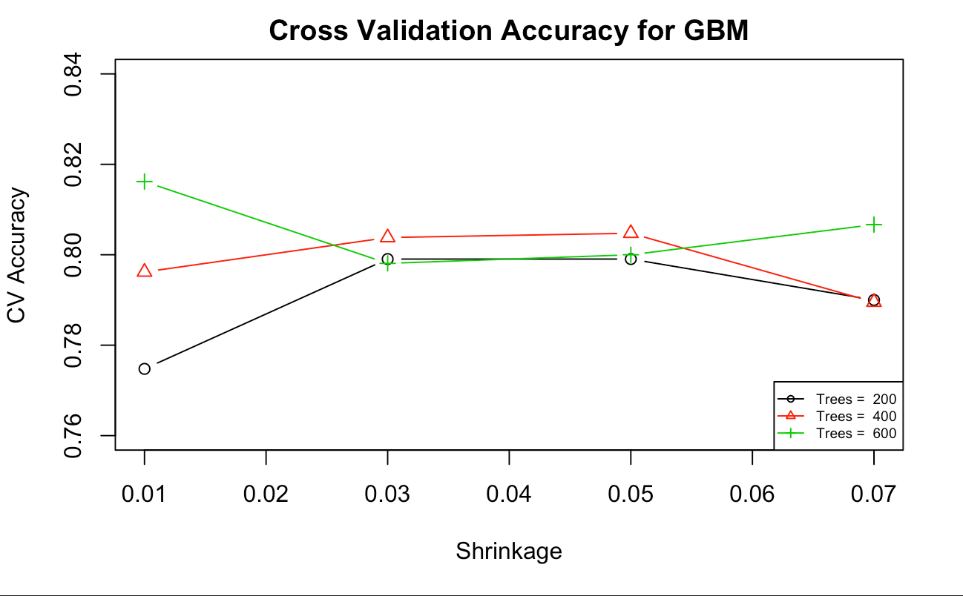
2) What is the performance of the current model ?
1
Feature Extraction using SIFT:
Extracting 5000 features from the 3000 images
Running time:
2
Classification using GBM:
Parameters Choice & Performance
Method:
we used Cross-Validation on a training data set to estimate the model parameters
we set interaction depth fixed to 3, and chose to test the:
trees numbers from 200 to 600
shrinkage values from 0.01 to 0.07
Parameters value chosen:
depth = 3, nb trees = 600, shrinkage = 0.07
Performance:
the GBM has an accuracy of 80.8% for a running time of 401.7s on the test set.
Set interaction depth fixed to 3, trees numbers from 200 to 600, and shrinkage values from 0.01 to 0.07 by 0.02.
Although the best parameters for GBM model is shrinkage = 0.01 and n.trees = 600. However, this accuracy is greater than 80%. In order to avoid overfitting, choose parameters corresponding to the second largest accuracy, that is shrinkage = 0.07 and n.trees = 600. The green "+" at the end.

Slide 4
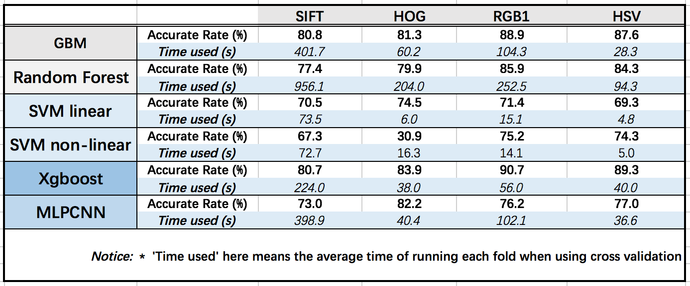
3) Is there any other classification strategies doing better than GBM on SIFT features ?
Methodology used
We try to find models that outperforms GBM model on the classification of SIFT features. For all models:
we used the same SIFT features
we selected the model parameters using Cross-Validation on a training data set
We estimated the accuracy of the model on a test-set
The baseline GBM model is the most accurate model tested on SIFT features, with an accuracy of 80.8%
The XGBoost model allows us to reach an almost equivalent accuracy in half the computation time:
Accuracy of 80.7% (vs. 80.8% for GBM)
Running time of 224s (vs. 402s for GBM)
→ According to our objective, XGBoost is a better classification model than GBM on SIFT features.

Slide 5
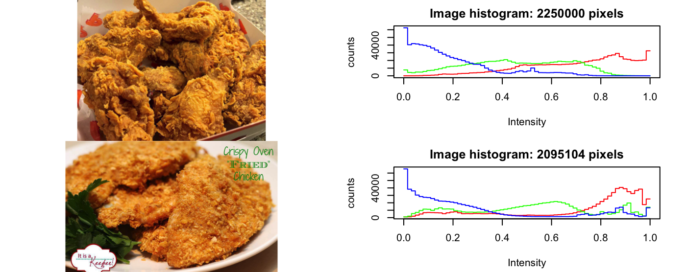
4) Different strategies are possible for feature extraction
1
SIFT: The scale-invariant feature transform (SIFT) is used to detect and describe local features in images. Here we use 5000 features and Matlab libraries.
2
HOG: The histogram of oriented gradients (HOG) is a technique that counts occurrences of gradient orientation in localized portions of an image. Here we set cells=8 and orientation=9 and used R.
3
HSV: The HSV (Hue, Saturation, Value) representation models the way paints of different colors mix together. Here we used parameters: nH= 10, nS=6 and nV= 6 and used R.
4
RGB: We analyze the Red, Green and Blue components of the images. The blue component is a good differentiator between nuggets and dog, while the green component distinguishes muffin from nuggets and dog. This is a key point for extracting RGB features.
We set red element to be 10, blue element to be 12,
and green element to be 12 and used R.

Slide 6
5) What combination of features extraction and classification strategies work the best ?
Insert comparative table !
The initial SIFT extraction model is outperformed by other method tested for almost every classifier
The RGB1 extraction model allows the best accuracy for 4 classifiers: GBM, SVM Linear and Non linear and XGBoost
The combination of RGB1 with an XGBoost model allows us to reach the best accuracy: 90.7% (vs. 80.8% for the base model) in a shorter running time: 56s (vs. 401s for the base model)

Slide 7
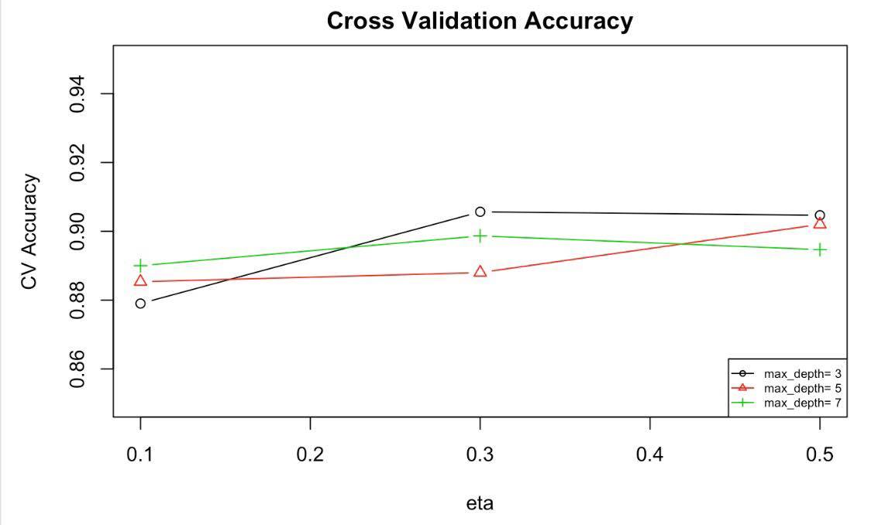
6) Recommendation for a reproducible and portable classification engine:
We recommend using the RGB1 feature extractor along with the XGBoost classifier, which gives the best accuracy: 90.7% in a short running time: 56s (vs. 401s for the base model)
We increased the accuracy by 12.25 points and only took 13.94% of running time as in baseline model.
1
RGB1 feature extractor:
method:
we tried the same method with 600 (RGB2), 800(RGB0) and 1440 features (RGB1).
we selected 1440 features since it outperformed the other two on every classifier.
Running time: for 3000 images
System time: 187.8 & Running time: 1169.7s
2
XGBoost classifier:
method:
we used Cross-Validation on the training set to fine the best parameters: max_depth in (3,5,7) and eta in (0.1,0.3,0.5)
we select ed max_depth = 3, eta = 0.3
Running time & accuracy: we use K-fold cross-validation to estimate the accuracy of the model: 90.7%. The running time is 56son the test set.

