Slide 1
Image Classification
Group 8 - Shiqi Duan, Jordan Leung, Jingkai Li, Peter Li, Stephanie Park

Slide 2
Agenda
Introduction
Feature extraction
Model selection
Results

Slide 3
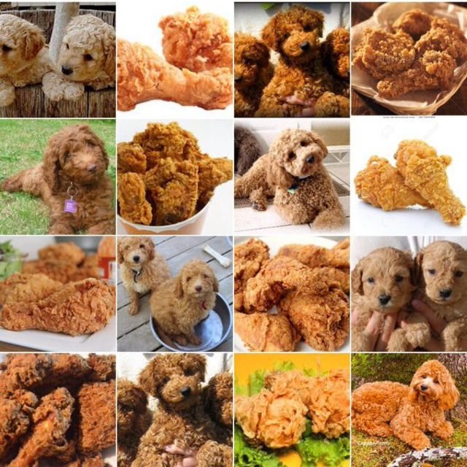
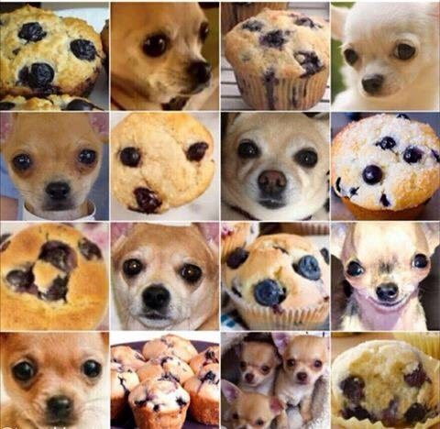
Introduction
Notes:
We did the same project as every other group - image classification. For this project we did a multiclass image classification, trying to classify fried chicken, dogs, and muffins.
So this example doesn’t seem that important, but image classification is a subset of computer vision, which has a lot of practical uses - can be used for image search, facial recognition, on the camera for self driving cars… so it is a very important problem in the world of data science.

Slide 4
Data
3000 Images
25% Testing
75% Training

Slide 5
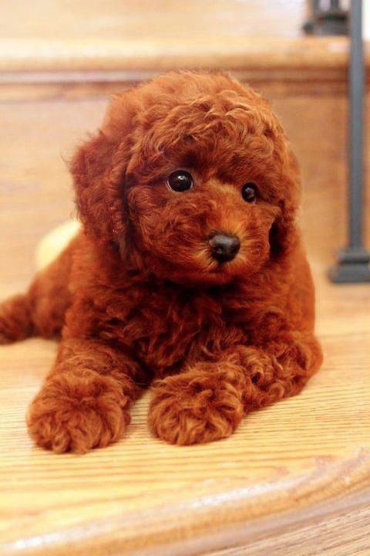
Feature Extraction
Convert contents of an image so that it can be used by classifiers.
Too little features
Not enough detail
Low accuracy
Too many features
Overfit/Not generalizable
Increased training time
Notes:
The first step of image classification is feature extraction, so that we can convert images to a form usable by some of our classifiers.
Here are 3 ways to do feature extraction. There is no best way to find the best amount of features, but the things we want to balance...

Slide 6
Feature Extraction
Convert contents of an image so that it can be used by classifiers.
SIFT
5000 features
GIST
512 features
HOG
54
features
Notes:
The first step of image classification is feature extraction, so that we can convert images to a form usable by some of our classifiers.
Here are 3 ways to do feature extraction. There is no best way to find the best amount of features, but the things we want to balance
We found that

Slide 7
Feature Extraction
Convert contents of an image so that it can be used by classifiers.
SIFT
5000 features
GIST
512 features
Training Time
HOG
54
features
Notes:
The first step of image classification is feature extraction, so that we can convert images to a form usable by some of our classifiers.
Here are 3 ways to do feature extraction. There is no best way to find the best amount of features, but the things we want to balance
We found that training time is drastically decreased with less features, without any loss in accuracy, so we decided to use HOG features.

Slide 8
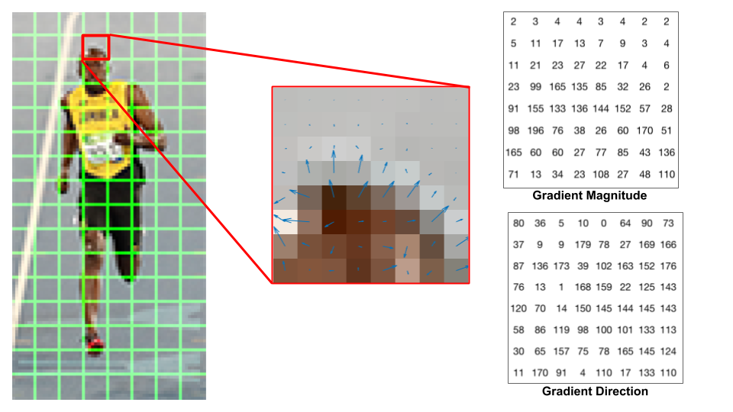
HOG - Histogram of Oriented Gradients
Saya Malick, Learn OpenCV
Notes:
A quick explanation of HOG - Histogram of Oriented Gradients.
It divides an image into partitions, and in each of these partitions it look for edges of an image…
So you can see here on usain bolt’s head it is detecting a edge. It gives the magnitude and also direction.
Magnitude is the strength, and direction is the direction. Direction is on a scale from 0 to 180, it is like an absolute direction, which makes sense because you are just concerned with edge detection.

Slide 9
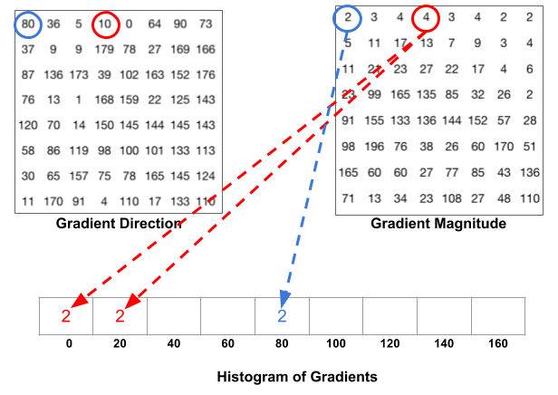
HOG - Histogram of Gradients
Saya Malick, Learn OpenCV
Notes:
Then it bins each of the magnitudes according to the gradient direction.
Note - are up to 180, so the two gradients in opposite direction have the same value… Makes sense because an edge is an edge. 180 shows better performance than scaling it from 0 to 360.
If it is on the boundary of gradients then it will split the magnitude.

Slide 10
Model Comparison - SIFT
GBM
SVM
(RBF)
SVM (Lin.)
LOG
XGB
RF
CV error
23.4%
Test error
23.1%
Train time
66.9 secs
Class. Time
10.8 secs
CV error
17.7%
Test error
17.8%
Train time
57.0secs
Class. Time
5.89 secs
CV error
30.6%
Test error
17.9%
Train time
62.3 secs
Class. Time
5.9 secs
CV error
27.3%
Test error
27.2%
Train time
190.9 secs
Class. Time
3.1 secs
CV error
20.1%
Test error
17.6%
Train time
245.6 secs
Class. Time
1.0 secs
CV error
24.8%
Test error
25.0%
Train time
235.6 secs
Class. Time
0.27 secs
Notes:
Our baseline model is here in blue, so we are measuring improvement in performance against the GBM model on SIFT features.

Slide 11
Model Comparison - HOG
GBM
SVM
(RBF)
SVM (Lin.)
LOG
XGB
RF
CV error
24.1%
Test error
26.4%
Train time
16.7 secs
Class. Time
0.9 secs
CV error
21.5%
Test error
20.0%
Train time
1.4 secs
Class. Time
0.15 secs
CV error
31.2%
Test error
29.6%
Train time
1.1 secs
Class. Time
0.1 secs
CV error
21.9%
Test error
22.8%
Train time
0.6 secs
Class. Time
0.01 secs
CV error
20.5%
Test error
20.9%
Train time
5.0 secs
Class. Time
0.5 secs
CV error
19.8%
Test error
25.1%
Train time
34.4 secs
Class. Time
0.1 secs

Slide 12
Model Comparison - HOG
GBM
SVM
(RBF)
SVM (Lin.)
LOG
XGB
RF
CV error
24.1%
Test error
26.4%
Train time
16.7 secs
Class. Time
0.9 secs
CV error
21.5%
Test error
20.0%
Train time
1.4 secs
Class. Time
0.15 secs
CV error
31.2%
Test error
29.6%
Train time
1.1 secs
Class. Time
0.1 secs
CV error
21.9%
Test error
22.8%
Train time
0.6 secs
Class. Time
0.01 secs
CV error
20.5%
Test error
20.9%
Train time
5.0 secs
Class. Time
0.5 secs
CV error
19.8%
Test error
25.1%
Train time
34.4 secs
Class. Time
0.1 secs

Slide 13
Ensemble Method - Majority voting
Majority vote using our top 3 models
SVM with RBF Kernel
Logistic Regression
XgBoost
Notes:
Support Vector Machine with Radial basis function Kernel

Slide 14
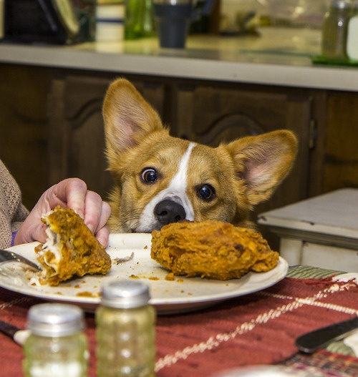
Results
Training time: 66.9 seconds → 7.4 seconds
CV error: 23.4% → 16.9%
Test error: 23.1% → 20.2%

Slide 15
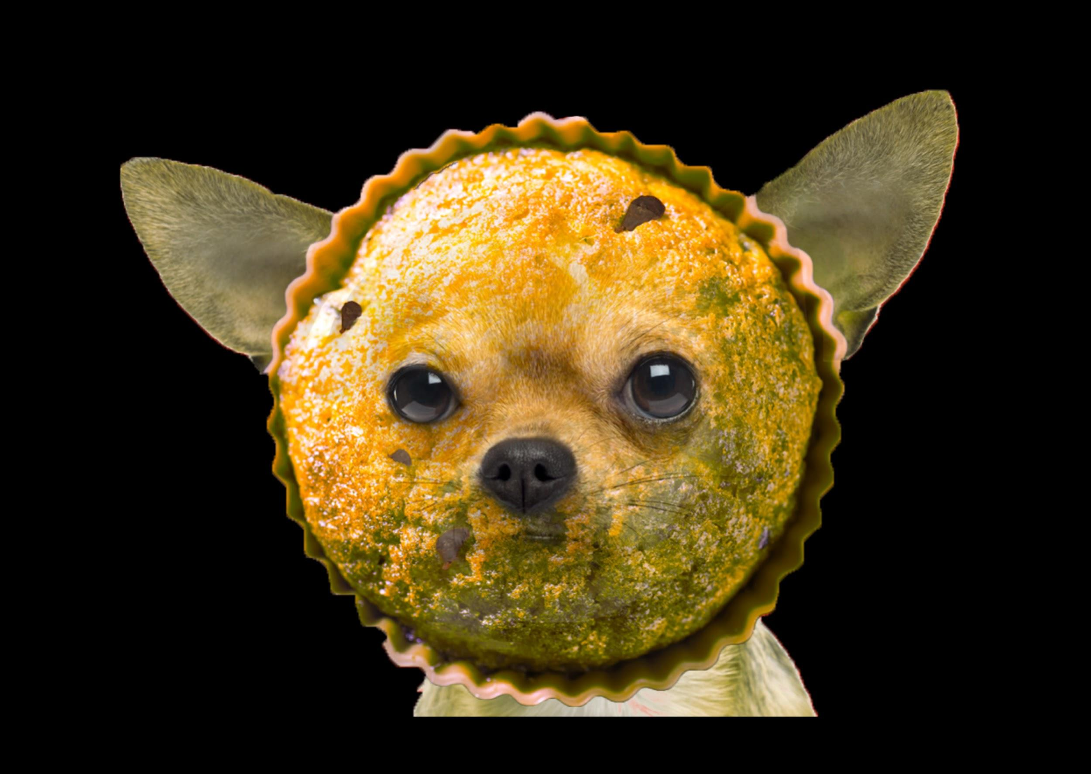
Thank you!
VIew our repository here:
https://github.com/TZstatsADS/Fall2017-project3-fall2017-project3-grp8

