Slide 1
Collaborative Filtering
Group 4: Lin Han, Vassily Carantino, Xinyao Guo, Qihang Li, Qian Shi
Layout:
Purpose of the study and approaches used
How to evaluate the performance of our different algorithms ?
Steps we took in our experimental approach
Finding the best Memory-Base Model
Finding the best Cluster Model
Results & Analysis: What is the best model overall

Slide 2
1) Purpose of the study and approaches we used
Goal of our Study
Experimental Approach
We want to compare different options to perform collaborative filtering on two distinct database.
We need to compare the following things:
Memory-based Algorithm(based on neighbors)
Different combinations of components
Model- based Algorithm
Choose the best meta-parameters
Here are the different steps of our experimental approach:
Find the best Memory-based Algorithm(based on neighbors)
Do predictions based on different combination of components
Evaluate the test data to find best combinations of components
Find the best Model-based Algorithm
Do predictions based on different parameters
Evaluate the test data to find the best parameters
Compare the two and come up with a recommended algorithm for a specific usage.
1
2
3

Slide 3
2) How to evaluate the performance of our different
algorithms ?
1
Web Dataset
Web Dataset: Ranked Scoring: we default alpha=5, d=0.5
2
Movie Dataset
MAE = ABS(Estimation – real score)
Multi-class ROC:
We extend the definition of ROC defined by Hand and Till, to more than 2 classes by averaging pairwise comparisons. This measure reduces to the standard form in the two class case.

Slide 4
3) Steps we took in our experimental approach
1
Memory-based Algorithm
2
Model-based Algorithm
dis-similarity to similarity.
Similarity Weight:
Pearson Correlation: 1,2
Entropy: 1,2
Mean-Square-difference: 1,2
SimRank: 1
Significance Weighting: 1,2
Selecting Neighbors:
Weight Threshold: 1,2
Best-n-estimator: 1,2
Combined: 1,2
Rating Normalization:
Deviation for Mean:1,2
Evaluation: Ranked Scoring for d1, MAE for d2
EM Algorithm(Log-likelihood Function
)
Score Estimation
Evaluation: MAE, ROC

Slide 5
4) Finding the best Memory-based Model
1
MAE for movie Data of Memory-based Algorithm
Analysis
For the Movie Dataset, Significance Weighting seems to be a need to reduce MAE in every combination. In terms of Selecting Neighbors, Weight Threshold outperforms Best-N and Combined Method. For best-N, n=15 outperform n=10.
Specifically, MSE+Significance Weighting+Weigth Threshold(0.85) performs the best. Pearson+Significance Weighting+Weight Threshold(0.5) and Pearson+Significance Weighting+Combined also perform well.

Slide 6
4) Finding the best Memory-based Model
2
Ranked Scoring for Web Dataset
Analysis
For the Microsoft Dataset, in terms of Similarity Weighting, MSE and Entropy outperforms Pearson Correlation in general. In terms of Selecting Neighbors, Weight Threshold seems to be the best in most combinations.
Specifically, Entropy+Significance Weighting+Weight Threshold(0.7) performs the best. MSE+Combined and MSE+Weight Threshold(0.7) also perform well.

Slide 7
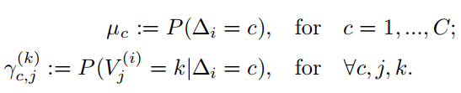
5) Finding the best Cluster Model
Before comparing the Cluster model with the memory-base algorithms respective performance on the Movie Data set we need to train the Cluster model
1
Idea of the Cluster model
idea: there are certain groups or types of users capturing a common set of preferences and taste.
Given a unobserved class variable C, the votes of users for a particular movie are iid
We can use the EM algorithm to learn the parameters:
2
Training the Cluster Model:
Method to find the best number of cluster C
We divide the training set into a sub-training set and a validation set. In the validation set, 70% of the each user’s votes are known, the remaining 30% are predicted.
For each value of C we run the EM algorithm on the sub-training set, and we evaluate the performance metrics on the validation set.
We obtain the following results, the best parameter is C=7
Testing performance:
We ultimately test the performance of the model on the test set with C=7
C | 3 | 5 | 7 | 9
MAE | 1.01345 | 1.00694 | 1.00455 | 1.021888
ROC | 0.2474 | 0.2467 | 0.2445 | 0.2535

Slide 8
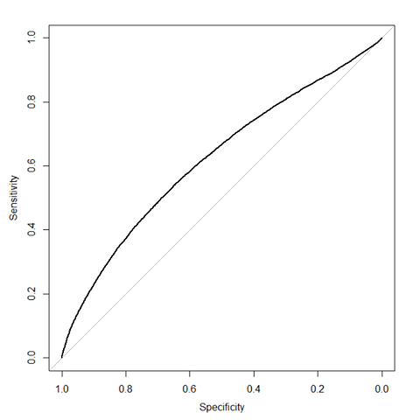
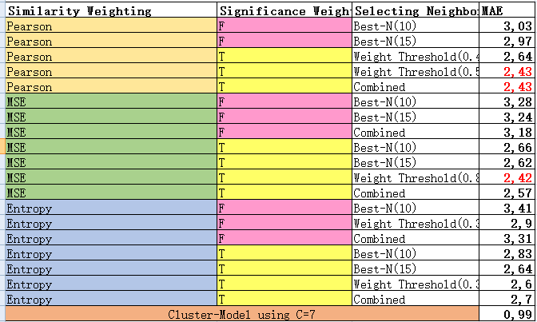
6) Results & Analysis: Comparing all the models
1
Cluster Models Performance
We choose C=7, train on the whole training set, and evaluate on the testing set.
The results are: MAE=0.99195, ROC=0.2397
2
Comparing the performance of all the methods on the Movie Data Set.
Recommendations
The best collaborative filtering algorithm on this data set is our Cluster Model with 7 latent classes.
Let’s note that might not be the case on the Web Data Set, for which our better tested algorithm is the memory-based Entropy+Significance Weighting+Weight Threshold(0.7). We will need to run our cluster model on this data base to conclude.

