Slide 1
Collaborative Filtering Algorithms:
Evaluation and Comparison
Group 7
Pinren Chen (presenter), Fan Gong, Yingbin Jiang, Siyi Wang, Xinhu Wang

Slide 2
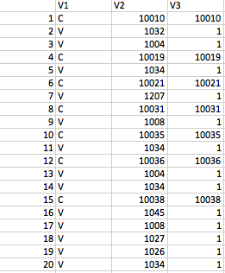
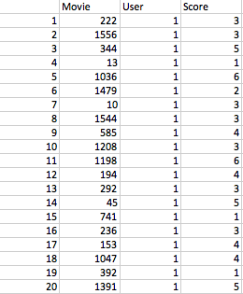
Two Data Sets - Implicit and Explicit Voting
Data Set 1: Anonymous Microsoft Web Data
Data Set 2: Movies Grading Data

Slide 3
Implementation: Variants being tested
Algorithm | Component | Variants | Data
Memory-based Algorithm | Similarity Weight | Pearson Correlation | 1,2
 |  | Vector Similarity | 1,2
 |  | Entropy | 1,2
 |  | SimRank | 2
 | Significance Weighting | No | 1,2
 |  | Yes | 1,2
 | Variance Weighting | No | 1,2
 | Selecting Neighbors | Best-n-estimator | 1,2
 | Rating Normalization | Deviation for Mean | 1,2
 |  | Z-score | 1,2
Model-based Algorithm | Cluster Models |  | 1

Slide 4
Memory-based Algorithm: Pipeline
Step 1: Load data
Step 2: Similarity Weight
Pearson Correlation
Vector Similarity
Entropy
SimRank
Step 3: Significance Weight
Step 4: Selecting Neighbors: Best-n-estimator
Neighbors for Pearson
Neighbors for Pearson w/ significance weighting
Neighbors for Vector Similarity
Neighbors for Entropy
Neighbors for SimRank

Slide 5
Memory-based Algorithm
Step 5: Rating Normalization(prediction)
Deviation for Mean
Z-score
Step 6: Evaluation
Ranked Scoring (for data 1)
Mean Absolute Error (for data 2)
ROC Sensitivity (for data 2)

Slide 6

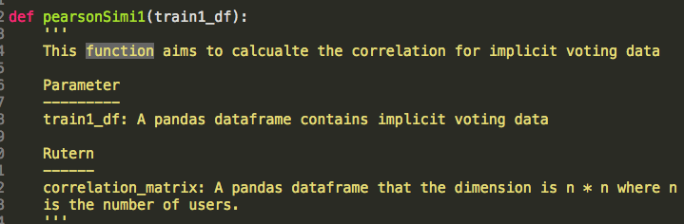
2. Similarity Weight
Pearson correlation
Function:

Slide 7
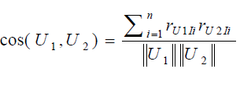
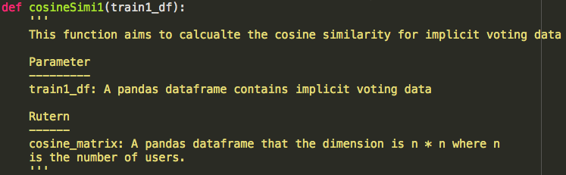
2. Similarity Weight
Vector similarity
Function:
Notes:
calculate the cosine theta to measure the similarity

Slide 8


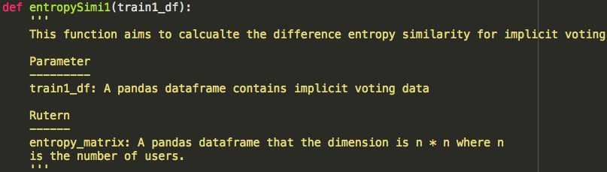
2. Similarity Weight
Entropy
Function:
Notes:
we use weighted difference entropy. First we calculate the rating difference between two users and then based on this distribution we calculate the entropy, finally we assign weights to it. (The larger the difference, the larger the weights)

Slide 9
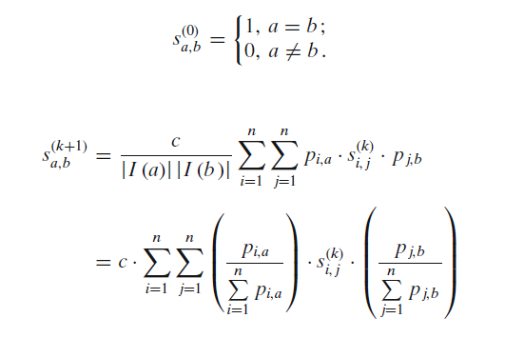
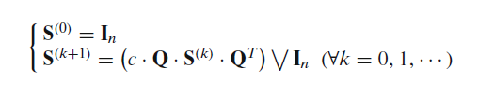
2. Similarity Weight
Simrank

Slide 10
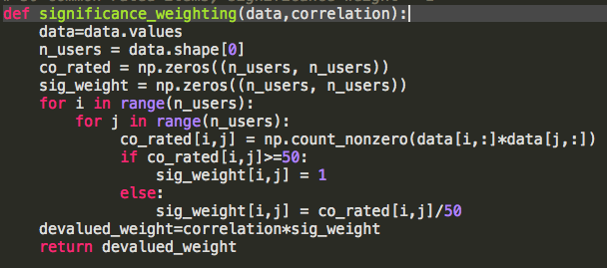
3. Significance Weight
= #common items / 50 ,if # common items<50
= 1 , else
{
Significance Weight
Notes:
multiply Pearson_correlation by Significance Weight and we get PearsonSig_correlation
It can be used to devalue the users that not strongly correlated

Slide 11
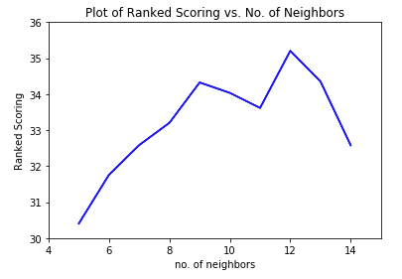
4. Selecting Neighbors: Best-n-estimator
For each user, select a subset of users (top n neighbors) that are the most correlated with that user.
Instead of using the entire user data, use the nearest n users to compute the prediction.

Slide 12

5. Rating Normalization
Deviation for mean
Z-score:
Notes:
z-score is a normalization
For some users, they may be very strict. They prefer to give low scores even for some good movies. Z-score can prevent this kind of situation

Slide 13
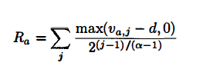

6. Evaluation
Ranked Scoring
Notes:
the first formula represents the utility of of our ranked list based on our prediction. And the second fomula represents the utiltiy score of our ranked list over the utiltiy score of the real ranked list based on the test data.

Slide 14

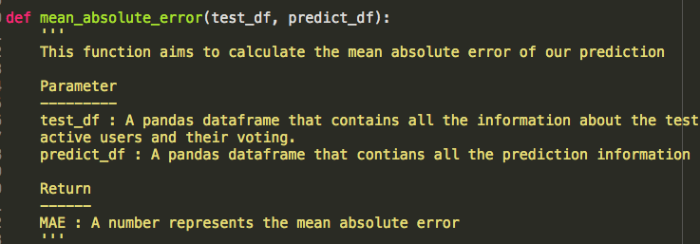
6. Evaluation
Mean Absolute Error
Notes:
the first formula represents the utility of of our ranked list based on our prediction. And the second fomula represents the utiltiy score of our ranked list over the utility score of the real ranked list based on the test data.

Slide 15
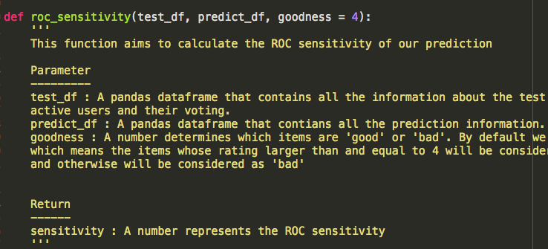
6. Evaluation
ROC-4 sensitivity
rating>4 good
rating<4 bad
calculate # true positive values / # actual good values

Slide 16
Model-based Algorithm: Cluster models
Step 1: Load data
Step 2: Train mixture model by EM algorithm
Step 3: Prediction
Step 4: Evaluation
Step 5: Choose the number of clusters by cross-validation

Slide 17
Model-based Algorithm: Cluster models
X: Input matrix
m: number of sers
n: number of items
k: clusters
h: votes (the scores users give for items)
A: assignment matrix
c: weights for clusters
θ: models’ parameters

Slide 18
Model-based Algorithm: Cluster models
Our assumption is that users in the same cluster have the same voting behavior. That is , users in the same cluster have the same probability to give one specific item one specific score.
K=[k1,k2,k3]
K[0](cluster 1) is a matrix:
 | Vote 0 | Vote 1
Item 1 | P_{0,0}^{(k1)} | P_{0,1}^{(k1)}
Item 2
Item 3
...
Item n
+ = 1

Slide 19
Use EM algorithm for training
Step 1: set initial values
# set initial values for cluster weights
c=np.repeat(1.0/k,k)
# randomly assign parameters for each cluster
THETA=[]
for i in range(k):
randoms=np.random.random(n*len(h))
theta_matrix=randoms.reshape(n,len(h)) # theta_matrix: THETA[K] nxh matrix
theta_matrix=theta_matrix/theta_matrix.sum(axis=1).reshape(n,1)
# for each item the sum of h should be 1
THETA.append(theta_matrix)

Slide 20
Use EM algorithm for training
Step 2: E-step
# recompute assignment matrix
for i in range(k):
A[:,i]=likelihood(X,i,THETA)*c[i]
A=A/A.sum(axis=1).reshape(m,1)
Step 3: M-step
c=A.sum(axis=0)/m # recompute weights for cluster
# reassign parameters for each cluster
for i in range(k):
A_selected=A[:,i]
v1=(X==0).T.dot(A_selected)/A_selected.sum(axis=0)
v2=(X==1).T.dot(A_selected)/A_selected.sum(axis=0)
THETA[i][:,0]=v1
THETA[i][:,1]=v2

Slide 21
Use EM algorithm for training
def likelihood(X,k,THETA):
""“
This is used to calculate likelihood function P(Xi|thetaK)
Xi means ith user. It is a vector: (Vi1,Vi2,...Vin). It records ith user's votes for n items.
e.g (1,2,5,6,0,2,...1)
k means kth cluster. The parameters for kth cluster is THETA[k]
THETA: three dimensional array for all parameters as mentioned above.
return the likelihood vector for all users within one cluster
vector=(user1P,user2P,...)
"""
theta_k=THETA[k]
theta_selected=theta_k[np.arange(theta_k.shape[0]),X]
return theta_selected.prod(axis=1)
#Calculate log_likelihood by
log_likelihood=np.sum(np.log(A.sum(axis=1)))
Repeat E step and M step until log likelihood converges. We choose the threshold as 0.0001

Slide 22
Prediction
Probability Matrix with rating 1:
How to calculate the probability:
P_{ij}⁰ = Σ_{k}P(user i in cluster k) * P(rating = 0|cluster k)
 | Item 0 | Item 1 | ... | Item n
User 1 | 0.7 | 0.3 |  | 0.6
User 2 | 0.4 | 0.6 |  | 0.9
...
User m | 0.2 | 0.1 |  | 0.7

Slide 23
Prediction
If the probability of user 1 gives item 0 score 0 is greater than 0.5, the prediction score for user 1 gives item 0 is 0
Prediction matrix:
 | Item 0 | Item 1 | ... | Item n
User 1 | 0 | 1 |  | 0
User 2 | 1 | 0 |  | 0
...
User m | 1 | 1 |  | 0

Slide 24
Evaluation: Memory-based
 |  | Ranked Scoring | Optimal N
Deviation for Mean | Pearson Correlation | 43.5 | 12
 | Pearson with Significance Weighting | 45.1 | 11
 | Cosine | 45.3 | 13
 | Entropy | 46.7 | 14
Z-Score | Pearson Correlation | 45.2 | 11
 | Significance Weighting | 46.2 | 11
 | Cosine | 44.6 | 11
 | Entropy | 43.3 | 10

Slide 25
Evaluation: Memory-based
 |  | ROC Sensitivity | MAE
Deviation for Mean | Pearson Correlation | 0.651 | 1.509
 | Cosine | 0.631 | 1.493
 | SimRank | 0.637 | 1.489
 | Entropy | 0.626 | 1.521
Z-Score | Pearson Correlation | 0.635 | 1.528
 | Cosine | 0.648 | 1.538
 | SimRank | 0.636 | 1.533
 | Entropy | 0.637 | 1.52

Slide 26
Evaluation: Model-based
Number of clusters | Ranked Score
3 | 32.02300583
4 | 31.9424132522
5 | 31.9444209026
6 | 28.5646816105
7 | 31.6779248212
8 | 29.9055972369
9 | 29.0201072183
10 | 29.7544491759
11 | 27.495674986
12 | 31.3537157196
13 | 31.8771600791
14 | 27.9064300172
15 | 31.6641433513

Slide 27
Conclusion:
Overly Speaking, memory based model is better than model based model
Not many differences. Choose the fastest one

Slide 28
To be Continued...
Advantage:
Python-based code
Matrix-based function
Very clear pipeline and notation
Maybe improved:
It is hard to generate the high-level conclusion that which similarity weights method outperforms other methods -- we may compare this result with other, for example, implicit datasets later.
Notes:
This project is a very interesting project, but due to the tight schedule, there is a lot of things that can be improved. Here are some summary about our model and what may continue to do.

