Slide 1
Churn Prediction for KKBox
Group 2: Xinyao Guo, Qingyun Lu, Peilin Qiu, Sijian Xuan, Yi Zhang

Slide 2
Overview
Introduction
EDA
Model Fitting & Selection
Future Improvements

Slide 3
Introduction
Goal:
Understand important drivers of the retention rate for popular musical Apps
Build predictive model to forecast whether a user will churn after subscription expires
Data:
User information at member, transaction and user logs level.
Merge data by id and select 5000 common users
Features Engineering: Select and create certain features based on EDA
Feature Importance: Random Forest, XGBoost
Models:
Baseline Model: SVM
Advanced Models:
Random Forest, GBM, XGBoost, ADABoost, Lasso
Notes:
Specifically, we want to see if a user make a new service subscription transaction within 30 days after their current membership expiration date.
Member: user information(city, age—has outlier, gender, registration method, registration time)
Transaction: pmt method, pmt plan days, plan list price, actual amount paid, whether auto renew, whether cancel, transaction date, expiration date
Userlog: daily user logs describing listening behaviors of a user. (#of songs played less than 25% of the song length, more than 98.5%...)
In the following time, I will go over our exploratory data analysis, feature engineering steps, and how we trained and evaluated models. And finally we will give our prediction and simply talk about potential improvements.

Slide 4
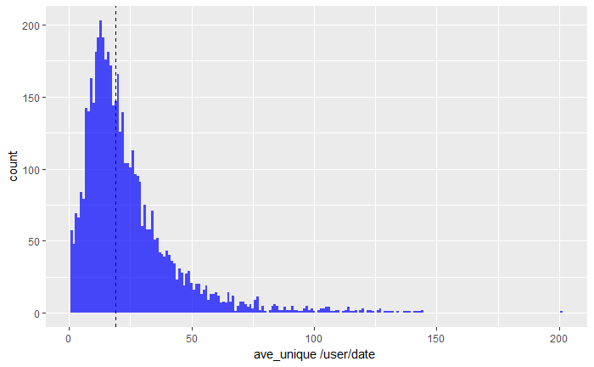
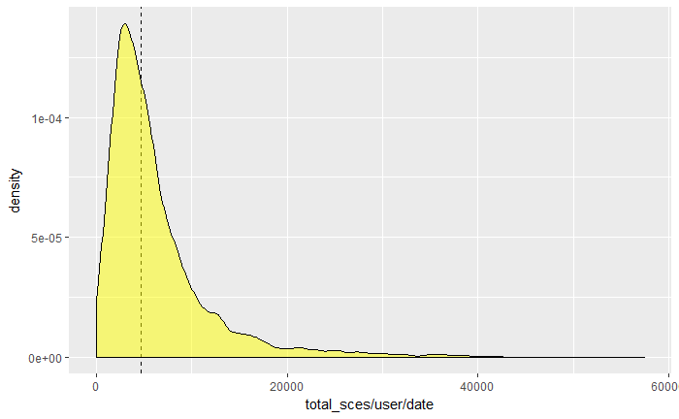
Exploratory Data Analysis --- User logs
Number of unique songs per day
Total listening time per day

Slide 5
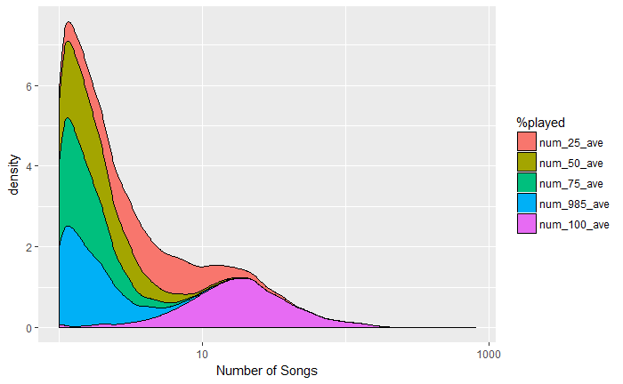
User logs
Distribution of number of songs played

Slide 6
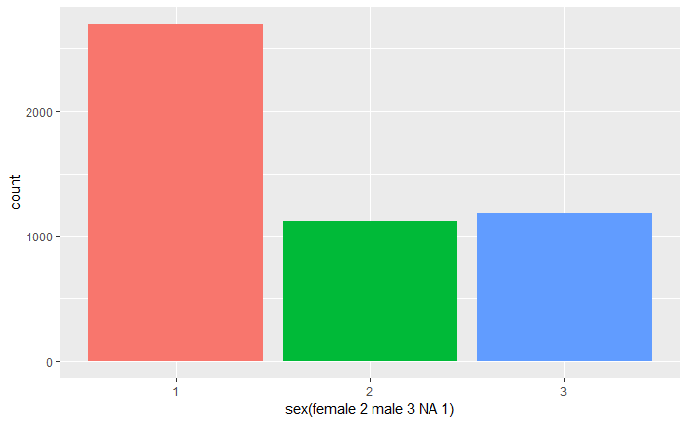
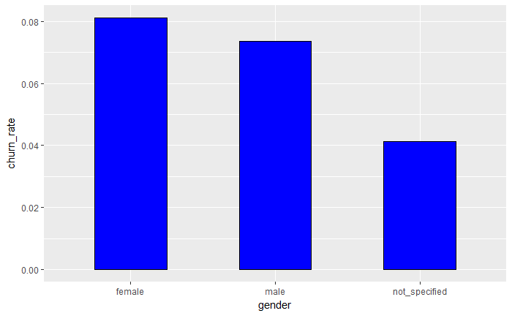
Member
Gender
Relationship between gender and churn rate

Slide 7
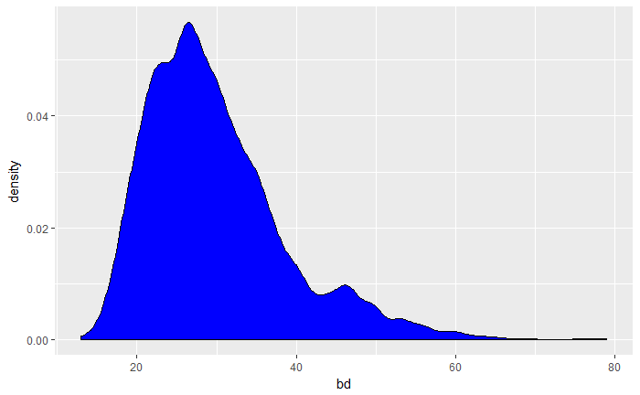
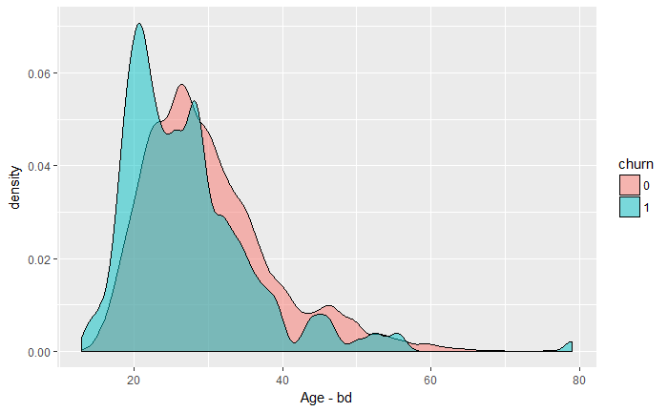
Member
Distribution of age
Age & is_churn

Slide 8
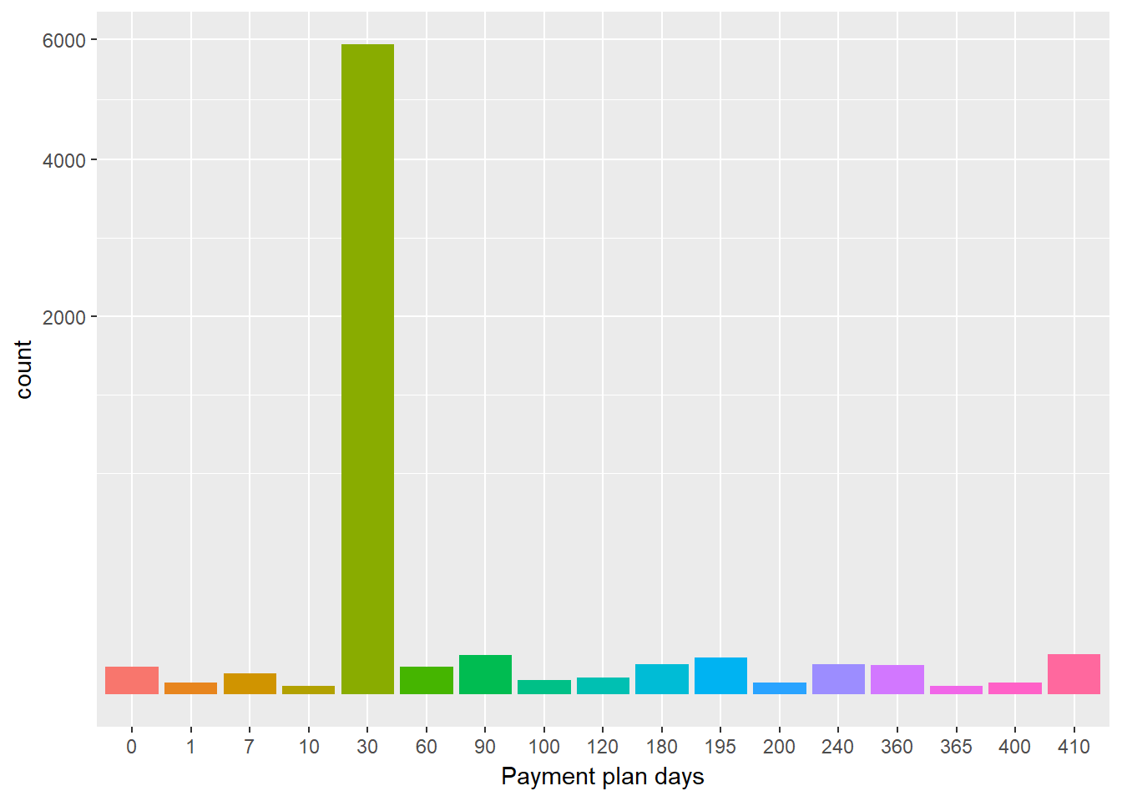
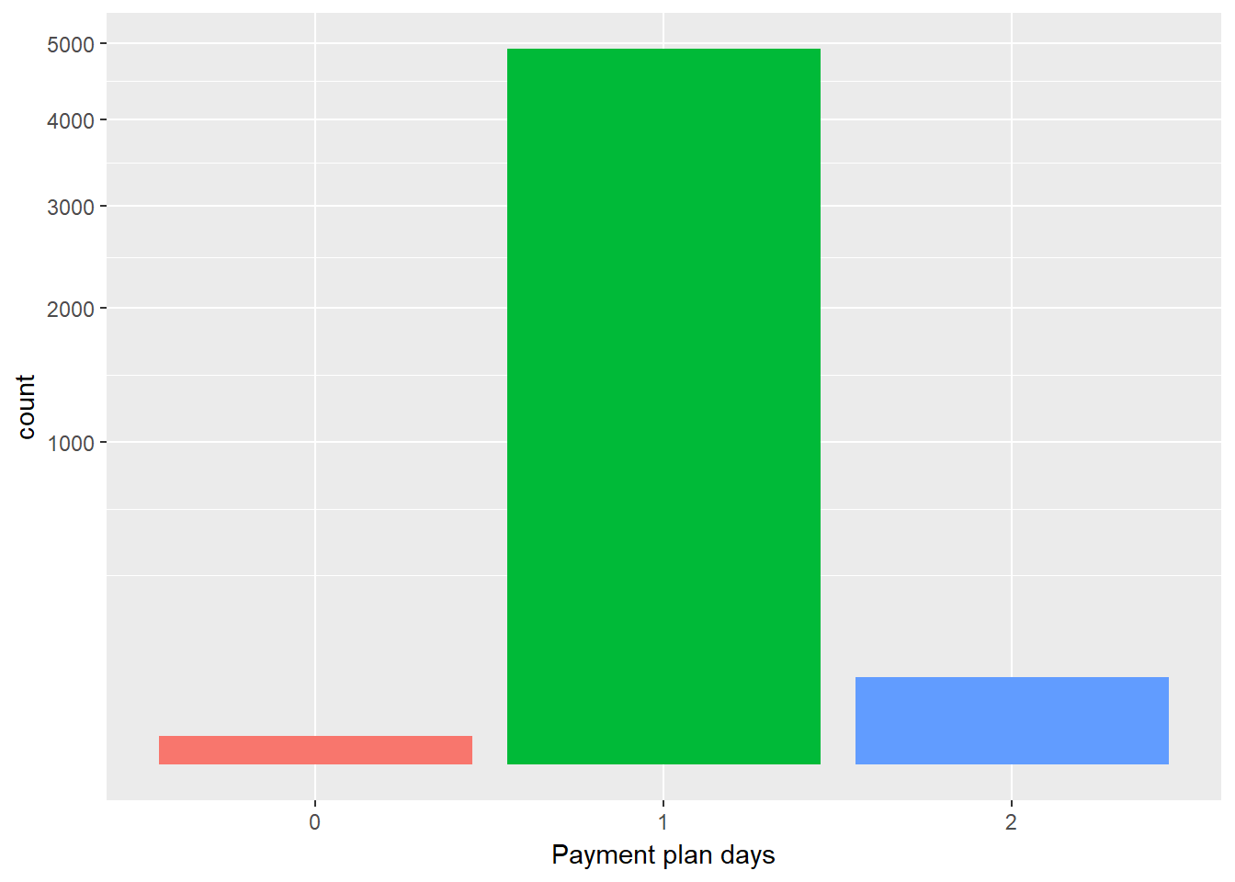
Transaction
Payment plan days
0: <30, 1: 30-90, 2: >90

Slide 9
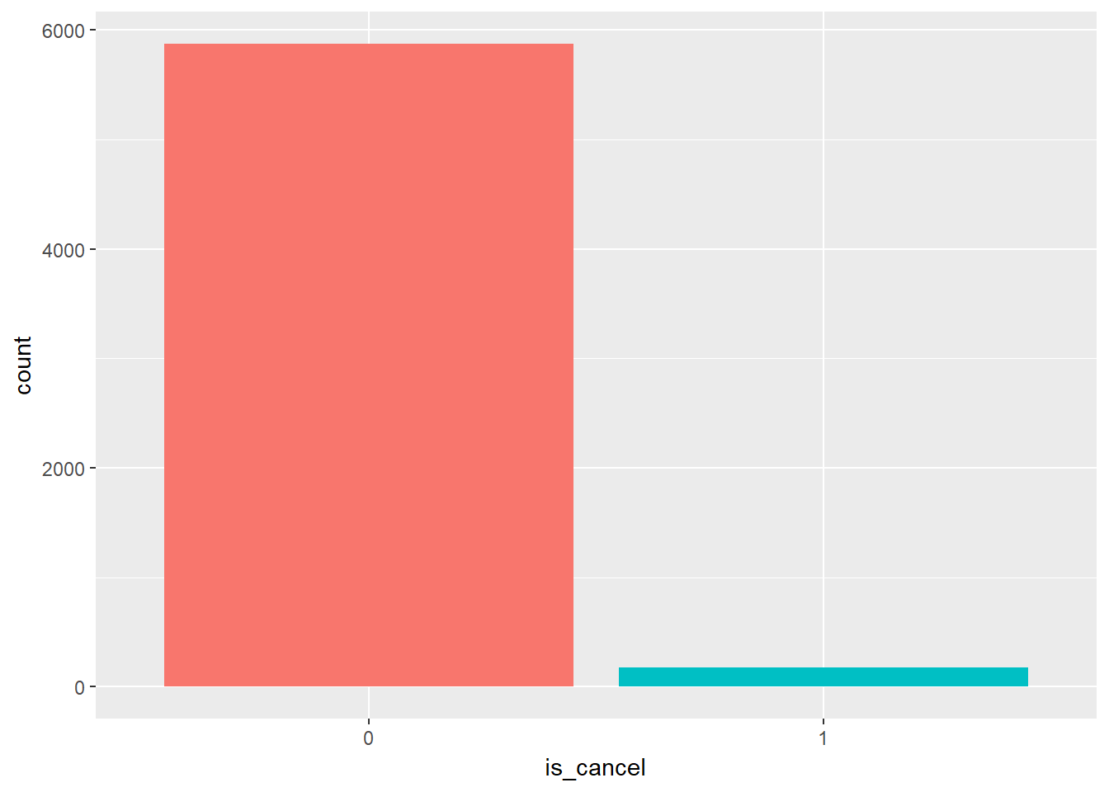
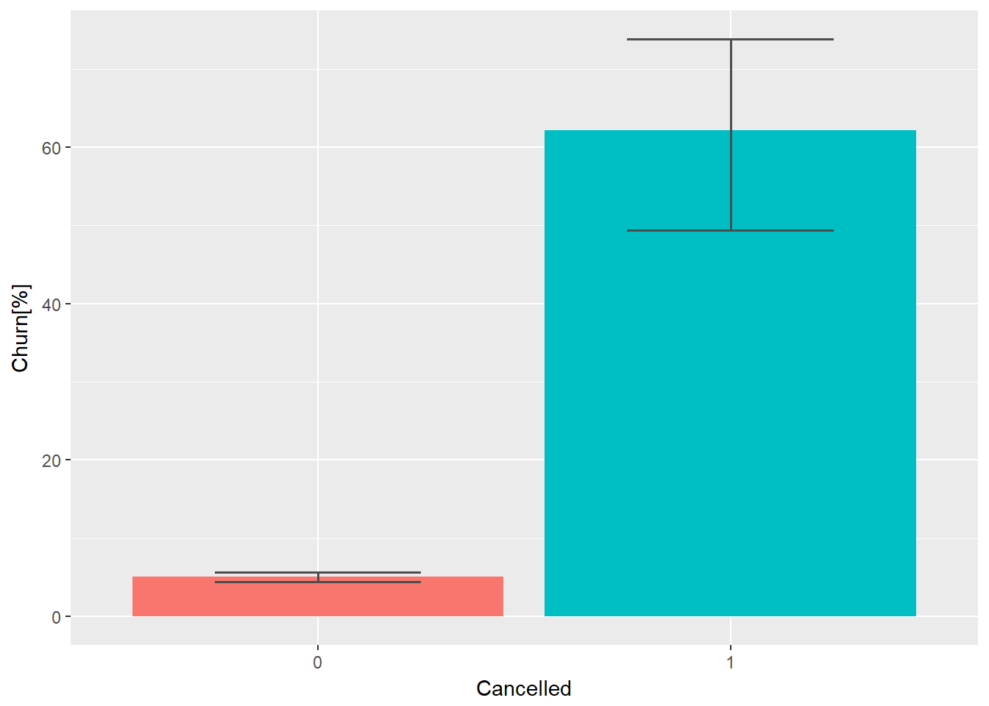
Transaction
Is_cancel
Is_cancel & churn rate

Slide 10
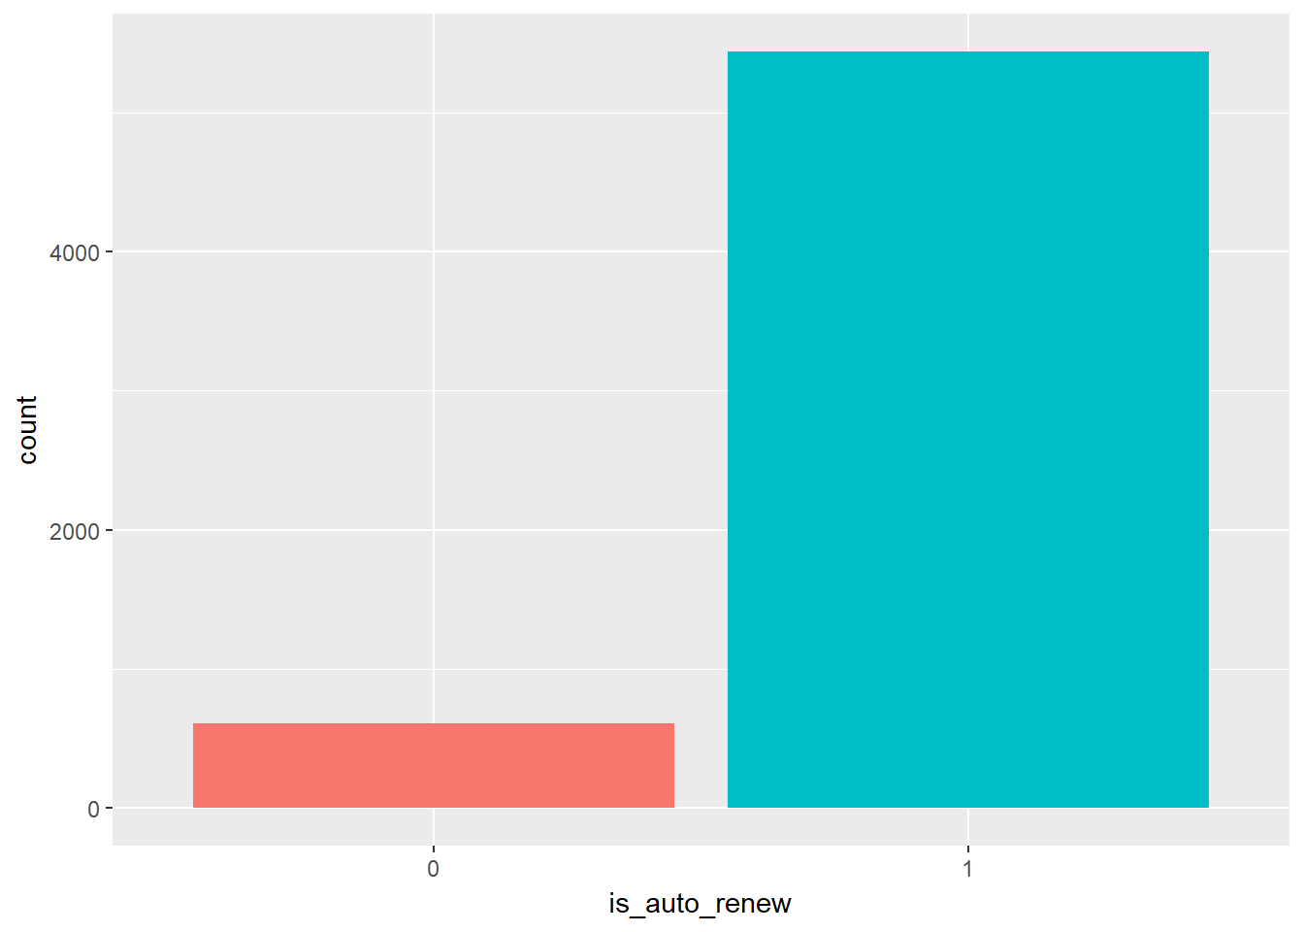
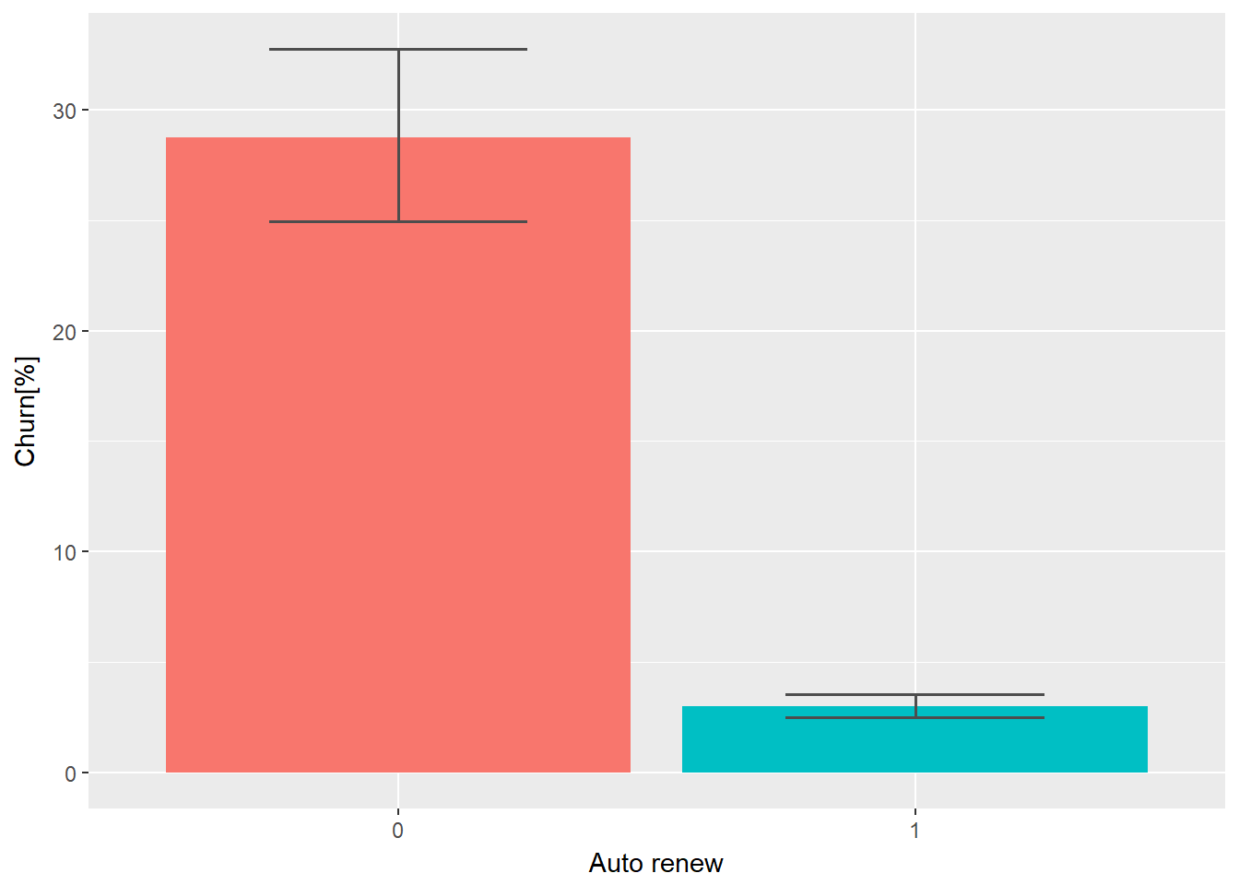
Transaction
Is_auto_renew
Is_auto_renew & churn rate

Slide 11
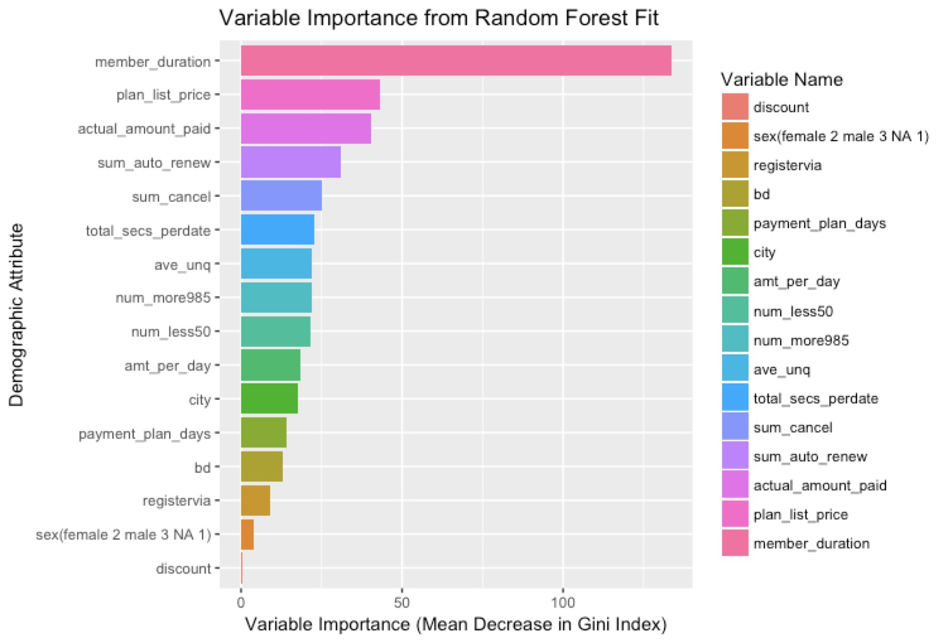

Feature Importance – RF
A low Gini (i.e. higher decrease in Gini) means that a particular predictor variable plays a greater role in partitioning the data into the defined classes.
Gini impurity index
Where n_c is the number of classes in the target variable and p_i is the ratio of this class.
Notes:
So next I will talk about the result of feature importance that generated from random forest. Generally, importance provides a score that indicates how useful or valuable each feature was in the construction of the regression and boosted trees within the model. The more an attribute is used to make key decisions with decision trees, the higher its relative importance.
What is RF? RF use averaging to improve the predictive accuracy and control over-fitting.
Random forest consists of a number of decision trees. And every time when you grow a tree, you have to split your node multiple times. At each split, you always choose the optimal feature from a random subset of all features that can reduce the variance of the split dataset. And computed how much each feature decreases the weighted variance in a tree. For a forest, the variance decrease from each feature can be averaged and the features are ranked according to this measure.
Deal with correlated features: when the dataset has two (or more) correlated features, then from the point of view of the model, any of these correlated features can be used as the predictor, with no concrete preference of one over the others. But once one of them is used, the importance of others is significantly reduced since effectively the impurity they can remove is already removed by the first feature. As a consequence, they will have a lower reported importance. This is not an issue when we want to use feature selection to reduce overfitting, since it makes sense to remove features that are mostly duplicated by other features. But when interpreting the data, it can lead to the incorrect conclusion that one of the variables is a strong predictor while the others in the same group are unimportant, while actually they are very close in terms of their relationship with the response variable.
The effect of this phenomenon is somewhat reduced thanks to random selection of features at each node creation, but in general the effect is not removed completely.

Slide 12

Evaluation
To deal with the imbalanced labels (90% of the users will not churn), we use Log Loss to evaluate our prediction:
where N is the number of observations, yi is the binary target, and pi is the predicted probability that yi equals to 1.

Slide 13
Model Fitting & Selection
1. Train-Test randomly split:
80% training set VS. 20% testing set
Metric: Log Loss
2. Tune Model—Grid Search with CV
Baseline model: SVM
Advanced Model:
XGBoost
AdaBoost
Lasso
Random Forest
GBM
Conclusion: Random Forest is the optimal model in our case.
Models |  | Test Error | CV Error
Baseline | SVM | 0.1572 | 0.1678
Advanced | XGBoost | 0.0749 | 0.1145
 | AdaBoost | 0.1166 | 0.1363
 | Lasso | 0.1446 | 0.1689
 | Random Forest | 0.0620 | 0.0822
 | GBM | 0.0655 | 0.0866

Slide 14
Deal with Potential Overfitting
1. Use Cross-Validation to select model
2. Further simplify our models:
Ignore certain dataset
1. Ignore UserLog dataset—perform worse
2. Ignore Member dataset—perform slightly worse → maybe ignore certain features is feasible
Ignore certain features
1. Ignore Gender, Registration Method in the Member dataset; Ignore Discount in the Transaction dataset
Conclusion:
Better result!
Random Forest is still our best model
Simpler Models |  | Test Error | CV Error
Baseline | SVM | 0.1318 | 0.1381
Advanced | XGBoost | 0.0848 | 0.1084
 | AdaBoost | 0.1137 | 0.1438
 | Lasso | 0.1351 | 0.1642
 | Random Forest | 0.0590 | 0.0906
 | GBM | 0.0674 | 0.0876

Slide 15
2. Ignore Gender, Registration Method in the Member dataset; Ignore Discount, Actual Amount Paid in the Transaction dataset
Conclusion:
Worse result
Still stick with the previous model
Simpler Models 2 |  | Test Error | CV Error
Baseline | SVM | 0.1304 | 0.1495
Advanced | XGBoost | 0.0745 | 0.1103
 | AdaBoost | 0.1175 | 0.1321
 | Lasso | 0.1364 | 0.1609
 | Random Forest | 0.0623 | 0.0836
 | GBM | 0.0661 | 0.0907

Slide 16
Results & Future Improvement
Final Model: Random Forest model on data with reduced features
Future Work:
Separate models for the users who provide valid information and no information (ex. Ignore the member dataset for those who did not have complete information and use a different model for them)
RF model for the group ignoring member dataset: Log Loss= 0.052
RF model for the remaining group with member dataset: Log Loss= 0.059
Need validation on a larger user base

Slide 17
Thank You! Q & A

