Slide 1

RedHat Kaggle Challenge
A Lesson in Behavioural Classification and Business Value Prediction
By: Vassily Carantino, Yajie Guo, Lin Han, Enrique Olivo
Notes:
title slide, intro, straightforward

Slide 2

Presentation Outline
Introduction to the Challenge: What Business Problem are we trying to solve ?
Introduction to the Data: Exploratory Data Analysis
What Models did we use ?
Model Comparison and Final Recommendation

Slide 3
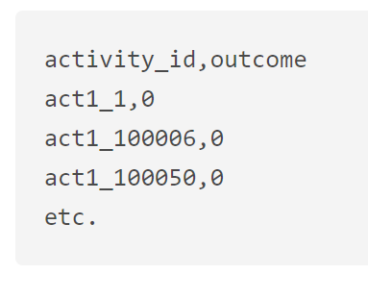
The Challenge: Predicting customers’ activities ”Business Value”
More on our client’s business problem
Challenge’s Requirements:
For each activity ID in the test set, predict the business value of this activity
Business value is here define as a binary variable 0 or 1
Our goal will be do predict the probability that the activity has value for the company (outcome=1)
Red Hat is the world's leading provider of open source, enterprise IT solutions
Red Hat is able to gather a great deal of information over time about the behavior of individuals who interact with them.
Goal of the project:
use this behavioral data to predict which individuals they should approach
create a classification algorithm that accurately identifies which customers have the most potential business value for Red Hat based on their characteristics and activities.
Source: https://www.kaggle.com/c/predicting-red-hat-business-value
Notes:
Read out the challenge, say a few words on what RedHat is: “a multi-armed software company that provides storage, applications, management products, support, training, and consulting services

Slide 4
Introduction to the Dataset provided
Contained in two separate files: “People” and “Activity”
People
1 x “people_id”
1 x “date”
1 x “group_id”
36 x “char_id”
1 cols of numeric values
(outcome)
8 cols of category values
27 cols of Logical values
Activity
1 x “people_id”
1 x “activity_id”
1 x “date”
1 x “activity category”
10 x “char_id”
10 types
**OUTCOME**
efficiency of each activity
1
2
Notes:
Speak about how this project differs from Project 3 in that the “features” are categorical, and we don’t exactly know what the different id’s mean.
#####Lin: explain the data

Slide 5
Exploratory Data Analysis
1
Find the features columns in people and activities dataset
For all logical features, convert all logical columns to numeric columns
For all character features, firstly rename all frequency=1 values in one column to the same name(‘type unique’), and then convert them to numeric values. This can avoid the dummy variable trap
Get the new dataset: train_num_runique.csv
2
3
4

Slide 6
Model Selection: Random Forest
Description: Random Forest is a classic ML algorithm for classification that operate by constructing a multitude of decision trees at training time and outputting the mean prediction of the individual trees.
Preprocessing:
All the variables that we use in this model are categorical variables except people_date and activity_date. RF implementation in R cannot deal with categorical variables if these have more than 52 categories.
→ We separate activity_group=1 with activity_group!=1, since the activities in these two groups doesn't have the same number of variables ('activity group'=1 has 9 additional variables).
→ We also decided to transform variables with more than 52 labels into numeric values.
Parameters:
→ Number of trees: 500
→ Parameter mtry=sqrt(44)=7
Results, LightGBM
Accuracy: 81.93% on activity_group = 1 97.15% on activity_group != 1 Running Time: 7.45 mins on activity_group = 1 422.4s on activity_group != 1

Slide 7
Model Selection: Xgboost
Description: XGBoost is short for “Extreme Gradient Boosting”, is a popular open source library for gradient Boosting.
Preprocessing:
In order to make computation more efficiency, we convert all non-sparse columns to sparse matrix and rbind them with other sparse columns.
Parameters:
We train the model using different parameters combinations.
The model have the highest accuracy with:
Eta= 0.02
max_depth=10,.
Results, Xgboost
Acurracy: 98.94% Running Time: 1357s

Slide 8
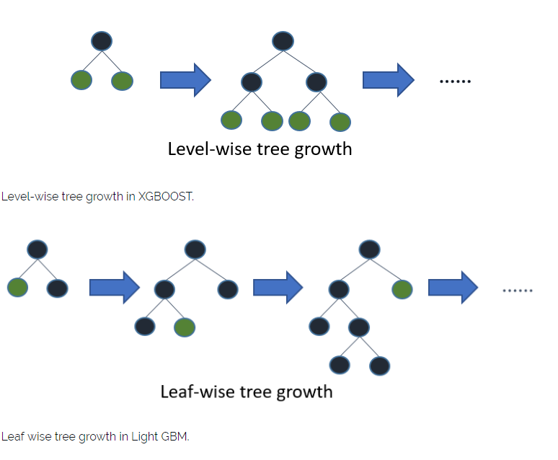
Model Selection: LightGBM
Description: Light GBM is a fast, distributed, high-performance gradient boosting framework based on decision tree algorithm.
Why is it different ?
→It splits the tree leaf wise with the best fit whereas other boosting algorithms split the tree depth wise or level wise rather than leaf-wise.
→ Leads to a greater accuracy.
Parameters: We used CV to find the best parameters for this model: max_depth = 8, learning_rate=0.1 and 1500 iterations
Results, LightGBM
Accuracy: 98.13% on activity_group = 1 97.15% on activity_group != 1 Running Time: 175.80s on activity_group = 1 422.4s on activity_group != 1

Slide 9
Model Selection: SVM
Description: Support vector Machine is a Machine Learning algorithm that performs classification based on “Decision Planes”, a space that separates inputs between the two classes of the response variable.
Preprocessing: Here, we just used train_num_runique file after data processing.
Parameters: We train a SVM with linear Kernel and with RBF kernel. We have two parameters here, one is data, which should be train_num_runique, the other one is k = 5.
Results, SVM
Accuracy: 83.09%(linear); 88.22%(RBF) Running Time: 370.4758; 102.7942
Notes:
Performs classification based on “Decision Planes”

Slide 10
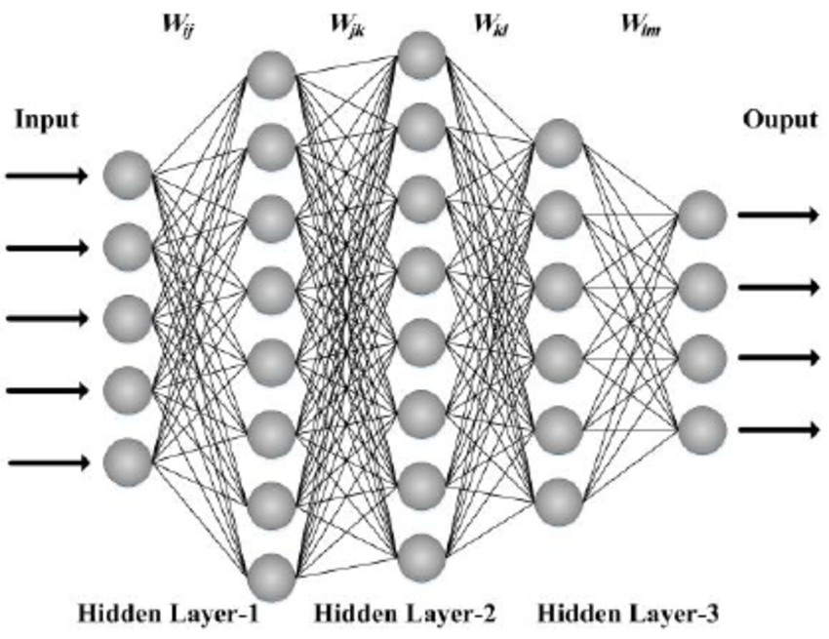
Model Selection: Neural Network
Results, Neural Network
Accuracy: 82.03% Running Time:364.6s
Description:
We used multiple-layer neural network to predict the outcome.
Method:
We use a 5 folds cross-validation to do select the best architecture for the Neural Network.
CV score | Hidden Layer | Running time
75.57% | 1 | 148.94s
82.03% | 6 | 354.62s
80.56% | 10 | 1639.65s
83.72% | 15 | 4380.30s

Slide 11
Model Selection: Multinomial log-linear
Description:
We used multinomial log-linear model to predict the outcome. This model is appropriate for testing the associations between: > Categorical explanatory variables > Categorical response variables
Our data consists of mostly all categorical variables
Results, Multinomial log-linear
Accuracy: 83.3% Running Time: 130.17

Slide 12
Model Comparison & Recommendations
The XGBoost model is the most accurate model, with an accuracy of 98.9% on the test set. But it is really slow to run ~1357s (22min !)
The Light GBM model allows us to reach an almost equivalent accuracy in 3 times less computation time:
Average accuracy of 97.7%
Running time of around 597s
According to what matters to our client: better accuracy or computational speed we recommend to use either the XGBoost or the Light GBM model.

