Slide 1
The Happiness Score
Deepika S Namboothiri
20th September, 2018

Slide 2
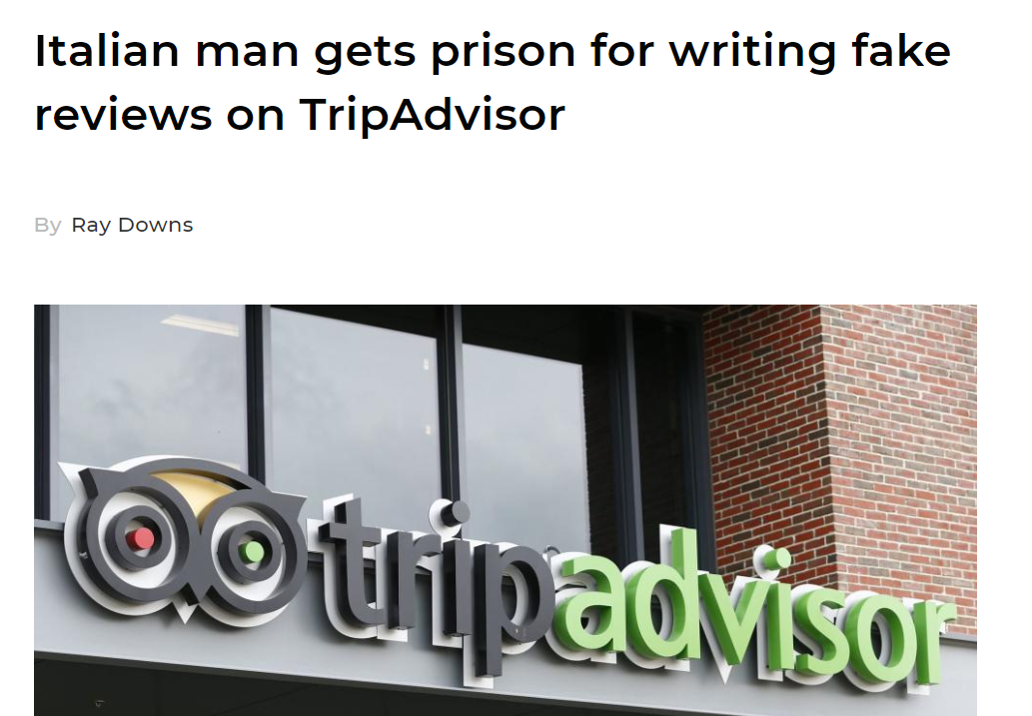
How did they find out…?

Slide 3
Can NLP identify the difference between a statement and an emotional expression?

Slide 4
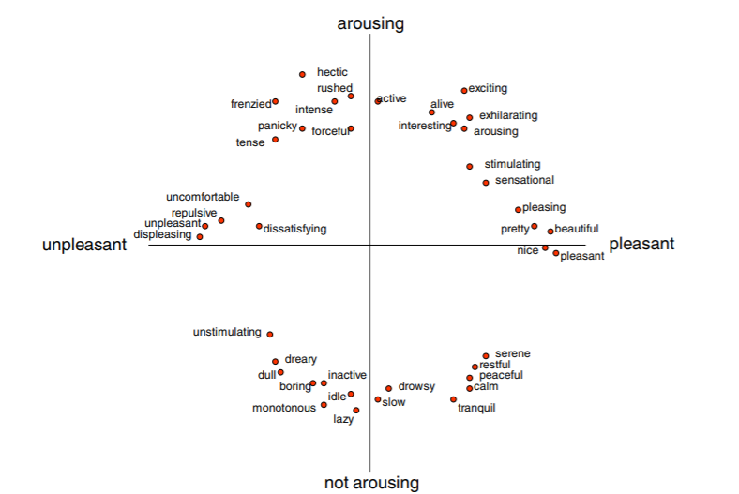
Valence, Arousal and Dominance
Source: Russell and Lanius 1984

Slide 5
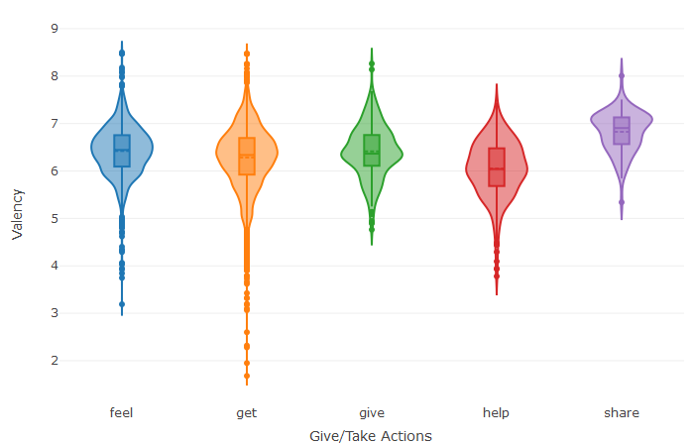
Giving makes you happier than taking

Slide 6
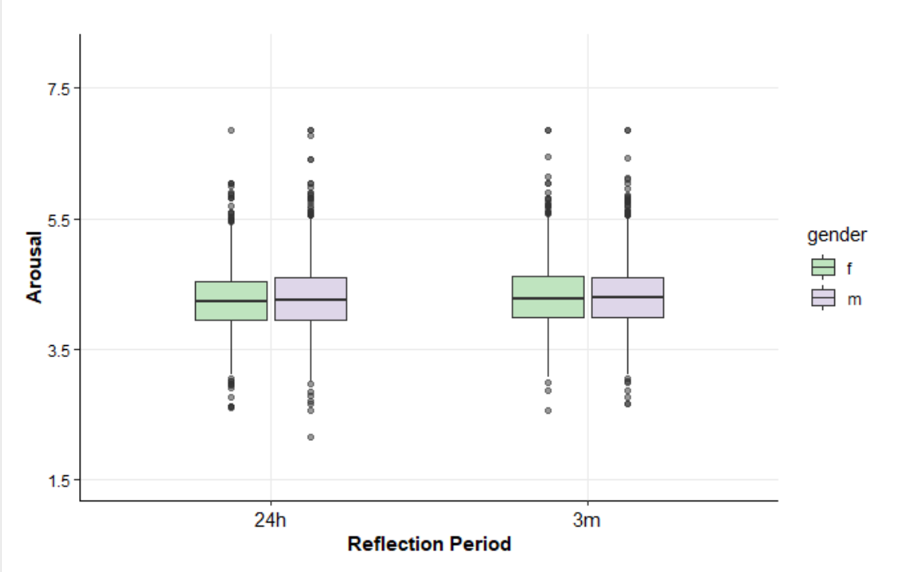
You remember events that have a greater emotional impact

Slide 7
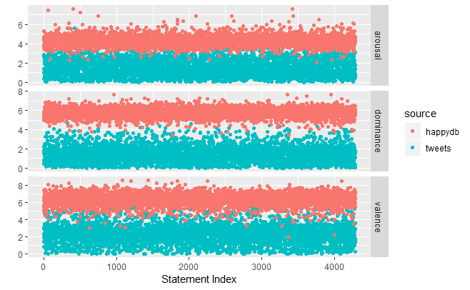
Expression vs Statement

Slide 8
What Next?
Enhance text conversion to Emojis
Marketing : Low Arousal and High Valence
Identify fake reviews

