Slide 1

Mom, wish you happy everyday! (A guidebook on how to make your mother happy)
Proj1 for 5243
Jiaqian Yu

Slide 2
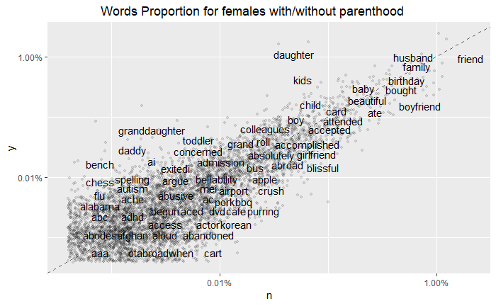
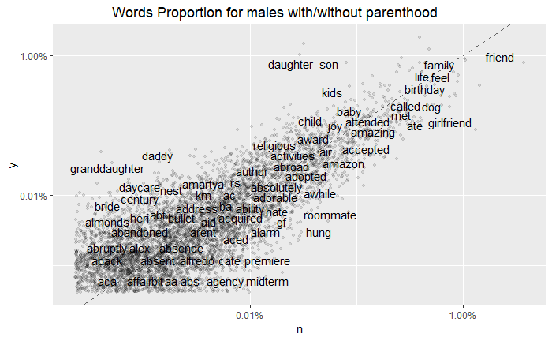
Question 1: Do mothers really regret giving birth to their kids? What about fathers?

Slide 3

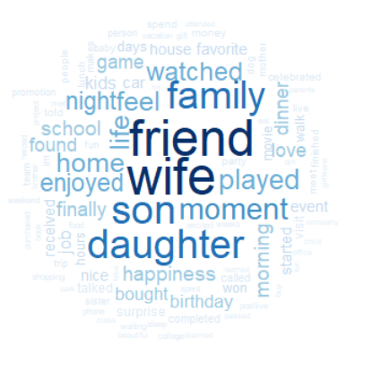



Slide 4
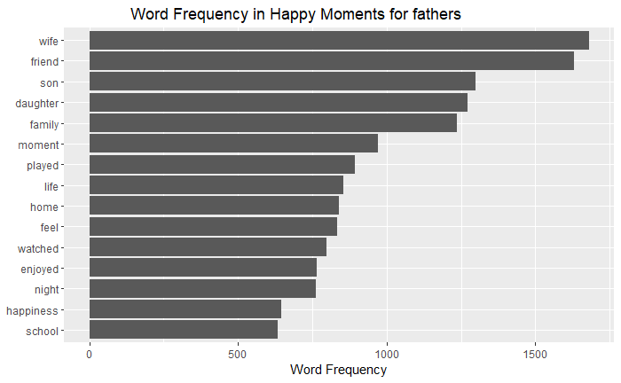
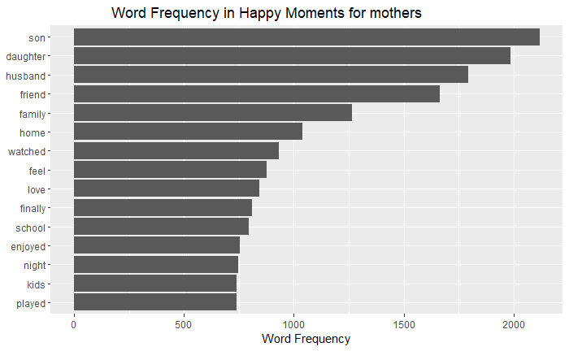

Slide 5
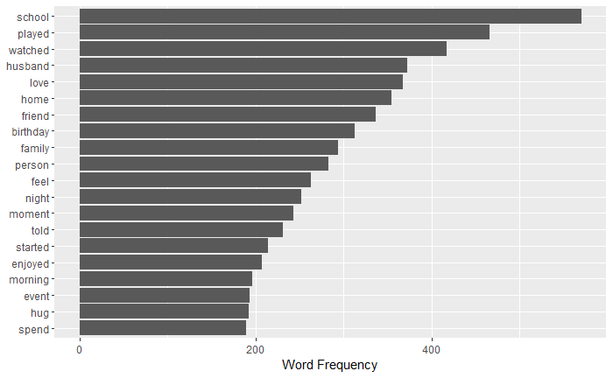

Question 2:How to make mothers happy?

Slide 6
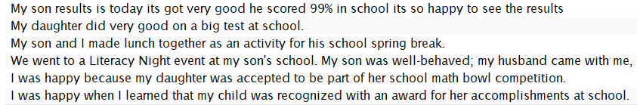


Slide 7
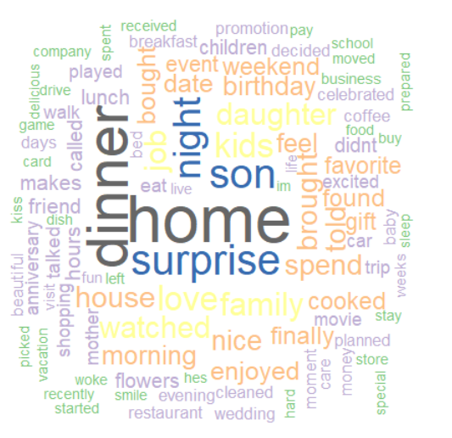
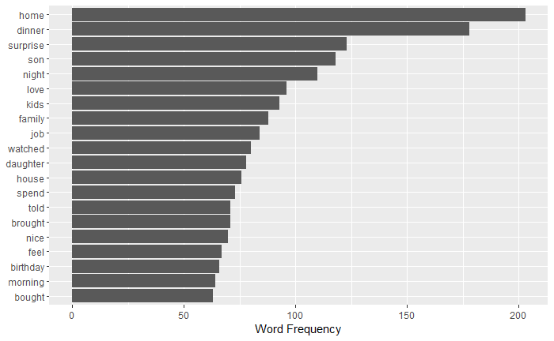
Question 3: Dad, do you know how you can make mother happier?

Slide 8


Slide 9

Conclusion
Mothers and fathers really gain happiness from their kids. Mothers mention kids most frequently when they recall their happy moments(Fathers also gain happiness from kids, however, they still put "wife" and "friend" in the first place).
Performing well in school makes mothers happy.
Ask fathers to spend time at home, make dinner and prepare surprise can also make mothers happy.

