Slide 1
PREDICTIVE MODELING PRESENTATION
GROUP 3

Slide 2
CONTENT
Introduction
Feature Extraction
Machine Learning
Tuning and Cross Validation
Prediction
Conclusion
Acknowledgement

Slide 3
INTRODUCTION
We introduce the progress of this analysis conducted by us.

Slide 4
FEATURE EXTRACTION
No. 1 No. 2 … No. 1500
R G B
R G B
R G B
[X1, X2, X3, X4, X5, X6, X7, X8]

Slide 5
FEATURE EXTRACTION
No. 1 No. 2 … No. 1500
R G B
R G B
R G B
R G B
R G B
R G B
[Y1, Y2, Y3, Y4]

Slide 6
MACHINE LEARNING
In machine learning, we train GBM to learn the response given the explanatory variables. Each channel, each response pixel, there is one GBM. That is, we have
Y1R = f1R(X); Y1G = f1G(X); Y1B = f1B(X)
Y2R = f2R(X); Y2G = f2G(X); Y2B = f2B(X)
Y3R = f3R(X); Y3G = f3G(X); Y3B = f3B(X)
Y4R = f4R(X); Y4G = f4G(X); Y4B = f4B(X)

Slide 8
Part I: Baseline

Slide 9
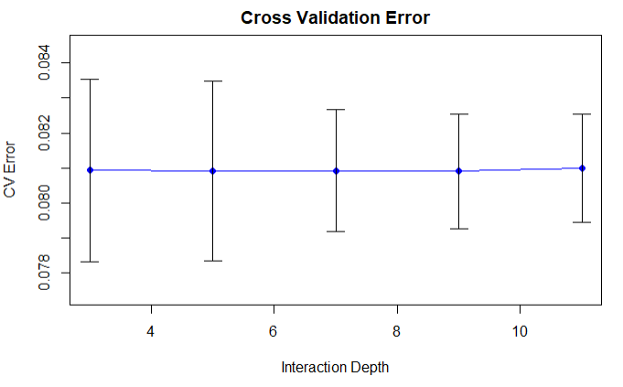
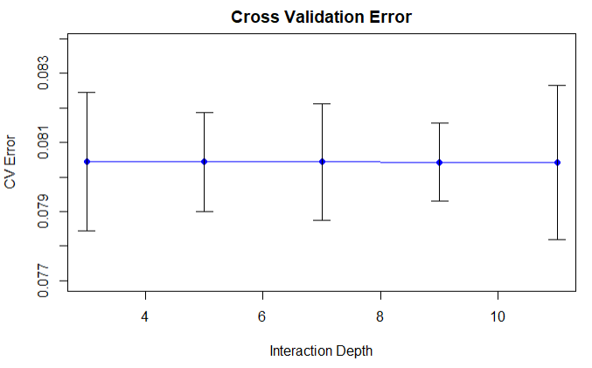
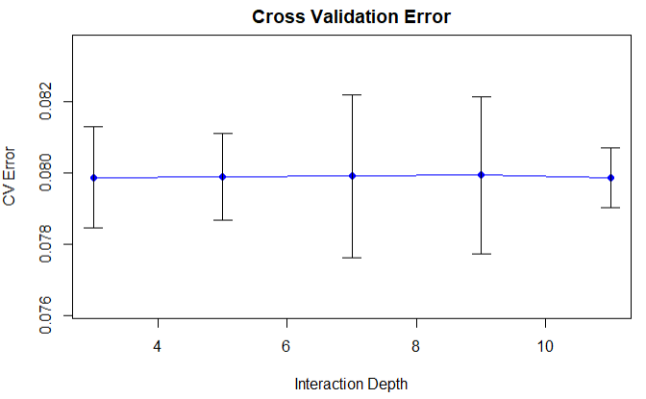
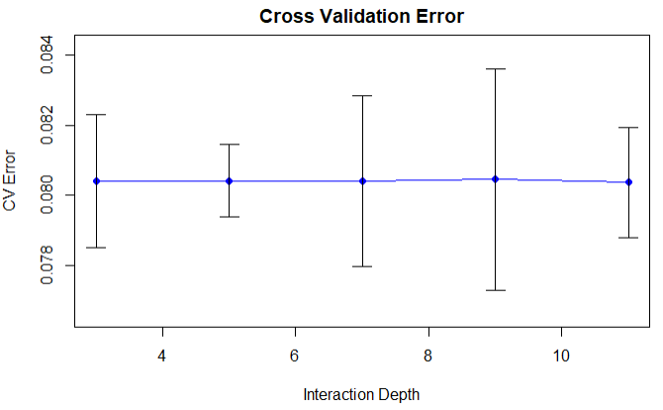
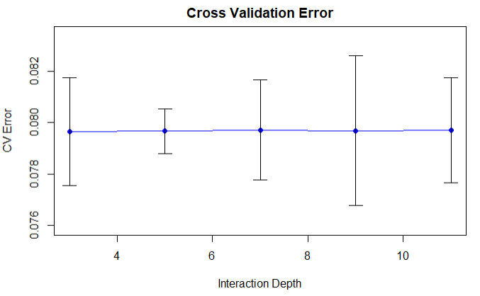
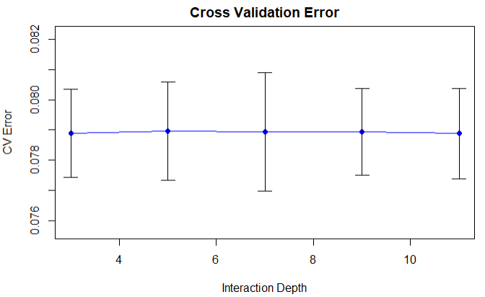
TUNING AND CROSS VALIDATION
(200, 5) (200, 10) (200, 10)
(300, 5) (300, 10) (300, 10)

Slide 10
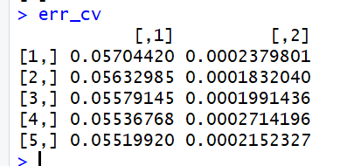
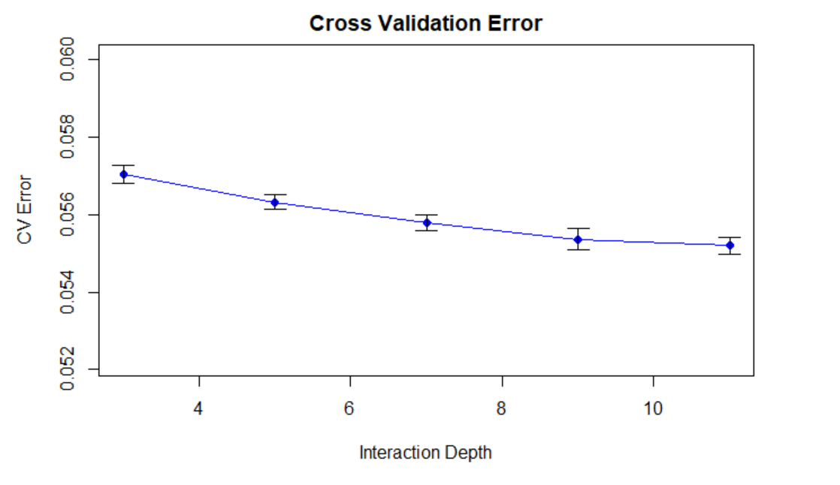
Base Line Model tuning
n Depth from 3 to 11, with the fixed parameter of n.tree = 200, bag.fraction = 0.5.

Slide 11
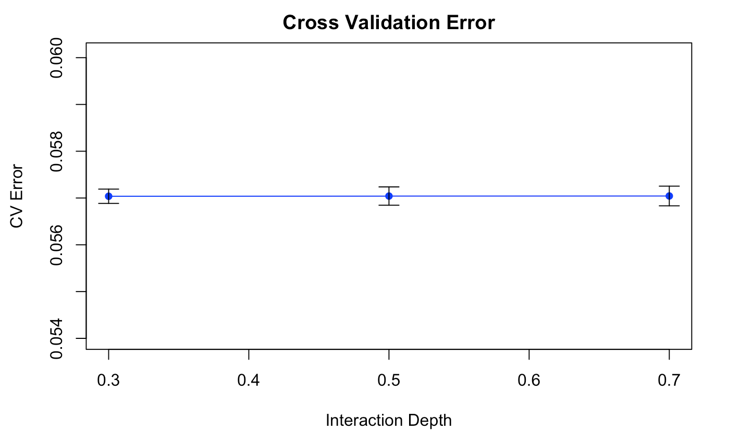
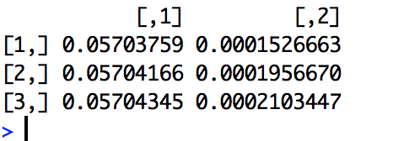
Base line tuning model
This result was generated with the depth & n.tree = default

Slide 12
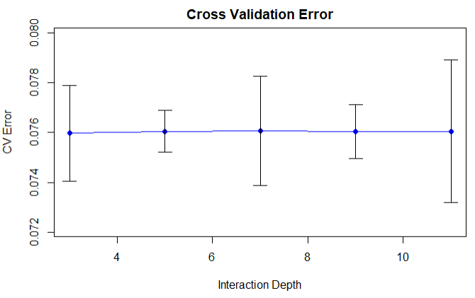
TUNING AND CROSS VALIDATION
In the end, we use (1) number of trees = 500, and (2) depth = 40. This gives us average cv error of 7.6%, an estimated 15% error reduction from baseline model with standard deviation to be 0.1%.

Slide 13
Improved: Linear Model
Result of Improved Linear Model: (May change it later)
mean(err) = 0.003564565
SD(err) = 4.220893e-05

Slide 14
Improved: XG Boost

Slide 15
PREDICTION
Setting tuning parameters to (1) number of trees, and (2) depth: number of interactions.
Holding all other factors equal, we observe 5-fold cross validation error to decrease when raising number of trees and also, separately, increase depth of the gradient boosting machine.
We achieved cv error to be 9% for baseline model and 7.8% for improved model. In both cases, we use Gradient Boosting Machine.
Under time constraint, we did not infinitely increase number of trees and depth in the model. However, we conjecture that the cv error will decrease and eventually flatten out if we increase the above two tuning parameters.

Slide 16
CONCLUSION (comparison of three models)
We conclude that from training and cross validation results on given image data. Gradient Boosting Machine will be able to produce mean square error of 9% on average. This is at least 30% in root MSE. Given a pixel with value 0.7 and such pixel may range from 0.01 to 1, the prediction can range from 0.4 to 1. This is a fairly large error and the produced high resolution image will not be given the same perception to us.
For future reference, we conjecture that more sophisticated AI algorithms can be used. For example, one can attempt to train Convolutional Neural Network. Moreover, one can also attempt to extract the 24 pixels in the neighborhood instead of 8 pixels.

Slide 17
WHAT NEXT?
More data
Convoluted neural networks

Slide 18
ACKNOWLEDGEMENT
We want to thank our instructor Ying Liu and TA Chengliang for guiding us through the materials. We also want to thank Professor Tian Zheng for the slides in preparation for this course.

