Slide 1
PREDICTIVE MODELING PRESENTATION
GROUP 4

Slide 2
CONTENT
Introduction
Feature Extraction
Tuning and Cross Validation
Prediction
Conclusion
Acknowledgement

Slide 3
INTRODUCTION TO PROBLEM
Let us address the following:
Task: for each pixel in low resolution image, we want to predict values of 4 pixels in high resolution image.
Feature: for each pixel in low resolution image, we extract the 8 pixels surrounding it as features.

Slide 4
FEATURE EXTRACTION
No. 1 No. 2 … No. 1500
R G B
R G B
R G B
[X1, X2, X3, X4, X5, X6, X7, X8]
Notes:
the first part of our project is feature extraction.

Slide 5
FEATURE EXTRACTION
No. 1 No. 2 … No. 1500
R G B
R G B
R G B
R G B
R G B
R G B
[Y1, Y2, Y3, Y4]

Slide 6
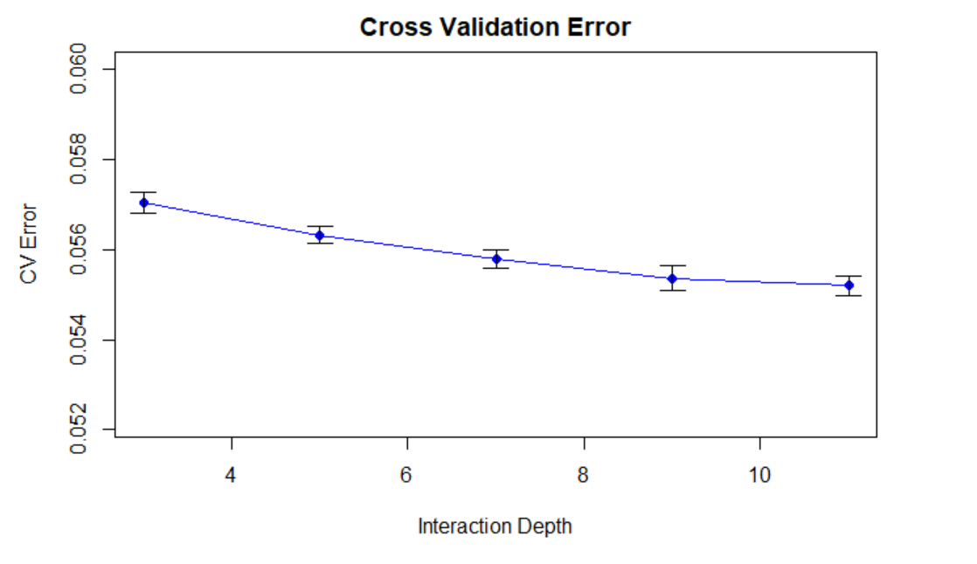
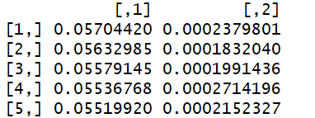
BASELINE MODEL TUNING
Tune: we change the depth of tree from 3 to 11 with everything else fixed.
CV Error CV SD
Notes:
Tuning for interaction.depth
Based on ?????how many pictures
We decided to choose 9 because of the trade off between cv error and complexity

Slide 7
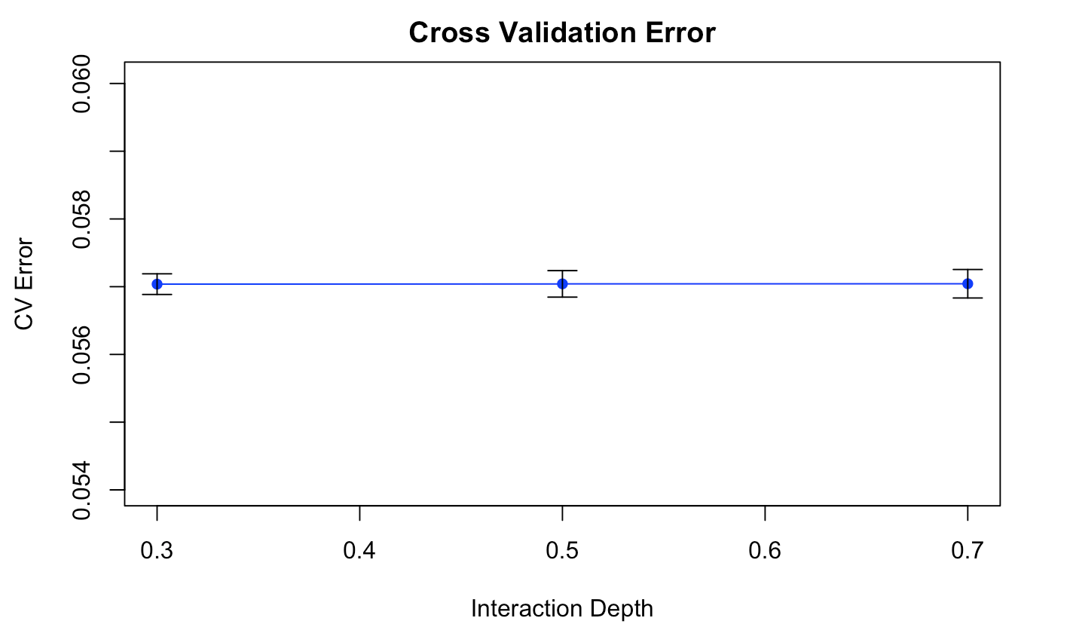
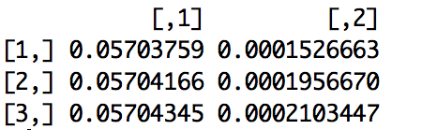
BASELINE MODEL TUNING
Tune: This result was generated changing bag fraction and holding everything else fixed.
CV Error CV SD
Notes:
Tuning for bag.fraction from ?????? change the graph “interaction Depth”

Slide 8
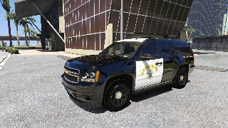
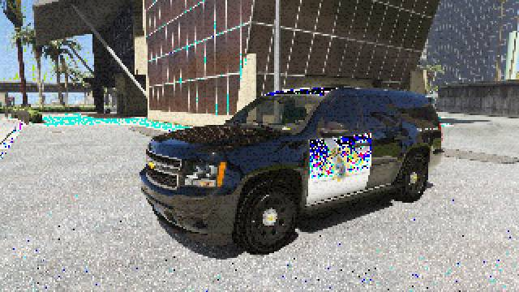
SUMMARY
Original Picture
Baseline Model

Slide 9
Thoughts about Improved models
The disadvantage of baseline model:
Although GBTs build trees one at a time, where each new tree helps to correct errors made by previously trained tree. GBDT training generally takes longer because of the fact that trees are built sequentially.
The goal of improved models:
Make it faster and keep the quality of the pictures the baseline model made.
Linear Regression model
XGBoost model with linear booster
Notes:
Tuning for interaction.depth
Based on ?????how many pictures
We decided to choose 9 because of the trade off between cv error and complexity

Slide 10
Improved Model 1:
Linear Regression Model
CV Error CV SD
0.003924888 1.261591e-05
0.003924903 1.261189e-05
0.003924903 2.541378e-05
0.003924916 1.011375e-05
0.003924987 1.263777e-05
The linear regression would achieve the goal of being faster. And as the result shows, it also better than the baseline model we used.
However, the clear disadvantage of linear regression is that Linear Regression over simplifies many real world problems.

Slide 11
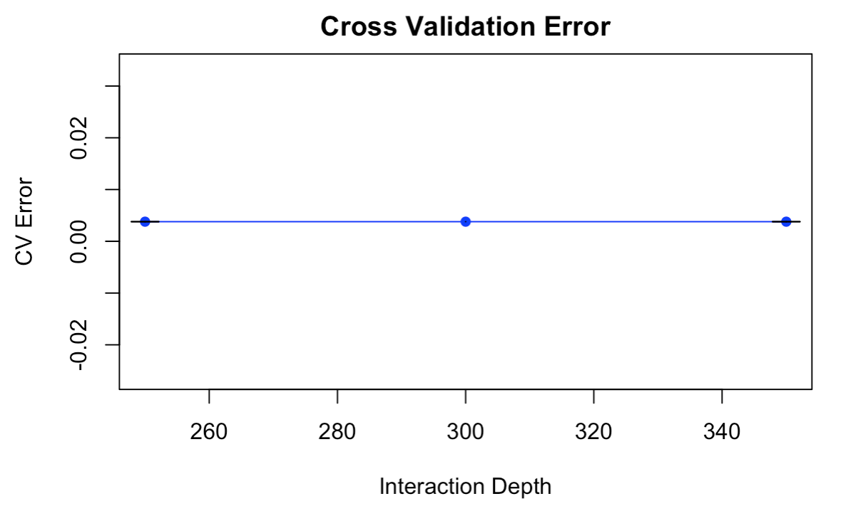
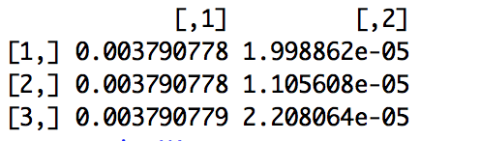
Improved Model 2:
XGBoost Model
Tune: This result was generated changing the maximum number of iterations in the training. This controls the maximum number of iterations required for gradient descent to converge.
CV Error CV SD

Slide 12
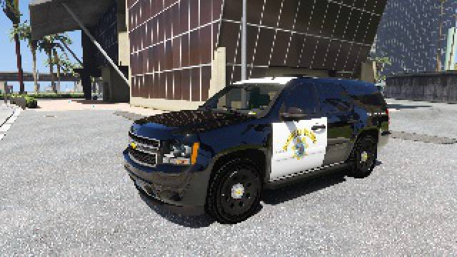
SUMMARY
Original Picture
Improved Model: XGBoosting

Slide 13
SUMMARY
Feature extraction time | 1-2 minutes
Summary | Baseline | Improved: Linear Model | Improved: XGBoost
CV Error | 5% | 3.9% | 3.8%
Time: train (Step 4) | 10-15 minutes | 15-25 seconds | 8-10 minutes
Super Resolution | 4.5 second / image | 1.5 second / image | 1.1 second / image

Slide 14
CONCLUSION
We conclude that from training and cross validation results on the above analysis we choose XGBoost as our improved model. We take full consideration of the tradeoff between computational cost and model performance. We observe that the candidates for improved can reduce error from baseline models. Moreover, XGBoost algorithm can finish superResolution with much less time required from baseline model. Hence, we select XGBoost as our candidate for improved model.

Slide 15
WHAT NEXT?
Potential Direction 1: Include more data
Potential Direction 2: We can use Convoluted Neural Network to classify which image fall in which category (e.g. for example, is this picture a flower or not?) After we classify all images, we can introduce baseline model and improved model on these category only instead of the entire data set.
Potential Direction 3: We can introduce more complicated regression problem framework such as (1) polynomial regression, (2) iterative Random Forest, (3) Bayesian Additive Regression Tree, and so on.
Potential Direction 4: Extraction of more features (eg: extract 24 neighboring pixels instead of 8)

Slide 16
ACKNOWLEDGEMENT
We want to thank our instructor Ying Liu and TA Chengliang for guiding us through the materials. We also want to thank Professor Tian Zheng for the slides in preparation for this course.

