Slide 1
Low to High Resolution Image:
Predictive Modeling
ADS Sec.2
Group 11

Slide 2
Introduction
Project Goal
Objectives
Predictive Modeling
Methodology
Improved Model
Results
Outline

Slide 3
Introduction

Slide 4
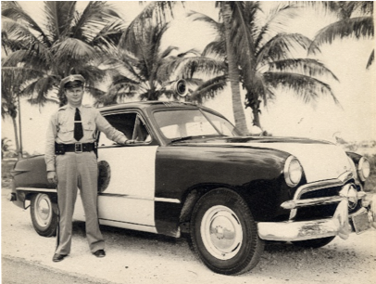
Project Goals
Predictive
Model
Input data
Run a baseline GBM model
Improve the baseline GBM model
Validate the improved model
Ground truth

Slide 5
Objectives
Minimize holding storage
Minimize memory cost
Portability
Optimize computation time
Cross-validation running time
Test running Time
Prediction Accuracy
MSE
PSNR

Slide 6
Predictive Modeling

Slide 7
Methodology
Training image
Model assessment
Feature extraction
Predicted model
Test image
Model training

Slide 8
Improved Model
Vector instead of loop
in feature extraction
Improve computation efficiency
Better PSNR
Try depth = 3,5,7 and find the best one is depth=5

Slide 9
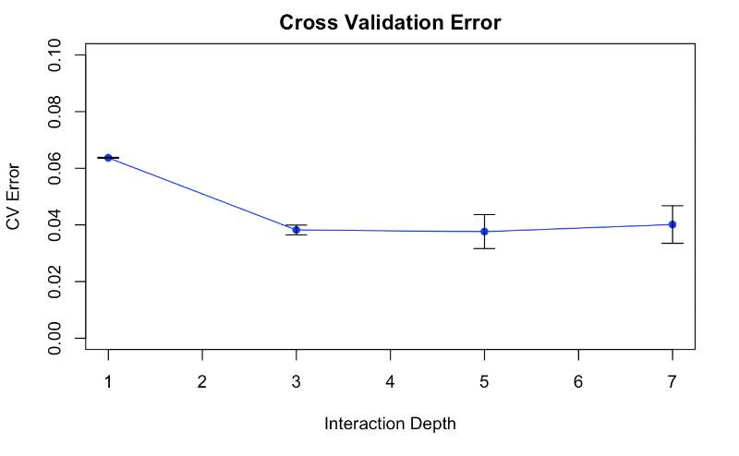
Improved Model

Slide 10
Results & Comparison

Slide 11
Improved Model Validation （1500 images）
Baseline Model
Speed:
Feature Extraction: 160.55s
Model Training: 1555.16s
Super Resolution: 3065.42s
MSE: 0.01163452
PSNR: 22 round
Improved Model
Speed:
Feature Extraction: 144.92s
Model Training: 2004.83s
Super Resolution: 4652.67s
PSNR:
Need time to fix

Slide 12


THANK YOU

