Slide 1
Image Super Resolution
Applied Data Science Project 3
Group 9

Slide 2

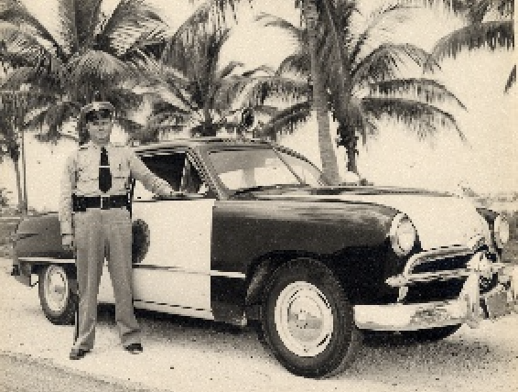
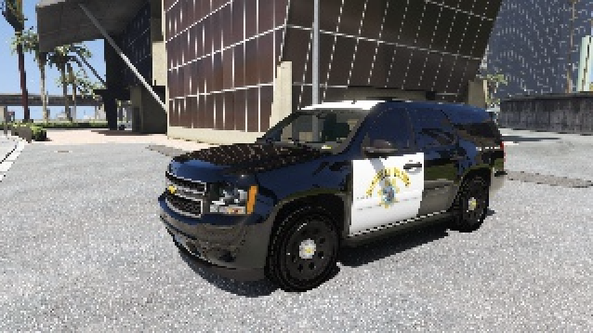




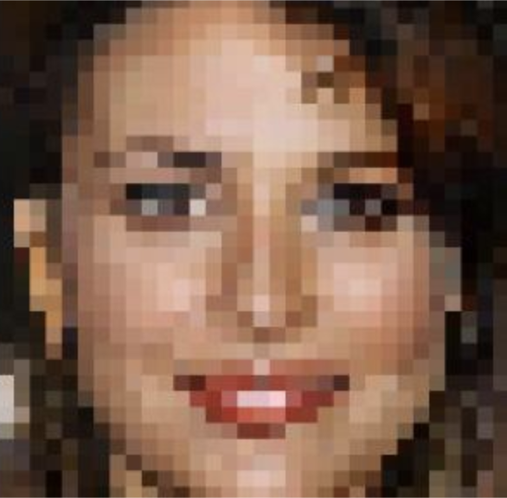
Motivation
……
Low Resolution
bigger neighborhood
Predictive model
……
smaller neighborhood
High Resolution
Train model

Slide 3
Proposed Algorithm
Intuition
1. More information extracted from LR images
Larger neighbour around the sample point
More pixel points sampled from each image

Slide 4
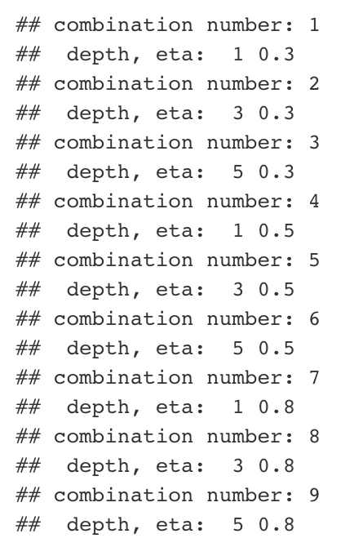
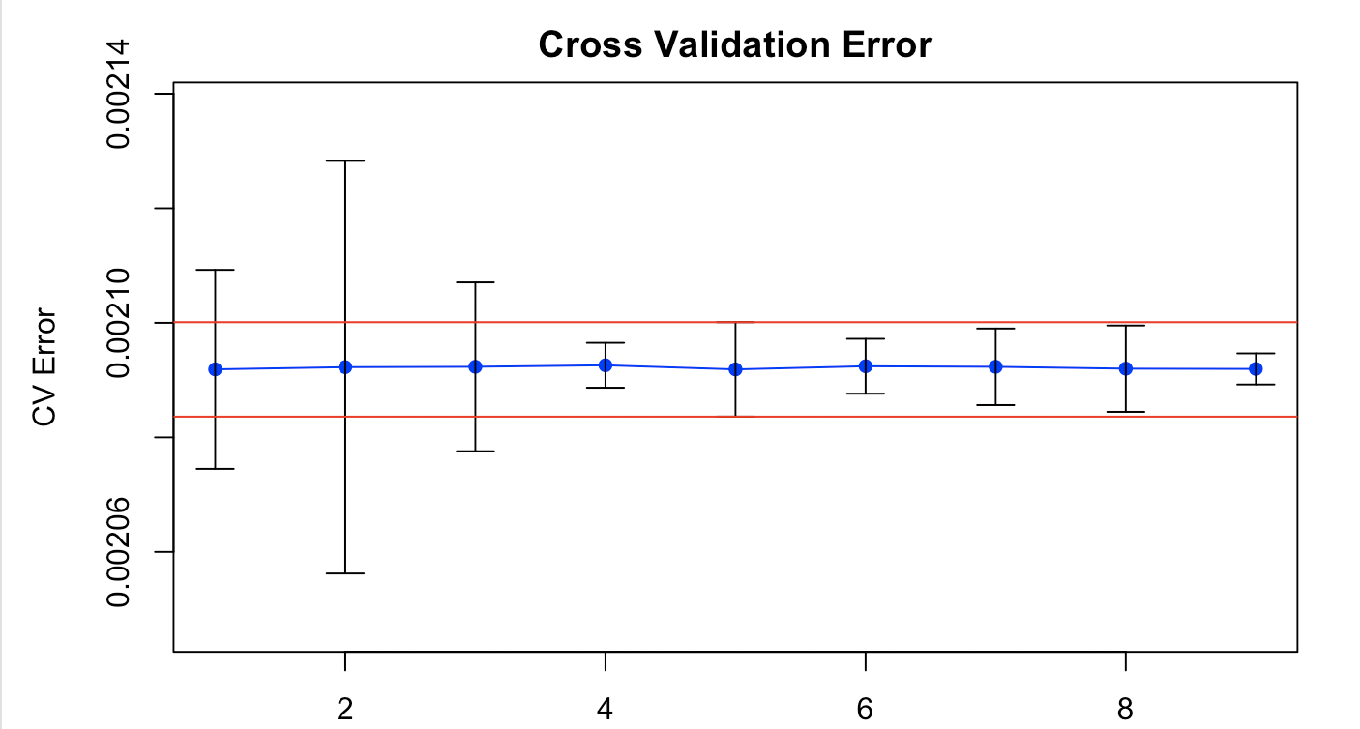
Proposed Algorithm
Intuition
2. More parameters tuned
Tune max depth and learning rate at the same time
Apply “one-standard-error rule” in cross validation process
Notes:
Choose the simpliest model whose error is no more than 1 standard error above the error of the best model

Slide 5
Proposed Algorithm
Intuition
3. Take advantage of a faster package
“xgboost” package in r
More options of tuning parameters
Notes:
Choose the simpliest model whose error is no more than 1 standard error above the error of the best model

Slide 6
Proposed Algorithm
Intuition
3. Take advantage of a faster package
“xgboost” package in r
More options of tuning parameters
Notes:
Choose the simpliest model whose error is no more than 1 standard error above the error of the best model

Slide 7
Proposed Algorithm
Performance
1. Time
 | Baseline Model | Proposed Improvement | Rate
Feature Extraction | 97.2 s | 125.2 s | Increase 28.8%
Train Model | 16.51 s | 4.1 s | Decrease 75.2%
Notes:
Choose the simpliest model whose error is no more than 1 standard error above the error of the best model

Slide 8
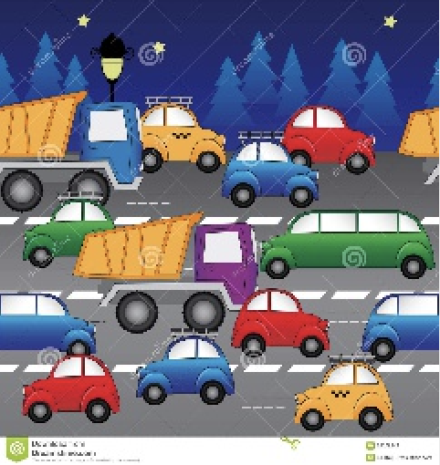
Proposed Algorithm
Performance
2. Accuracy
 | Baseline Model | Proposed Improvement
cross-validation PSNR | 25.87 | 26.79
Notes:
Choose the simpliest model whose error is no more than 1 standard error above the error of the best model

Slide 9
Advantage & Limitations
Faster implementation of gradient boosting
However, limited power of the algorithm

Slide 10
Thank you!

