Slide 1
PAPER RE-PERFORMANCE
OCR
DETECTION
AND CORRECTION
Team: Shiqing Long, Yingqiao Zhang, Yiding Xie, Yang Yue

Slide 2
CONTENTS
PART ONE
Detection
PART TWO
Correction
PART THREE
Evaluation

Slide 3
01
DETECTION

Slide 4

PART ONE
DETECTION
EIGHT RULES
>20 Characters
#Punctuation > #Alphanumeric
>=2 Different Punctuations in a String
>= 3 Identical Characters in a row
EIGHT RULES
＃Uppercase > ＃Lowercase Characters #Uppercase Characters < #Total Characters
If all alphabetic, #consonants > 8 *# vowels, or vice-versa
>= 4 consecutive vowels or >=5 consecutive consonants
1st and last characters are both lowercase and any other character is uppercase

Slide 5
02
CORRECTION

Slide 6
Candidate
Search
Feature
Scoring
Candidate
Ranking
Step 01
Step 02
Step 03
COMPANY | LOGO
Notes:
1.considering all the words available in the vocabulary within a limited distance
2.then use features to narrow down the candidates number.
3. model could provide the correction in top three suggestions

Slide 7

PART TWO
CORRECTION
Candidate Search
Limited number of character modifications, that is
For each error, calculate its Damerau-Levenshtein Distance with all words in Corpus
Top 50 min Distance, Unique 1 Error => 20 Candidates
COMPANY | LOGO

Slide 8
PART TWO
CORRECTION
Feature Scoring
Levenshtein Edit Distance
String Similarity
Language Population
Longest
Common
Sequence
Candidate Frequencies
The larger, the better
Spelling Difference
TITLE HERE
Detect Words in Subjects
N-gram Frequency
Put Candidates in N-gram Context
Lexicon Existence
Exact-context Popularity
Relaxed-context Popularity

Slide 9
PART ONE
CORRECTION
Candidate Ranking
Formulate confidence as prediction, a regression problem
What is AdaBoost.R2?
Proposed by Drucker, used for regression problems
How to build model?
Use 6 sores as features, label Candidates as 1 if is Correctly predicted, otherwise 0
Data Imbalance, resample
Build AdaBoost.R2 Model to predict confidence
COMPANY | LOGO
Notes:
Sample the number of 0 as same as number of 1

Slide 10
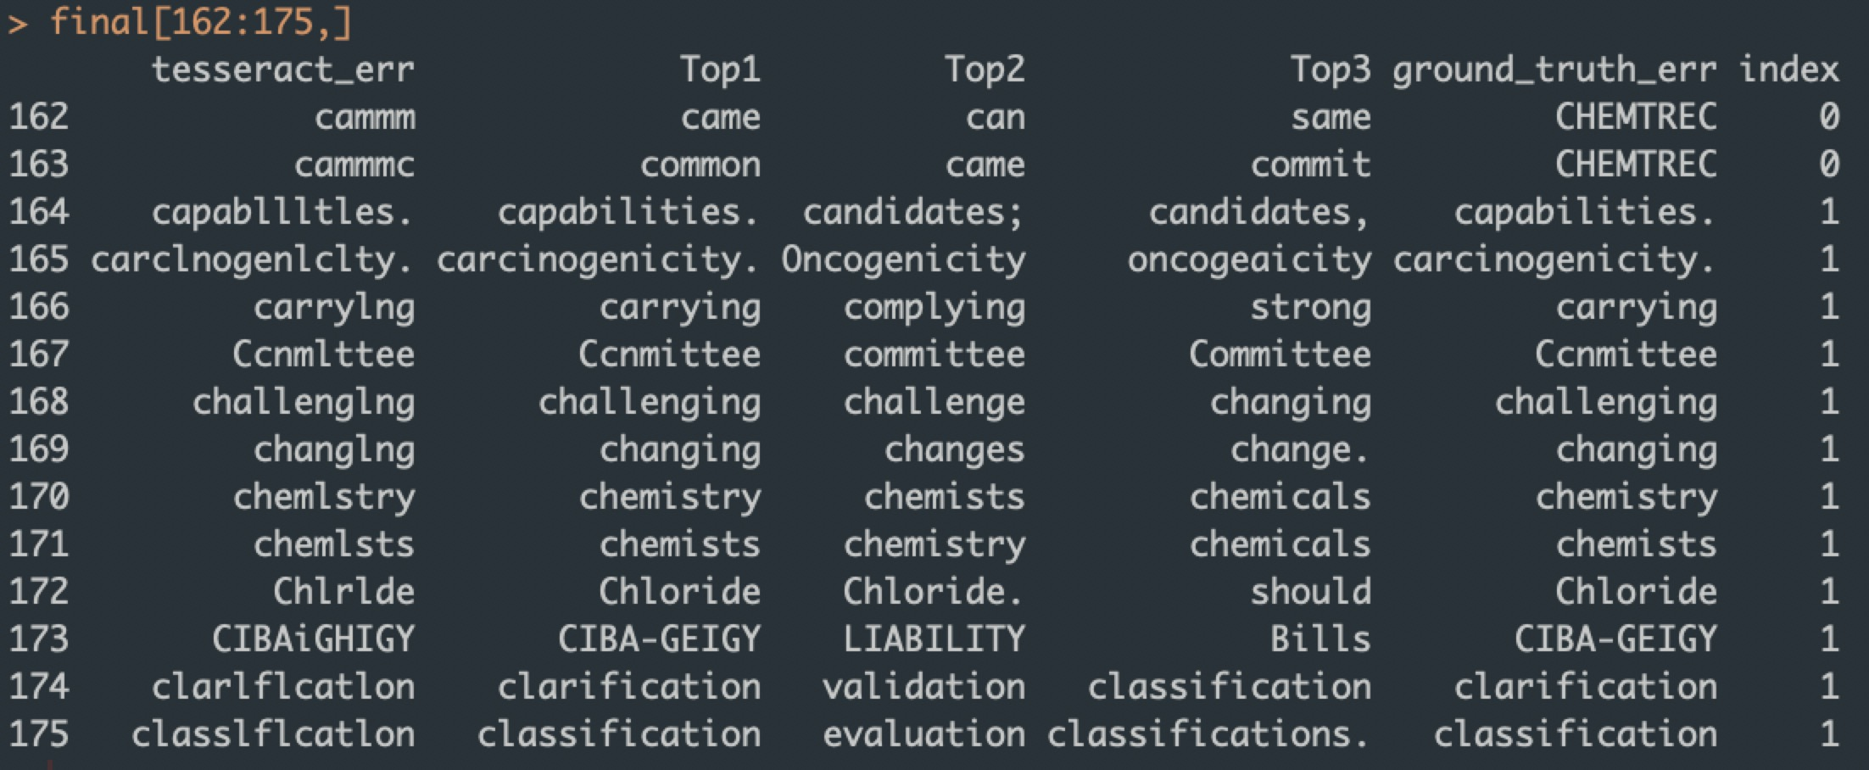
PART ONE
CORRECTION
Candidate Ranking
Prediction
Error
Ground Truth
Index
Model Evaluation
Any prediction in Top 3 matches ground truth
Accuracy: 84.6%

Slide 11
03
EVALUATION

Slide 12
THANK YOU!

