Slide 1
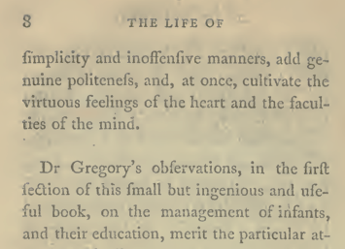
Algorithm Implementation and Evaluation
Group1 Shilin Li, Zehan Wang, Yiqiao Yin, Qiaqia Sun, Peiqi Jin

Slide 2
Overview
Papers:C4+D1
Objectives
Error detection
Error correction
Evaluation

Slide 3
1. Objectives
We have processed raw scanned images relying on the Tessearct OCR machine
BUT this is not the FOCUS of our project!!!
In this project, we are going to focus on post-processing which includes two tasks: error detection and error correction

Slide 4
2. Error Detection
Methods 1
Methods 2
Methods 3
Methods 4
Ignoring the first and last characters in a string, if there are two or more different punctuation characters in the string, it is garbage.
Example: b?bl@bjk.le.322
If all the characters in a string are alphabetic, and if the number of consonants in the string is greater than 8 times the number of vowels in the string, or vice-versa.
Example:jabwqbpP
If the number of punctuation characters in a string is greater than the number of alphanumeric characters,it is garbage.
Example: ?3//la’
If a string is more than 20 characters in length, it is garbage.
Example: iiiiiiiiiiiii…..
by | C: 2
my | V: 0
Methods 5
Methods 6
Methods 7
Methods 8
If there are three or more identical characters in a row in a string, it is garbage.
Example: aaaaaBlE
If there are four or more consecutive vowels in the string or five or more consecutive consonants in the string, it is garbage.
Example: buauub
If the first and last characters in a string are both lowercase and any other character is uppercase, it is garbage.
Example: awwgrapHic
If the number of uppercase characters in a string is greater than the number of lowercase characters, and if the number of uppercase characters is less than the total number of characters in the string, it is garbage
Example: BBEYaYYq

Slide 5
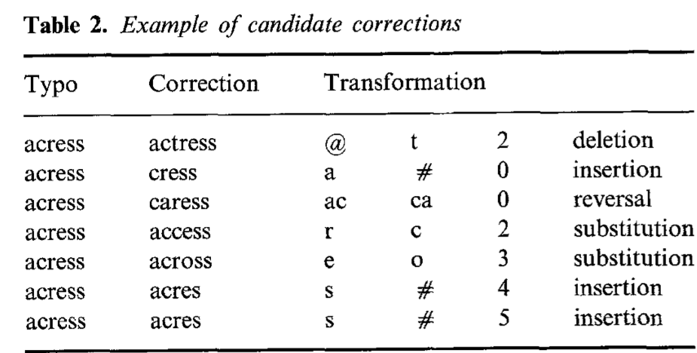
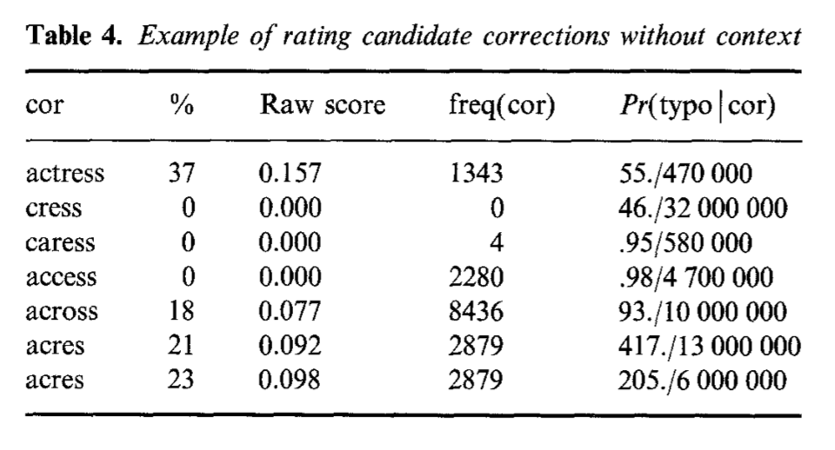
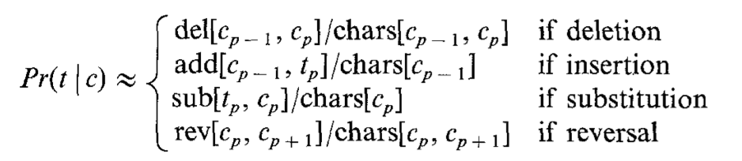
3. Error Correction

Slide 6
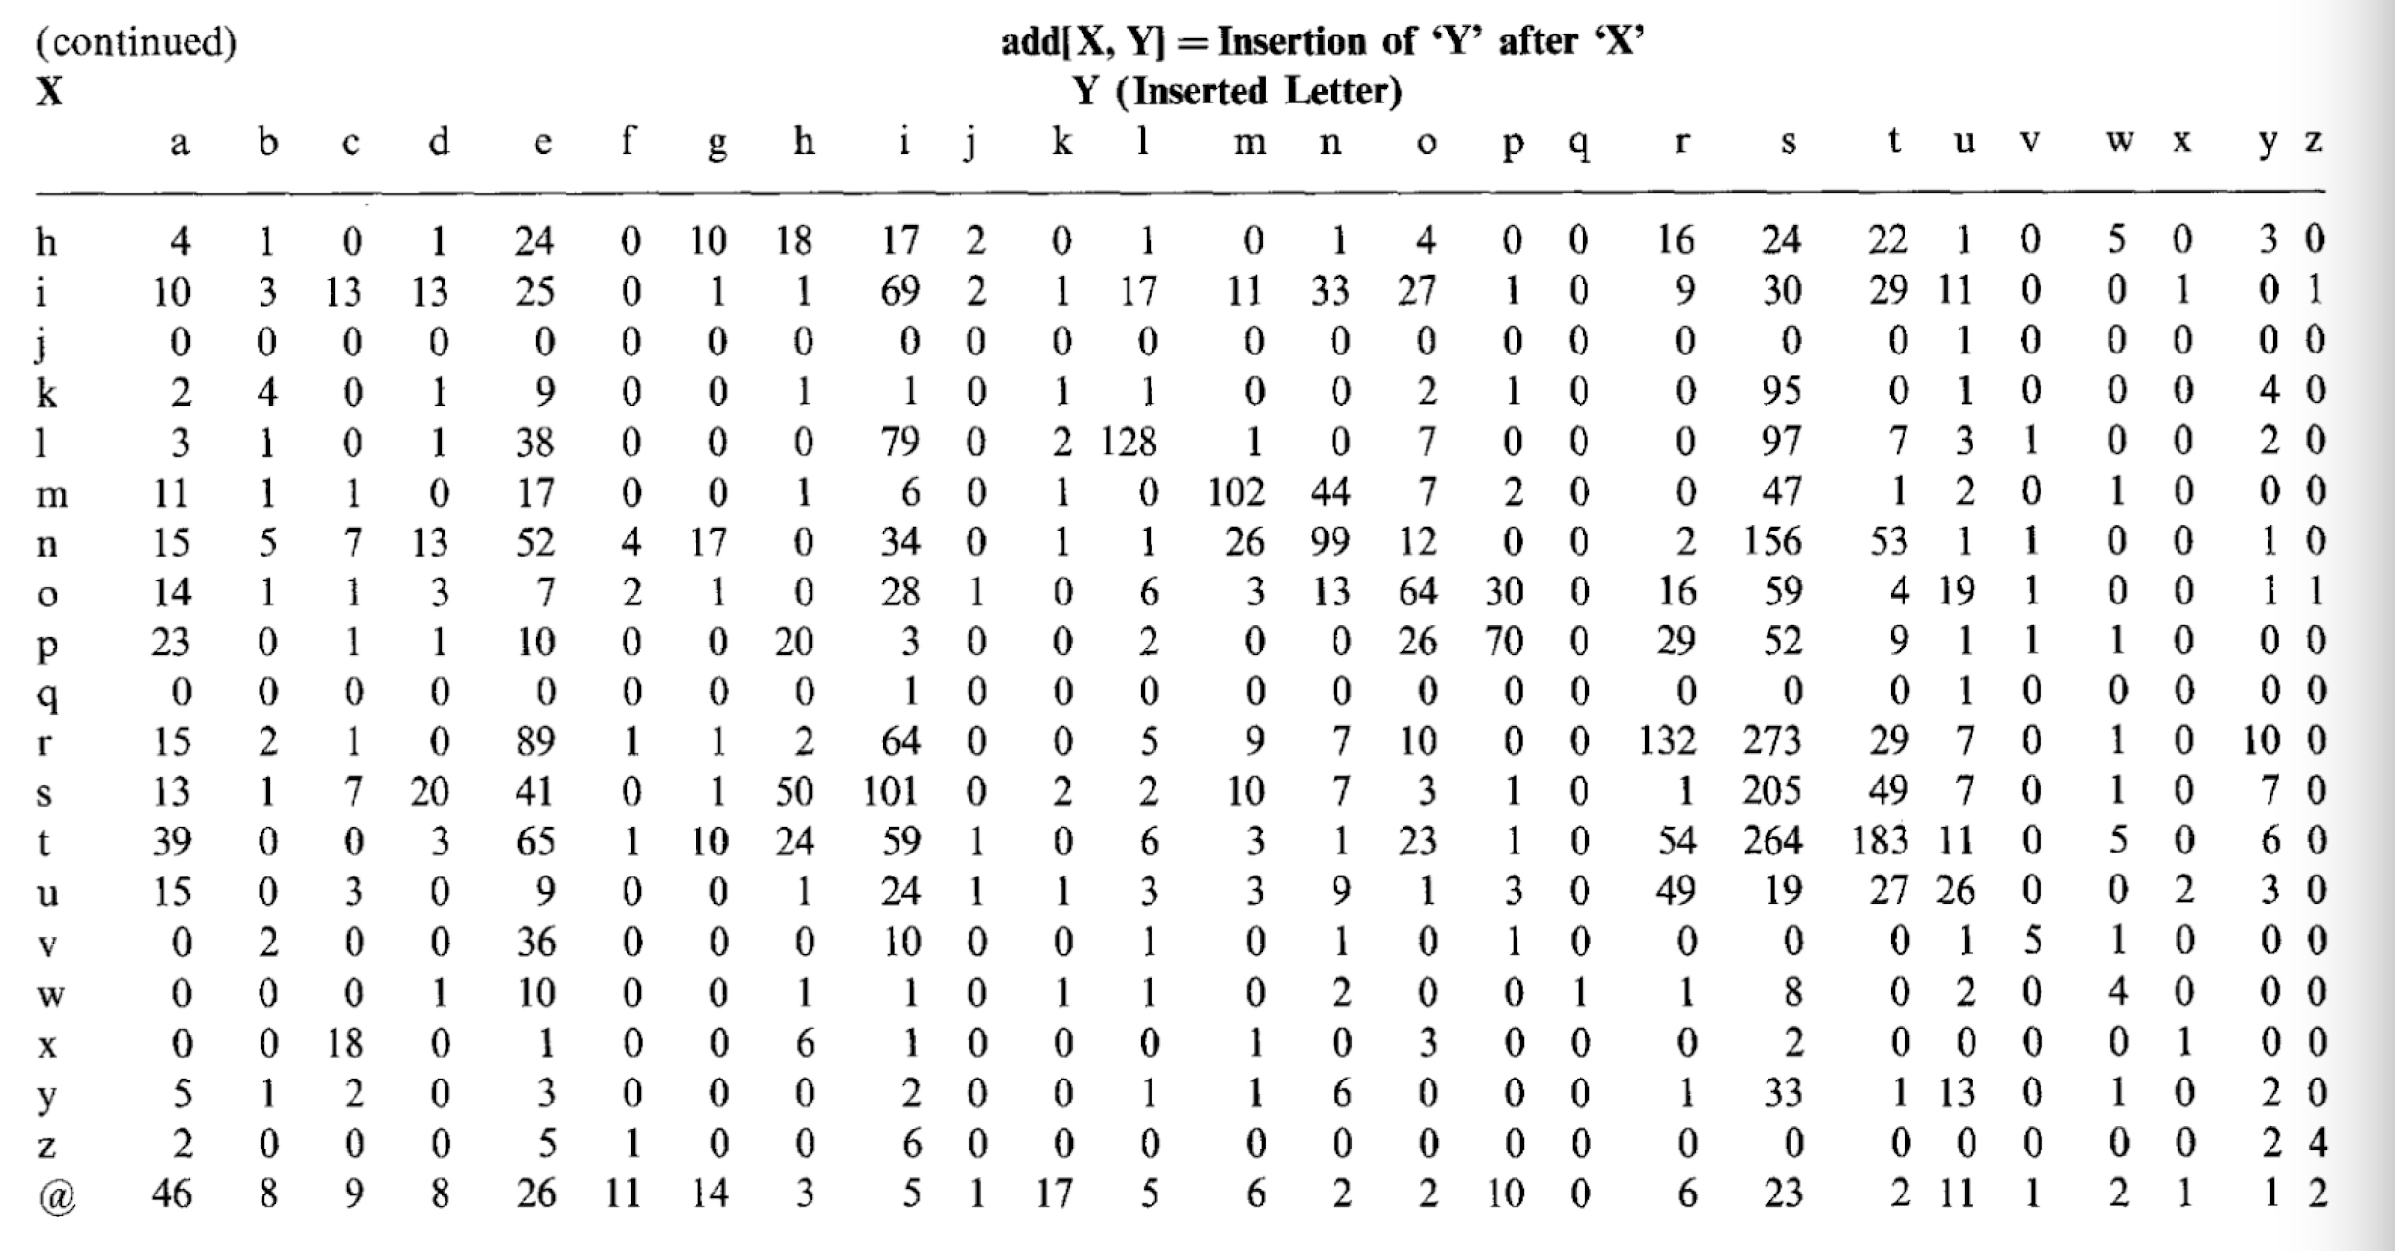

Slide 7
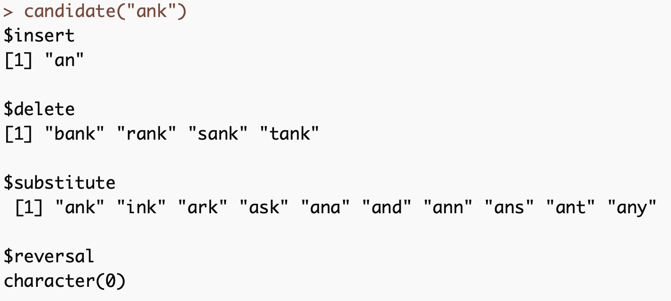
Candidates selection:

Slide 8
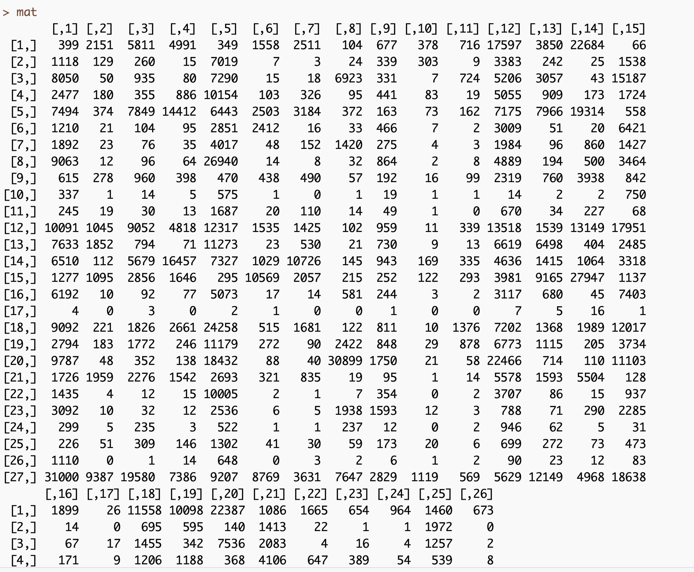
What we got:
The Denominator Matrix
& Characters Frequency

Slide 9
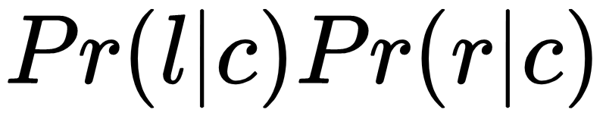



The Inferior methods of estimating
If we assume that the context is determined by the adjacent words, and , and that these factors are independent with each other and with the typo, then we can use the formula:

Slide 10
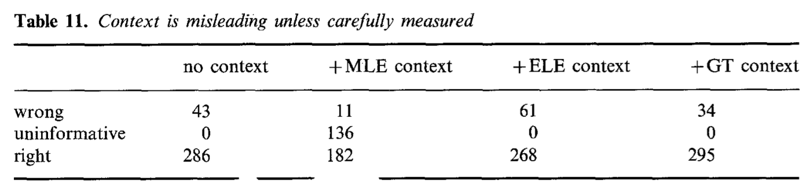
MLE and ELE:
The MLE is particularly poor when observed frequencies is equal zero, since the true probabilities are probability greater than 0 in some case.
We can assume an uninformative prior and reach a posterior distribution for p. We call this the expected likelihood estimate (ELE).
Unlike the MLE, ELE estimates assign non-zero probabilities, even when the observed frequencies is equal zero. This is probably a desirable property.

Slide 11
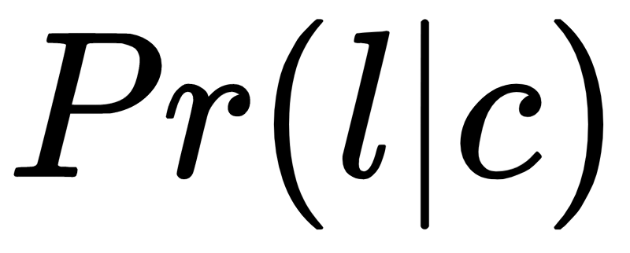
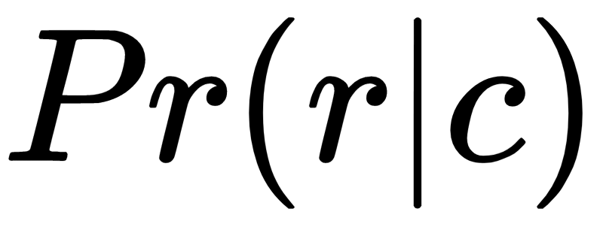
The Inferior methods of estimating
The MLE method is uninformative in nearly half of the cases because either or is zero. Simple attempts to fix these zeros can be disasterous.
The ELE, for example, badly overestimates the probability of a bigram that has not been seen in the training set, and consequently, it is wrong more often than it is right. Formula: (freq(c) + 0.5)/(N+V/2)
A more sophisticated method of fixing the zeros based on the Good-Turing(GT) estimate is for the future study.

Slide 12

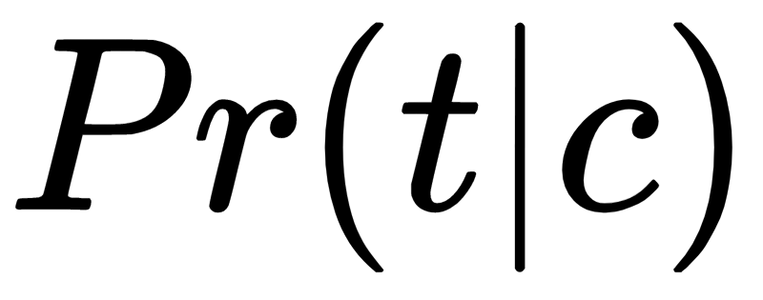
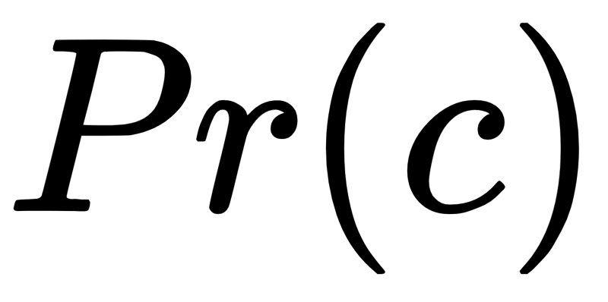
Compute
Computed from four confusion matrices
Estimated by ELE, is freq(c)+0.5)/(N+V/2), where freq(c) is the number of times that the proposed correction c appears in corpus.
> candidate_list(“acress”)
$insert
[[1]] acres acces
$delete
[[2]] actress
$substitue
[[3]] access across
$reversal
[[4]] caress
[[1]] | (1, 1.5) | (3, 3.5)
[[2]] | (2, 2.5)
[[3]] | (1, 1.5) | (4, 4.5)
[[4]] | (0, 0.5)
Group 23 | 13

Slide 13
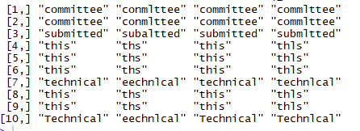
Outcome of Ground truth, MLE, ELE& typo
 | Ground Truth | MLE | ELE | Typo

Slide 14
4
Evaluation

Slide 15
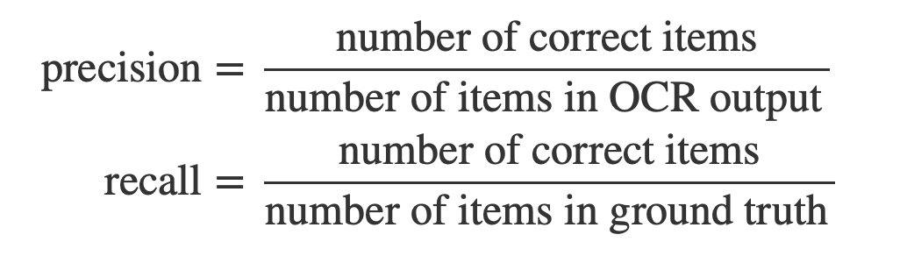
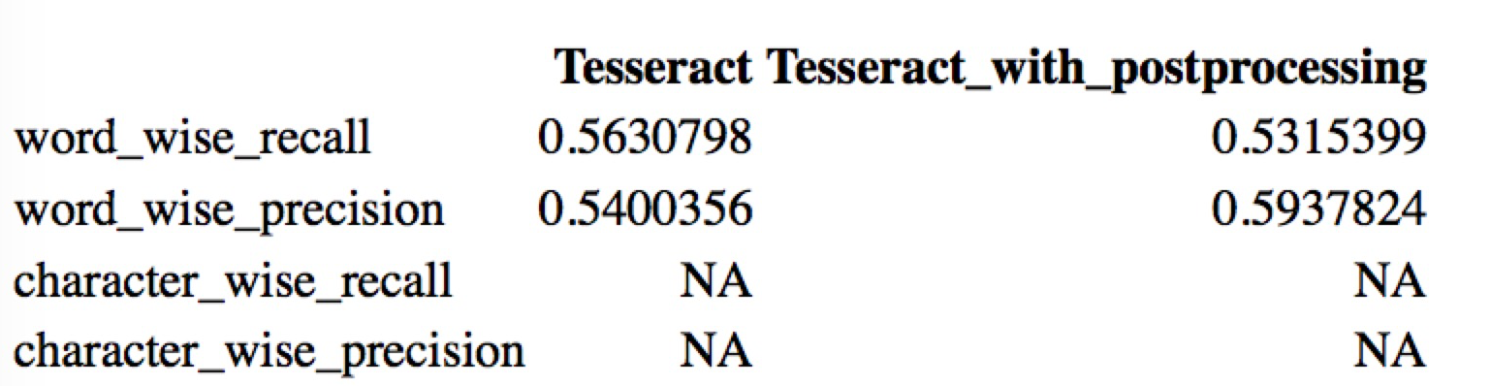
Performance measure
 | Tesseract | Tesseract_with_ postprocessing_MLE | Tesseract_with_ postprocessing_ELE
word_wise_recall | 0.6306212 | 0.6590778 | 0.6654901
word_wise_precision | 0.6223755 | 0.6590778 | 0.6654901
character_wise_recall | 0.9053267 | 0.9116422 | 0.9126347
character_wise_precision | 0.9191743 | 0.9228908 | 0.9238955

Slide 16
Thanks!
Any questions?

