Slide 1
Optical Character Recognition (OCR)
Group 10
Chenzhong Zhong|Fangqi Ouyang|Yiming Shi|Sarah Faye Wu

Slide 2
Overview
Task
Error Detection
Error Correction
Performance Measure
Limitation

Slide 3
Task
Our task is to implement and evaluate an algorithm for OCR post-processing to enhance Tesseract OCR output
Algorithm Sources:
1. Detecting Garbage in OCR Output on Historical Documents (D3)
2. Context-Sensitive Error Correction (C5)
Notes:
We are assigned to papers D3 and C5
D3 is talking about an SVM based Garbage detection method in OCR Output of Historical Documents
C5 talks about a Context-Sensitive Error Correction method

Slide 4

SVM Error Detection
Extracted 13 features for every word in tesseract outputs
Most basic: length; number of vowels, consonants, special symbols, upper/lower case, digits, consecutive same symbol, consecutive consonants; most frequent symbol; non-alphabetical symbols;
Bigram: calculate “naturalness” :
Notes:
Here are some details of our error detection.
We extracted 13 features of every word in tesseract files in our training set. Besides those features regarding some basic rules about number of vowels, consonants, special symbols etc in a word. We measures the frequency in a word of common letter bigrams like “th”,”ca”,
And also the levenshtein distance, a feature that takes into account the change in spelling of historical words.
The feature extraction can take 3 hours.

Slide 5
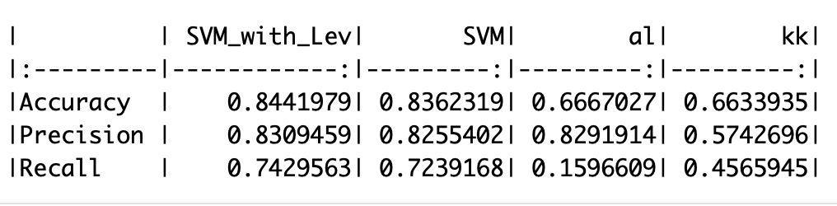
SVM Error Detection
Result
Notes:
SVM is also time consuming due to the process of parameter tuning. But the results are satisfying. The table here shows the performance of our error detection.
Three indicator shows the type I error and the power of our test . (The ratio of truly error words in all the words we classify as error)
Svm WITH LEV DISTANCE is slightly betters than svm without the distance, but both are better than the simple rule based detection.

Slide 6
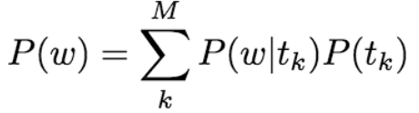
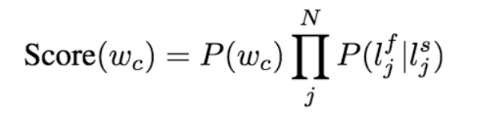
Topic Modeling For Error Correction
Error Correction Algorithm
Topic Model
OCR Model
Character Errors Probability
Word Probability
Notes:
Given the detected word error, in order to find the best correction, we need to generating some candidates from a dictionary. The dictionary contains the unique words in ground truth file for training plus the stop words we removed before topic modelling. Look at the first equation of topic model candidate probability, if omega is a stop word we set this to 1, because stop words are very common. Then we need to invoke some character level similarity measure between the misspelled string and the candidates based on OCR error model.

Slide 7
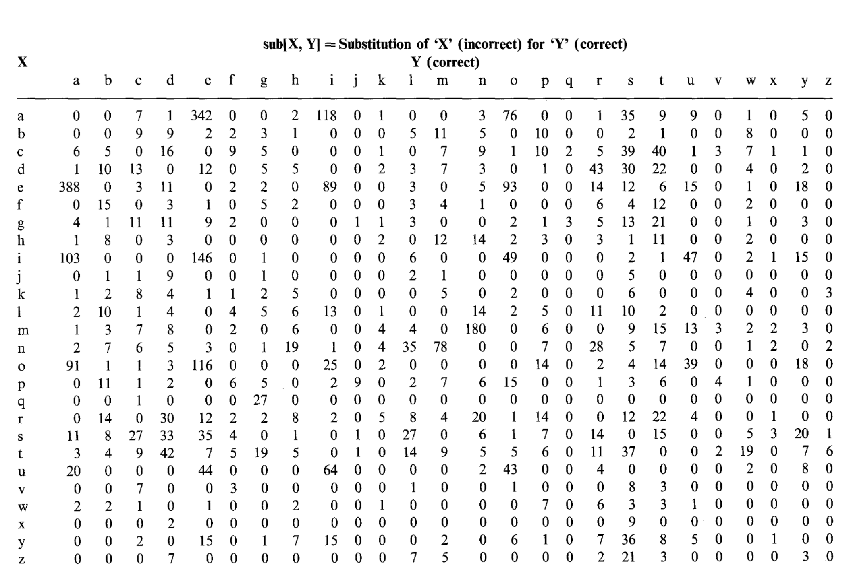
Error Correction
The candidate list is generated by applying Substitution Transformation
Confusion matric ( calculate Pr(l_{j}^{f} |l_{j}^{s}) )
Notes:
This matrix is an empirical OCR error model we used in the scenario of substitution type OCR error . Of course there are other kinds of OCR error, like insertion or character missing, but paper C5 seems to ignore these kinds of errors

Slide 8
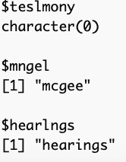

Limitation
We do not know undetected word errors.
We can only replace detected word error with the same length of post-corrected words in ground truth.
We only consider the substitution transformation, do not think of Deletion, Insertion, Reversal situation.
The correct words in dictionary was considered as wrong words, but our model can return the same word.
Notes:
As you can see we fail to give correction to the first error word, which should obviously be testimony. Compared to the third error, the first one drops one letter besides mistaking i for l.
Some time we miss classify right words to error, but if it’s in our dictionary, we return the same word,

Slide 9
Summary
Tessearct OCR output
Detected Word Error
Undetected Word Error
Capital
Punctuations
Numbers
Correctable Words
Uncorrectable Words
Right (Stopwords,etc)
Wrong
Fail to give correction
Notes:
Here is the summary,a structure of our process and the source of error. In the detection part there are undetected error and misclassified right words. Given the error words returned by detection, there are uncorrectable words containing capitals, symbols or numbers . And if it’s correctable words we may give wrong correction or we fail to give any correction.

Slide 10
Performance Measure
 | Tesseract | Tesseract_with_postprocessing
Word_wise_recall | 0.6209315 | 0.8800251
Word_wise_precision | 0.5525367 | 0.8785890
Character_wise_recall | 0.8835865 | 0.9010333
Character_wise_precision | 0.8163117 | 0.8990259
Notes:
And here is our performance measure. As you can see post processing did improve the accuracy of tesseract files.

Slide 11
Thank you!!!!
Q & A

