Slide 1
Post-processing For OCR Data
Group Members: Cai Yang, Cui Jiayi, Nannan Wang,
(group 2) Yang Yang, Yu Wenting
Use topic models to improve OCR (D1,C5)

Slide 2
Content
1
Data Cleaning
Error Detection
Part I
Part II
Error Correction
Performance Evaluation
Part III
Part IV

Slide 3
PART I Data Cleaning Process
2
Load Data
Clean Text
Delete Uneven
Comparing with ground-truth by rows
Delete the uneven lines.
Uneven: in our project means two lines don’t equal number of characters.

Slide 4
PART II Error Detection（garbage words）
3
From Paper D1 Sectiom2.2
8 Error Detection Rules
01
02
03
04
06
05
07
08
A string composed of more than 20 symbols is garbage.
If the number of punctuation characters in a string is greater than the number of alphanumeric characters.
Ignoring the first and last characters in a string, if there are two or more different punctuation characters in the string
If there are three or more identical characters in a row in a string
If the number of uppercase characters in a string is greater than the number of lowercase characters, and if the number of uppercase characters is less than the total number of characters in the string
If all the characters in a string are alphabetic, and if the number of consonants in the string is greater than 8 times the number of vowels in the string, or vice-versa,
If there are four or more consecutive vowels in the string or five or more consecutive consonants in the string, it is garbage
If the first and last characters in a string are both lowercase and any other character is uppercase

Slide 5
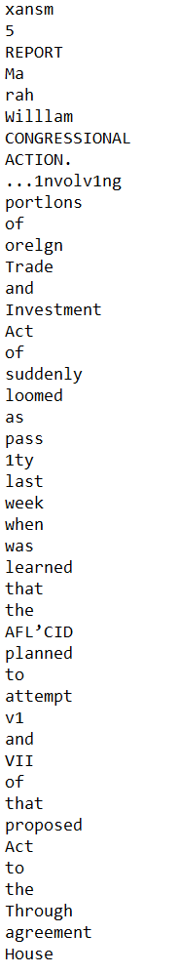
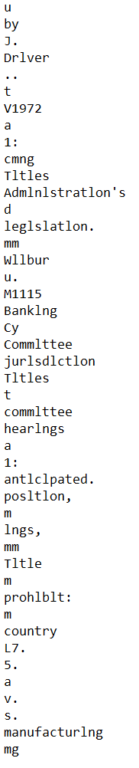
PART II Error Detection（garbage words）
3
From Paper D1 Sectiom2.2

Slide 6
PART III Error Correction-Topic Models
4
From Paper C5 Section 3.2
Step1 LDA Topic Models
Step2 Calculate Confusion Matrix
Step3 Compute Scores
Step4 Correct
Generate
30 topics
for each documents
and compute
the probability
Doing Fuzzy Matching
Generate Confusion
Matrix
Generate all possible word candidates
Compute scores for each candidates using step1 & step2
For each words
select the
highest score
Correct the words

Slide 7
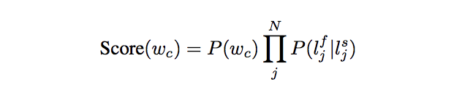




PART III Error Correction-Topic Models
5
From Paper C5 Section 3.2
Probability of a word under
a topic
Probability
of a topic in a document

Slide 8
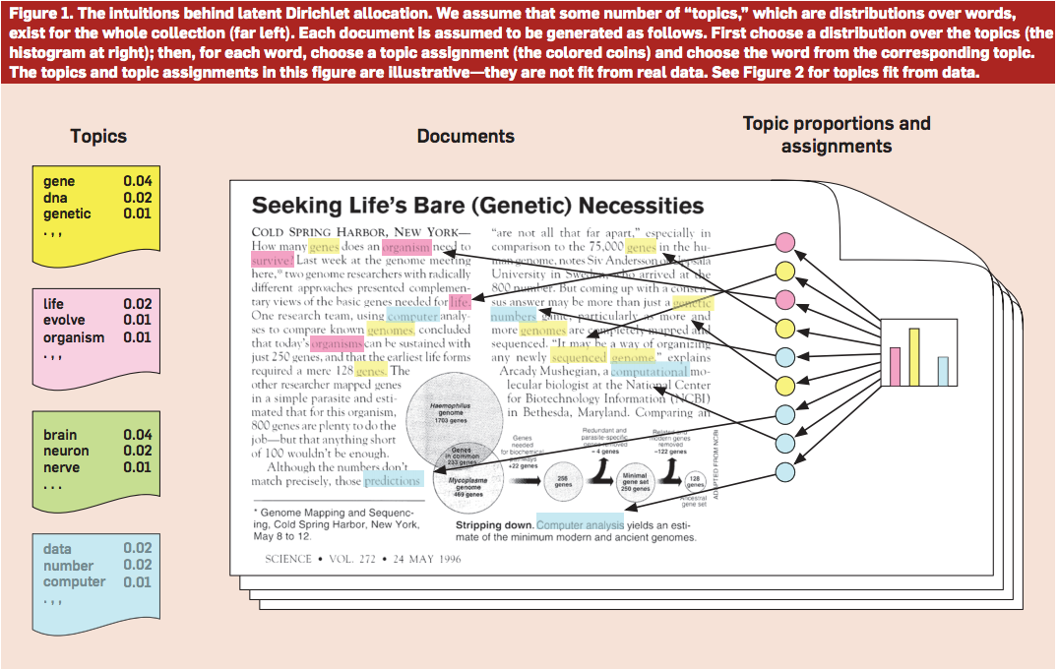
6
Step1 LDA Topic Models

Slide 9
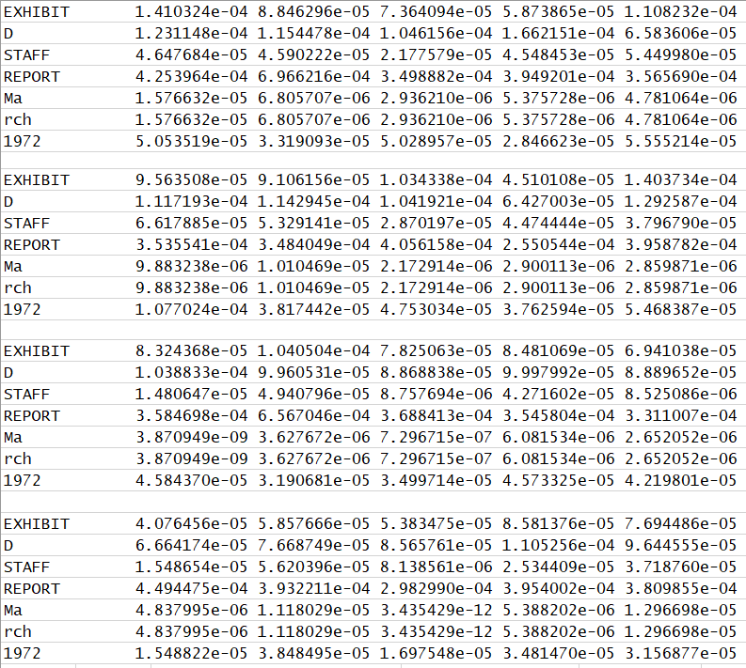
7
LDA Topic Models
Train set: 80 documents
Test set: 20 documents
P(W) -- Result

Slide 10
8
Step2 Confusion Matrix -- Fuzzy Matching
Step1
LD_similarity=1-(levenshtein distance)/(nchar of actual world)
##Levenshtein distance : the minimum number of deletions, insertions, or substitutions required to transform string_s into string_t
Step2
Choose the one with largest LD_similarity in CANDIDATE_NUM(here we choose 3) of OCR words.
Step3
To match the actual word.
If none of these candidate has LD_similarity above SIM_THRES(we choose 0.5), then give up this actual word.
We also give up the words which do not have the equal length
Confusion Matrix

Slide 11
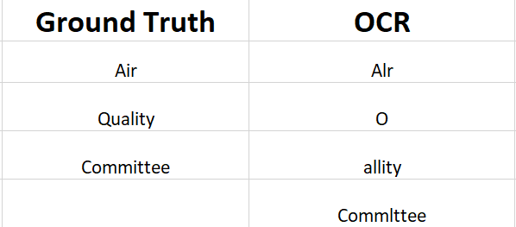
9
Step2 Confusion Matrix -- Fuzzy Matching
Alr : LD = 1
O : LD = 4
allity : LD = 5
Alr : LD_similarity = 1-1/3 = 2/3 > 0.5
O : LD_similarity = 1- 4/3 = -1/3
allity : LD_similarity = 1-5/3 = 2/3
Confusion Matrix
O : LD = 7
allity : LD = 3
Commlttee : LD = 8
O : LD_similarity = 1- 7/7= 0
allity : LD_similarity = 1- 3/7 = 4/7 > 0.5
Commlttee : LD_similarity = 1- 8/7= -1/7

Slide 12
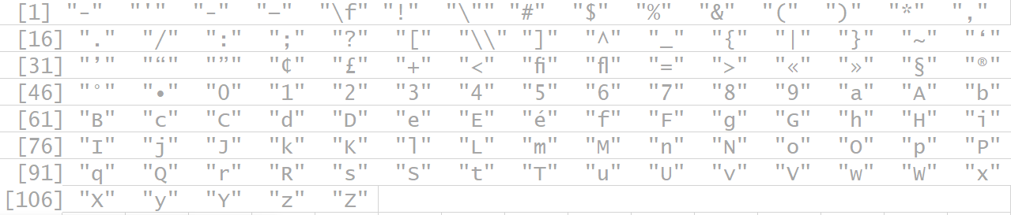
10
Step2 Confusion Matrix -- results: 110 * 110 matrix
110 strings :u sioat

Slide 13
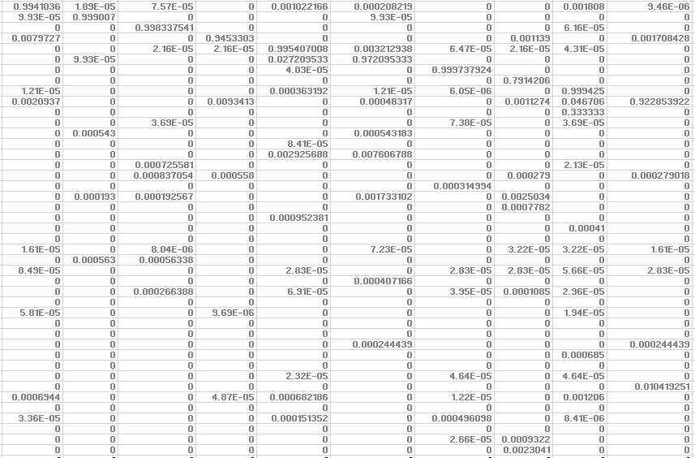

11
Step2 Confusion Matrix -- results: 110 * 110 matrix
Part of Matrix :u sioat

Slide 14

12
Step3 Compute all candidates Scores
(generate all possible candidates)
Step4 Select the best candidates (the highest score)
+ bias(1+e5)
Truth | Tesseract | Processed Tesseract
exhibit | exhlblt | exhibit
driver | driver | driver
before | before | before
in | 1n | an
last | last | last

Slide 15
PART IV Performance Evaluation
13
From Paper —— A Fast Alignment Scheme for Automatic OCR Evaluation of Books (Ismet Zeki Yainiz, R.Manmatha）
Step1
Step2
Step3
Step4
Find unique words in two texts separately. And only the ones that appear in both texts are used.
Use unique words as anchors to split each segment into smaller ones
Delete unique words from all segments (delete the first and the last word in every segments)
Use levenshtein distance to calculate the number of incorrect characters in every segments
The distance gives the minimal possibly weighted number of insertions, deletions and substitutions needed to transform one string into another.
Calculate precision and recall
Recall: number of correct items/number of items in ground truth

Slide 16
PART IV Performance Evaluation
14
 | Tesseract | Tesseract with (detection) | Tesseract with (correction)
Word_wise_recall | 0.6245921 | 0.5822522 | 0.631548
Word_wise_precision | 0.6160689 | 0.7250324 | 0.7087555
character_wise _recall | 0.72467 | 0.48775 | 0.8747239
character_wise _precision | 0.71864 | 0.47854 | 0.8936824
Have a nice day!

Slide 17
Thanks for Listening !
Have a nice day!

