Slide 1
Customer Revenue Prediction
Prediction and Inference

Slide 2
Goal: To compare models To
Predict if a customer is going to make a purchase
Predict average revenue per customer
Hits
Medium
Channel
Geography
Device
Source

Slide 3
PROBLEM!!
……..The data is Imbalanced.
No Purchases | Purchases
98.74% | 1.26%

Slide 4
Two Stage Approach
Processed Data
Classification
Regression
RMSE

Slide 5
EDA

Slide 6
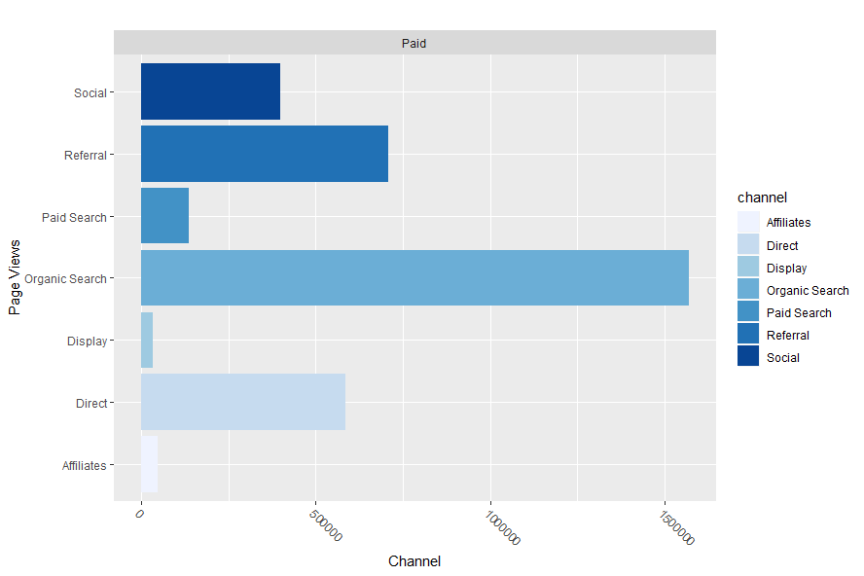
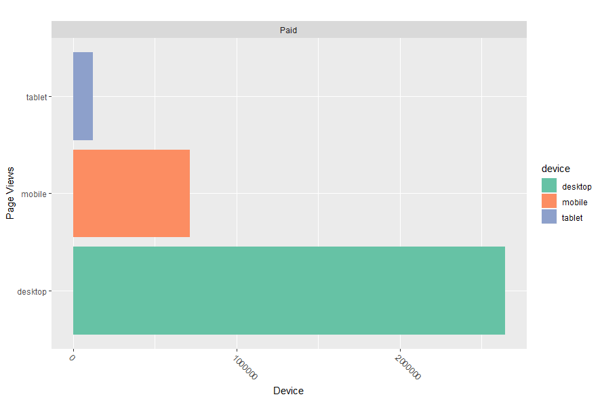
Channels for Paying vs Free customers
Hits by Device for Paying vs Free customers

Slide 7
One Stage Models
Classification/Regression

Slide 8

One-Stage Models
XGBoost Linear Regression
XGBoost Tweedie Regression
Classification Models

Slide 9
XGBoost Linear Regression
Hyper Parameters:
Eta = 0.1
Maximum Depth = 8
Number of rounds = 100
Train RMSE | Test RMSE
1.07 | 1.7

Slide 10
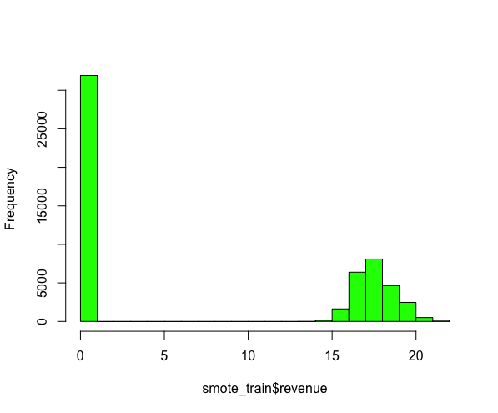
XGBoost Tweedie Regression
The Tweedie distribution has a point mass at zero before following a “regular” exponential curve.
Train RMSE | Test RMSE
1.07 | 1.68

Slide 11
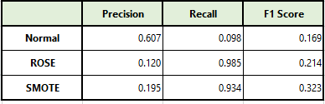
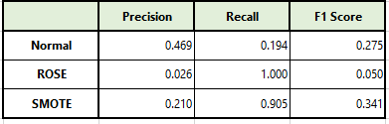
Classification Results
Regular Classification
Boosted Classification
Notes:
SMOTE has the highest F1 for both methods

Slide 12
One-Stage Models
XGBoost Linear Regression
XGBoost Tweedie Regression
Classification Models

Slide 13
Two Stage Models
Classification + Regression

Slide 14
Two Stage Models
Penalized LDA + Lasso Regression
Boosted Trees SMOTE+ xgboost (Full Power Boost)

Slide 15
Penalized LDA + Lasso Regression
Test RMSE
1.342
The same results were obtained for Ridge

Slide 16
Boosted Trees SMOTE+XGBoost Linear
Why?
Method
Train RMSE | Test RMSE
6.5 | 6.76

Slide 17
Two Stage Models
Penalized LDA + Lasso Regression
Boosted Trees SMOTE+ xgboost (Full Power Boost)

Slide 18
THANKS!

Slide 19
Results

Slide 21
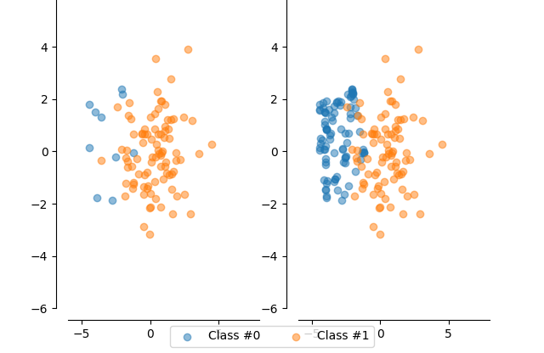
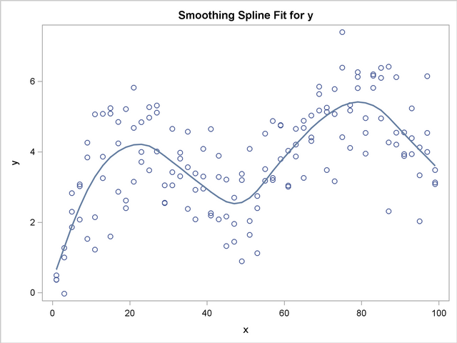
Boosted Trees SMOTE+Spline
+
Train MSE | Test MSE
6.6 | 6.7899

Slide 22
Regression
 | MSE | Advantages | Disadvantages
 | 10 | 20 | 7
Imbalanced Lasso | 30 | 15 | 10
XGBoost | 5 | Fast | Tendency to overfit

Slide 24
Appendix

Slide 25
SlidesCarnival icons are editable shapes.
This means that you can:
Resize them without losing quality.
Change fill color and opacity.
Change line color, width and style.
Isn’t that nice? :)
Examples:

