Slide 1

GR5243 APPLIED DATA SCIENCE
Data Analysis of Wines Reviews
Group 5
Jianping Mu
Nannan Wang
Qingyang Zhong
Han Gao
Notes:
Hello,
This is group 5, our project is working on data analysis Wine Reviews. Our goal is to find complement wines for a wine which are not sold at local liquor store.

Slide 2



Contents
1
Basic Introduction
Introduction of wine and wine market
Target of our research
2
Descriptive Statistics
Data Preview
Distribution of wine price & points
Wordcloud
3
Two Classifier
KNN
Ball Tree
4
Conclusion
Notes:
We contains four sections in this project, 1. Introduction of wine and wine market. 2. Descriptive Statistics 3. Two Classifiers 4. Conclusion

Slide 3
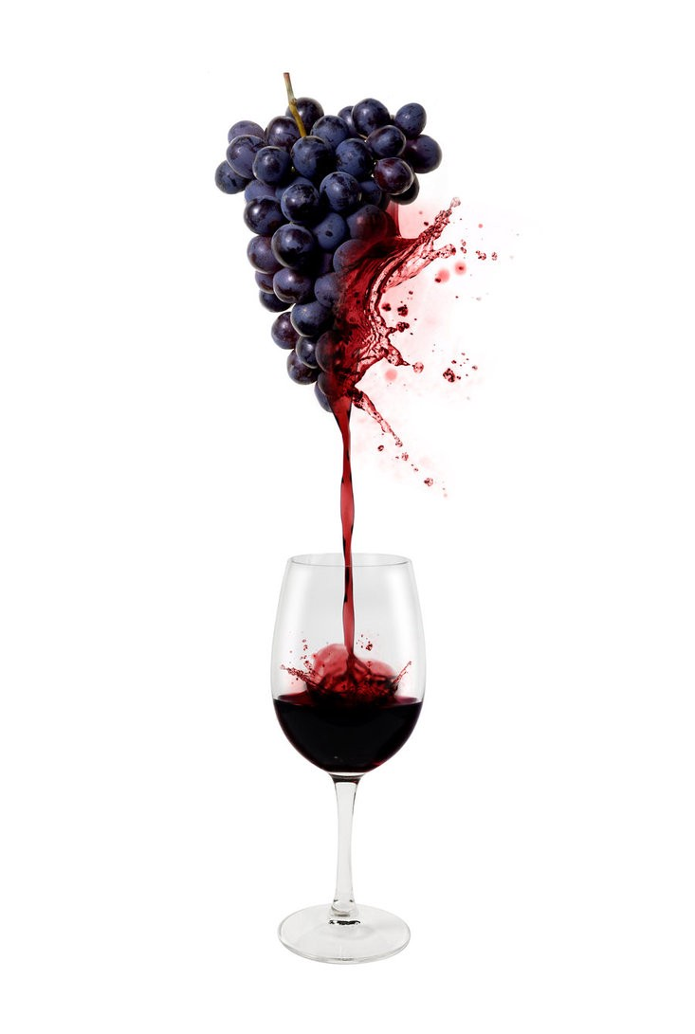
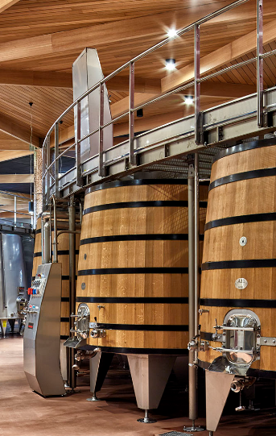
1. Basic Introduction
(1)Wine And Wine market
Wine is an alcoholic beverage made with the fermented juice of grapes, but they are different than what you’ll find at the grocery store. Technically, wine can be made with any fruit (i.e. apples, cranberries, plums, etc) but most wines are made with wine grapes.
The quality of grapes decides the quality and price of wine.
The quality of grapes decides the quality and price of wine.
Wine market is huge and growing steadily.U.S. consumers quaffed $32 billion worth of wine in 2017, and that figure is expected to reach $43 billion by 2022, an annual growth rate of more than 6%.Premium is the place to be, the “fine and premium” category (over $10 a bottle) has been almost bubbly.
Notes:
Wine market is huge and growing steadily.U.S. consumers quaffed $32 billion worth of wine in 2017, and that figure is expected to reach $43 billion by 2022Here is the brief summary of the background

Slide 4
1. Basic Introduction
(2). Target of our research
Governments
Companies
To help local governments manage the grape and wine industry and introduce suitable varieties and companies.
To assist companies build new factories in the profitable locations.
Wine
Reviews
Shops
Customers
To enhance the quality and value of money of the wine they sell. To guide them sell more popular wine.
To advise customers choose wine by the quality, money and the place of origin.
Notes:
Goal: When a local liquor doesn’t have a wine that u desire. We are better to switch to another kind of wine. Our goal is to classify wines into similar groups for customers.

Slide 5
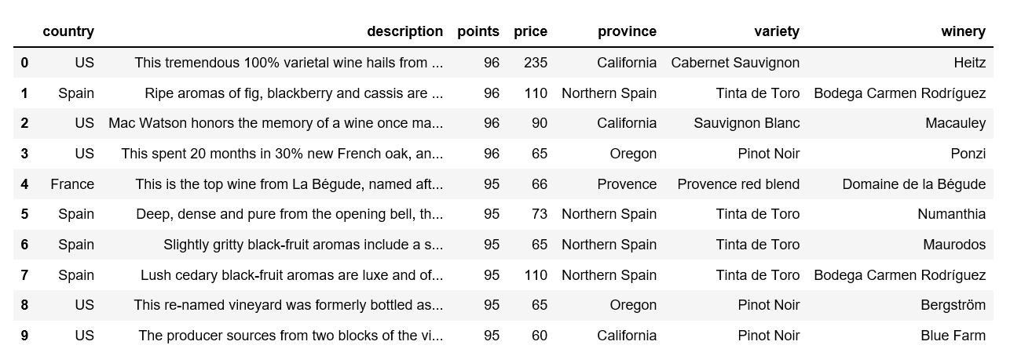
2.Descriptive Statistics
(1). Data preview
Companies
Customers
The data are collected from Kaggle, after we removing all NA values we finally get 258144 data.
Notes:
Here is the original DATA of project. The data are collected from Kaggle, after we removing all NA values we finally get 258144 data. First we will visulize the data.

Slide 6
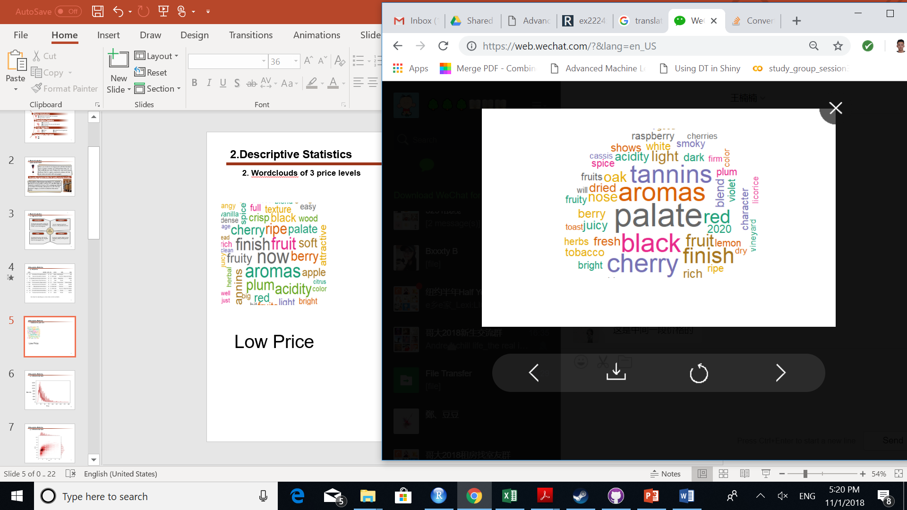
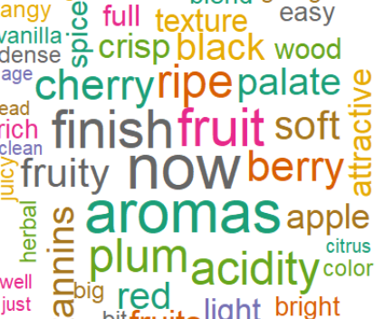

2.Descriptive Statistics
(2). Wordclouds of 3 price levels
Low Price
Medium Price
High Price
h
Companies
Notes:
Here is the Wordclouds of 3 price levels. There are slight difference among these 3 price levels.
In Low Price level, words related to aromas appear most frequently;
In Medium Price level, words related palate appear most frequently;
In high Price Level, words related to tannins appear most frequently.
We can see there are some different features among different price levels of wines.

Slide 7
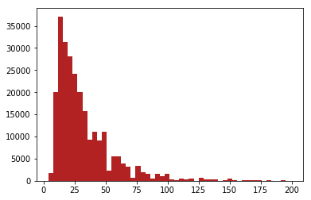
2.Descriptive Statistics
(3). Distribution of wine price
Quantity
Companies
Customers
Price
Notes:
Here is the histogram of the wine prices. The majority of wine prices are distributed between 10USD to 75USD

Slide 8
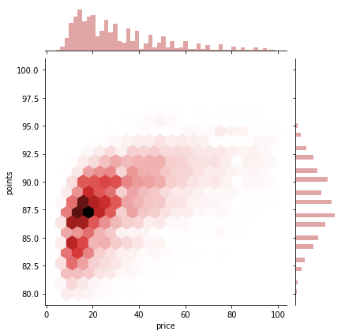
2.Descriptive Statistics
(4). Distribution of wine price & points
Companies
Customers
Notes:
This is the heatmap of wine price against wine point.
Horizontal axis is price and vertical axis is the point.
The darkest hexagon in the map means that the majority wines have price of 20 USD and with point of 88.

Slide 9
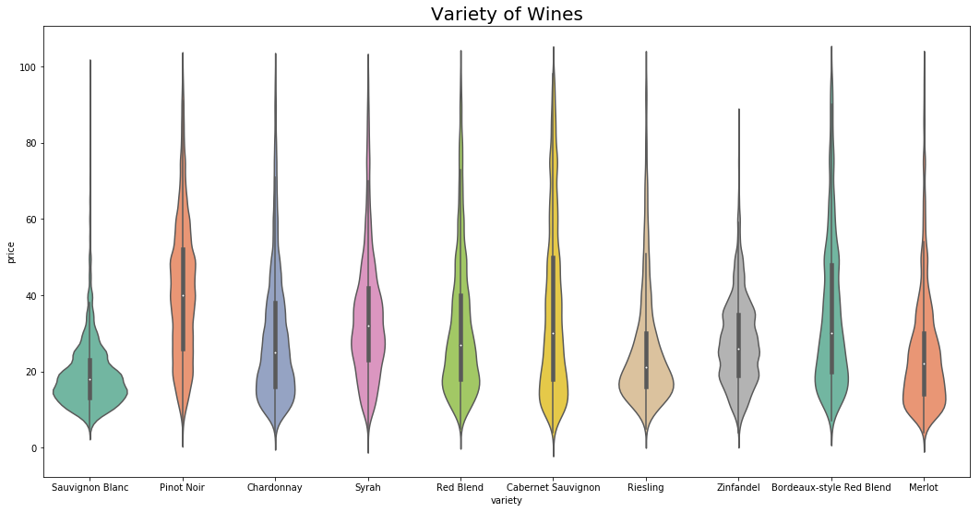
2.Descriptive Statistics
(5). Price of wine by variety
Companies
Customers
Notes:
This is the Bar plot of wine prices against wine variety.

Slide 10
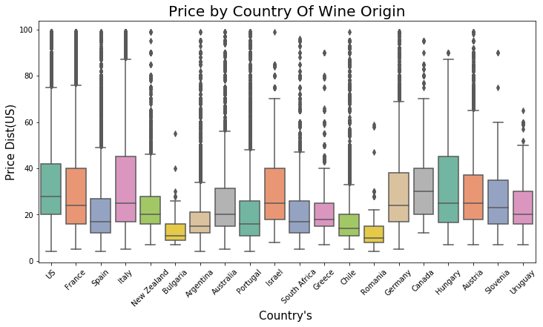
2.Descriptive Statistics
(6) Price of wine by country
Companies
Customers
Notes:
This is the Bar plot of wine prices against the country where the wine original produced.

Slide 11
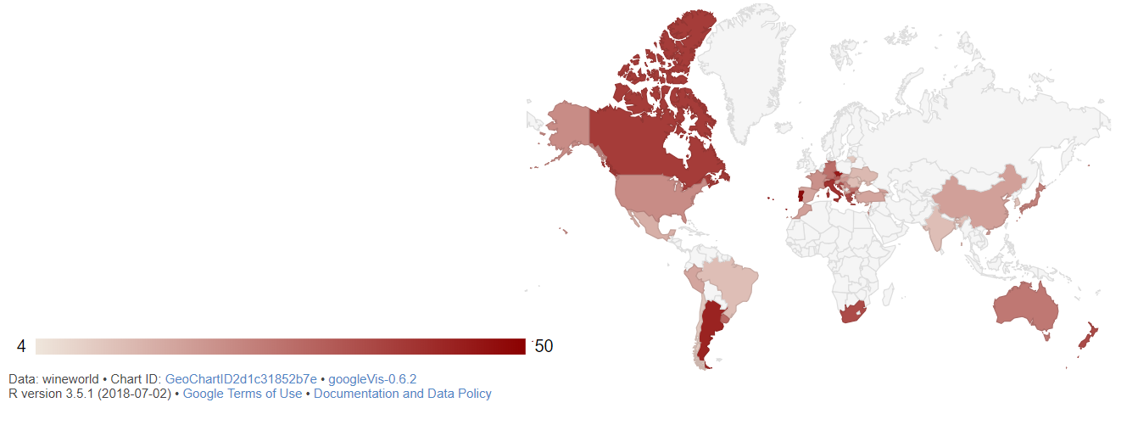
2.Descriptive Statistics
(9) Price shown in Worldmap
Companies
Customers
Notes:
Here is the price map of world, the dark the color is the higher the price is.
The wines from Canada have relative high price than the other places.

Slide 12
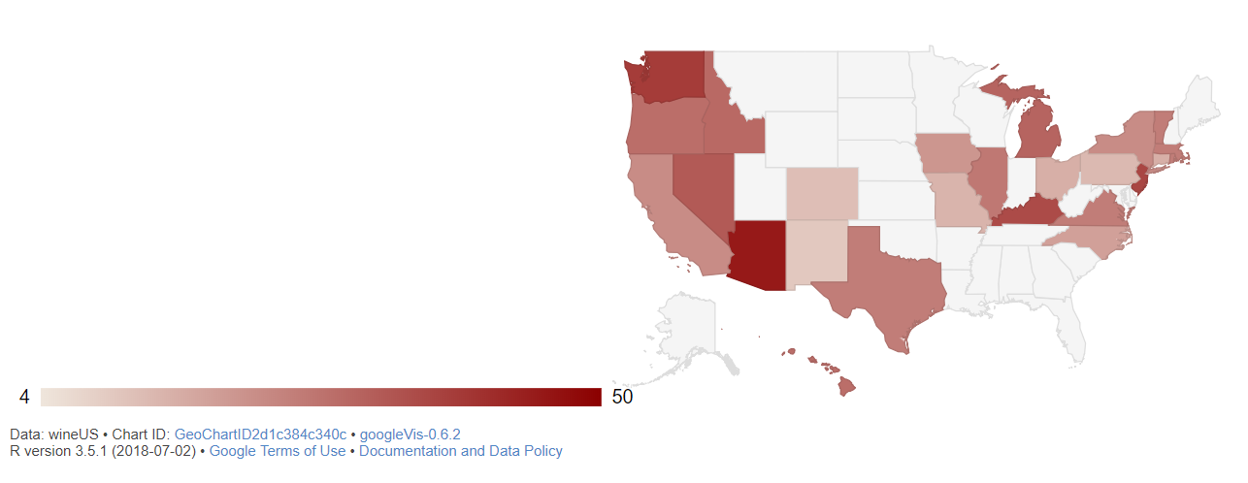
2.Descriptive Statistics
(10) Price shown in USmap
Companies
Customers
Notes:
In USA, the wines from Arizona have relatively high price than the other places.

Slide 13
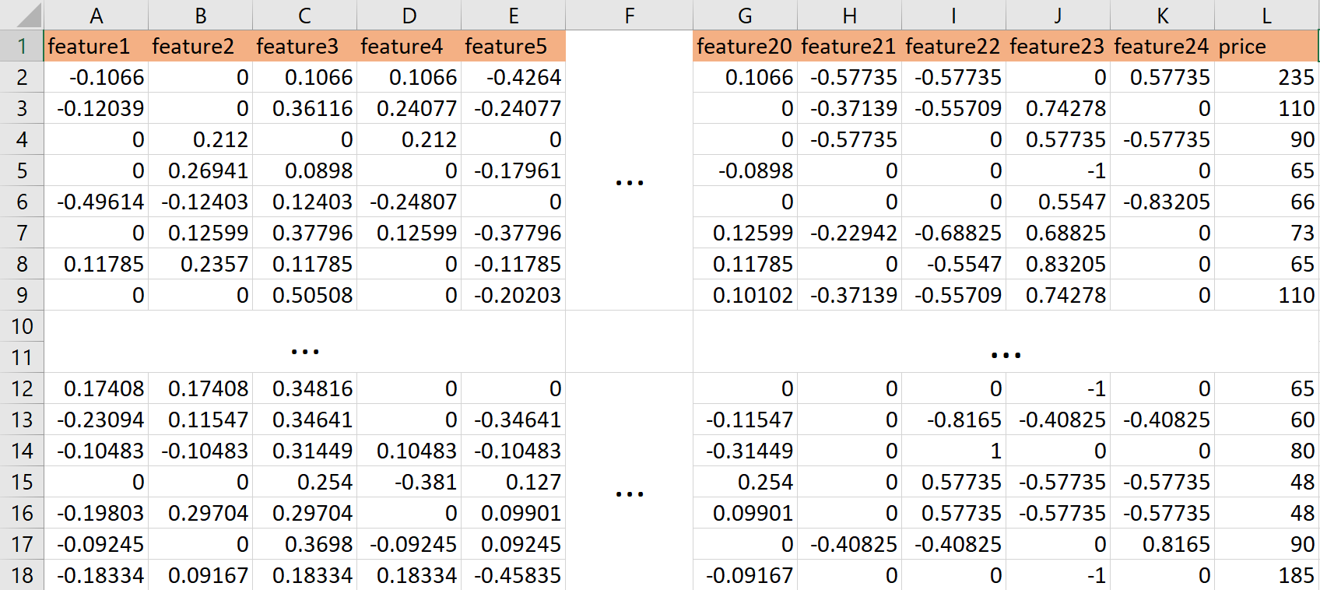
2.Descriptive Statistics
(11) Data Processing (Text Number)
Hashing Vectorizer
Companies
Customers
Description: feature1 - feature 20
Country/Province/Variety/Winery: feature 21 - feature 24
Notes:
After EDA, we want to explore deeper in our data, but We cannot work with text directly when using machine learning algorithms. We need to convert the text to numbers so each observation is taken as “input” and a class label is the “output” for our predictive algorithm.
we finally choose the Hashingvectorizer based on the large datasets we used, because compared to other methods, it is very low memory scalable to large datasets as there is no need to store a vocabulary dictionary in memory.
We finally get 20 features from ‘description variables’ and collect 4 features from variables—country/province/variety/winery.

Slide 14
3.Algorithm
(1).K-nearest neighbors algorithm
Calculate the distance between two data instances within the training set, using Euclidean distance measure
Companies
Locate k most similar data instances in the training set with the similarity measures
Split the data into a training set (to make predictions) and a test set (to evaluate model accuracy)
2. Distance Calculation
3. K Decision
KNN
Algorithm
1.Dataset
Creation
Customers
4. Response Generation
For the most similar neighbors of a test instance given by k most similar data instances in the training set, we can generate a response
5. Accuracy
test
Test the accuracy of predictions
KNN method has to run every data in the dataset, so it is very time consuming.
Notes:
First we applied KNN model to capture the similarity among wines.
We started with splitting the whole data into training group and test group. Within the training group, we calculated the distance between every pair of data. We determine the number of K (closest neighbours) based on the distance result. With those neighbour points, we predict the response, and tested it with the test group.

Slide 15
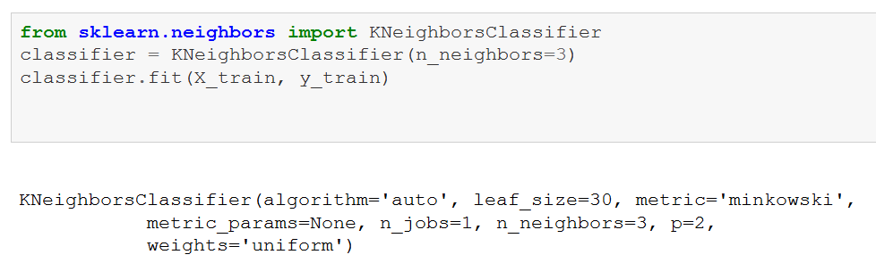
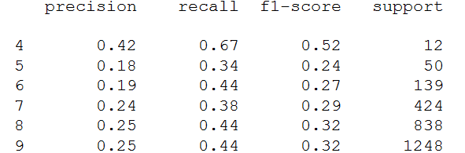
3.Algorithm
(1).K-nearest neighbors algorithm
Take the response of the two nearest points for each predictor and compare it with the test set.
Companies
Output Result
When the KNN model is applied to the test set, the average precision is only 28%.
The relevance between features is not high, resulting in poor adaptability of KNN and 28% average precision.
Notes:
Unfortunately, it turns out that the KNN model does not fit our data well. The model works out the best with small 3 neighbors. Even though, the accuracy of prediction is around 30%. Some reasons can be the low relevance between our features, and the fact that KNN is inefficient with large data.

Slide 16
3.Algorithm
(2). Balltree
Advantage: Higher
running speed than other
algorithm
Disadvantage:
Calculating and
understanding the
meaning are not easy.
Advantage: Higher
running spped than other
algorithm
Disadvantage:
Calculating and
understanding the
meanning are not easy.
Calculate distances between all other points and p, then select the largest one marked as p1.
Generate/Select a random point p in the hyperspace
2
1
3
Repeat step 2-5 until there are less than k points in subset n.
Calculate distances between all other points and p1, then select the largest one marked as p2.
Balltree
Customers
6
Finally we will get a tree with many leaves or external nodes.
4
Calculate distances between all other points in subset 1 and p1, select the largest one denoted as r1. Repeated in subset 2 and p2.
Compare the distance of point to p1 and p2.If a point is closer to p1, we can put it into subset 1, otherwise put it into subset2.
5
Notes:
Balltree is a kind of advanced nearest neighbor clustering algorithm which is similar as KNN. This algorithm is especially efficient when dataset is large.
Here are the steps of Balltree algorithm
Step1: Pick a random point p in the hyperspace.
Step2: Calculate distance btw it and all other pts and select the farthest one marked as p1.
Step3: Calculate distance btw it and all other pts and select the farthest one marked as p2.
Step4: According to the distance to p1 and p2 divide all pts into 2 subsets
Step5: Repeat 1-4

Slide 17
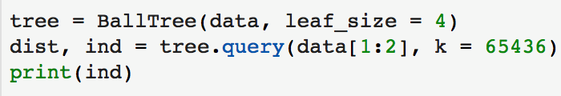


3.Algorithm
(2). Balltree
We classify the data into four classes through balltree.
Code
The quantities of clusters is depend on ourselves, here is four. Considering the factors like description, combined of others, price, origin, grape varieties etc.
By calculating Euclidean distance between Wine No.1 and other wines, it reaches the lowest value between itself, and second lowest value to Wine No.257857, which means Wine No.1 is most similar to Wine No.257857 except itself.
Output
Notes:
Here are the results of our Balltree algorithm, The

Slide 18
4. Conclusion
Different price levels have different features with respect to target customers
American Wines are expensive!
Arizona’s wines are generally more expensive than the other places
KNN did poor on classifying the groups of wines
Balltree performs good, it is hard to understand the meaning of each leaf of the result of Balltree Algorithm
Notes:
2. The growing success is partly due to the climate. Southeast Arizona is one of only four high desert grassland micro biomes in the world, regions with environmental conditions that make them perfect for growing wine. Another reason for the rapid expansion belongs to the entrepreneurial efforts of the farmers and wine producers in Elgin and Wilcox.

Slide 19
Thanks！
Q&A

