Slide 1
Facial emotion recognition
Group 4 - Model evaluation and selection

Slide 2
Model
Gradient Boosting
XG Boosting
Decision Tree
Random Forest
KNN
Logistic Regression
Linear SVC
Other SVC
Feedforward Neural Networks

Slide 3

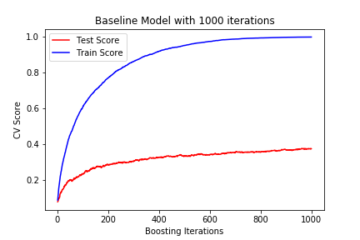
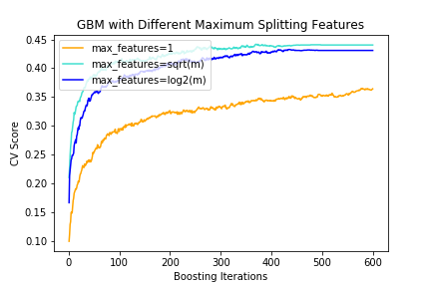
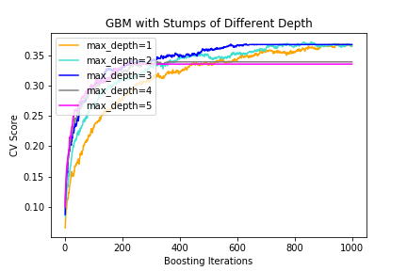
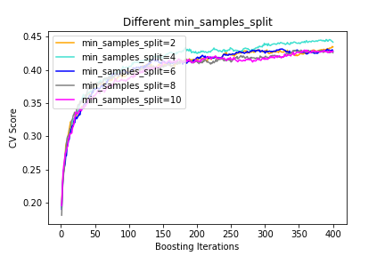
Gradient Boosting
Input : Fiducial Points Distance
Accuracy (after 3 features tuning) : 43.6%
Time spend on training: 841s
Computer Equipment: 8GB memory

Slide 4
XG Boosting
Input : Fiducial Points Distance
Accuracy (after 3 features tuning) : 43.6%
Time spend on hyperparameters tuning : 3 Hr
Computer Equipment: 8GB memory

Slide 5
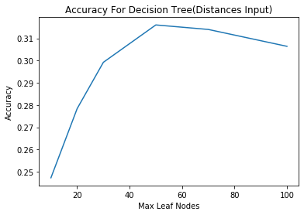
Decision Tree
Input : Fiducial Points Distance
Accuracy (after tuning) : 31.6%
Time spend on hyperparameters tuning : 24.6 S
Computer Equipment: 32GB memory

Slide 6
Random forest
Input : Fiducial Points Coordinate
Accuracy (after tuning) : 43.8%
Time spend on hyperparameters tuning : 65 S
Computer Equipment: 8GB memory

Slide 7
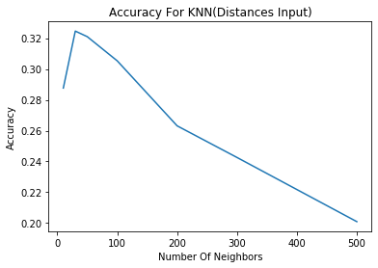
KNN
Input : Fiducial Points Distance
Accuracy (after tuning) : 32%
Time spend on hyperparameters tuning : 7.7 S
Computer Equipment: 32GB memory

Slide 8
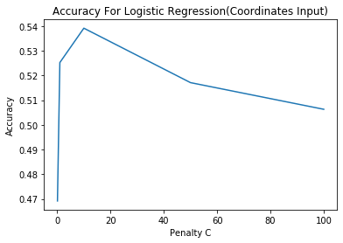
logistic REGRESSION
Input : Fiducial Points Coordinate
Accuracy (after tuning) : 53.9%
Time spend on hyperparameters tuning : 41.2 S
Computer Equipment: 32GB memory

Slide 9
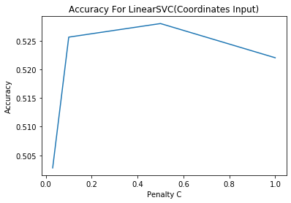
linear SVC
Input : Fiducial Points Coordinate
Accuracy (after tuning) : 52.8%
Time spend on hyperparameters tuning : 81 S
Computer Equipment: 32GB memory

Slide 10
‘RBF’ AND ‘POLY’ SVC
Input : Fiducial Points Distance
Accuracy (after tuning) : 44.2% (‘RBF’) and 27.6% (POLY)
Time spend on hyperparameters tuning : -
Computer Equipment: 32GB memory

Slide 11
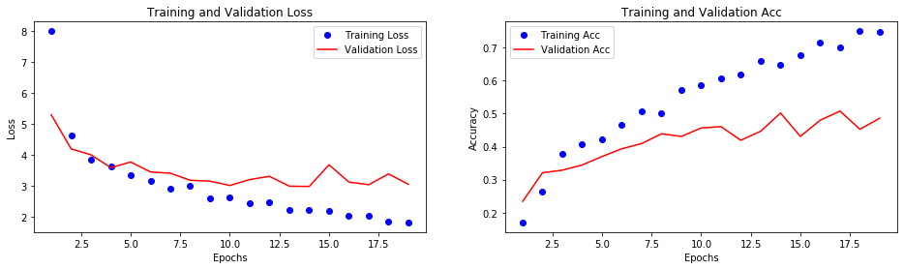
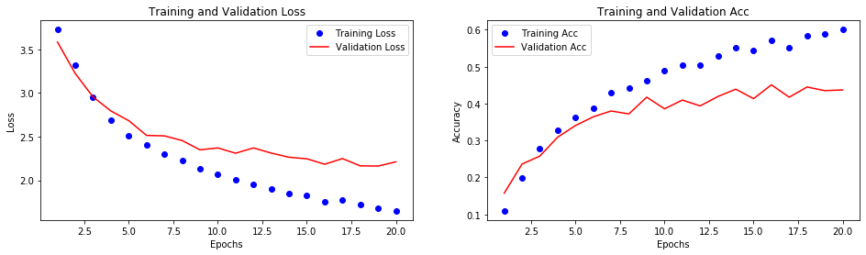
feedforward NEURAL NETWORKS
Input : Fiducial Points Distance
Accuracy (after tuning) : 59.5%
Time spend on hyperparameters tuning : 36.2
Computer Equipment: 32GB memory

