Slide 1
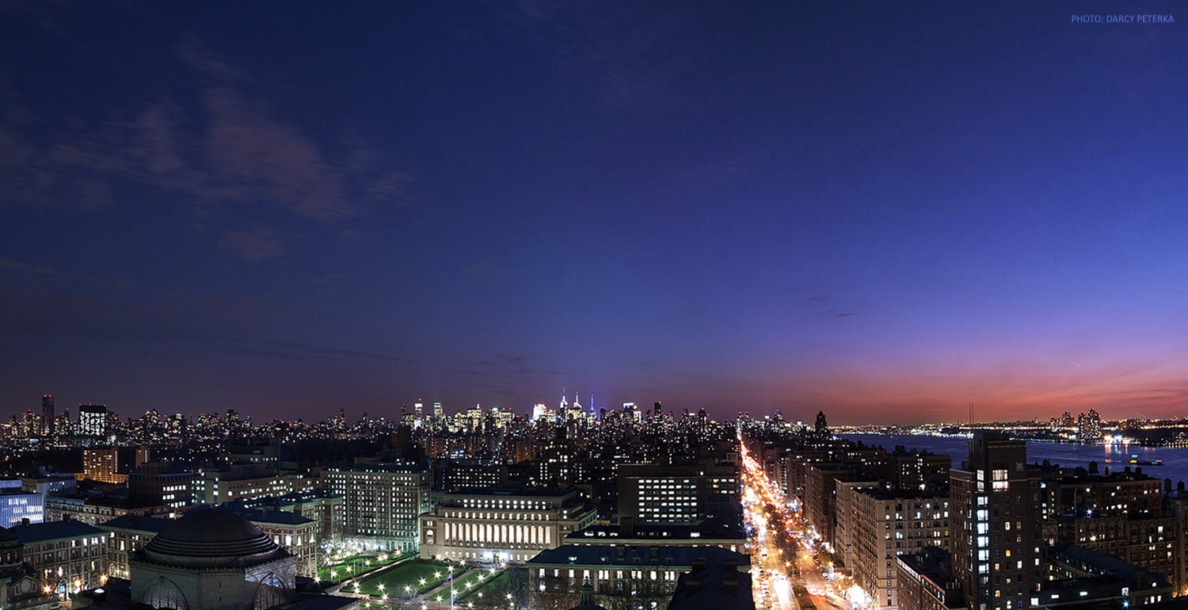

Are Americans Who Concerned About Economy Concerned About Covid-19?
By Mengyao He
TRANSCENDING DISCIPLINES, TRANSFORMING LIVES

Slide 2
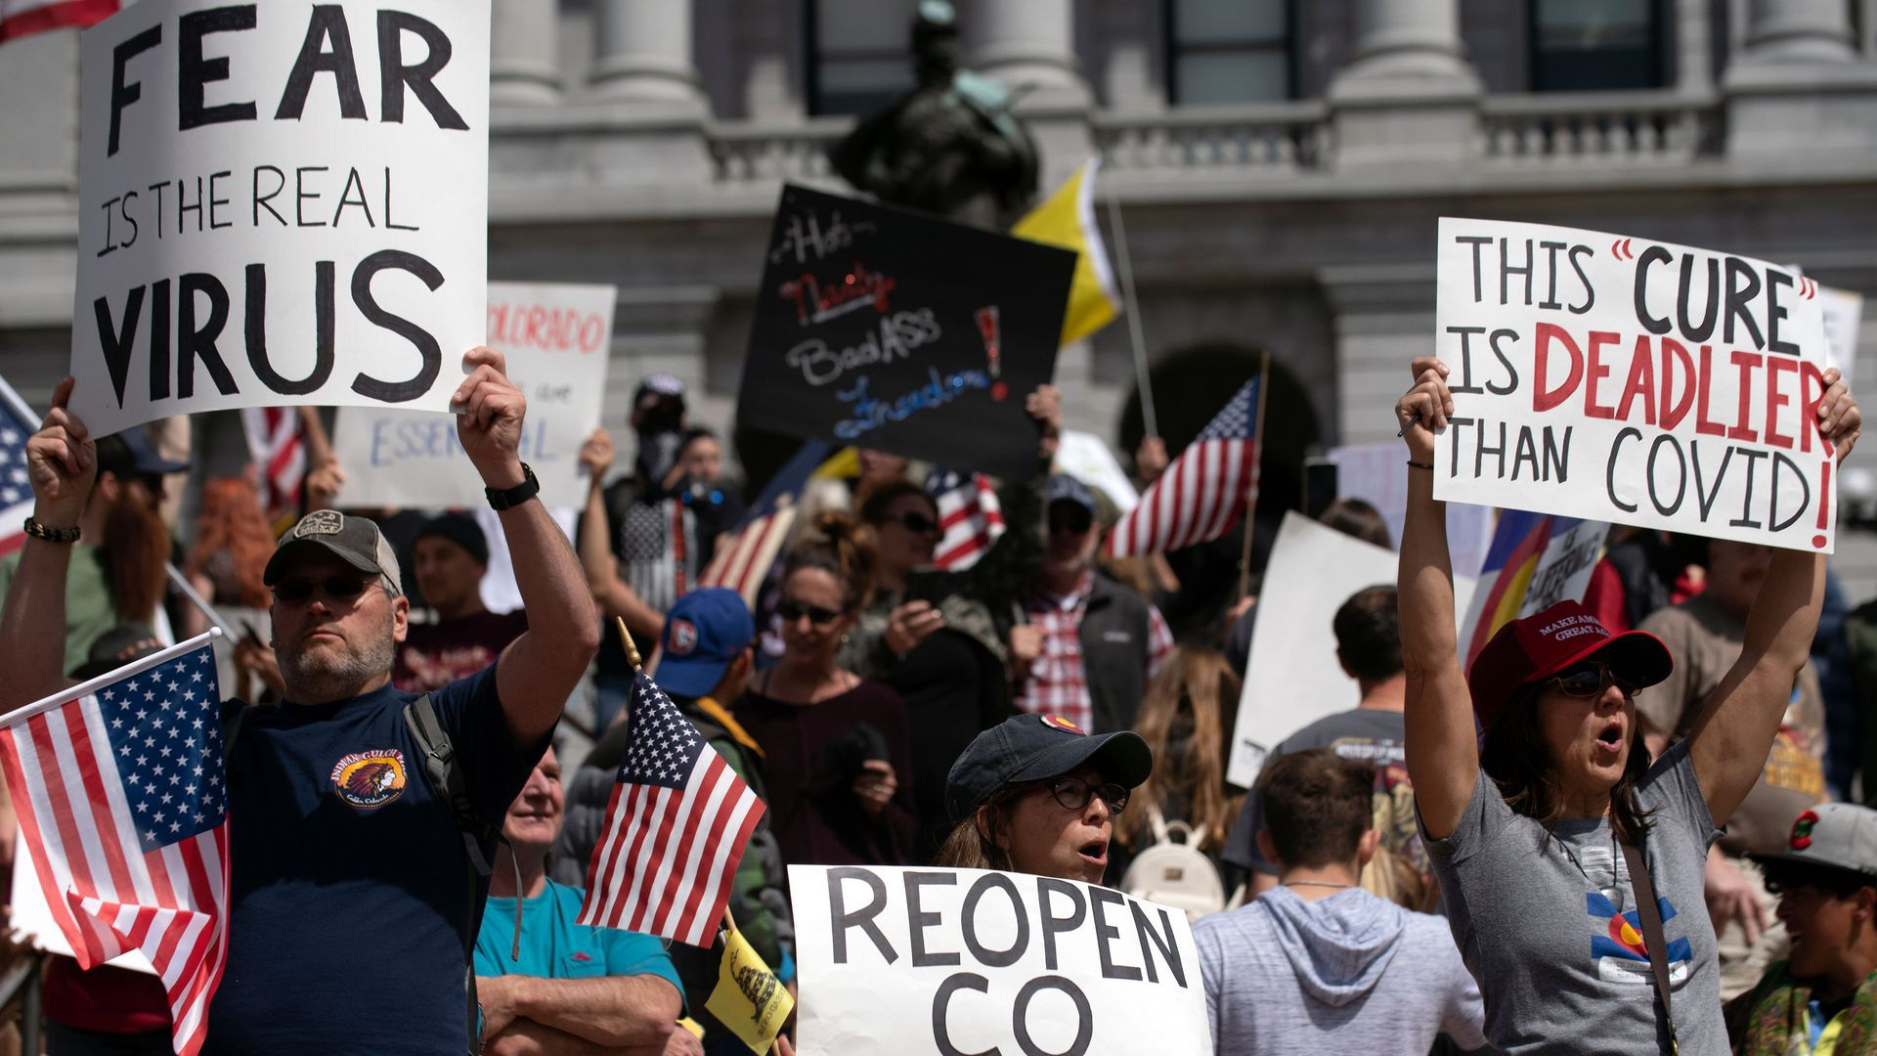
Introduction
From the past 6 months news, it’s easily to notice that a majority of Americans are very worried about the American economy. The lockdown policy raised a storm of protest across the county. People went to street and asked for reopen with risk of Covid-19.
<number> | Are Americans Who Concerned About Economy Concerned About Covid-19?

Slide 3
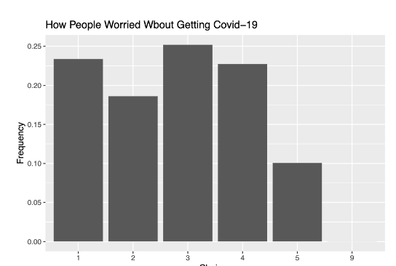
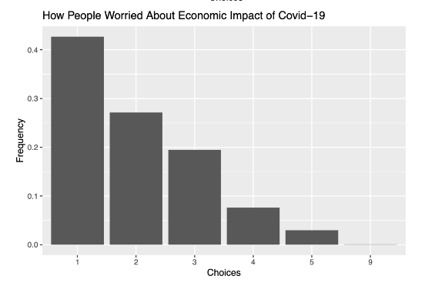
Introduction
<number> | Are Americans Who Concerned About Economy Concerned About Covid-19?
Notes:
From the ANES survey, as many as 89.3 percent of Americans said they were concerned about the impact the coronavirus would have on the economy. And 69.8 percent of Americans said they were “extermely” or “very” worried that the coronavirus would negatively impact the economy. Moreover, 67.2 percent of Americans showed that they were concerned about getting Covid-19.

Slide 4
Question
Don’t those who worried about the economy care about the risk of Covid-19?
<number> | Are Americans Who Concerned About Economy Concerned About Covid-19?

Slide 5
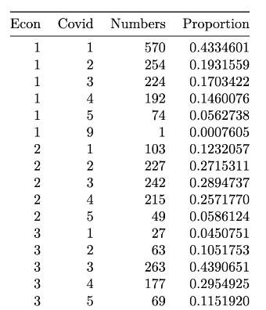
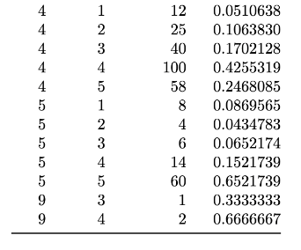
In General
Most Americans who were concerned about the economy were also concerned about the Covid-19; and those who didn’t think the economy could be a problem didn’t worried about Covid-19.
The correlation between these two features, and it gave a positive correlation with 0.43
<number> | Are Americans Who Concerned About Economy Concerned About Covid-19?

Slide 6
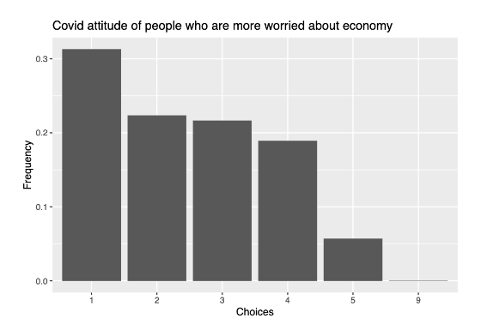
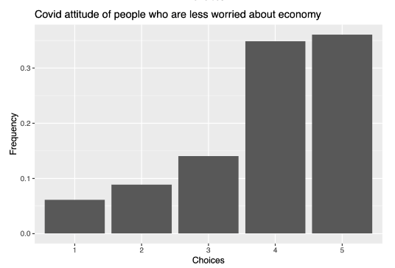
Introduction
<number> | Are Americans Who Concerned About Economy Concerned About Covid-19?

Slide 7
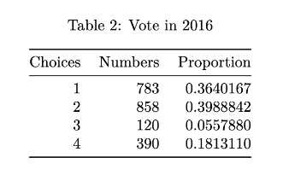
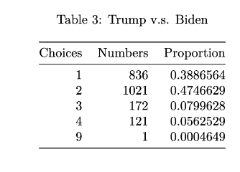
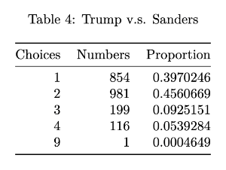
Policy Preference
<number> | Are Americans Who Concerned About Economy Concerned About Covid-19?

Slide 8
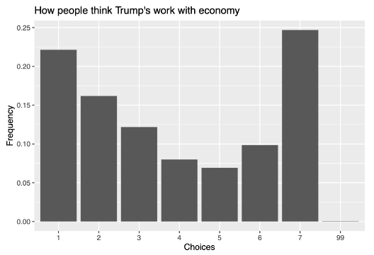
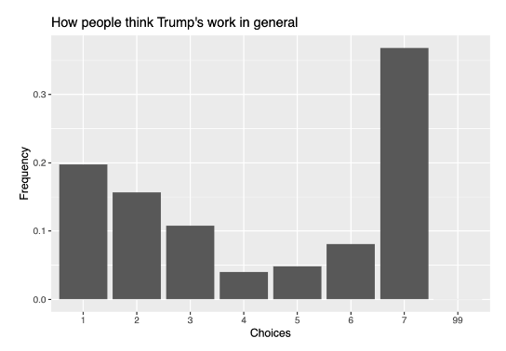
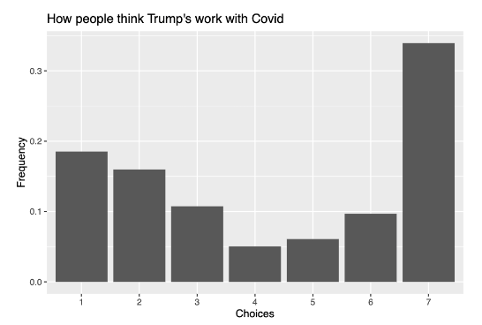
Policy Preference
<number> | Are Americans Who Concerned About Economy Concerned About Covid-19?

Slide 9
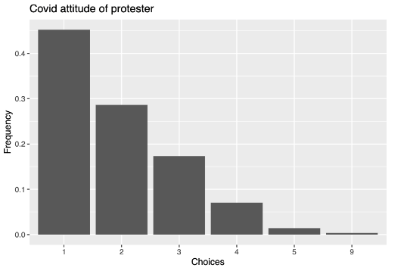
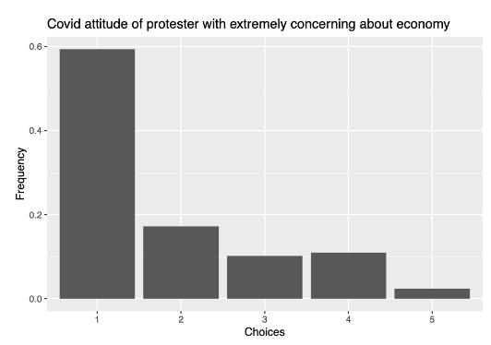
Protesters Attitude
<number> | Are Americans Who Concerned About Economy Concerned About Covid-19?

Slide 10
Conclusion
Americans who are worried about the economy are also worried about coronavirus.
A majority of Americans who are worried about the economy don’t satisfy with Trump’s work.
Protesters are also worried about coronavirus
<number> | Are Americans Who Concerned About Economy Concerned About Covid-19?

Slide 11
Discussion
Problems
  The survey contains many missing values which could cause some biases.
  Also, for the protestor part, the assumption I made will cause some problems since not all people who attend protests in the past 12 months went to a protest that asked for reopening.
<number> | Are Americans Who Concerned About Economy Concerned About Covid-19?

Slide 12
Discussion
Americans are worried about the economy. At the same time, they are worried about coronavirus. Why did this happen?
These people are worried about coronavirus, but obviously, financial issues are more deadly for them.
<number> | Are Americans Who Concerned About Economy Concerned About Covid-19?

Slide 13
THANK YOU!
<number> | Are Americans Who Concerned About Economy Concerned About Covid-19?

