Slide 1
Who Should Biden Target?
Yotam Segal

Slide 2
Introduction
Overview, Switchers & Research presentation

Slide 3
Overview
The 2020 Elections are coming up, and campaigners are tirelessly advertising their candidate.
Harnessing social media, campaign managers can target specific user profiles to optimize their reach.
Using the ANES database, in this research I will explore past cases in which an incumbent president lost and who are the ones who tipped the balance.
There were only a couple such cases that ANES has data on: the 1980 elections, when Carter lost to Reagan, and the 1992 elections, when Bush lost to Clinton.
This research will study who are the people most likely to switch – Those who vote against their declared political affiliation.

Slide 4
Who are the Switchers?
“Switchers” in this study are defined as voters who voted against their political affiliation:
Democrats who voted for Reagan in 1980
Republicans who voted for Clinton in 1992
Reasoning for chosen variables:
Implementation: The chosen variables can be used on social media algorithm to directly target specific populations (age group, for example).
Breadth: The chosen variables provide a snapshot of the typical Switcher

Slide 5
The Research
Elections in which a sitting president looses are fundamentally different from those in which a sitting president is elected for a second term. It rarely happens, only 10 times in the history of the US¹
Because these elections are different, it would be interesting to specifically study who are the Switchers, and try to construct an image of those voters who are open to change
The variables of interest are diverse and include demographic, socio-economic and geographical data, as well as more qualitative measures such as political awareness
The data was normalized to account for different sample sizes
Colors in this work represent the color of the winning party: Rep in 1980, Dem in 1992

Slide 6
Results
Variables:
Age, Gender, Race, Marital Status, Geographics, Urbanization, Income, Political Awareness, Election Interest

Slide 7
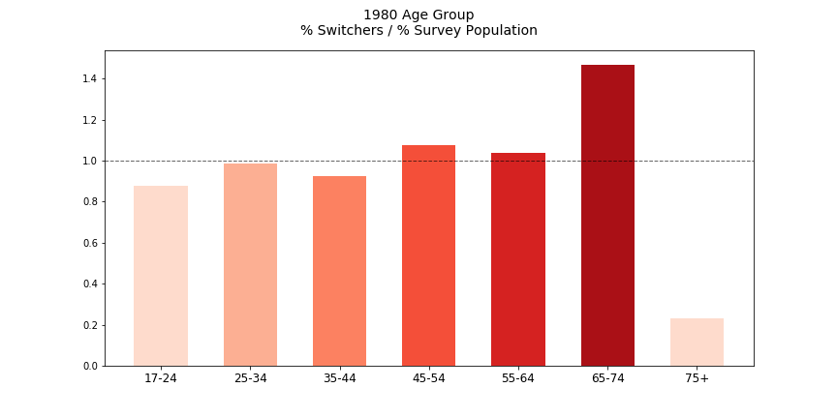
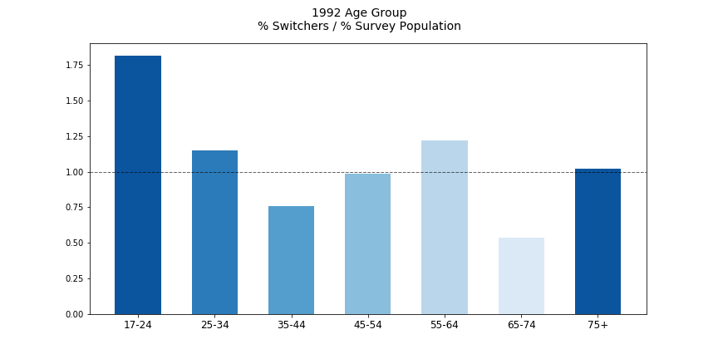
Age
The results of 1980 and 1992 somewhat agree.
In 1980, 65-74 year old comprise most of the switchers, whereas in 1992 these are mainly young voters (17-24). Adult voters (25-64) tend to vote according to their partisan affiliation.
I would assume that younger voters, who have not yet formed a very strong political identity would be more prone to switch.
In both elections, however, older voters switched less. This makes intuitive sense, as these voters vote out of habit in many cases.

Slide 8
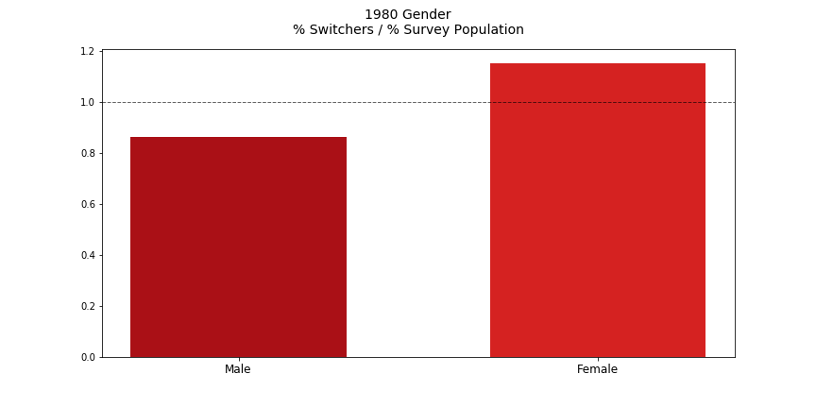
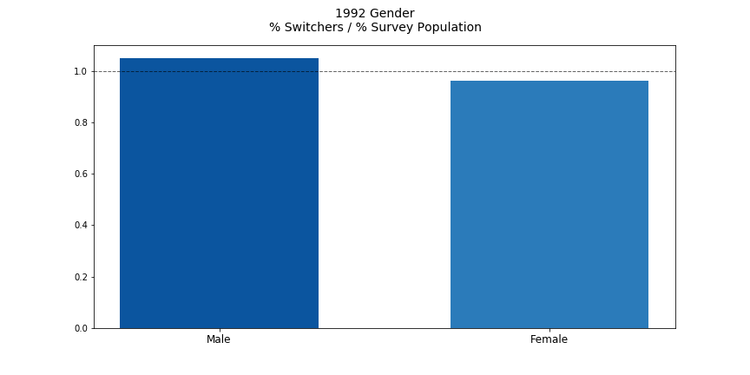
Gender
The results of 1980 and 1992 do not agree.
In 1980 we see that Women switched more frequently than men, whereas in 1992 men switched more often.
The variation is too small to make an informed conclusion.

Slide 9
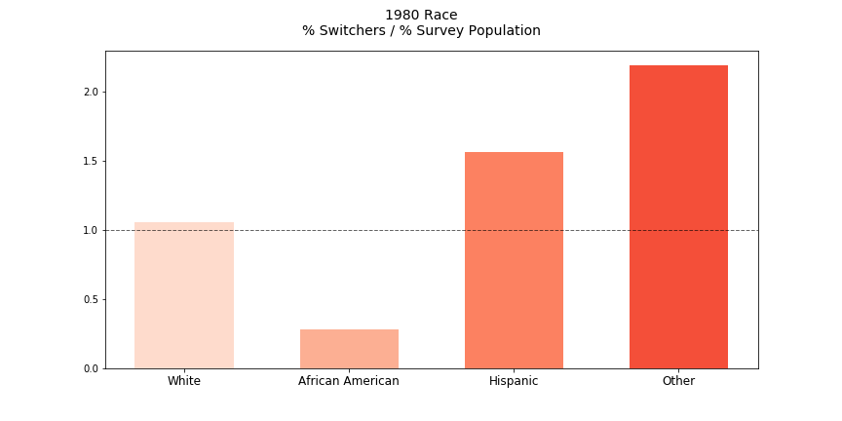
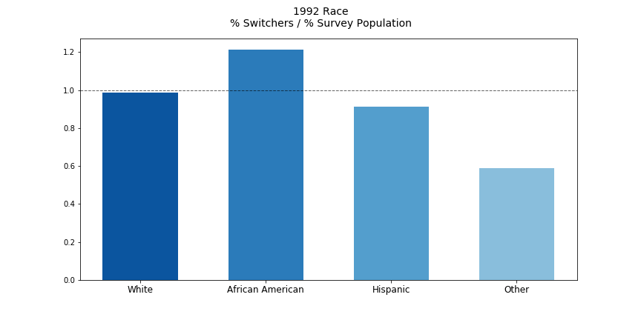
Race
The results of 1980 and 1992 somewhat agree.
In 1980 we see that “Other” and Hispanics tend switched more often than Whites, and in 1992 most of the switchers were African American.
It is possible that Non-White voters would be more prone to switch than white voters.

Slide 10
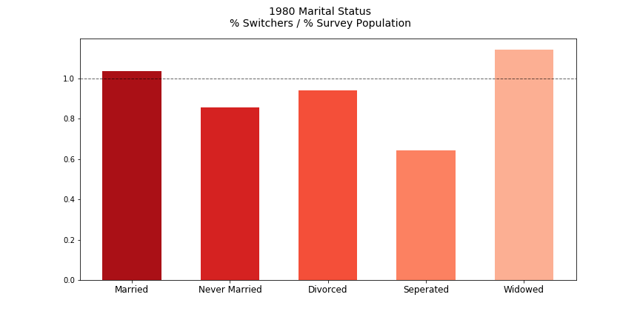
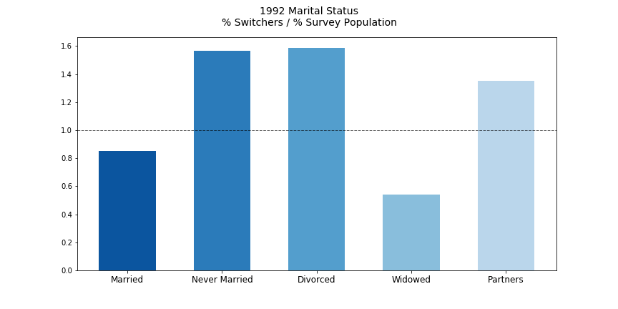
Marital Status
The results of 1980 and 1992 do not agree.

Slide 11
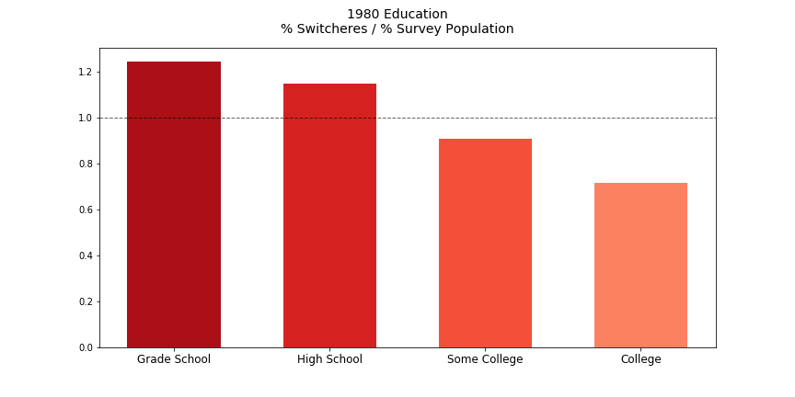
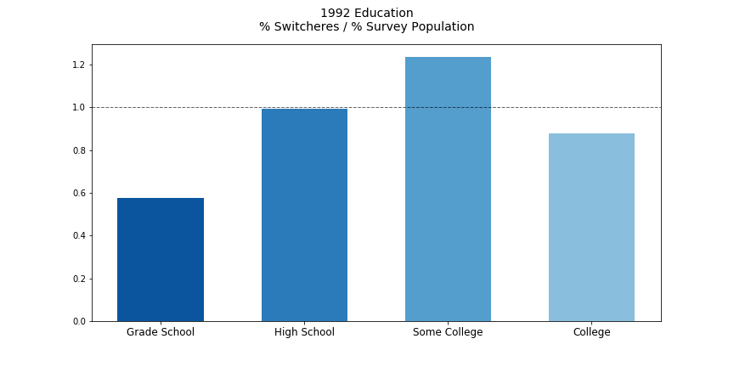
Education
The results of 1980 and 1992 somewhat agree.
In 1980 most of the switchers were Grade School or High-School educated, while in 1992 most of the switchers had some college education.
I would attribute this difference to the specific economic situation that prevailed in 1980 and to the rising inflation that mostly hurt Blue-Collar workers, who often had Grade School education.
However, in both election years College educated individuals did not switch. This is somewhat surprising as one would expect that higher education would lead to higher openness to change.

Slide 12
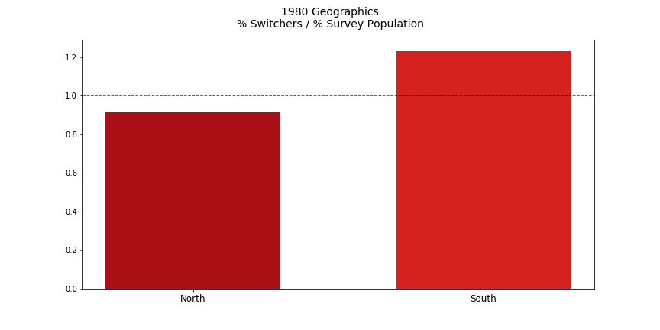
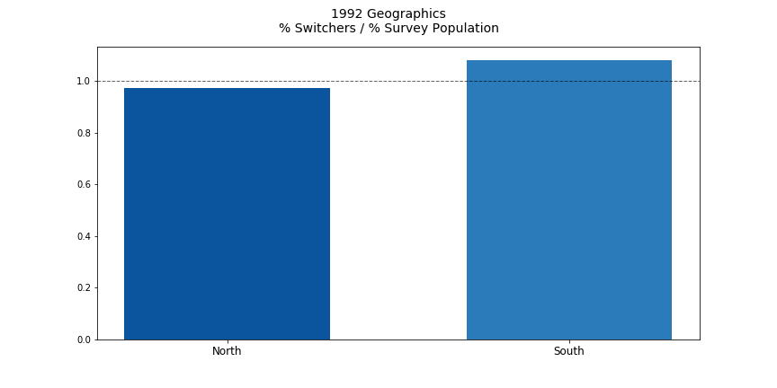
Geographics
The results of 1980 and 1992 agree.
In both election years we see that Southerners switched more often than Northerners, by about 20%.

Slide 13
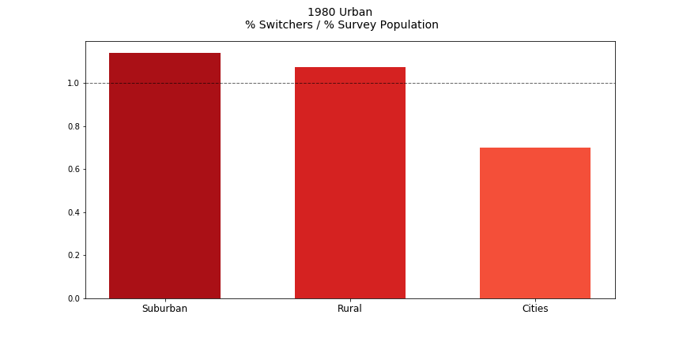
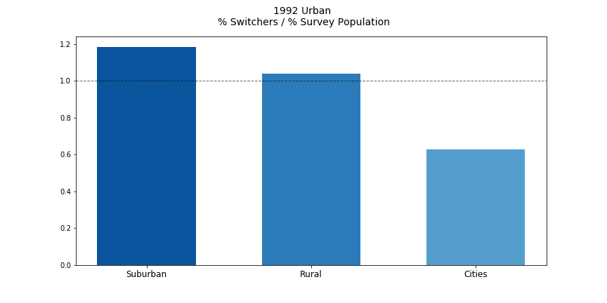
Urbanization
The results of 1980 and 1992 agree.
In both election years, Suburban and Rural voters tended to switch more often than city residents.

Slide 14
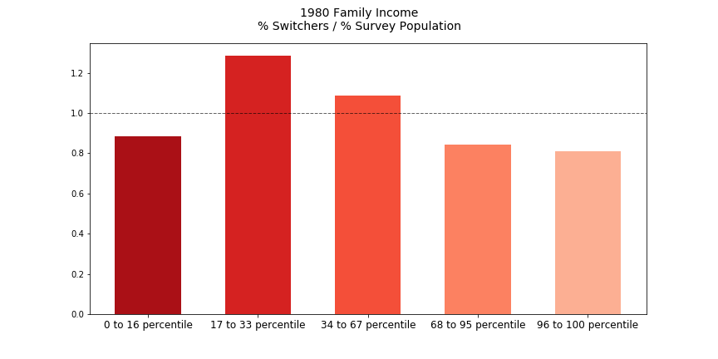
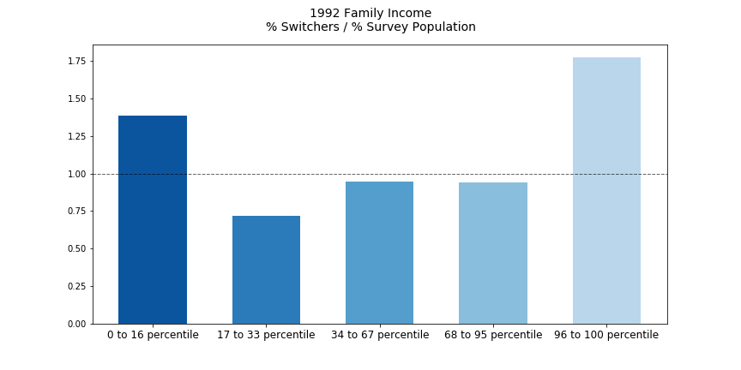
Income
The results of 1980 and 1992 do not agree.
In 1980 lower-middle income voters comprise most of the switchers. But in 1992 the Switchers cam from either very low or very high income households.
I would attribute this divergence to the specific conditions prevailing in these election years; High unemployment in 1980 and rising inflation probably hurt more the lower-middle income class, and more specifically blue collar workers.
In 1992, even though the economy was in recession, the main event was foreign affairs, as the Soviet Union collapsed.

Slide 15
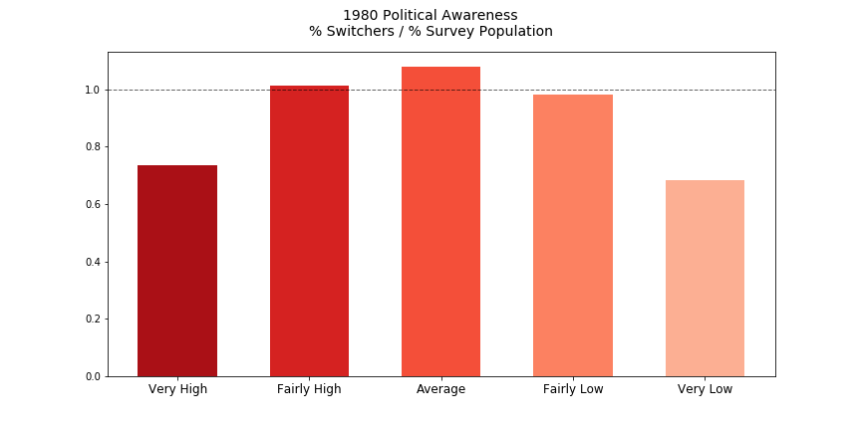
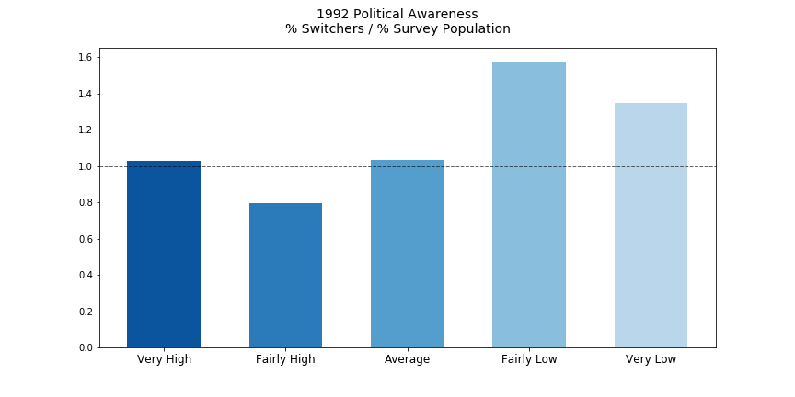
Political Awareness
The results of 1980 and 1992 somewhat agree.
In 1980 “Average” politically aware voters mostly switched. In 1992 the Switchers had “Fairly Low” or “Very Low” political information.
In both cases, highly aware individuals did not switch as much.
I would attribute this to the essence of “politically aware” voters – They tend to care more about their political beliefs, which drives them to consume more information, creating a feedback loop.
The results of 1980 and 1992 somewhat agree.
In 1980 “Average” politically aware voters mostly switched. In 1992 the Switchers had “Fairly Low” or “Very Low” political information.
In both cases, highly aware individuals did not switch as much.
I would attribute this to the essence of “politically aware” voters – They tend to care more about their political beliefs, which drives them to consume more information, creating a feedback loop.

Slide 16
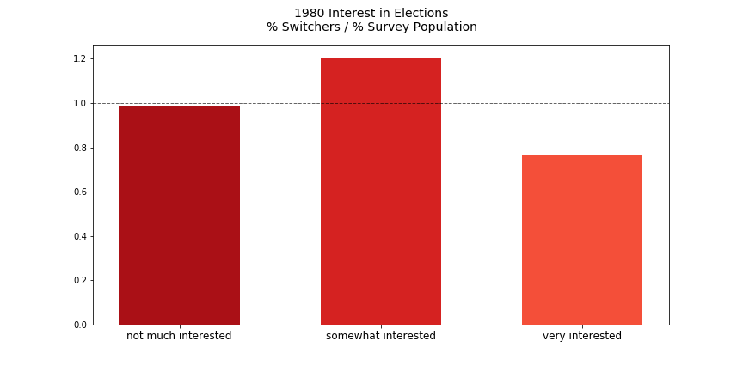
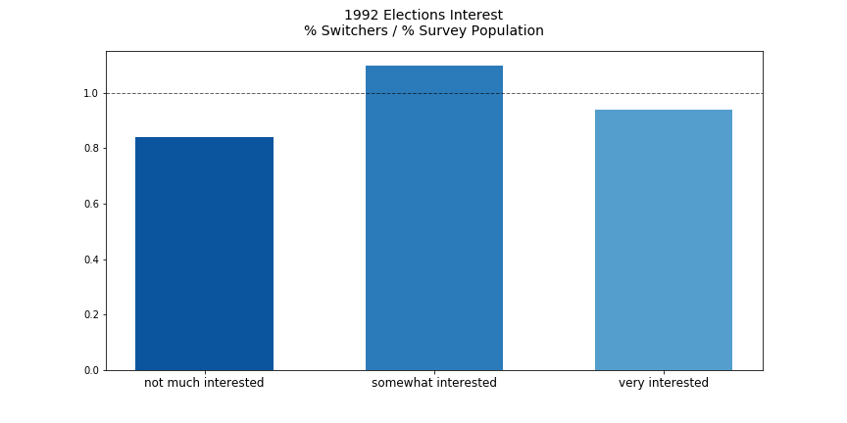
Interest in Elections
The results of 1980 and 1992 agree.
In both 1980 and 1992 “Somewhat Interested” voters mostly switched, and “Very Interested” voters switched the least.
These results reinforce the conclusion derived from Politically Awareness results; Voters who care deeply about the elections tend to have stronger beliefs and are less prone to convincing.
These results seem counterintuitive, as one would assume that people who care deeply about the elections would be more willing to vote for the optimal candidate, rather than according to their political allegiance.

Slide 17
Conclusion
Discussion, Critical Analysis, Future Research

Slide 18
Discussion
Switcher’s Profile:
Young (17-24) or senior (65-74), Non-White, Southerner who lives in the Suburbs and is not college educated. She/he has average political information and cares little about the elections.
We need more information to decisively determine if men or women more easily switch. We cannot also conclude what is the average income of a typical Switcher and if one is married or not.

Slide 19
Critical Analysis
Sample size:
145 in 1980
101 in 1992
This sample size is too small for the research to provide statistically significant results. The research is overly prone to outliers
Self-testifying, subjective questions:
Considering oneself as “Republican” or “Democrat” is non-binding and subjective. Can lead to biases, especially if this question is asked after voting day, as people tend to reinforce the winner and change their mind in retrospect (Hindsight Bias).
Several questions such as “Political Awareness” or “Interest in Elections” can also lead to biases
Only two election years in which a sitting candidate lost:
The event where a sitting president looses is rare. It is therefore prone to omitted, uncontrolled variables that shift voters opinions regardless of their demographics (the collapse of the Soviet-Union, for instance)
Digitization of data from 1980 and 1992 can lead to collection errors

Slide 20
Future Research
Increasing sample size
Conduct research on switchers who voted to non-winning presidential candidates who run against a sitting president
Study when voters usually decide to vote, to establish Switchers’ time patterns. Is there a perfect time for a campaign to spend more money?

Slide 21
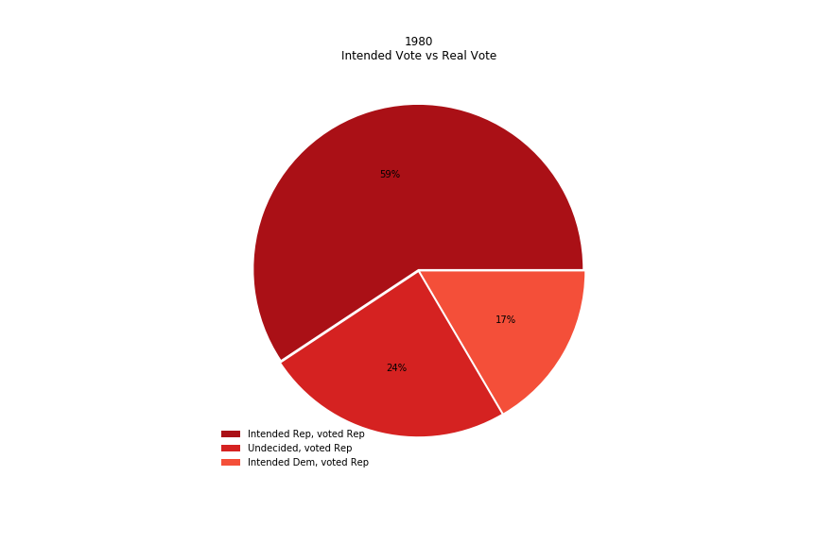
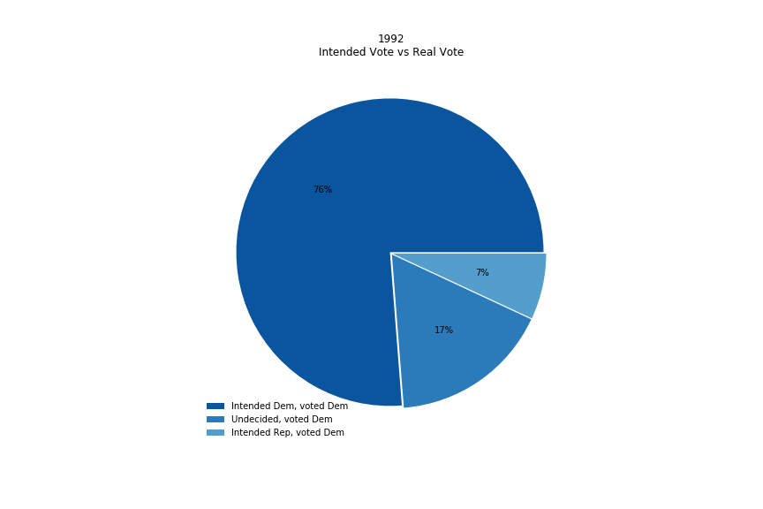
Future Research teaser Are Switchers impulsive?

