Slide 1


GR 5243 Applied Data Science
Project 4: Causal Inference Algorithms Evaluation
Group #4: Zhenglei Chen, Jaival Desai, Qinzhe Hu,
Levi Lee, Luyao Sun, Xinyi Wei
Perform Date: 12/02/2020

Slide 2
Contents
Introduction
Regression Trees
Propensity Score
Average Treatment Effect
Procedure
Cross Validation
PS Estimation
ATE Algorithms
Results
Comparison of ATE
Comparison of Runtime
Conclusions
References

Slide 3
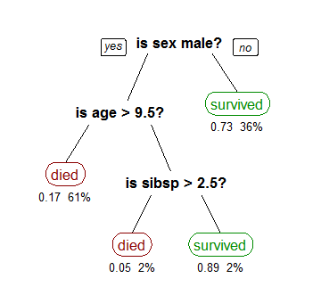
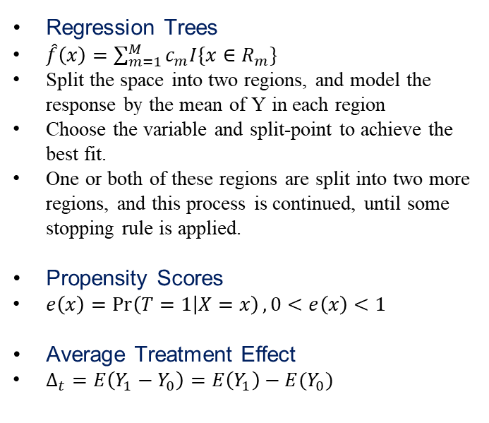
Classification & Estimation
Regression Trees
$\hat{f}\left(x\right)=\sum_{m=1}^{M}{c_{m}I\{x∈R_{m}\}}$
Split the space into two regions, and model the response by the mean of Y in each region
Choose the variable and split-point to achieve the best fit.
One or both of these regions are split into two more regions, and this process is continued, until some stopping rule is applied.
Propensity Scores
$e\left(x\right)=\operatorname{Pr}\left(T=1 | X=x\right),0<e\left(x\right)<1$
Average Treatment Effect
$Δ_{t}=E\left(Y_{1}−Y_{0}\right)=E\left(Y_{1}\right)−E(Y_{0})$
Figure: https://zh.wikipedia.org/wiki/%E5%86%B3%E7%AD%96%E6%A0%91%E5%AD%A6%E4%B9%A0

Slide 4
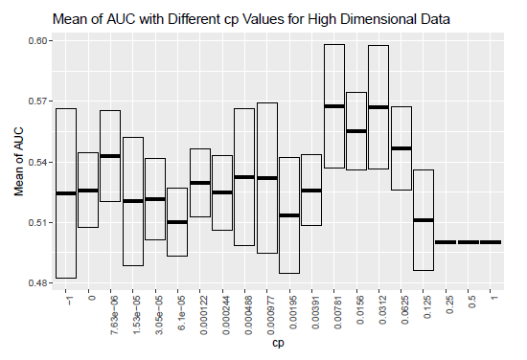
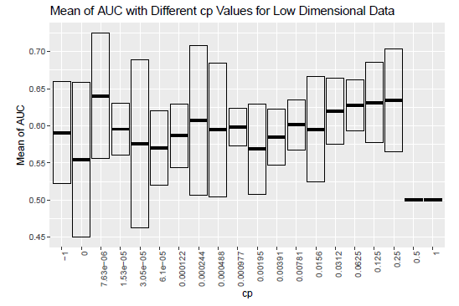

Procedure – 3 Folds Cross Validation

Slide 5
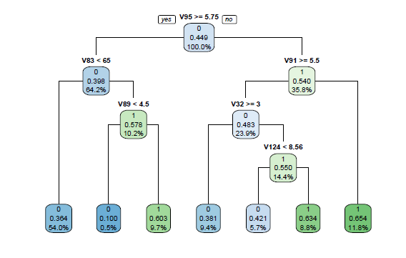
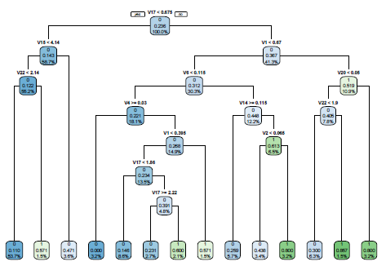
Procedure - PS Estimation
High Dimension Data
Low Dimension Data

Slide 6
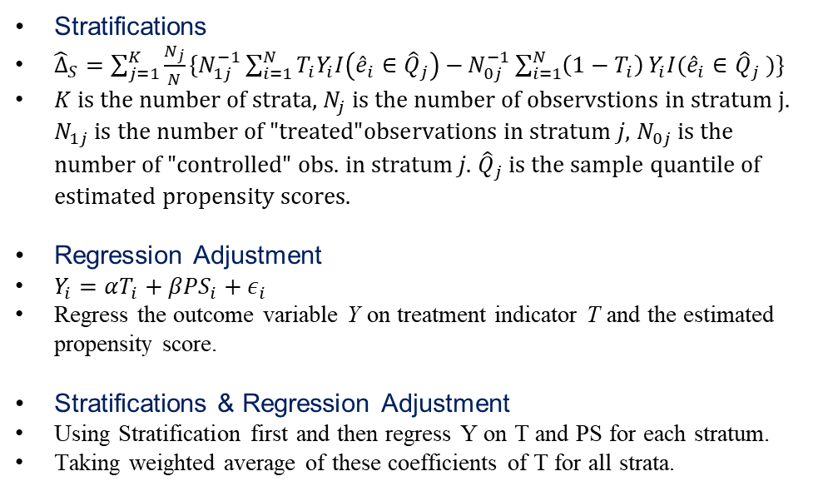
ATE-Algorithms
Stratifications
${\hat{Δ}}_{S}=\sum_{j=1}^{K}{\frac{N_{j}}{N}\{N_{1j}^{−1}\sum_{i=1}^{N}{T_{i}Y_{i}I\left({\hat{e}}_{i}∈{\hat{Q}}_{j}\right)−}N_{0j}^{−1}\sum_{i=1}^{N}{\left(1−T_{i}\right)}Y_{i}I({\hat{e}}_{i}∈{\hat{Q}}_{j} )\}}$
$K \text{is} \text{the} \text{number} \text{of} \text{strata}\text{, }N_{j} \text{is} \text{the} \text{number} \text{of} \text{observstions} \text{in} \text{stratum} \text{j}\text{. }N_{1j} \text{is} \text{the} \text{number} \text{of}\text{ "}\text{treated}\text{"}\text{observations} \text{in} \text{stratum} j\text{, }N_{0j} \text{is} \text{the} \text{number} \text{of}\text{ "}\text{controlled}\text{" }\text{obs}\text{. }\text{in} \text{stratum} j\text{.} {\hat{Q}}_{j} \text{is} \text{the} \text{sample} \text{quantile} \text{of} \text{estimated} \text{propensity} \text{scores}\text{.}$
Regression Adjustment
$Y_{i}=αT_{i}+βPS_{i}+ε_{i}$
Regress the outcome variable Y on treatment indicator T and the estimated propensity score.
Stratifications & Regression Adjustment
Using Stratification first and then regress Y on T and PS for each stratum.
Taking weighted average of these coefficients of T for all strata.

Slide 7
Results
 | High Dimension Data | Low Dimension Data
True | -3.000000 | 2.500000
Stratifications | -2.144670 | 2.673899
Regression Adjustment | -2.527116 | 3.053240
Reg Adjust. & Strati. | -2.503732 | 3.022839
ATE
 | High Dimension Data | Low Dimension Data
PS Estimation | 1.24324393 | 0.03291011
Stratifications | 0.31650686 | 0.12155604
Regression Adjustment | 0.04108310 | 0.01595902
Reg Adjust. & Strati. | 0.03195000 | 0.02493501
Runtime
(NVMe SAMSUNG SSD with 16 GB RAM.)

Slide 8
Conclusion
Regression adjustment performed the best for the high dimensional data and stratification performed the best for the low dimensional data.
Using classification/regression trees for propensity scores was not the ideal approach for either dataset.
Different values of K, that is, the number of strata, resulted in an empty stratum in our results. Even after choosing a value of K which would present no empty strata, we saw that each stratum tend to have imbalanced classes.
This complication may explain why the stratification plus regression adjustment method would not have performed the best.
The results were relatively consistent among all three methods–there were no large deviations from the true value.
All of these algorithms have very short runtime.

Slide 9
Reference
Atkinson, Beth. “Recursive Partitioning And Regression Trees.” R Documentation, DataCamp, www.rdocumentation.org/packages/rpart/versions/4.1-15/topics/rpart.
Austin, Peter C. 2011. “An Introduction to Propensity Score Methods for Reducing the Effects of Confounding in Observational Studies.” Multivariate Behavioral Research 46 (3): 399–424.
Chan, David & Ge, Rong & Gershony, Ori & Hesterberg, Tim & Lambert, Diane. (2010). Evaluating online ad campaigns in a pipeline: Causal models at scale. Proceedings of the ACM SIGKDD International Conference on Knowledge Discovery and Data Mining. 7-16. 10.1145/1835804.1835809.
Hastie, Trevor„ Robert Tibshirani, and J. H Friedman. The Elements of Statistical Learning: Data Mining, Inference, and Prediction. 2nd ed. New York: Springer, 2009. Print.
D’Agostino RB Jr. Propensity score methods for bias reduction in the comparison of a treatment to a non-randomized control group. Stat Med. 1998 Oct 15;17(19):2265-81. doi: 10.1002/(sici)1097- 0258(19981015)17:19<2265::aid-sim918>3.0.co;2-b. PMID: 9802183.
Lunceford, Jared K, and Marie Davidian. 2004. “Stratification and Weighting via the Propensity Score in Estimation of Causal Treatment Effects a Comparative Study.” Statistics in Medicine 23 (19): 2937–60.
Rosenbaum PR, Rubin DB. The central role of the propensity score in observational studies for causal efiects.Biometrika 1983; 70:41–55.

