Slide 1
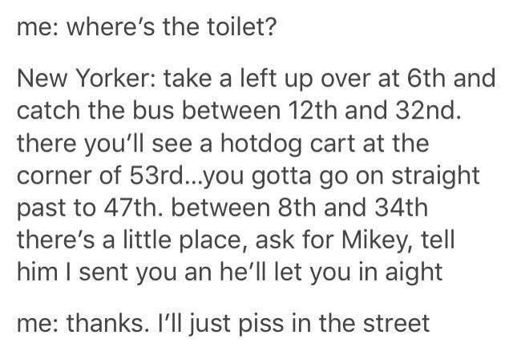

Slide 2
Has that ever happened to you?
New York is not a friendly place for public restrooms!
Where do you usually go if you need a bathroom?
Duane Reade
Starbucks
Restaurant
This often costs money, or requires a pin code, or you might even be turned away!
Group 10 was on a mission to Flush away these worries, and thus created…

Slide 3


Slide 4
Who We are
Group 10 is:
Inspired to aid in fulfilling a basic and universal human need; going to the bathroom.
Because lets be honest, SH*T happens
Motivated to enable seamless, easy access to public restrooms for all people, and their varied unique needs
Not afraid to get down and dirty with the data!

Slide 5
What we do
The best way to find not only the closest Free toilet, but also filter out your needs by :
Proximity
To GPS location, as well as subway, bus routes and highways
If it is open/ Seasonality of the restroom
Wifi Access
Disability/Wheelchair access
Also has GPS function to automatically locate you as well, if you are not sure where you are

Slide 6
The Data
We are a “Yelp” for toilets
We Will wipe away the competition through a mix of NYC open data, and the ability to keep up with 311 reports
Data sources from:
311 Complaints
Public Park, playground and restroom data
Public wifi hotspots
Housing Prices of Manhattan (for statistical analysis)
Facilities Data (for Statistical analysis)

Slide 7
The Statistics
We also offer some statistical analysis to Aid in discerning the relationships between public restroom availability and income level of area:
Density maps
To give insight how many restrooms are in a certain area
Population density map
Income Maps
By location
By housing Prices
Restrooms per zip code
Different graphical displays
Number of restrooms per person per area
Housing prices vs population, by number of restrooms available

Slide 8
Are you ready to go? (and are you tired of the toilet puns yet?)

