Slide 1
Model Selection and evaluation
Project 3

Slide 2
Project 3 Description
Project 3
Carry out model evaluation and selection for predictive analytics on image data.
Evaluate different modeling/analysis strategies and decide what is the best.
Present sound evidence in the form of model assessment, validation and comparison.
Communicate your decision and supporting evidence clearly and convincingly in an accessible fashion.

Slide 3
Not a competition of PreDICTION ACCURACy

Slide 4
Baseline Model
Model Comparison
Using color histogram (or color distribution) as features.
Linear SVM as classifier.
Task 1 will be implementing this strategy and tune it correctly.

Slide 5
Proposed STRATEGY
Consider better features
Consider better models
Comparison should be structured to establish the values added by
New features
New method
Nested model comparison structure.

Slide 6

Classifiers using Feature set 2
Feature Set 2
Linear SVM feature set 2
Classifiers using Feature set 1
Feature set 1
Linear SVM Feature set 1
Feature set 1
+
Linear SVM
Feature set 1
+
new Classifier
Feature set 2
+
Linear SVM
Feature set 2
+
new Classifier

Slide 7
SUBMISSION of PROJECT 3
Text
Submission
A well-documented GitHub repo (following instruction given in the starter codes).
a file of feature processing codes (feature.R) should take
an input folder containing images
outputs a folder of “feature” objects with features for each image
RData, or other R readable file
Each file should have the same name as the corresponding image.

Slide 8
SUBMISSION of PROJECT 3
Text
Submission
A well-documented GitHub repo (following instruction given in the starter codes).
a file of training codes (train.R) should take
a folder of input feature objects (for training images)
a CSV file contains image names and labels
outputs two “model” objects (RData, or other R readable file); One for the baseline model and one for the new model.
model training should include tuning.

Slide 9
SUBMISSION of PROJECT 3
Text
Submission
A well-documented GitHub repo (following instruction given in the starter codes).
a file of testing codes (test.R) should take
a folder of input feature objects (for testing images)
an input “model” object from train.R
output predicted labels

Slide 10
SUBMISSION of PROJECT 3
Text
You can use any methods to generate features
On March 23rd, we will first fork all project repos to save a time-stamped version of all your codes.
On a new set of 2000 images (similar sizes as the data set used for project 3), each team will have 30 minutes to process them into features chosen.
Submit the process features as a folder of feature objects file. The feature objects should be readable by train.R and test.R.
We (the instruction team) will then run an evaluation.R file on all submissions.

Slide 11
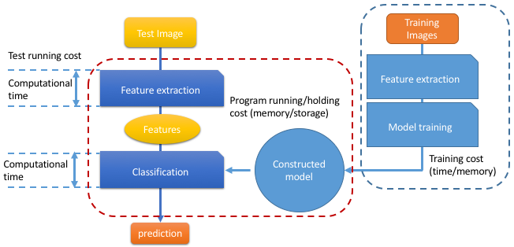
Feature.R
Feature.R
Train.R
Test.R

Slide 12
SUBMISSION of PROJECT 3
Text
You should also prepare a presentation for this project
Methodology details of the proposed solution
Evaluation results as supporting evidence
Prediction performance comparison between baseline and new models.
Time/cost analysis.

Slide 13
EVALUATION of PROJECT 3
Text
Peer rating on presentations 20%
By instructional team
Presentation 40%
Methodology
Interpretability of the features selected (scientific insights?)
Presentation
Reproducibility evaluation based on the 2000 new images 40%
Comparing training error rate and test error rate (0-1 loss will be used) on the 2000 new images.
Comparing stability of the methodology comparison results on baseline and new models (using cross-validation methods on the 2000 new images)
Consistency between the results from new images with the results from the project images (in terms of percent of improvement)

Slide 14
Tutorials
Text
[Today] Image features
[Next week] Cross-validations, avoid overfitting

