Slide 1

Gradient Boosting Model Utilizing Edge Features Team 9

Slide 2
Problem
“Create an AI Program that can accurately distinguish pictures of cats from pictures of dogs”
Gradient Boosting Model with Edge Features
SOLUTION

Slide 3
Analysis Overview
Features
Models
Color Histograms
800 predictors
Colors do not necessarily correspond
Edge objects
88 predictors
Use 8 largest edge objects of photo
11 features for each object
Baseline
Linear SVM
Proposed Model
Gradient Boosting Model (GBM)
Definition: Iteratively combine weak learners (decision trees) into single learner

Slide 4
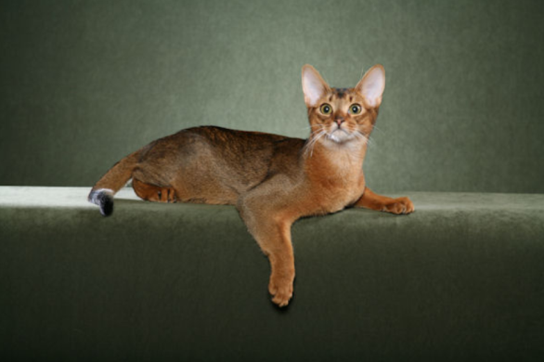
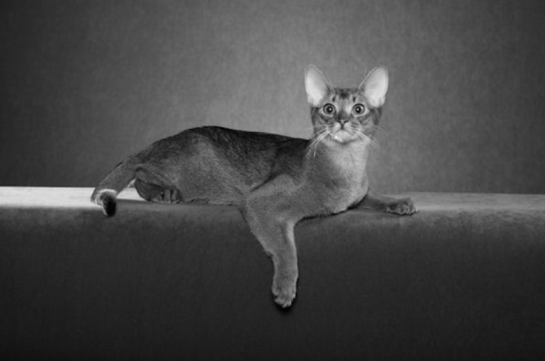


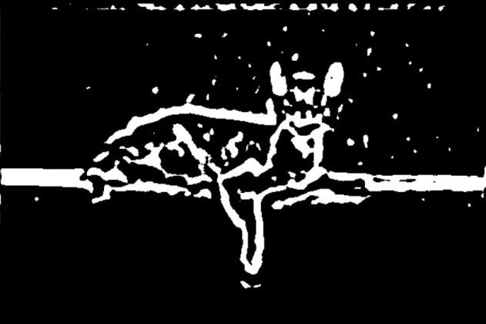
New Features - Edge Objects
Original Image
Apply gray scale
Apply Gaussian smoothing
Img2<-channel(img,’gray’)
x = makeBrush(9, shape="gaussian", sigma=5)
x <- x / sum(x)
Img3<-filter2(img2,x)
Resulting feature is composed of 8 edges per picture with each edge having 11 saved values
Total 88 predictors per image
Take 8 largest objects
Threshold image
Img4<-thresh(img3)

Slide 5
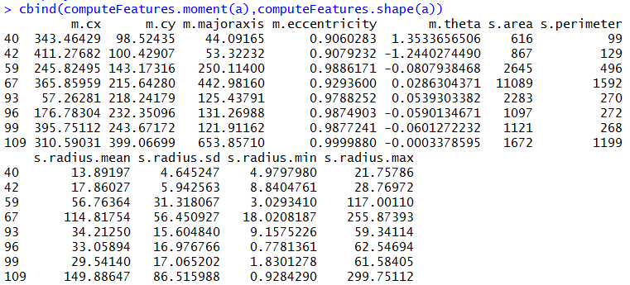
Feature Values
X coordinate
Y coordinate
Angle off x-axis

Slide 6
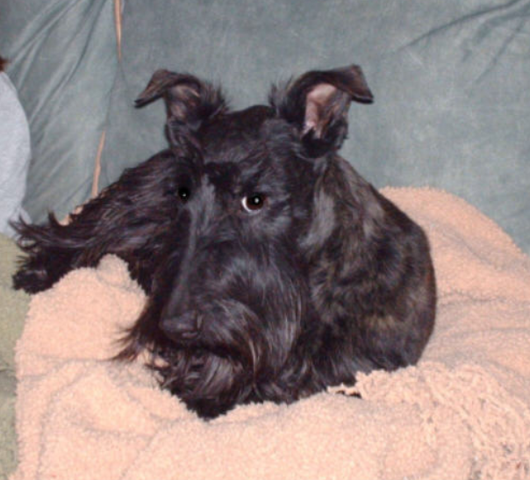
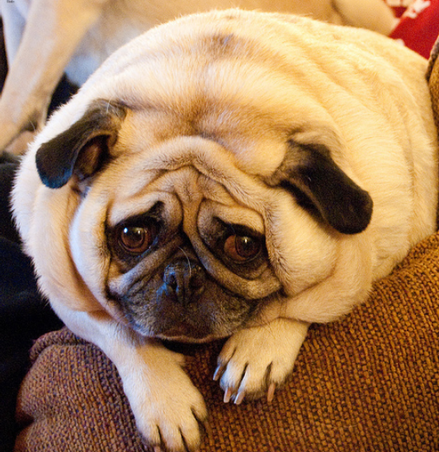
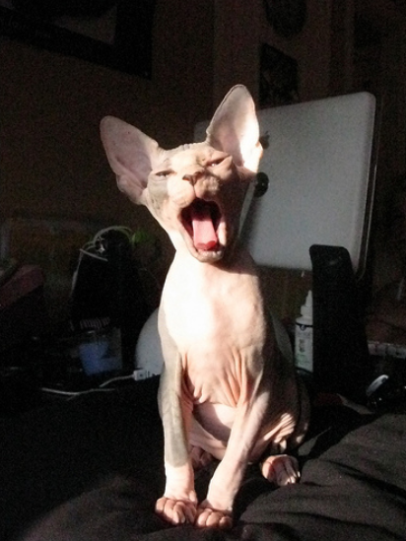


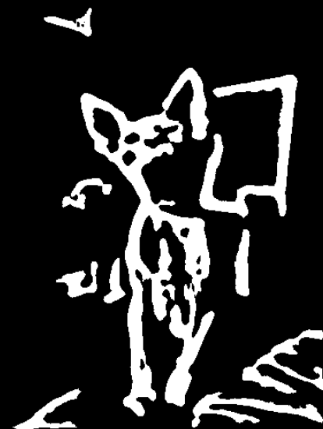
Example Features

Slide 7
Comparing the Models
Linear SVM
Gradient Boosting
Used kvsm library
Did not tune support vector machine
Used linear kernel “vanilladot”
10 minute computation
Used gbm library
Tuned boosting model with cross-validation
Number of trees: 1 - 500
Tree depth: 1 – 3
Minimum number of nodes: 10 and 50
Learning/step rate: .1
10 minute computation
20 minute computation

Slide 8
Model Results
Baseline – Color Histogram
(Everything classified as dog/subject to change)
Training error – 32%
Testing error – 33%
Baseline – Edge Features
Training error – 46%
Testing error – 46%
GBM – Color Histogram
Training error – 15%
Testing error – 29%
GBM – Edge Features
Training error – 16%
Testing error – 29%

Slide 9

Recommendation
We recommend using the Gradient Boosted Model with Edge Features for the following reasons:
Performance improvement
Reliable performance (compare to baseline)
Manageable run-time
Intuitive features (compare to baseline)

