Slide 1

Gradient Boosting Model Utilizing Edge Features Team 9

Slide 2
Problem
“Create an AI Program that can accurately distinguish pictures of cats from pictures of dogs”
Gradient Boosting Model with Edge Features
SOLUTION

Slide 3
Analysis Overview
Features
Models
Color Histograms
800 predictors
Colors do not necessarily correspond
Edge objects
88 predictors
Use 8 largest edge objects of photo
11 features for each object
Baseline
Linear SVM
Proposed Model
Gradient Boosting Model (GBM)
Definition: Iteratively combine weak learners (decision trees) into single learner

Slide 4
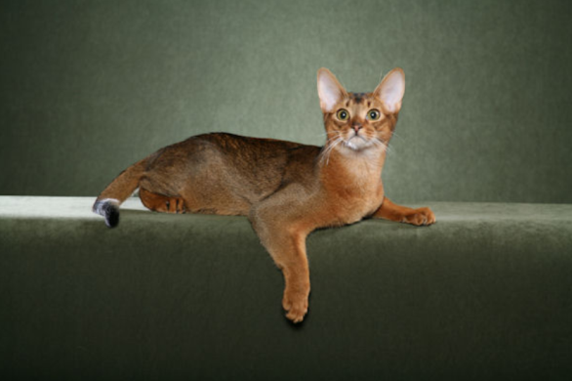
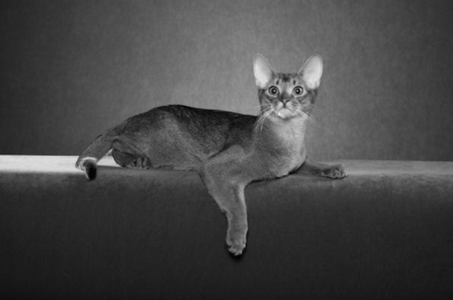



New Features - Edge Objects
Original Image
Apply gray scale
Apply Gaussian smoothing
Img2<-channel(img,’gray’)
x = makeBrush(9, shape="gaussian", sigma=5)
x <- x / sum(x)
Img3<-filter2(img2,x)
Resulting feature is composed of 8 edges per picture with each edge having 11 saved values
Total 88 predictors per image
Take 8 largest objects
Threshold image
Img4<-thresh(img3)

Slide 5
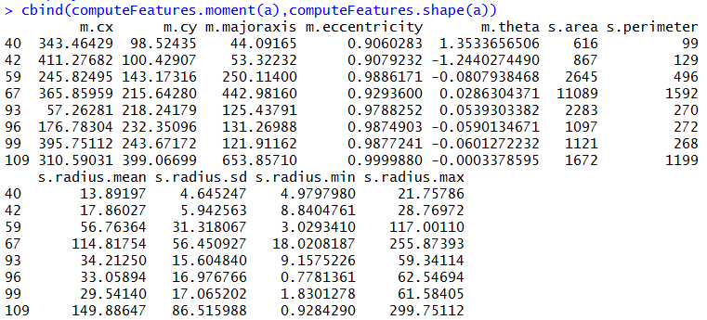
Feature Values
X coordinate
Y coordinate
Angle off x-axis

Slide 6
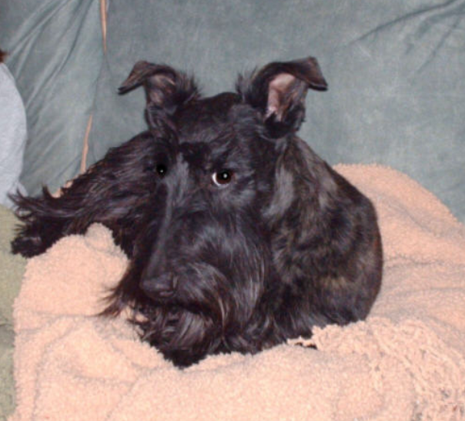


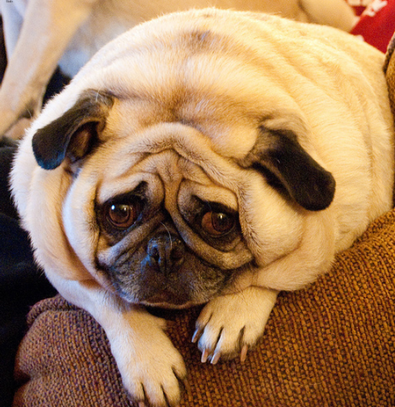


Example Features

Slide 7
Comparing the Models
Linear SVM
Gradient Boosting
Used kvsm library
Did not tune support vector machine
Used linear kernel “vanilladot”
10 minute computation
Used gbmlibrary
Tuned boosting model with cross-validation
Number of trees: 1 - 500
Tree depth: 1 – 3
Minimum number of nodes: 10-50
Learning/step rate: .1
10 minute computation
20 minute computation

Slide 8
Model Results
Baseline – Color Histogram
(Everything classified as dog/subject to change)
Training error – 32%
Testing error – 33%
Baseline – Edge Features
Training error – 46%
Testing error – 46%
GBM – Color Histogram
Training error – 15%
Testing error – 29%
GBM – Edge Features
Training error – 16%
Testing error – 29%

Slide 9
Recommendation
We recommend using the Gradient Boosted Model with Edge Features for the following reasons:
Performance improvement
Reduction in testing error from 33% to 29%
Reliable performance (compare to baseline)
Manageable run-time
Intuitive features (compare to baseline)

