Slide 1


Kaggle: Home Depot Search relevance
Group7: Ouwen Sha, Ruixiong Shi, Xiaoyu Wang, Yuchen Shi, Yicheng Wang

Slide 2
Overview
Tasks: Given product title and product description, predict the relative relevance score for the search query and the product
Example:
2,100001,"Simpson Strong-Tie 12-Gauge Angle","angle bracket",3
3,100001,"Simpson Strong-Tie 12-Gauge Angle","l bracket",2.5
Relevance Score is slightly right skewed distributed
Either regression problem or classification problem.
Reason: NLP problem, less computational burden, challenging
Time: 3 weeks, 2 weeks for feature engineering
Results: 25% of total 2125 teams, RMSE 0.47214, Top RMSE 0.43192

Slide 3
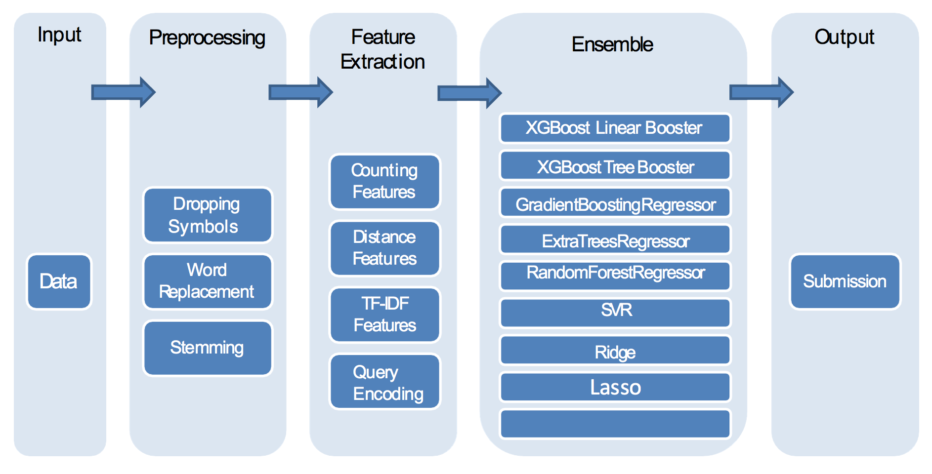
Flow Chart
Data

Slide 4
Struggling
Optimistic to this competition
Material
Many great ideas
First entry scored 0.485 with only 20 features
Basic preprocessing
Counting features and distance feature (key word matching)
Random forest regressor without fine tune.
More we tried, lower score we received
Add many fancy features e.g. colors, brands, materials
Computational burden
Coding ability
word2vec

Slide 5
Educational
Taking preprocessing more seriously (200 lines of code)
Stemming
Check misspelling (huge misspelling dictionary by google API)
Synonym replacement
Gives 0.05 increase
Code management (crowdflower winner solution)
Separate scripts for functions, generating features and modelling
Better for team to communicate
Wrap up the whole thing as a pipeline
Run script on external services
Feature union
Grid search on tune model
Save physical memory
Start to write your own functions and class
Customize metric function

Slide 6
Think more..
More data exploration !
In total 240000 pairs of data, only 40000 unique query search
More key word matches, higher relevance score
98539,130815,"Screen Tight 36 in. x 80 in. Brookgreen Solid Vinyl White Screen Door","36 screen door",1.67
97918,130541,"Klein Tools Tradesman Pro 10 in. Tote Organizer","klein bag",1.67
obvious information-floor
Everyone get very close score on leaderboard
More information should be involved
Not 2-gram, 3-gram or even 6-gram
Everyone in the team should work on features

Slide 7
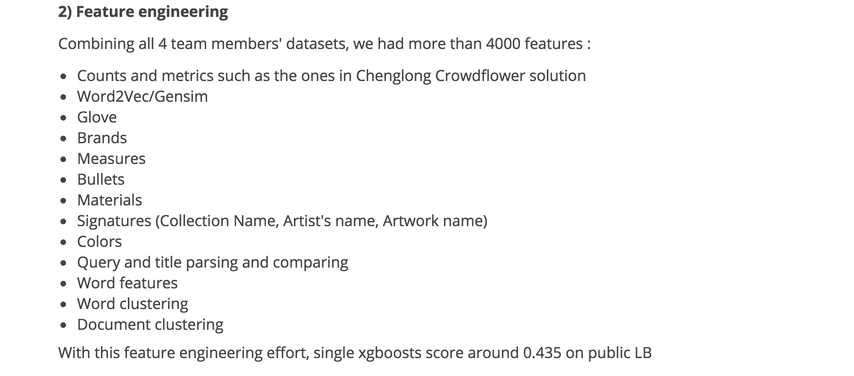
Winner solution screen shot

Slide 8
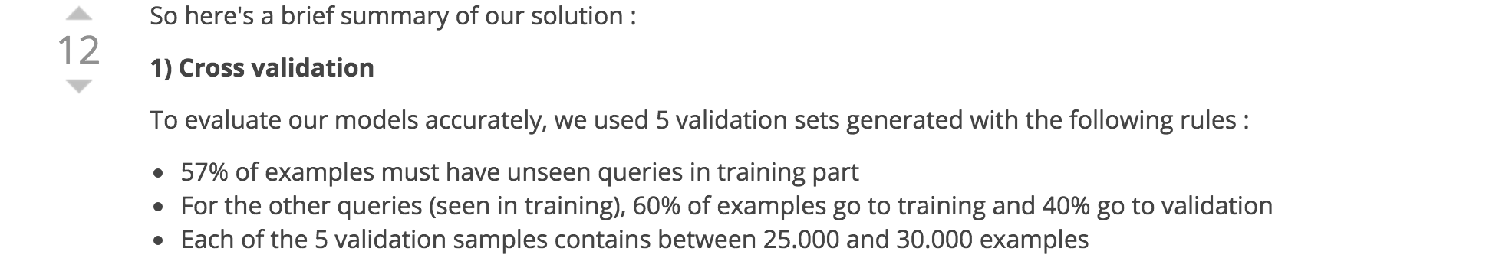
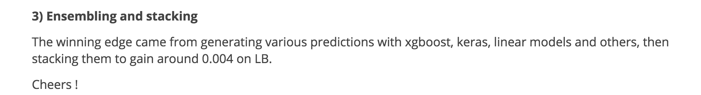

Slide 9
Thank YOU!
More you invest, more you will gain!

