Slide 1
Who Is Who ——Entity Resolution
Paper #2(SVM) & Paper #6(HMRF-EM with C2+C6 constraints)
Team 1: Yuan Mei
Ruscassie, Raphael
Zhishan Wang
Yuxi Zhou(presenter)
He Zhu

Slide 2



Paper # 2 —— SVM
Optimization
Linear decision function
Classification performance

Slide 3
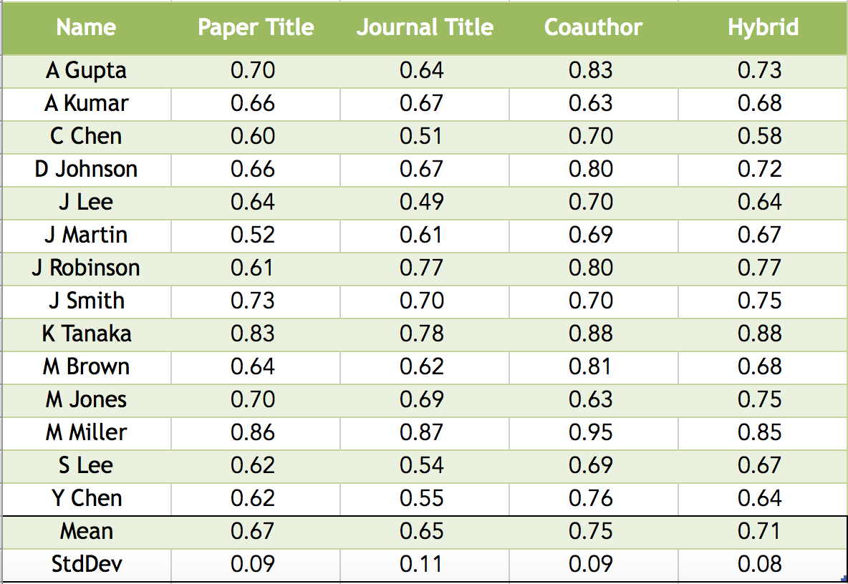
Paper # 2 —— SVM
Evaluation(accuracy)

Slide 4
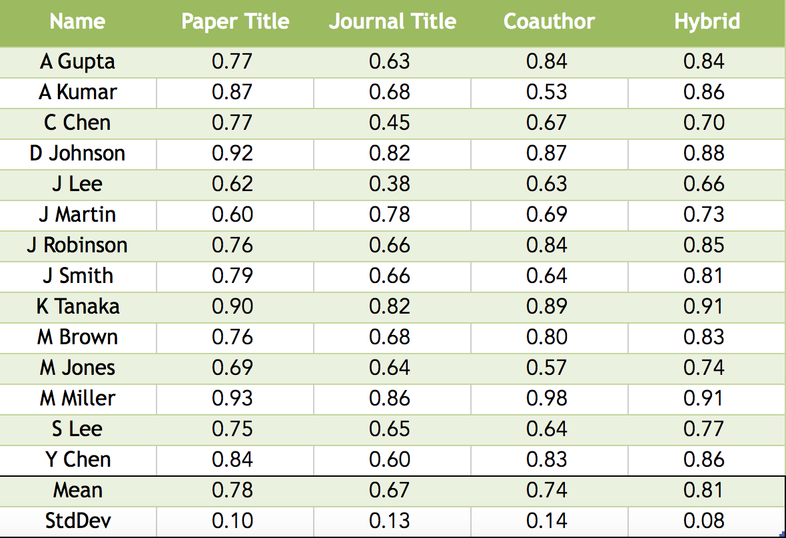
Paper # 2 —— SVM
Evaluation(precision)

Slide 5
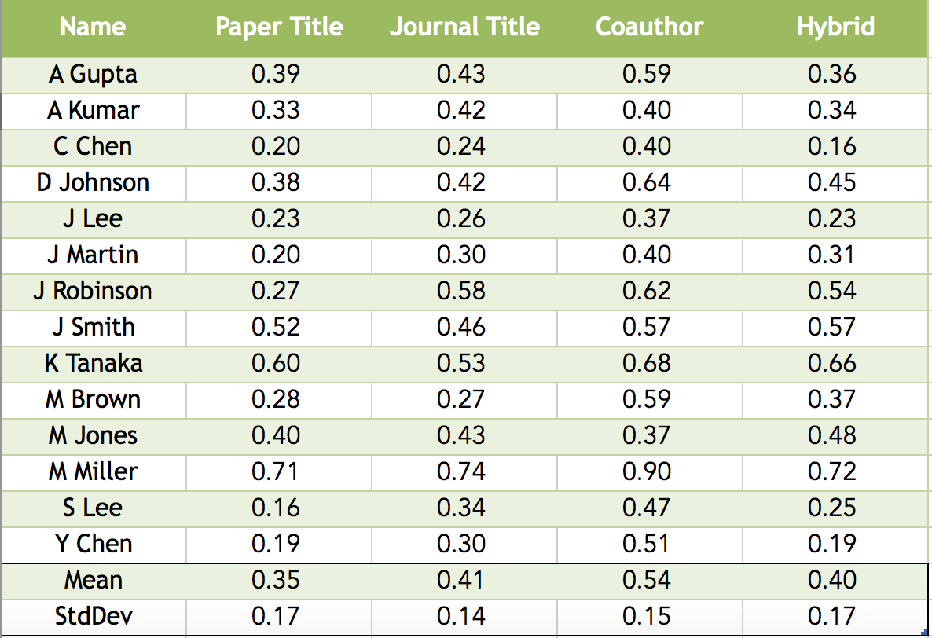
Paper # 2 —— SVM
Evaluation(recall)

Slide 6
Paper # 2 —— SVM
Evaluation(f1: 2*harmonic mean of presicion and recall)

Slide 7

Paper # 6 —— HMRF(Semi- supervised framework)
HMRF(Hidden Markov Random Fields):
Constraint selection(define wi):
C2(CoAuthor): Two papers have a secondary author with the same name
C6(τ-CoAuthor): Gives deeper coauthorship within papers
define w₂=0.7, w₆=0.7^{τ}

Slide 8
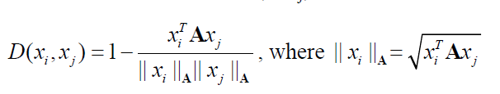


Paper # 6 —— EM algorithm with HMRF
Initialization:
Define distance function:
E-step
M-step: update the diagonal elements of matrix A

Slide 9
Paper # 6 —— Our attempt
Making attempts to vectorize each loop to reduce the running time (still kind of too slow)
Using permutation to test the clustering sequence which gives the most accurate result(still kind of slow)

Slide 10
Paper # 6 —— Evaluation
So sorry that we’ve finished the clustering step but were not able to produce the evaluation result report before due, but we will finish that no matter how.

