Slide 1
Who Is Who ——Entity Resolution
Paper #2(SVM) & Paper #6(HMRF-EM with C2+C6 constraints)
Team 1: Yuan Mei
Ruscassie, Raphael
Zhishan Wang
Yuxi Zhou(presenter)
He Zhu

Slide 2



Paper # 2 —— SVM
Optimization
Linear decision function
Classification performance

Slide 3
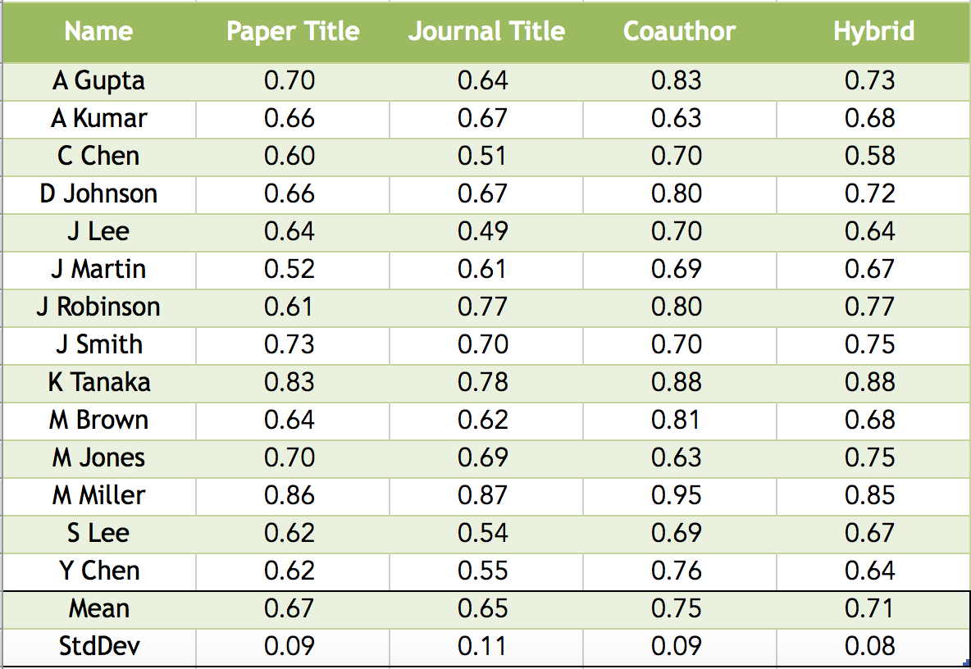
Paper # 2 —— SVM
Evaluation(accuracy)

Slide 4
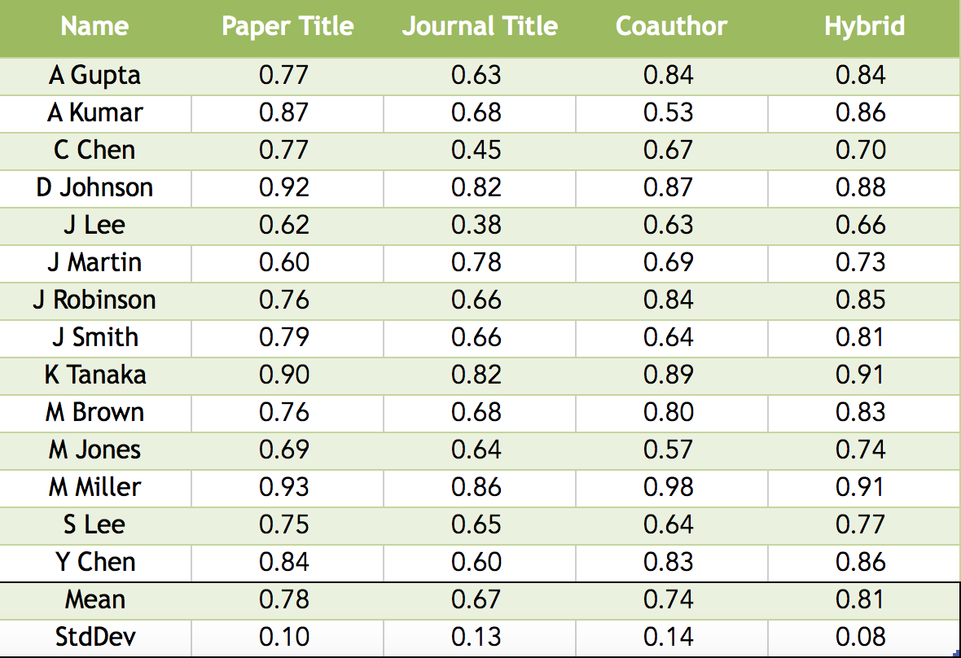
Paper # 2 —— SVM
Evaluation(precision)

Slide 5
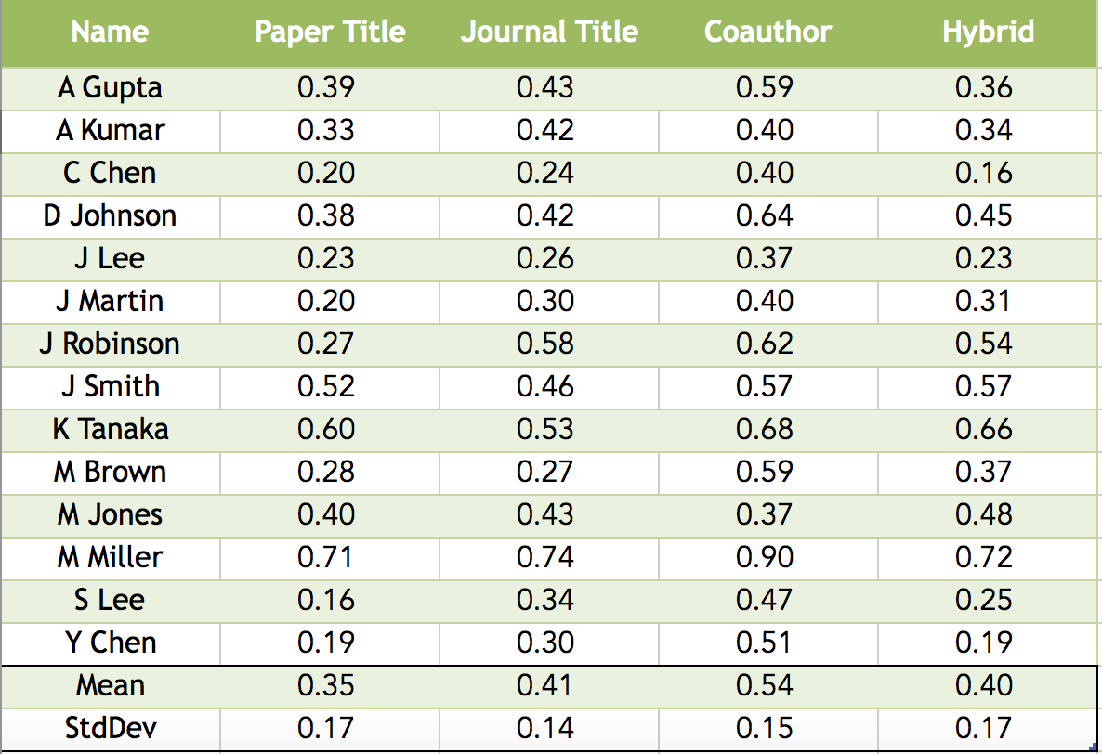
Paper # 2 —— SVM
Evaluation(recall)

Slide 6
Paper # 2 —— SVM
Evaluation(f1: 2*harmonic mean of presicion and recall)

Slide 7

Paper # 6 —— HMRF(Semi- supervised framework)
HMRF(Hidden Markov Random Fields):
Constraint selection(define wi):
C2(CoAuthor): Two papers have a secondary author with the same name
C6(τ-CoAuthor): Gives deeper coauthorship within papers
define w₂=0.7, w₆=0.7^{τ}

Slide 8
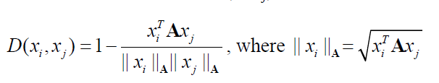


Paper # 6 —— EM algorithm with HMRF
Initialization:
Define distance function:
E-step
M-step: update the diagonal elements of matrix A

Slide 9
Paper # 6 —— Our attempt
Making attempts to vectorize each loop to reduce the running time (Our EM step gives a much faster speed after vectorization)
Using permutation to test the clustering sequence which gives the most accurate result(still kind of slow)

Slide 10
Paper # 6 —— Evaluation
So sorry that we’ve finished the clustering step but were not able to produce the evaluation result report before due, but we will finish that no matter how.

