Slide 1
Entity Resolution Algorithms
Group 13
By
Boxuan Zhao
Zixuan Guan
Zheren Tang
Jihan Wei
Yingxin Zhang

Slide 2
Outline
Introduction to Algorithms
Our Evaluations Methods
Result
Questions

Slide 3
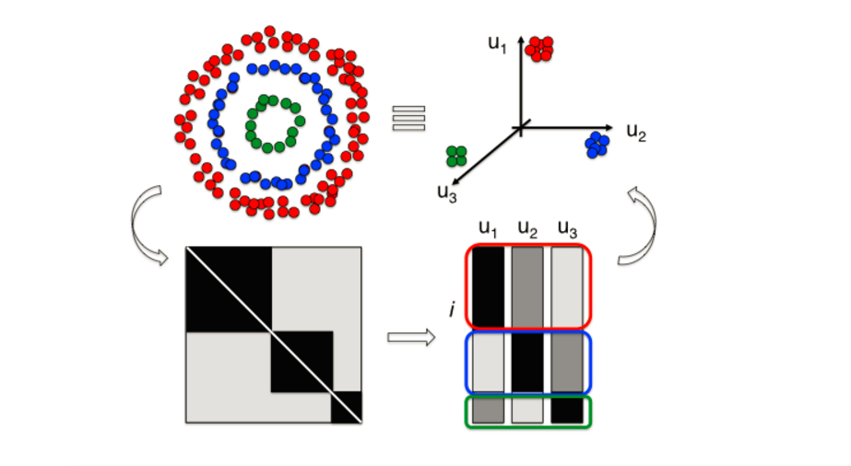
Spectral Clustering Using QR Decomposition

Slide 4
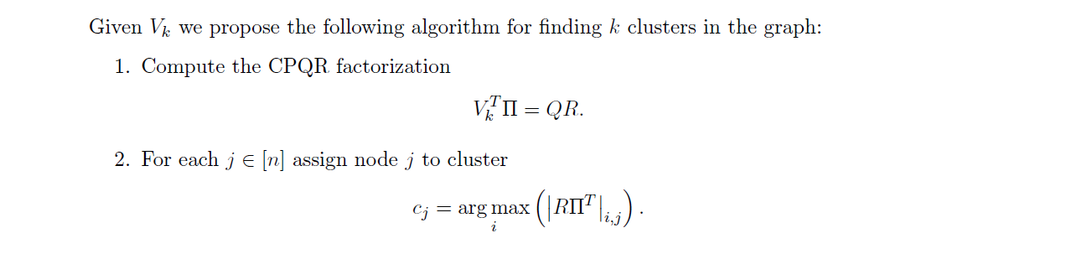
Spectral Clustering Using QR Decomposition

Slide 5
Algorithm B

Slide 6
Evaluation Method
Gold Standard Method

Slide 7
Our Results

Slide 8
Questions

Slide 9
THANKS!

