Slide 1
Entity Resolution Algorithms
Group 13
By
Boxuan Zhao
Zixuan Guan
Zheren Tang
Jihan Wei
Yingxin Zhang
ALLPPT.com _ Free PowerPoint Templates, Diagrams and Charts

Slide 2
Outline
Introduction to Algorithms
Our Evaluations Methods
Result
Questions

Slide 3
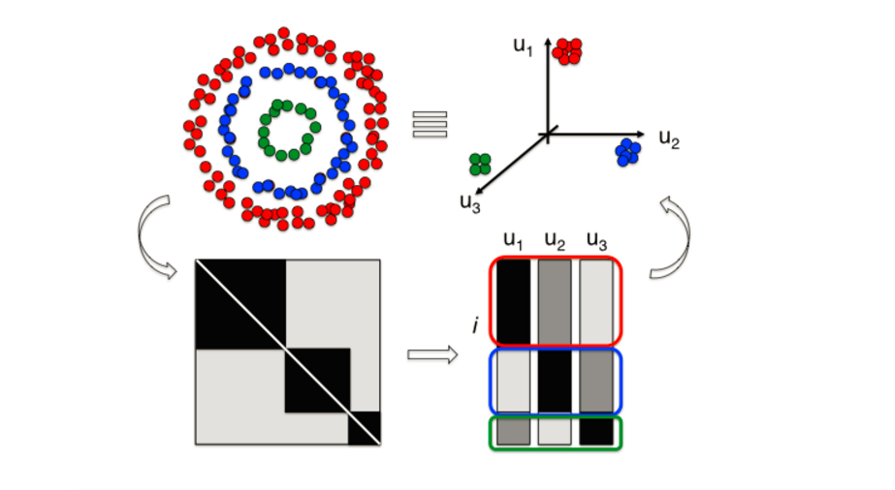
Spectral Clustering Using QR Decomposition

Slide 4
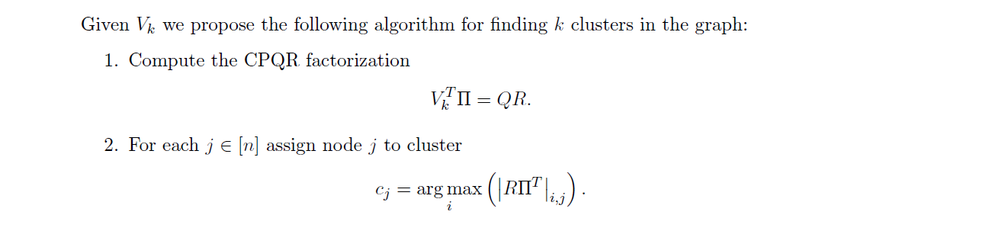
Spectral Clustering Using QR Decomposition

Slide 5
Algorithm B
Initlization cluster assignment based on c2 constraint
(two citataion vecotrs has the same coathor)
Lambda > k
Cluster the nearnest group umtil there are only K groups left
Lambda < k
Random pertubations of the global centroid
M step:
Update diagonal elements of A cuz get the dist
E step:
Reassign xi to minimize the obj fun
Stop when no paper change its assignment betweeen two successive iterations.
End

Slide 6
Initialization

Slide 7
Evaluation Method
Gold Standard Method

Slide 9
Our Results

Slide 10
Questions

Slide 11
Thanks!
ALLPPT.com _ Free PowerPoint Templates, Diagrams and Charts

