Slide 1
Entity Resolution Algorithms
Group 13
By
Boxuan Zhao
Zixuan Guan
Zheren Tang
Jihan Wei
Yingxin Zhang
ALLPPT.com _ Free PowerPoint Templates, Diagrams and Charts

Slide 2
Outline
Introduction to Algorithms
Our Evaluations Methods
Comparison Result
Interesting Results! (if we have time)
Questions

Slide 3
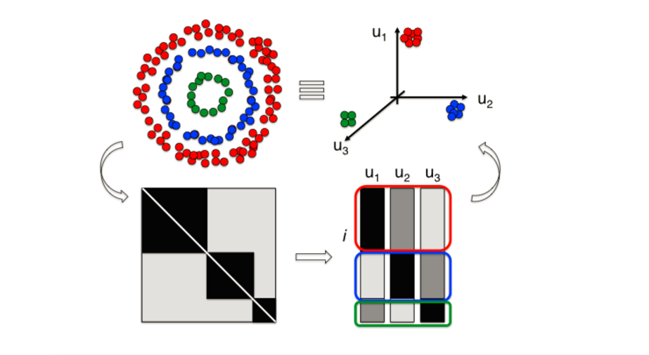
Spectral Clustering Using QR Decomposition

Slide 4
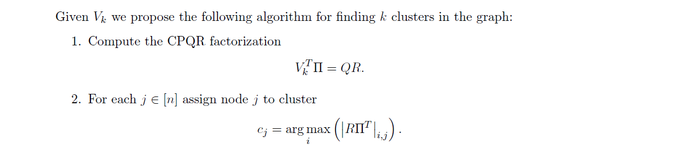
Spectral Clustering Using QR Decomposition

Slide 5
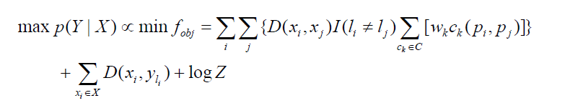
A Constraint-Based Probabilistic Framework approach
An EM algorithm who aims to minimize
My team focus on the C2 criterion(whether two citation vectors have the same
coauthor)
Iterates until convergence criterion (i.e.. There is no change of cluster
assignment) has been satisfied
Have to tune the weight parameter Wk
Have to initialize cluster assignment L for each citation vector
Have to initialize a parameter matrix A for distance calculation

Slide 6

Evaluation Method
We constructed our feature by using TF-IDF statistics and we compare our algorithm by calculating the degree of agreement between system-output
partitions and true partitions
The evaluations are carried out using the following two types of features:
1. TF-IDF DTM using individual features(coauthor, paper, journal)
2. TF-IDF DTM using all features

Slide 7
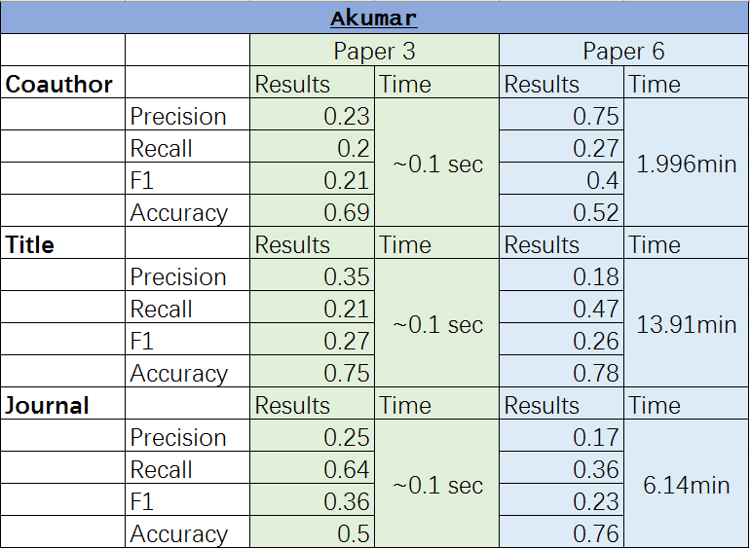
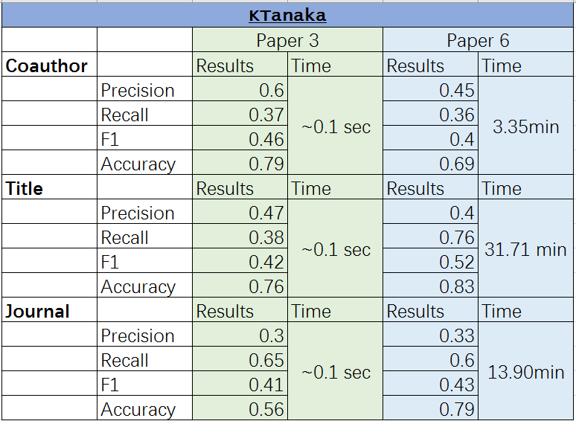
Our Results

Slide 8
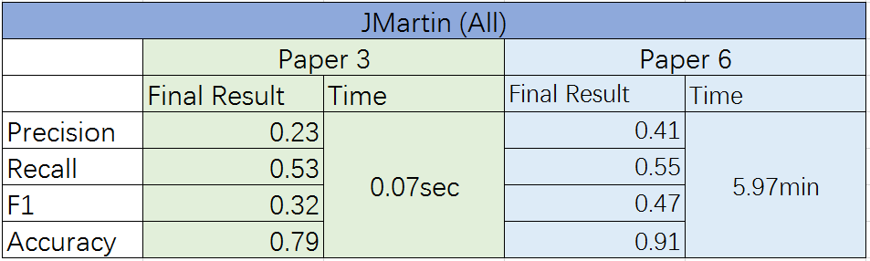
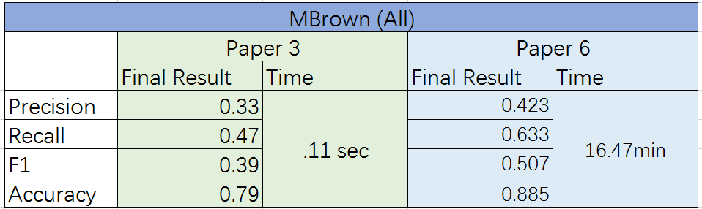
Our Results

Slide 9
Conclusion
1. Construct TF-IDF DTM using all features
2 . Generally, algorithms proposed by the sixth paper takes significantly
long time to run than that of the third paper
3. Algorithm from the sixth paper outperforms that of the third paper when constructing TF-IDF DTM using all features
Which one is better? Your Choice!
If you value the speed of cluster, spectral clustering is the way to go,
but if performance is the focus, the constraint approach is better.

Slide 10
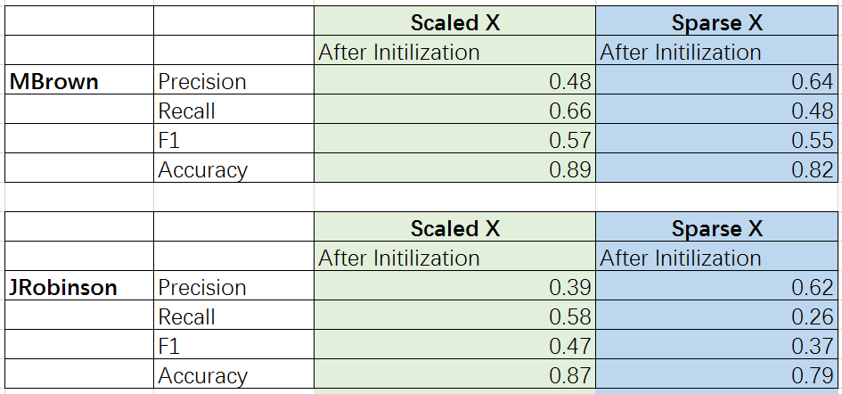
Our Observations

Slide 11
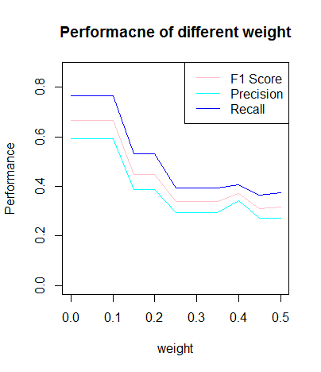
Our Observations cont’d

Slide 12
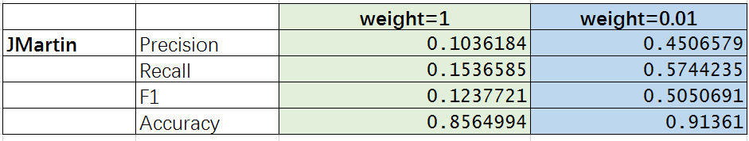
Our Observations cont’d

Slide 13
Any Questions?

Slide 14
Thanks!
ALLPPT.com _ Free PowerPoint Templates, Diagrams and Charts

Slide 16
A Constraint-Based Probabilistic Framework approach
We initialize our cluster assignment based on C2 constraint, namely
the two citation vectors that have the same coauthor will have the same
cluster assignment
If number of the resulting cluster is greater than our known cluster K,
we cluster the nearest group until K groups left. Otherwise, we randomly sample perturbations of the global centroid to make it up.
Then, based on he current cluster assignment, we reassign each paper by
maximizing p(Y|X), and the cluster centers are also re-estimated from
the assignment, with the same objective to maximize the p(Y|X), with the
distance measure is also updated.
We can finally stop the algorithm when there is no further changes in
cluster assignment.

